Slide 1
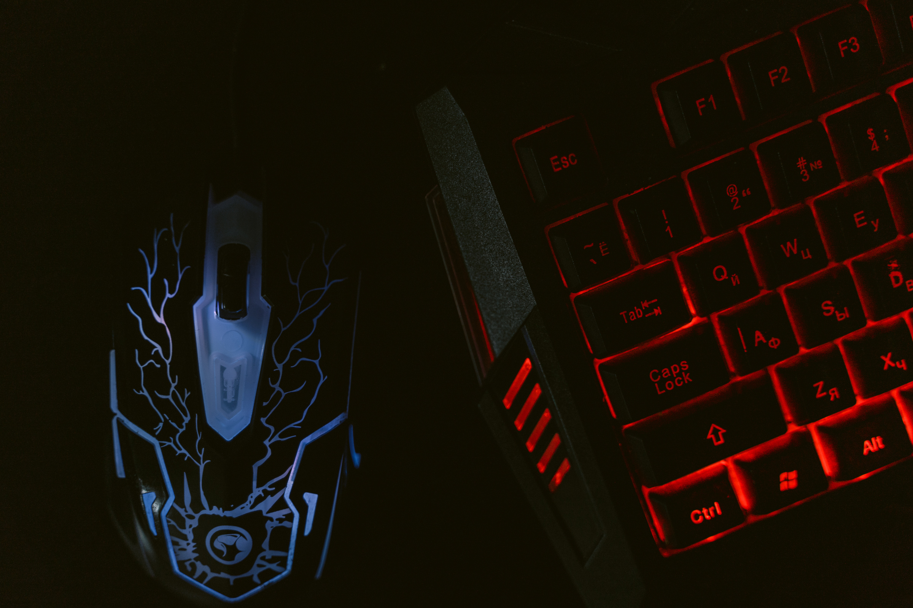
CERTIFICATE
OF APPRECIATION
IS PRESENTED TO :
{{NAME}}
For his achievement in participating in the 2026 Hackathon organized by GDG with the team {{TEAM_NAME}}.
Sameer S Katte
Sai Jadhav
SUPERVISOR
VICE PRESIDENT

