Slide 1

Call Of Adventure 1-25-2017
Project Release Plan
Team CoA
James Iwamasa (PO)
Nickolas Bayt
Julius Mazer
Shirley Huang
Kenneth Bendo
Majid Reza Barghi (SM)

Slide 2
Call Of Adventure
Project Release Plan
A web based “game” where users go on quests to get gold and loot.
Users can hire other users’ characters to help them out for harder quests

Slide 3


Call Of Adventure
Project Release Plan
Rather than a full game in the classic sense, “playing” the game will be done mostly by navigating between pages.
Like...
Or
...But for adventurers

Slide 4
Sprint 1
Project Release Plan – User Stories
Goal: Set up the basic website elements and some basic design elements.
- The user can create an account to keep track of their character and items.
- The user can go on quests to gain money and loot.
- The user can hire other users’ characters to help them on quests.
- The user can purchase and equip items to improve their character’s performance.

Slide 5

Sprint 2 Ideas
Project Release Plan – User Stories
Goal: Make the questing experience more active and interesting.
- Starting a quest opens up an embedded rpg-battle to make the questing experience more active and challenging.

Slide 6
Sprint 3 Ideas
Project Release Plan – User Stories
Goal: Polish the design elements.
- Users can post their own quests, paying other adventurers to bring them “special resources” that can’t be gained otherwise.
- Users can use “special resources” to craft customized items that can’t be bought normally to better specialize their character for certain kinds of quests.
- Users can trade items between each other to share crafted (or normal) items and help each other do quests that require a lot of specialization.

Slide 7
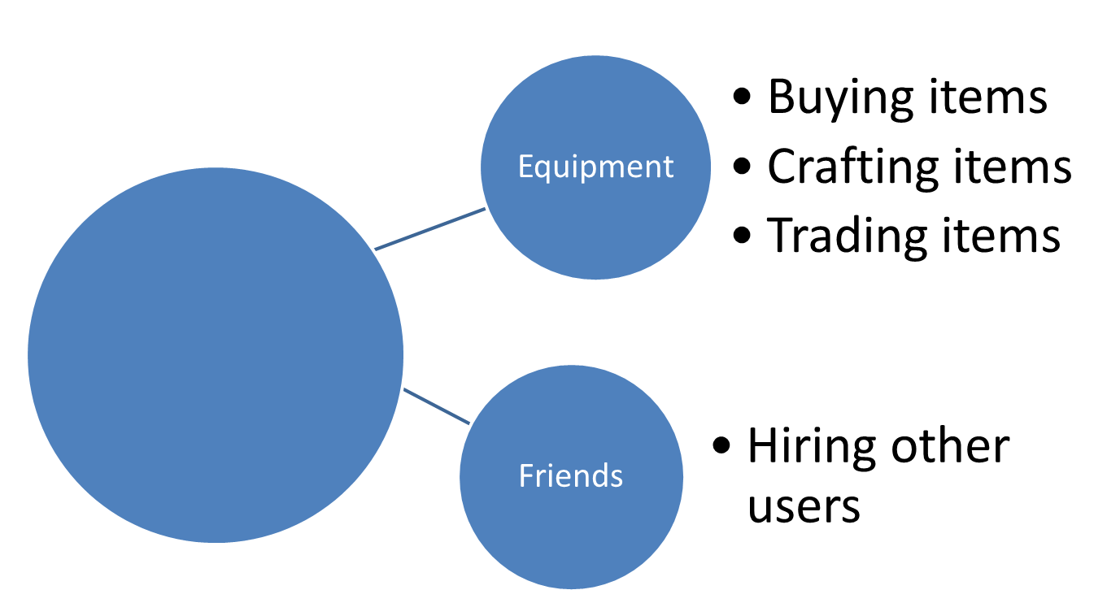
Basic Game Flow
Project Release Plan – Architecture
Loot
Quest

Slide 8
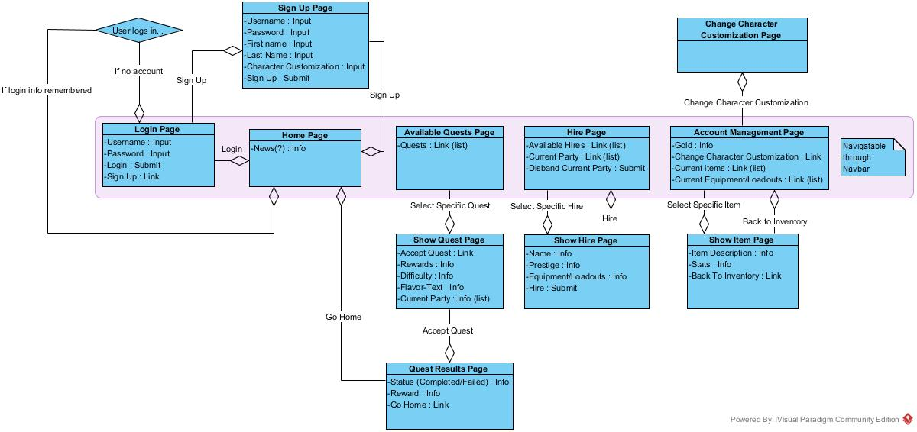
Page Structure
Project Release Plan – Architecture

Slide 9
Call Of Adventure
Project Release Plan – Challenges/Risks
Challenge 1: Lack of web app experience.
Challenge 2: Games are naturally physical asset heavy.
Challenge 3: Game design complexity (balancing).

Slide 10
Call Of Adventure
Project Release Plan – Technologies
Technology 1: web2py as basic framework
Technology 2: Possibly JQuery for front-end
Technology 2: HTML5, Javascript, and Python.
Technology 3: Unity (C#).

Slide 11
Call Of Adventure
Project Release Plan
Questions/Comments?

