Slide 1
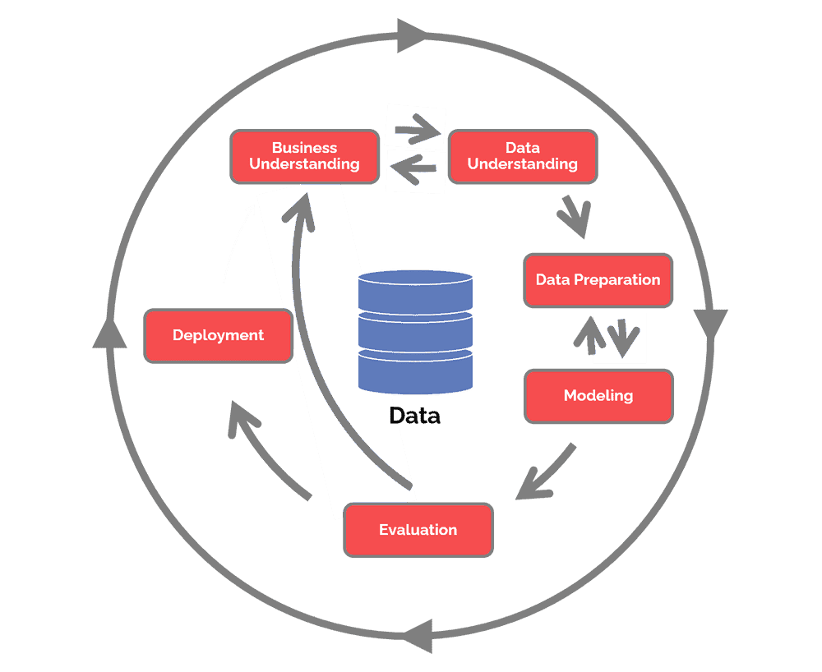
Project Reflection
Wenyu Ji
Notes:
https://www.datascience-pm.com/crisp-dm-2/
Cross Industry Standard Process for Data Mining (CRISP-DM)
Understanding Business Problem
Data Cleaning and Preparation
Data Visualization
Modeling and Model Checking
Evaluating and Finalizing the Model
Prediction for the Final Result

Slide 2
Reflection
What you did right with the analysis
Got rid of some unimportant variables at first before dig into the analysis.
70% of N/As (weekly_price, monthly_price, and square_feet).
Unrelated variables (house_rules, host_name, host_since, host_has_profile_pic etc.).
Used the median to replace missing values of (cleaning_fee, beds, security_deposit, host_total_listings_count, host_listings_count, reviews_per_month).
Used correlation heat map showed the correlation between numeric variables.
Calculated the %IncMSE (percent increase in mean squared error) and listed out the important variables.
Used linear regression, XGBoost, forest with Ranger and cross-validation, Random Forest works the best for me.
Where you went wrong
I eliminated too many variables by self-consciousness which is not always accurate.
At first, I eliminated around 40 variables without using any feature selection.
I chose 45 important attributes as my final prediction variables, which is a large number of predictors. However, this gave me the smallest RMSE result but could lead to overfitting.
What you would do different.
Use feature selection such as Lasso Regression, Forward, or Backward selection to find around 30 significant attributes.
Replace missing values by mean or 0 (ex. Cleaning fee could be 0).
For the categorical data, I would like to generate histograms to compare each different category.
Try different models.

