Slide 1




Bavisitter: Integrating Design Guidelines into Large Language Models for Visualization Authoring
Jiwon Choi
Jaeung Lee
Jaemin Jo
jiwnchoi@skku.edu
dlwodnd00@skku.edu
jmjo@skku.edu
Sungkyunkwan University, Republic of Korea
Notes:
Hello everyone, I am Jiwon Choi, a master's student in Interactive Data Computing Lab at Sungkyunkwan University.
Today, I'm going to present Bavisitter, Integrating Design Guidelines into Large language models for visualization authoring.

Slide 2




Notes:
I believe most of you have probably tried generating visualizations using large language models at least once.

Slide 3
Are they good for
Visualization?
Notes:
However, were their visualizations perfect?
As you may have experienced, LLMs produce improper visualizations like humans.
In fact, this happens quite often.

Slide 4
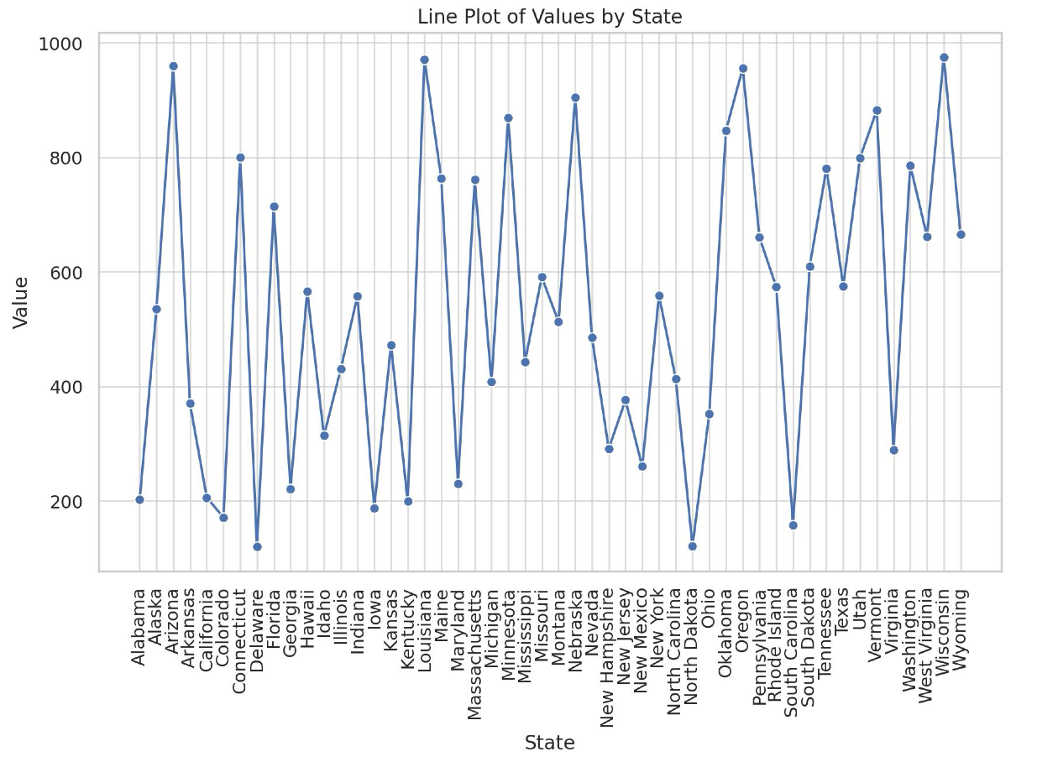
LLM-generated visualizations, gpt-4-turbo-1106
Notes:
This is an example visualization that generated by GPT-4.
As you can see, categorical values on the x-axis are connected by line marks.
Which is common mistakes that we can easily find in infovis textbooks.

Slide 5
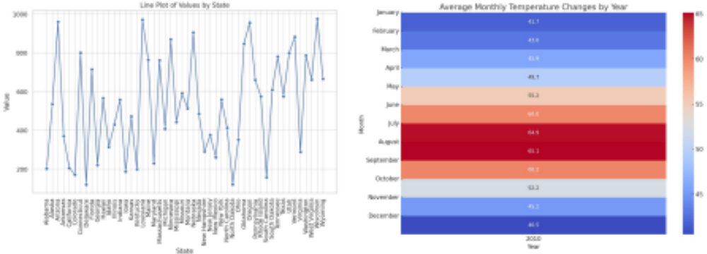
LLM-generated visualizations, gpt-4-turbo-1106
Notes:
Let's look at another example. This visualization shows average monthly temperature changes by year.
There is only one unique value in the year attribute, and temperature is encoded in the color channel.
In this case, if swapping the channels between year and average temperature, makes it easier to compare the temperature values.
While everybody in this session can easily correct these visualizations by giving appropriate prompts, not everyone has this ability. especially novices.
As more people become dependent on LLMs, there is a risk that such improper visualizations may become more widespread.

Slide 6
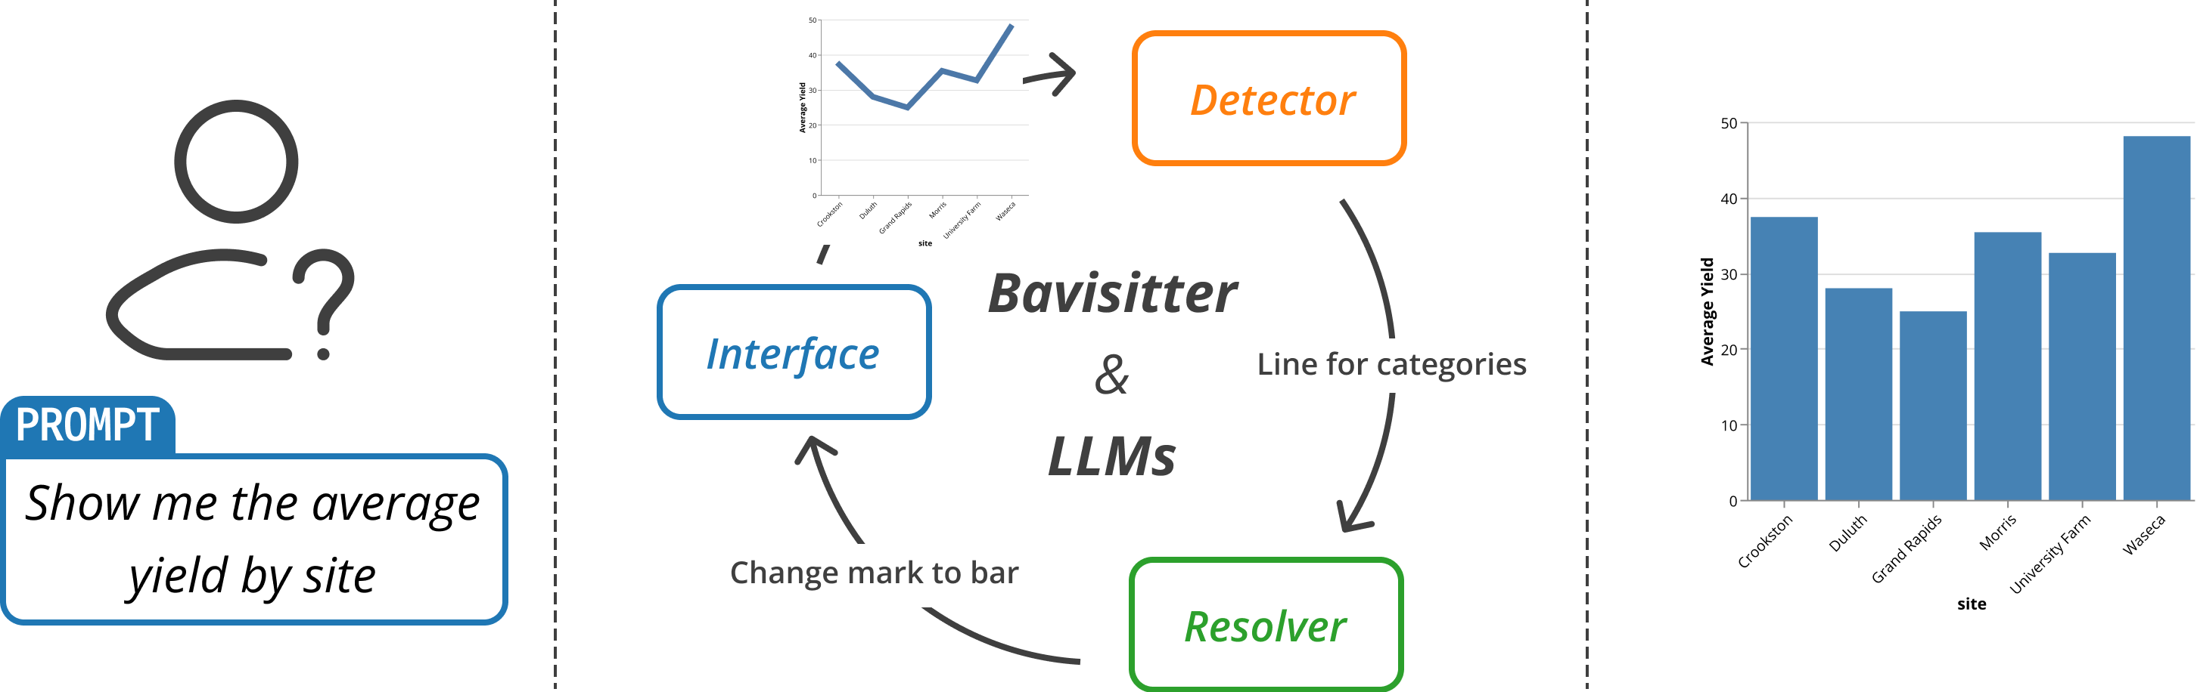
Notes:
We propose Bavisitter as a solution to this problem.
Bavisitter detects errors in visualizations generated by LLMs, and designs corrected visualizations by repeatedly providing feedback prompts.

Slide 7
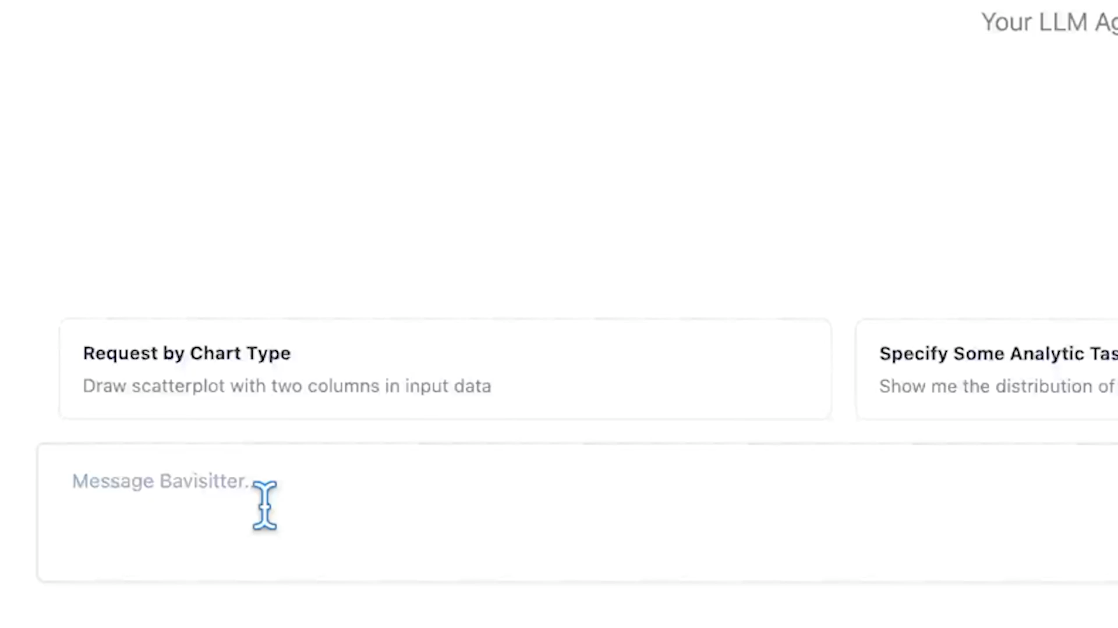
Notes:
Let’s see the short demo video of Bavisitter.
[재생]
When the user specify their needs, Bavisitter automatically designs visualization as the other LLMs do.
However, we can see that the labels of destination are overlapping each other because of high cardinality of destination attribute.
Bavisitter presents the identified and their potential solutions for the user to choose.
Once the user selects solutions, Bavisitter displays revised visualization based on the feedback prompt.

Slide 8











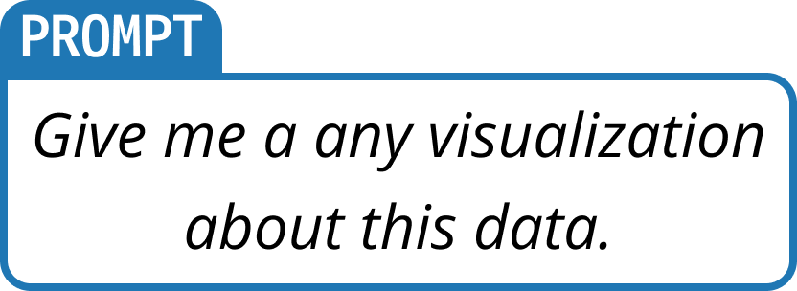
59 Tabular Datasets
from Vega Datasets
Expressiveness
Interpretability
Perception
Effectiveness
Legibility
Random
Sample
Annotate
Manually
wrong-title
mark-overplotted
no-legend
…
Thematic
Analysis
LLM
gpt-4-turbo-1106
with Assistant API
590 LLM-generated
Visualizations
10 visualizations per dataset
200 Visualizations
with 24 chart types
23 Unique Issues
from 104 / 200 improper
visualizations
5 Types of Design Issue
based on Visualization Theory
x 10 times
Notes:
To design Bavisitter, we first needed to understand what mistakes LLMs typically make.
To this end, we first generated ten visualizations for each of the fifty-nine (59) tabular datasets from the Vega Datasets repository.
As a result, we were able to get a corpus of five hundred ninety (590) visualization images.

Slide 9
59 Tabular Datasets
from Vega Datasets
Expressiveness
Interpretability
Perception
Effectiveness
Legibility
Random
Sample
Annotate
Manually
wrong-title
mark-overplotted
no-legend
…
Thematic
Analysis
LLM
gpt-4-turbo-1106
with Assistant API
590 LLM-generated
Visualizations
10 visualizations per dataset
200 Visualizations
with 24 chart types
23 Unique Issues
from 104 / 200 improper
visualizations
5 Types of Design Issue
based on Visualization Theory
x 10 times
Notes:
Then, we sampled two hundred visualization images consist of twenty four chart types.
Two authors manually annotated the issues that occurred in the design visualization images.
As a result, we identified one hundred and four improper visualizations which contains twenty three unique issues.

Slide 10
59 Tabular Datasets
from Vega Datasets
Expressiveness
Interpretability
Perception
Effectiveness
Legibility
Random
Sample
Annotate
Manually
wrong-title
mark-overplotted
no-legend
…
Thematic
Analysis
LLM
gpt-4-turbo-1106
with Assistant API
590 LLM-generated
Visualizations
10 visualizations per dataset
200 Visualizations
with 24 chart types
23 Unique Issues
from 104 / 200 improper
visualizations
5 Types of Design Issue
based on Visualization Theory
x 10 times
Notes:
Finally, we conduct a thematic analysis to identify common themes.
We identified 5 common themes of the design issues, expressiveness, effectiveness, perception, interpretability, and legibility issues.

Slide 11
Three-Phased Visualization Authoring
Prompting
Phase
Detecting
Phase
Resolving
Phase
Notes:
Now, let's see how Bavisitter integrates the issues that we identified into the LLMs.
It's a three-phased process Prompting, Detecting, and Resolving.

Slide 12
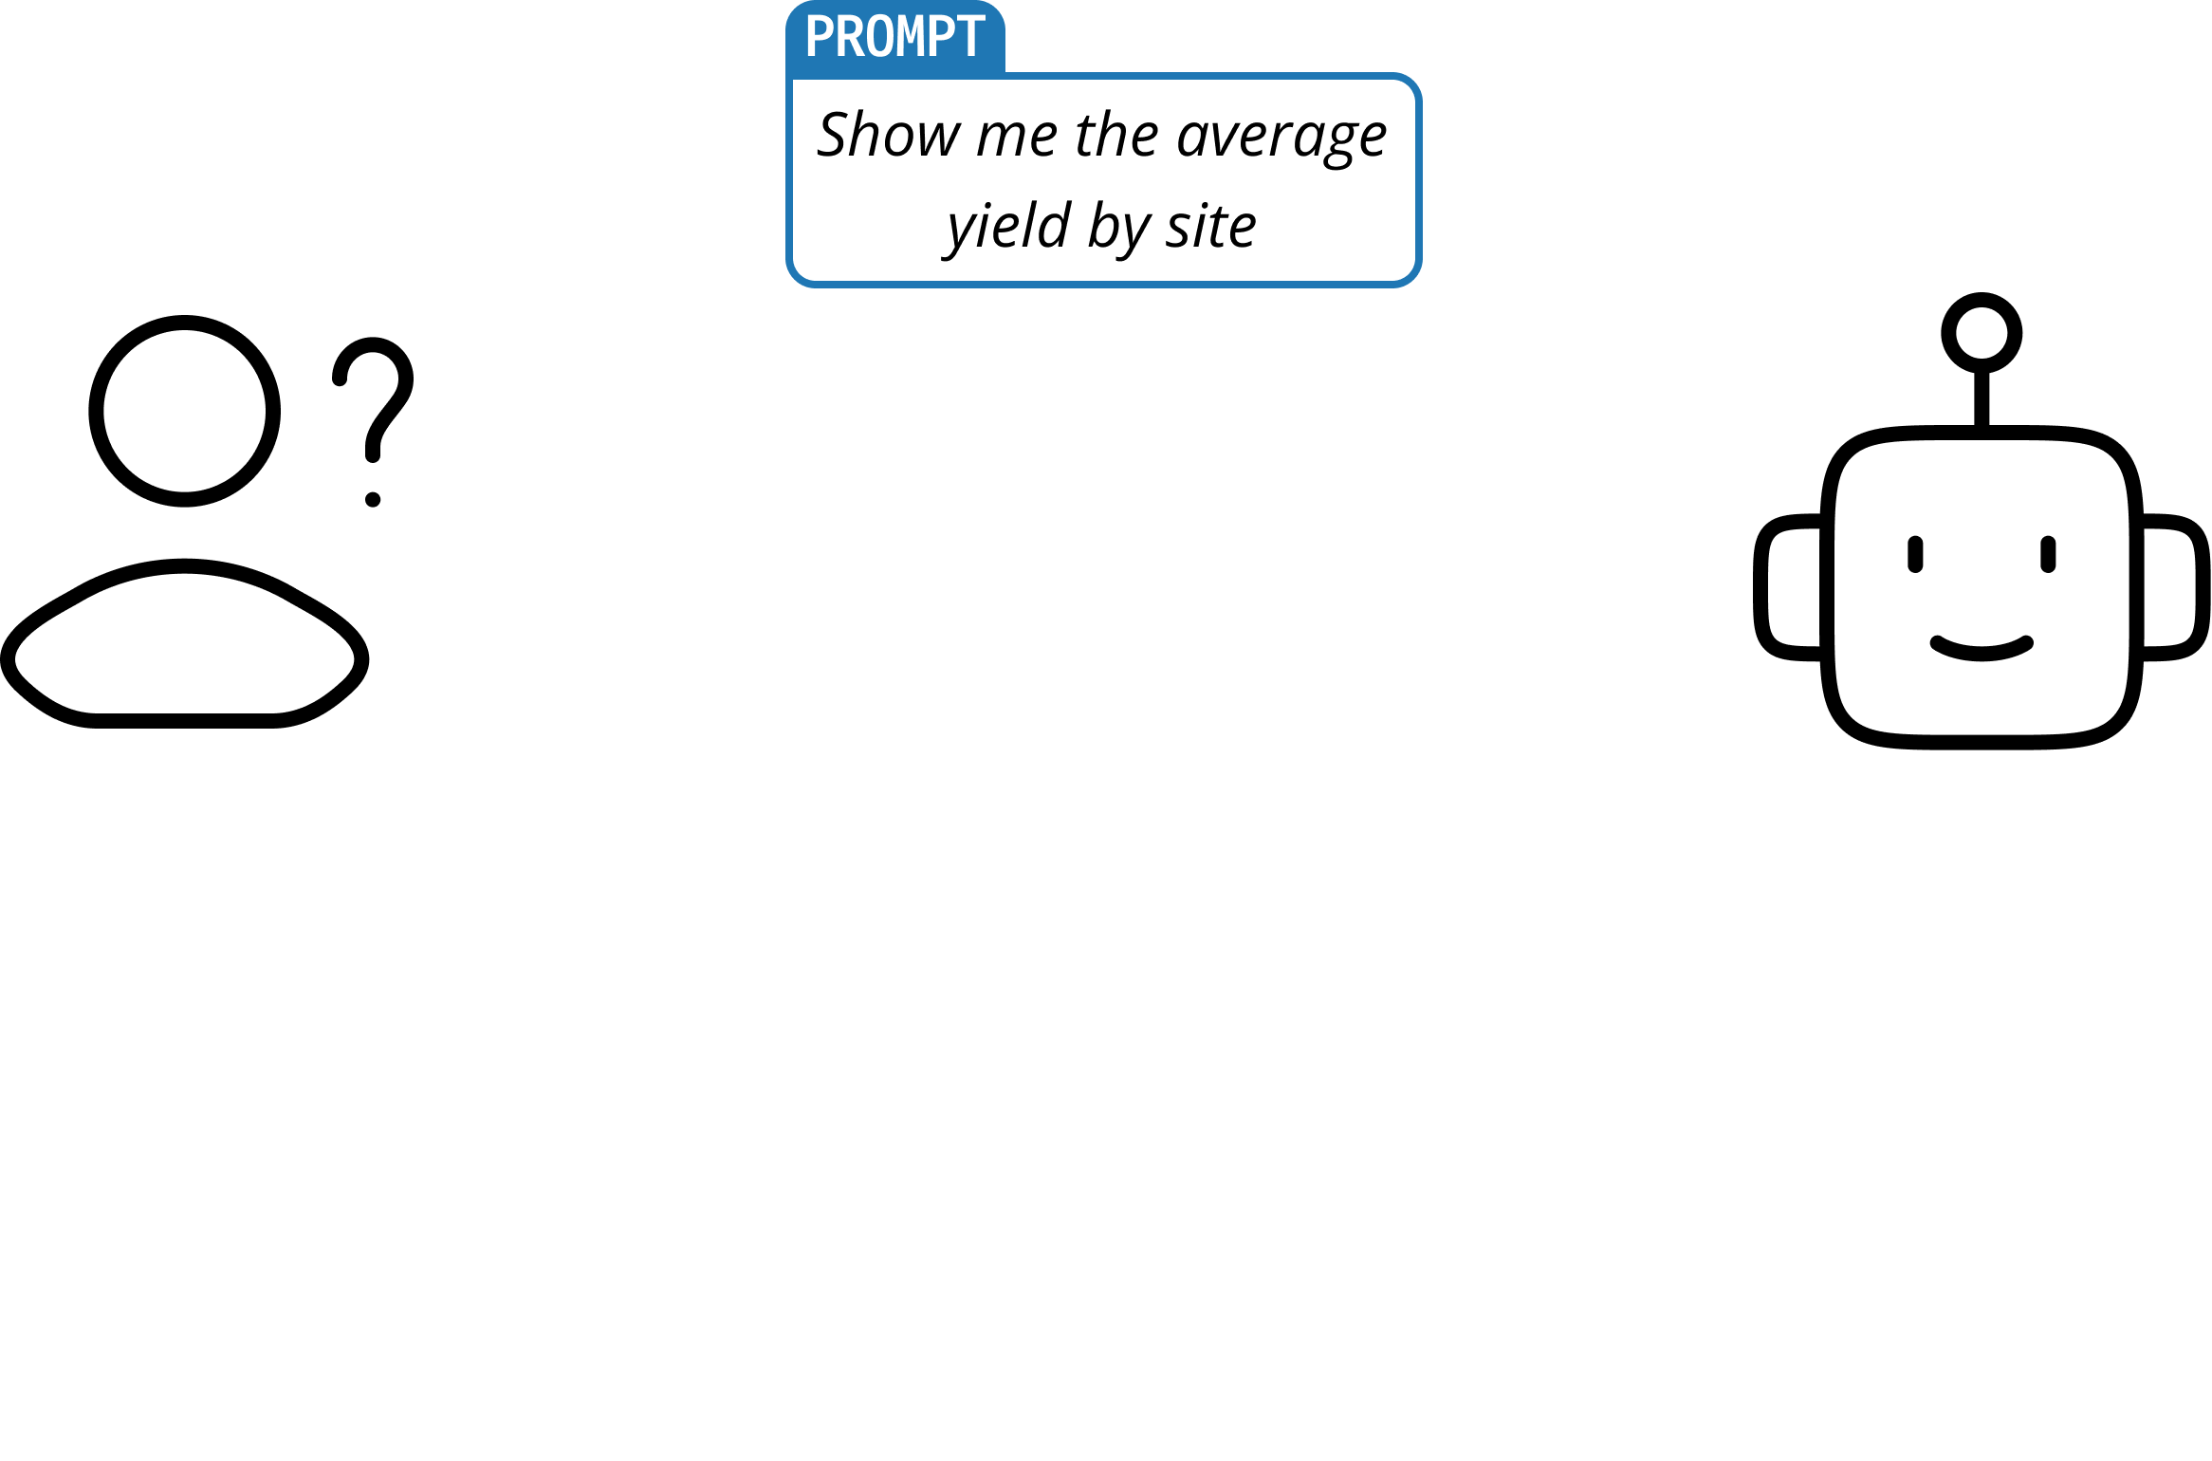
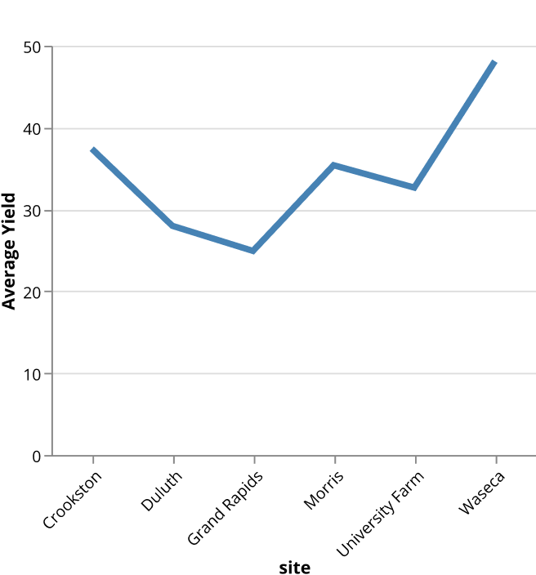
Three-Phased Visualization Authoring
Prompting
Phase
Notes:
In the Prompting phase, it's just like using any other LLMs.
The user enters what they want, and the LLM designs a visualization.
However, as we've seen earlier, LLMs sometimes generate improper visualizations.
Like this one here, LLM generates a line chart for categorical attribute.

Slide 13
Three-Phased Visualization Authoring
Prompting
Phase
Detecting
Phase
Notes:
Once a visualization is generated, Bavisitter performs the Detecting Phase, unlike other existing LLMs which displays without any extra steps.

Slide 14
Three-Phased Visualization Authoring
Prompting
Phase
Detecting
Phase
line-for-categorical
Notes:
During this phase, Bavisitter identifies issues in the visualization.

Slide 15
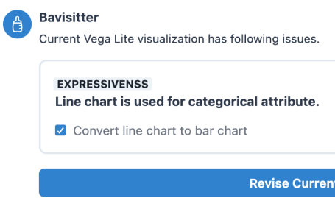
Three-Phased Visualization Authoring
Prompting
Phase
Resolving
Phase
Detecting
Phase
line-for-categorical
Notes:
In the Resolving Phase, Bavisitter suggests multiple feedback prompts that can address the detected issues, and the user can select some of these.

Slide 16
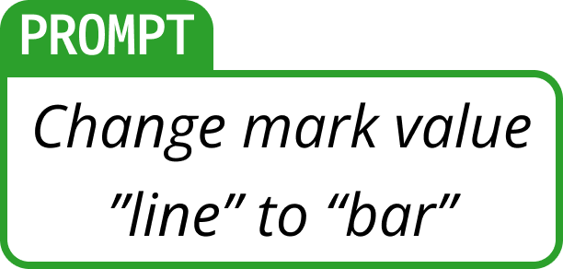
Three-Phased Visualization Authoring
Prompting
Phase
Resolving
Phase
Detecting
Phase
line-for-categorical
Notes:
When the user selects the feedback prompts, they are sent to the LLM.

Slide 17
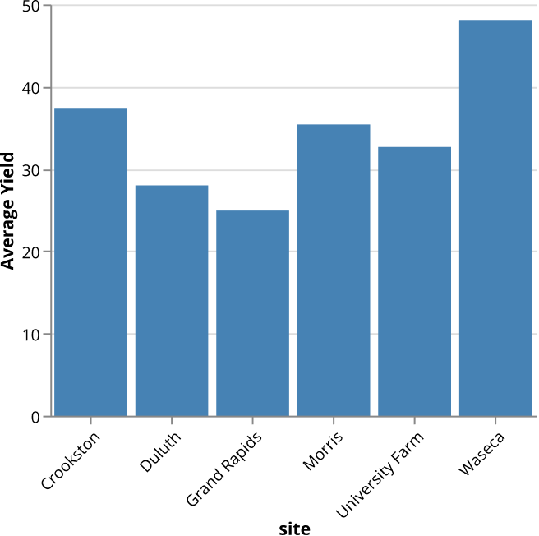
Three-Phased Visualization Authoring
Prompting
Phase
Resolving
Phase
Detecting
Phase
line-for-categorical
Notes:
Finally, Based on the user-selected feedback prompt, Bavisitter revises previous visualization.

Slide 18
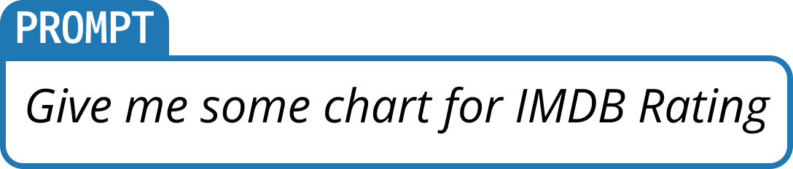
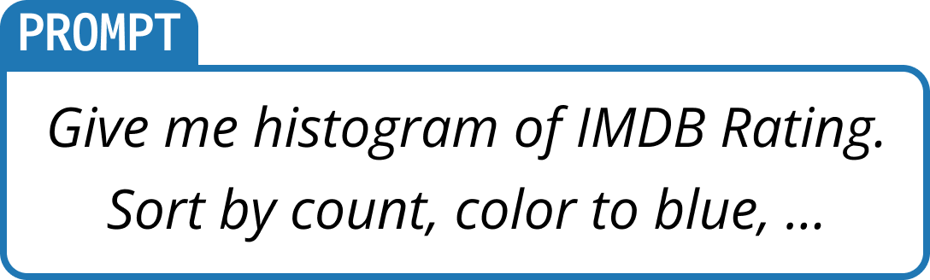
Specificity-Generalization Trade-off
More
General
Prompting
Phase
mark: "bar",
encoding: {
x: { field: "IMDB Rating", type: "quantitative" },
y: { aggregate: ”?" },
}
More
Specific
Notes:
From now on, let's discuss about implementation of the three-phased process.
The powerful generalization capabilities of LLMs enable them to process various inputs.
Let's see the example for the Prompting Phase.
The user can enter the most general request, such as "give me some chart."
More specifically, the user can specify encodings, data aggregation, and colors in natural language. Such as "give me a histogram of IMDB Rating, sort by count, color to blue, ..."
Even further, it is possible to input the partial visualization specifications to the LLM.

Slide 19
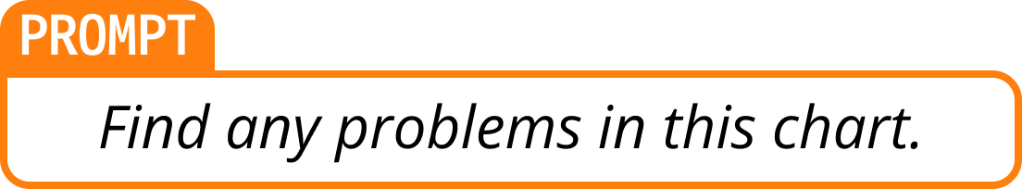
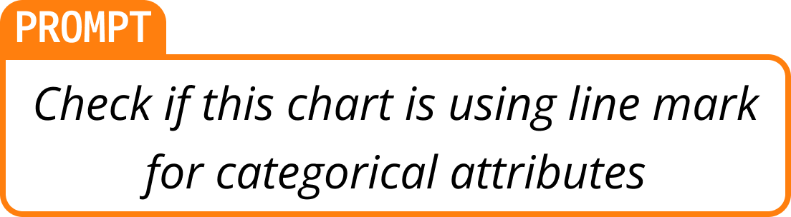
Specificity-Generalization Trade-off
More
General
Detecting
Phase
if (
hasCategoricalAttributes(spec, ["x", "y”]) &&
isMark(spec, "line")
) {
return true
}
More
Specific
Notes:
Similarly, in the Detecting Phase, we can prompt the LLM to "Find any problems,"
or prompt it to "check if the chart is using line marks for categorical attributes,"
or we can directly implement functions that detect issues.
Since the Detecting Phase is performed by the system not the user,
it is necessary to determine the level of specificity in implementing the Detecting Phase.

Slide 20
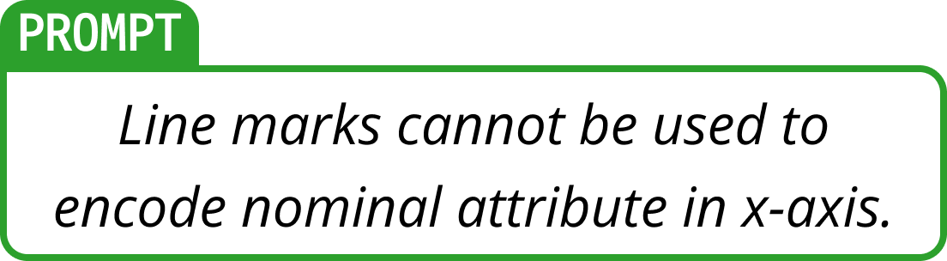
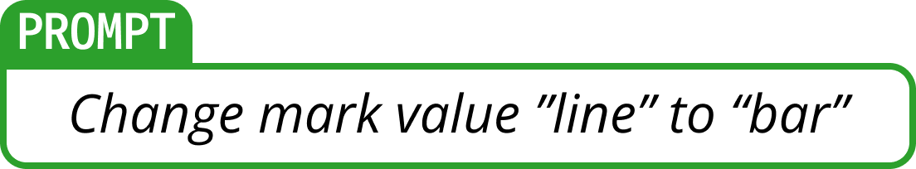
Specificity-Generalization Trade-off
More
General
Resolving
Phase
spec["mark"] = "line”
return spec
More
Specific
Notes:
A similar tension appears in the Resolving Phase as well.
We can prompt by saying ”there is an issue that line mark is used for encode categorical attribute,"
or "change the mark value line to bar,"
Most specifically, we can directly implement functions to handle these feedbacks.

Slide 21
Specificity-Generalization Trade-off
More
General
if (
hasCategoricalAttributes(spec, ["x", "y”]) &&
isMark(spec, "line")
) {
return true
}
spec["mark"] = "line”
return spec
More
Specific
Notes:
Unfortunately, each choice has trade-offs, and there is no one-size-fits-all approach. In Bavisitter, we take a hybrid approach.

Slide 22
Specificity-Generalization Trade-off
More
General
if (
hasCategoricalAttributes(spec, ["x", "y”]) &&
isMark(spec, "line")
) {
return true
}
spec["mark"] = "line”
return spec
More
Specific
Notes:
We chose to use pre-defined heuristics for Detecting Phase to keep the detection logic interpretable and ensure not to miss the issues that we surveyed.
In the Resolving Phase, we chose to append the additional feedback prompt to the original prompt.
This approach exploits the great generalizability of LLMs and better keeps the user informed of the changes made by the system.

Slide 23




Python Libraries from
Process Data / Visualizations
Local / API-provided
Large Language Models
Bavisitter
Vega-Lite
Visualization
IPython Environment
Notes:
Bavisitter runs as a widget in an interactive Python environment.
It interacts with LLMs, executing other python libraries, and designs Vega-Lite visualizations as a result.
This design not only allows users to integrate different types of LLMs provided either locally or through APIs,
but also various Python libraries, including research outputs from VIS communities.

Slide 24
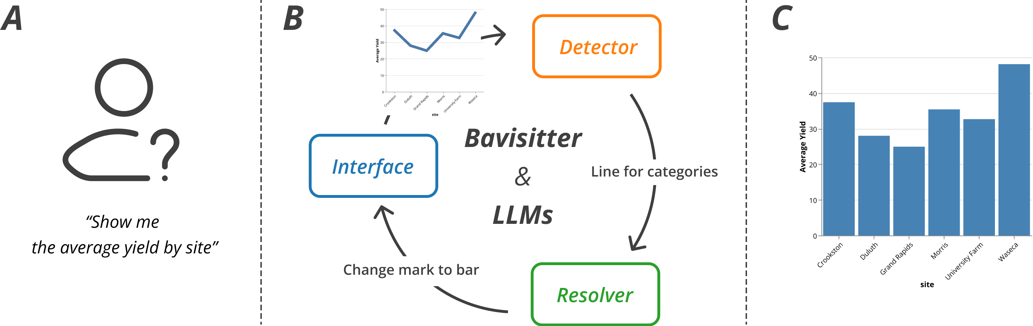





Identified Issues LLM make in Visualization Design
  Identified 23 common issues in LLM-generated visualizations
Designed Bavisitter
  Designed a natural language interface that detects design issues and resolves them with feedback prompt.
Jiwon Choi
https://jiwnchoi.me
jiwnchoi@skku.edu @jiwnchoi
Find Bavisitter in GitHub and PyPI!
https://github.com/jiwnchoi/Bavisitter
pip install bavisitter
Notes:
In conclusion, we identified twenty three common issues LLMs that make while generating visualizations.
Based on these issues, we designed Bavisitter, a natural language interface that detects design issues and resolves them with feedback prompts.
Bavisitter is fully open-sourced software in GitHub and can be easily installed with pip.
Thank you for listening!

Slide 25
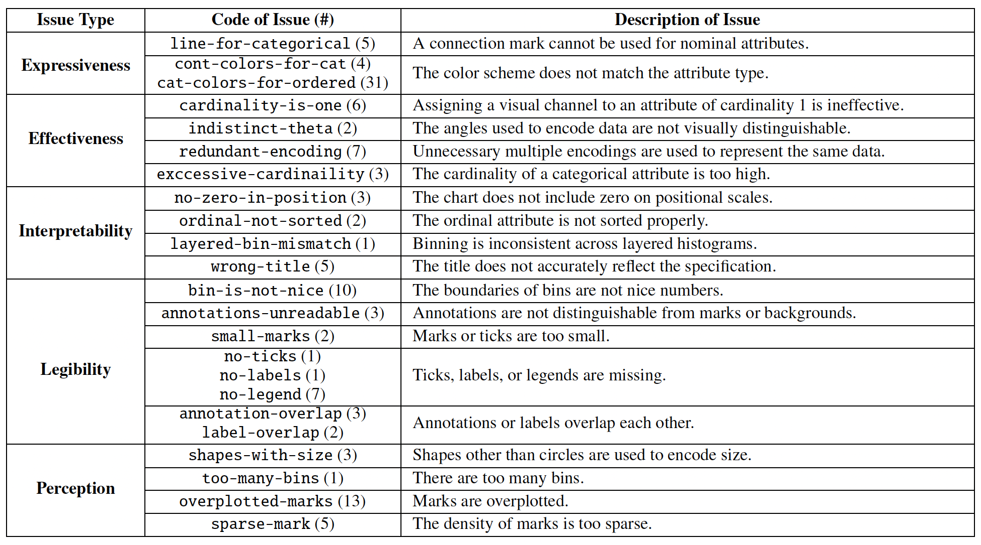

Slide 26
Future Work
Conducting a User Study
  To understand how the Bavisitter helps visualization authoring, especially for novices.
Advanced Model
  Develop large-scale training datasets and models to generalize heuristics.
Beyond Resolving Design Issues
  Extend Bavisitter to LLM client or LLM-based framework specialized in various visualization & visual analysis
Notes:
Looking ahead, we have outlined several key areas for future work. We plan to conduct comprehensive user studies to evaluate Bavisitter's effectiveness, with a particular focus on how it aids novice users.
To overcome current limitations, we aim to develop more advanced models and larger training datasets, allowing us to generalize our heuristics.
Lastly, we intend to expand Bavisitter's capabilities by integrating external visualization libraries, broadening its applicability and utility.

