Slide 1
딥러닝의 역사

Slide 2
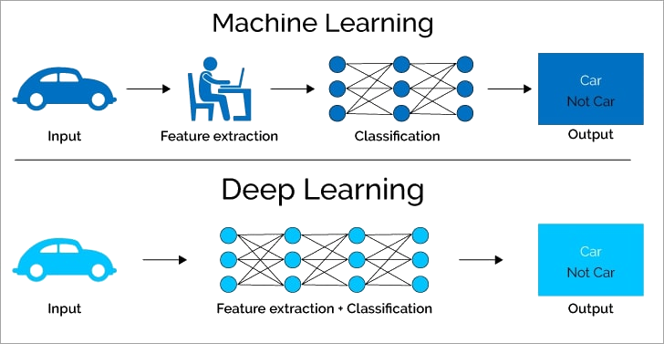
1. Machine Learning vs Deep Learning
Human Intervention -> ANNs(Artificial Neural Network)

Slide 3
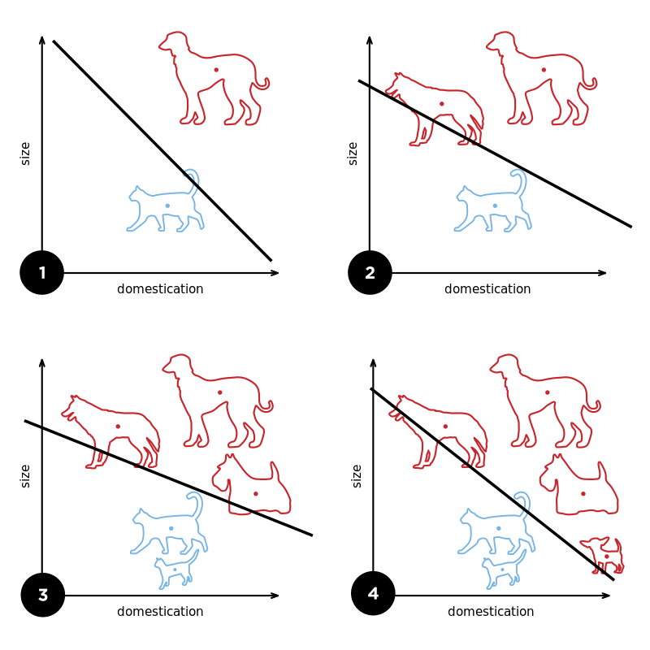
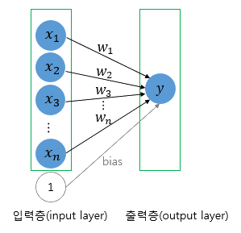
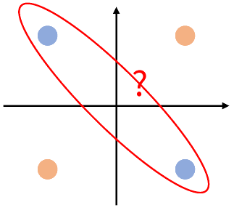
2. Perceptron
Can’t handle XOR problems
A diagram showing a perceptron updating its
linear boundary as more training examples are added

Slide 4
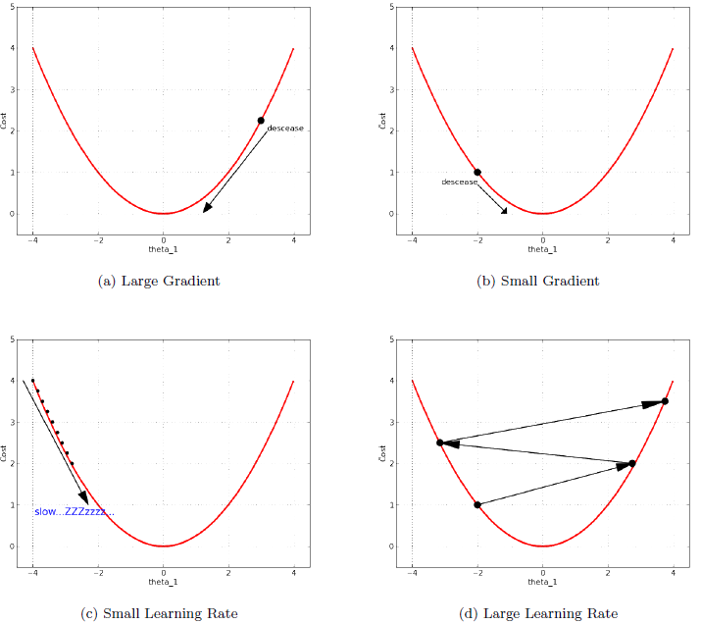
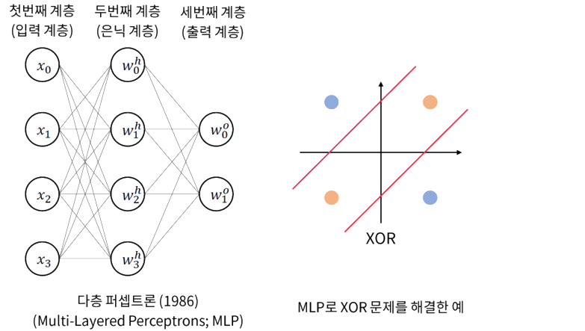
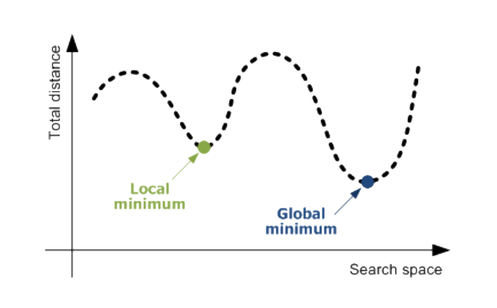
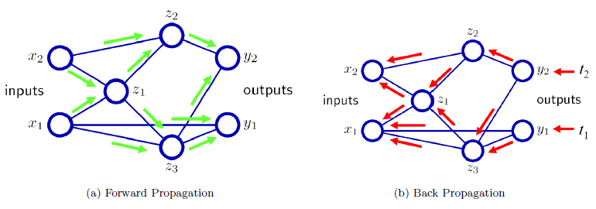
3. Multi-Layered Perceptron
1. Vanishing Gradient
2. Amount of Labeled Data
needed
3. Overfitting
4. Local Minima
MLP, Gradient Descent, Back Propagation

Slide 5
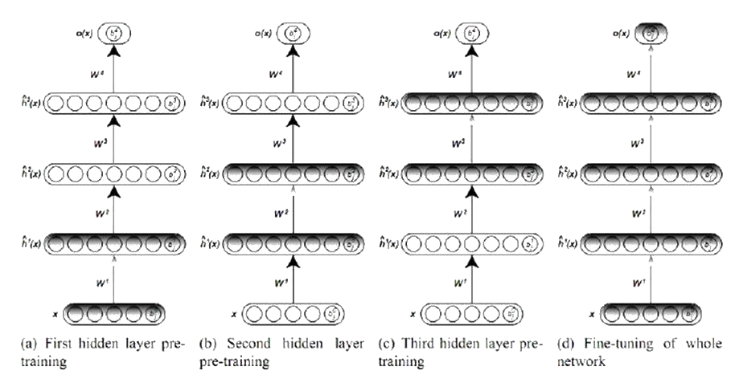
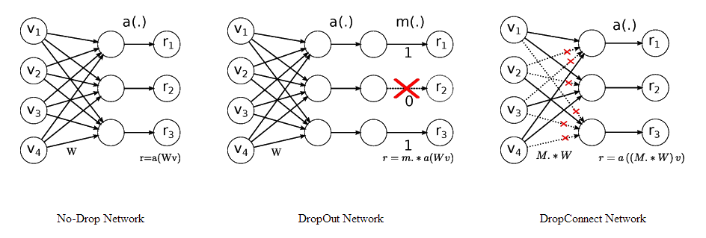
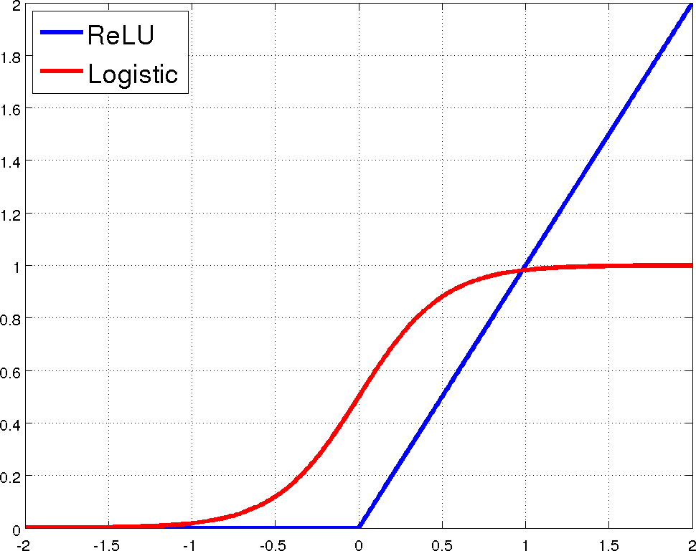
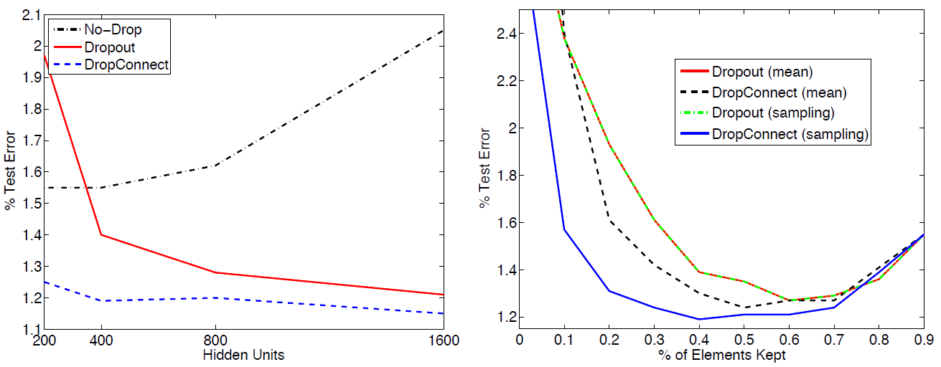
4. 3rd Generation : RBM, DBN, ReLU, Dropout …
Deep Belief Network
DropOut Network
Sigmoid vs ReLU
DropOut’s Effectiveness

