Slide 1
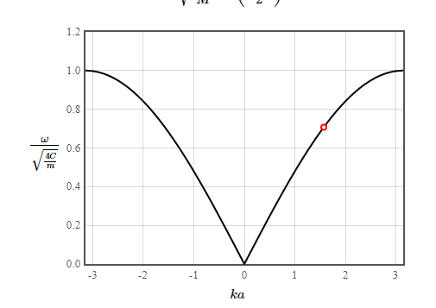
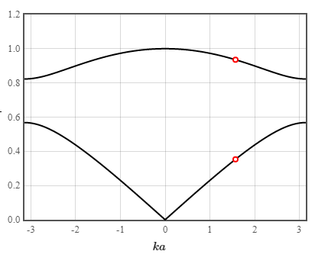


a
+External pinning (notches, VCMA?)
$$x_{i}$$
Treat DW position as quasiparticle…
Set up analytical equations for coupled harmonic oscillators
Then resolve spin wave DOS + transfer function for resonate and fire neurons?
Or reconfigurable spin wave antennas?
Should be of $≈$equivalent maths to phonon dispersions

Slide 2
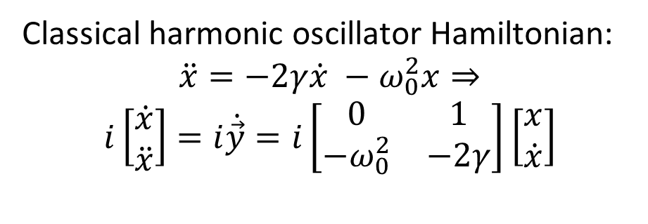
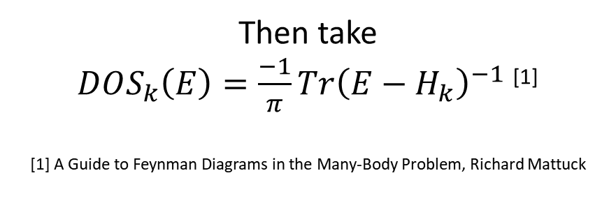
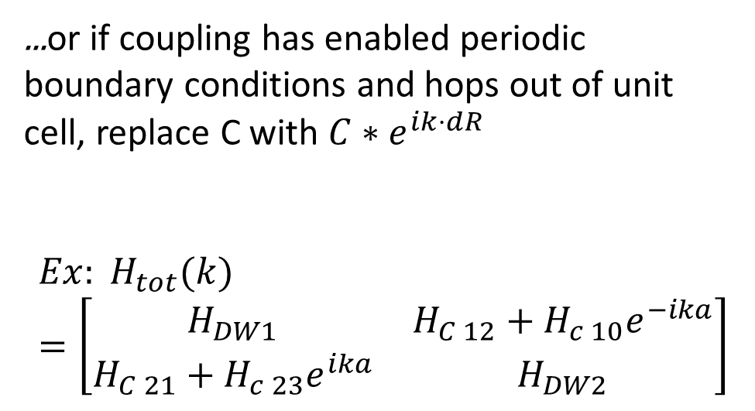
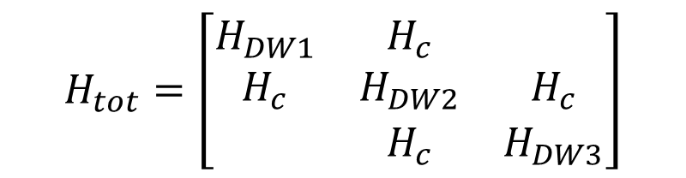
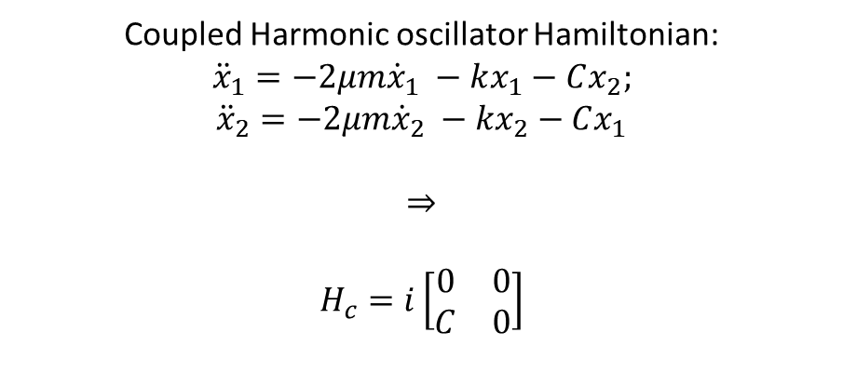
Classical harmonic oscillator Hamiltonian:
$$\ddot{x}=−2γ\dot{x} −ω_{0}^{2}x⇒$$
$$i\left[\begin{matrix}\dot{x} \\ \ddot{x}\end{matrix}\right]=i\dot{\vec{y}}=i\left[\begin{matrix}0 & 1 \\ −ω_{0}^{2} & −2γ\end{matrix}\right]\left[\begin{matrix}x \\ \dot{x}\end{matrix}\right]$$
...or if coupling has enabled periodic boundary conditions and hops out of unit cell, replace C with $C∗e^{ik⋅dR}$
$$Ex: H_{tot}(k)=\left[\begin{matrix}H_{DW1} & H_{C 12}+H_{c 10}e^{−ika} \\ H_{C 21}+H_{c 23}e^{ika} & H_{DW2}\end{matrix}\right]$$
Coupled Harmonic oscillator Hamiltonian:
$${\ddot{x}}_{1}=−2μm{\dot{x}}_{1} −kx_{1}−Cx_{2};$$
$${\ddot{x}}_{2}=−2μm{\dot{x}}_{2} −kx_{2}−Cx_{1}$$
$$⇒$$
$$H_{c}=i\left[\begin{matrix}0 & 0 \\ C & 0\end{matrix}\right]$$
Then take
$DOS_{k}\left(E\right)=\frac{−1}{π}Tr{\left(E−H_{k}\right)}^{−1}$ ^{[1]}
[1] A Guide to Feynman Diagrams in the Many-Body Problem, Richard Mattuck
$$H_{tot}=\left[\begin{matrix}H_{DW1} & H_{c} & \\ H_{c} & H_{DW2} & H_{c} \\ & H_{c} & H_{DW3}\end{matrix}\right]$$

Slide 3
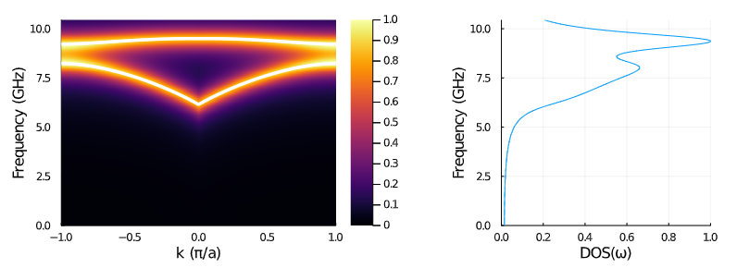
Staggered, anti-aligned racetracks with magnetostatic contribution from 500 nearest neighbors

Slide 4
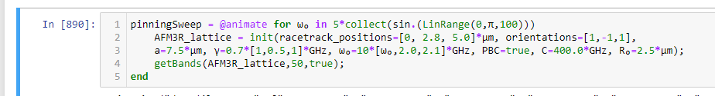
Or, one can sweep the pinning strength on one site.

