Slide 1


TrustTrace AI
Autonomous Fraud Intelligence Workflow
Detect
•
Explain
•
Respond
•
Audit
TEAM NAME: Code Raiders | ET HACKATHON 2026

Slide 2

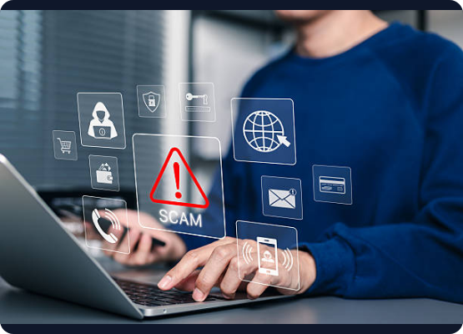
The Escalating Threat Landscape
Rising Fraud Complexity: Surge in sophisticated SMS scams, targeted phishing emails, fake UPI requests, and deceptive job offers.
Limitations of Existing Tools: Current solutions rely on basic keyword blocking. They only filter spam but fail to explain why a message is dangerous or guide user action.
The Intelligence Gap: Users require more than simple blocking. They need proactive detection, clear explanation, actionable response protocols, and complete auditability.

Slide 3


















TrustTrace AI: The Autonomous Solution
Detects Scam Likelihood
Retrieves Context (RAG)
Assigns Final Risk
Analyzes incoming message syntax, sentiment, and urgency signals to predict initial fraud probability accurately.
Searches enterprise databases for historical, similar fraud cases using vector embeddings to establish malicious intent.
Aggregates AI analysis and RAG context to classify the threat level accurately as Low, Medium, or High.
Suggests Safe Actions
Generates Complaint Draft
Maintains Audit Trail
Provides immediate, context-aware guidelines on how to handle the suspicious message (e.g., block number, do not click link).
Autonomously formats a formal report ready to be submitted to internal IT security or national cybercrime portals.
Logs every reasoning step, data retrieval, and decision made by the AI agents for complete transparency and review.

Slide 4

Why Agentic AI?
Fraud detection requires a multi-agent workflow, not just a standard chatbot. TrustTrace utilizes specialized agents that are autonomous, structured, explainable, and retry-capable.

Slide 5








System Architecture & Workflow
User Input
Detection
Retrieval
Analysis
Decision
Action
Audit
Suspicious SMS/Email
Initial Parse
Vector Search
Context Mapping
Risk Classification
Suggest & Draft
Log Trail

Slide 6
Intelligence Dashboard
Real-Time UI Capabilities:
Risk Classification & Confidence: Visual indicators for threat levels with AI confidence scoring.
Scam Indicators: Highlighted exact phrases and urgency triggers.
Similar Fraud Cases: Displays matched historical records retrieved via RAG.
Automated Outputs: Suggested safety actions and a 1-click complaint draft export.

Slide 7



Quantifying the Business Impact
Assuming a volume of 1,000 suspicious messages processed per day by a SOC team.
Resolution Time per Alert
Monthly Analyst Hours Saved
45s
1,125
3 min
Time recovered for complex threat hunting (37.5 hrs/day)
Manual Review vs. TrustTrace AI

Slide 8




"
From suspicious message to safe action — autonomously.

Slide 9
THANK YOU
GitHub Link: https://github.com/jiya-19/Trust-Trace-AI

