Slide 1
Unit- 3
FUNDAMENTALS OF ECONOMICS
BY- PROF.TANVI BAGGA

Slide 2

WHAT IS ECONOMICS?
Economics is a social science that focuses on the production, distribution, and consumption of goods and services, and analyzes the choices that individuals, businesses, governments, and nations make to allocate resources.

Slide 3
Why are some countries rich and some countries poor?
Why do women earn less than men?
How can data help us understand the world?
Why do we ignore information that could help us make better decisions?
What causes recessions?
Economics can help us answer these questions.
Economics can be defined in a few different ways. It’s the study of scarcity, the study of how people use resources and respond to incentives, or the study of decision-making. It often involves topics like wealth and finance, but it’s not all about money. Economics is a broad discipline that helps us understand historical trends, interpret today’s headlines, and make predictions about the coming years.

Slide 4
EXAMPLE-
You have $30 and you'd like to get a regular shirt, pants, and a pair of shoes to attend a free show that's normally $10. At the same time, there is a special brand of shoes that you're interested in. The regular shirt, pants, and pair of shoes cost $10 each, whereas the special brand shoes cost $30 a pair.
Economics is important because it helps you decide how to use your $30. Let's assume you have no clothes, to begin with. Buying the special brand pair of shoes means you don't get to see the free show because you are still naked! Looking at this situation, economics suggests that you should take the first set of options and buy the regular shirt, pants, and pair of shoes for a total of $30 because this enables you to go to the free show and gain additional value than if you had chosen just the shoes! This is the option that makes the best use of your $30.

Slide 5
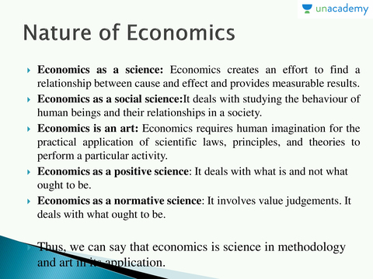
NATURE OF ECONOMICS
Economics is the scientific study of the ownership, use, and exchange of scarce resources – often shortened to the science of scarcity.

Slide 6
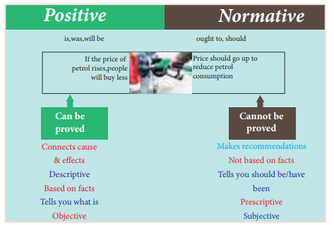

Slide 7
Examples -
Positive Economics a. An increase in money supply implies a price-rise in an economy.
b. As the irrigation facilities and application of chemical fertilizers expand, the production of food-grains increases.
c. An increase in the birth rate and a decrease in the death rate reflect the rate of growth of population.
Normative Economics a. Inflation is better than deflation.
b. More production of luxury goods is not good for a less-developed country.
c. Inequalities in the distribution of wealth and incomes should be reduced.

Slide 8
Scope Of Economics
Microeconomics
Micro refers to small; it is the study of individual units of consumption of goods and services as well as that of production and much more. It is concerned with one single household, office, industry or market.
Moreover, concepts such as product pricing and consumer or firm behaviour are a part of it. Various types of markets are also studied under this. Hence, the consumption of goods and services and the behaviour responsible for it is a part of microeconomics.
Macroeconomics
Macro means large; it is the study of the overall production and consumption of goods and services. It is concerned with national income, GDP, GNP or gross national product. Concepts such as macro-level business cycles, national budget, unemployment and money supply are a part of macroeconomics.

Slide 9
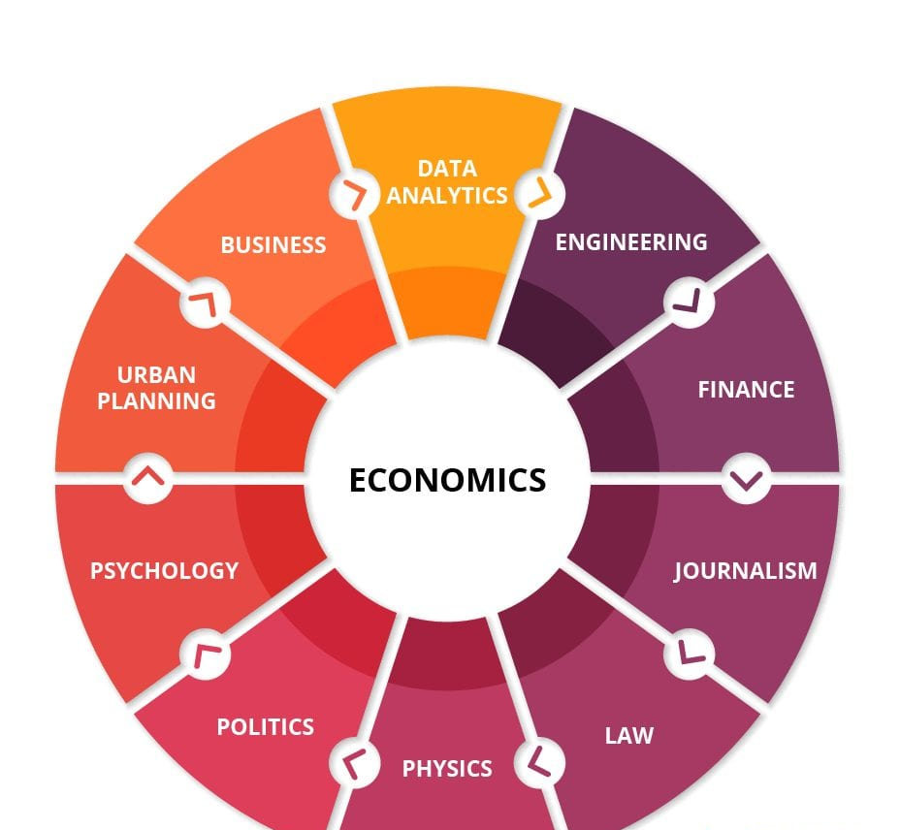

Slide 10
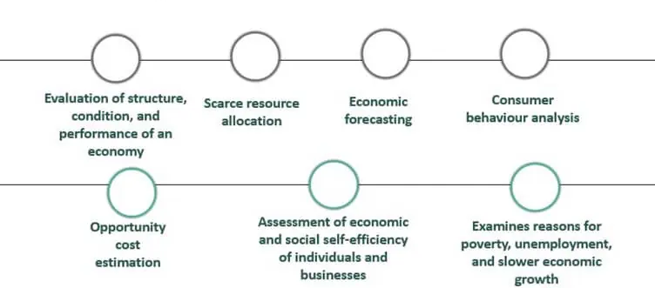
SIGNIFICANCE OF ECONOMICS

Slide 11
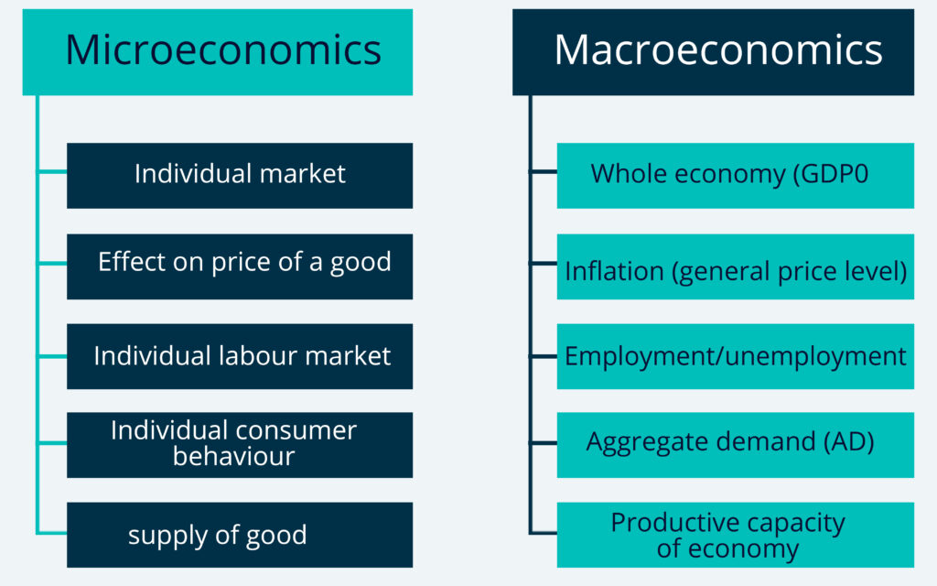
DIFFERENCE BETWEEN MICRO AND MACRO ECONOMICS

Slide 12

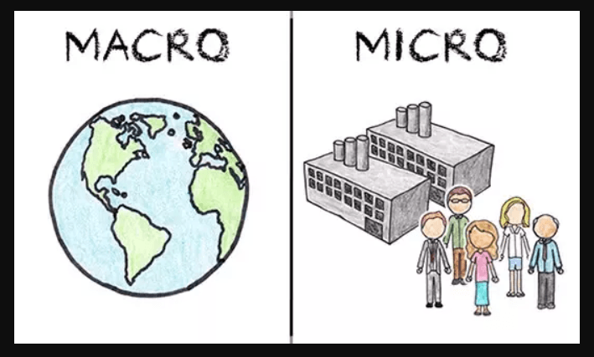

Slide 13
Microeconomics focuses on the choices made by individual consumers as well as businesses concerning the fluctuating cost of goods and services in an economy. Microeconomics covers several aspects, such as –
Supply and demand for goods in different marketplaces.
Consumer behaviour, as an individual or as a group.
Demand for service and labour, including individual labour markets, demand, and determinants like the wage of an employee.
One of the main features of microeconomics is it focuses on casual situations when a marketplace experiences certain changes in the existing conditions. It takes a bottom-up approach to analyse the economy.
What are the Different Components of Microeconomics?
The different components of microeconomics include:
Market demand and supply (For example Textile)
Consumer Behavior ( for example Consumer Choice Theory)
Producers are driven by individual preferences.
Market-specific labor markets ( For example demand labor wage determination in specific markets).

Slide 14
Macroeconomics studies the economic progress and steps taken by a nation. It also includes the study of policies and other influencing factors that affect the economy as a whole. Macroeconomics follows a top-down approach, and involves strategies like –
The overall economic growth of a country.
Reasons that are likely to influence unemployment and inflation.
Fiscal policies are likely to influence factors like interest rates.
Effect of globalization and international trade.
Reasons that affect varying economic growths among countries.
Another feature of macroeconomics is that it focuses on aggregated growth and its economic correlation.
What are the Different Components of Macroeconomics?
The different components of macroeconomics include:
National Output
Unemployment
Inflation

Slide 15
Studying microeconomics and macroeconomics is important for several reasons:
1. Understanding Individual and Market Behavior: Microeconomics helps you comprehend how individuals and firms make economic decisions, allocate resources, and interact in markets.
2. Resource Allocation: Microeconomics aids in the efficient allocation of resources, which is crucial for businesses and policymakers.
3. Policy Analysis: Macroeconomics focuses on the economy as a whole, helping to analyze and formulate policies related to inflation, unemployment, and economic growth.
4. Real-World Applications: Both micro and macroeconomics provide valuable insights into real-world issues, from personal finance decisions to national economic stability.
5. Business Management: Microeconomics is useful for businesses in setting prices, understanding consumer behavior, and making production decisions.
6. Economic Citizenship: A basic understanding of economics enables informed citizenship and better decision-making in areas like voting and personal finance.

Slide 16
WHAT IS TIME VALUE OF MONEY?(TVM)
WHAT IS TIME VALUE OF MONEY(TVM)?
The time value of money is a basic financial concept that holds that money in the present is worth more than the same sum of money to be received in the future.
This is true because money that you have right now can be invested and earn a return, thus creating a larger amount of money in the future. (Also, with future money, there is the additional risk that the money may never actually be received, for one reason or another).
The time value of money is sometimes referred to as the net present value (NPV) of money.

Slide 17
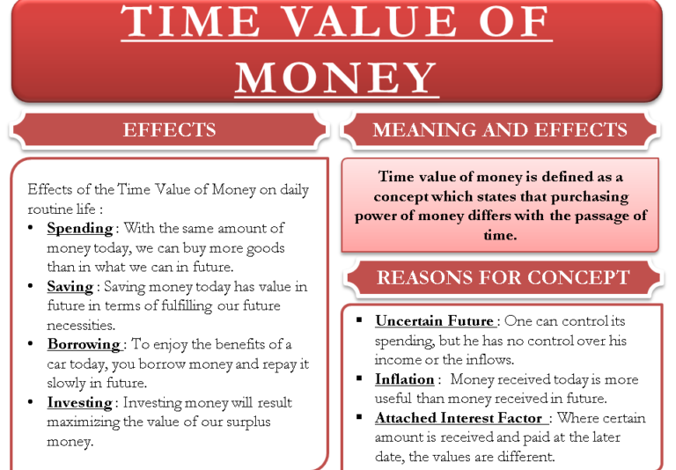

Slide 18
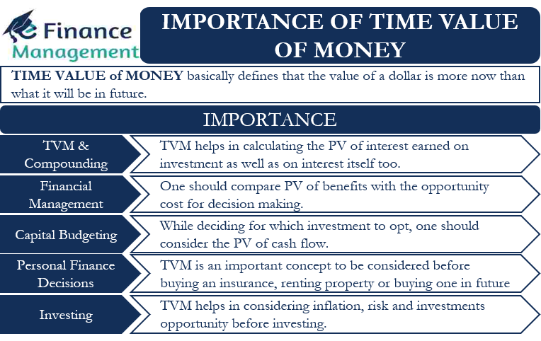

Slide 19
LAW OF DIMINISHING MARGINAL UTILITY
According to many economists like Dr Marshall, the law of diminishing marginal utility definition is when the additional benefit that a person derives from a given increase of his stock of anything diminishes with the increase in the stock that he already has. The law states that the more we have of a commodity, the less we want to have more of it as the utility derived from every success unit of the commodity keeps on declining when more is consumed.
John, for example, is starving and hasn't consumed anything for a while. When he eventually starts to consume, the very first piece will provide him with a considerable measure of satisfaction. As he continues to eat even more meals, his hunger will wane to the extent that he no longer wants to eat

Slide 20
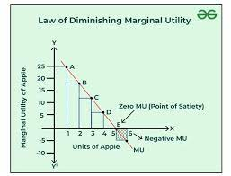
two important terms – total utility and marginal utility
Total Utility or Full Satiety – is the sum of utility derived from different units of a commodity consumed by a consumer. Therefore, Total Utility = the sum total of all marginal utility.
Marginal Utility or Marginal Satiety – is the additional utility derived from the consumption of an additional unit of a commodity. Therefore, Marginal Utility = the addition made to the Total Utility by consuming one more unit of a commodity.

Slide 21
Assumptions of the Law of Marginal Utility-
Units of commodities consumed should be identical or homogeneous, that is, the same in all respects.
Units should be consumed in quick succession with minimal breaks in between.
Units should be of a standard size, that is, neither too big nor too small.
The taste of the consumers should be constant.
There should be no change in the price of substitute goods. If the prices of substitute goods change, it may become difficult to have an idea about the utility that the consumer might get from the main commodity.
The utility is measurable.
The consumer is rational while making consumption decisions.

Slide 22
Limitations of the Law of Diminishing Marginal Utility:
The law does not operate in the following cases:
Very Small Units: If the units of commodities are very small then the law does not operate.
Dissimilar units: The unit should be similar in size, quality etc. The law of diminishing marginal utility will not operate if the units that are consumed are not similar in size and quality.
Too long an interval: The law will also not operate if the units are consumed after long breaks.
Mentally unstable people: People like drunkards or drug addicts will get greater satisfaction with every successive dose of liquor. Hence, the law fails to operate in these cases.
Rare collections: This refers to hobbies. When people collect rare coins and stamps for example, in such cases the person’s satisfaction increases with every addition to his stock or collection. The law hence cannot operate.
Not applicable to money: Money is a commodity which is appreciated greatly by rich and poor. There is a saying that the more money a person has the want he wants of it, hence, the law cannot operate in the case of money.

Slide 23
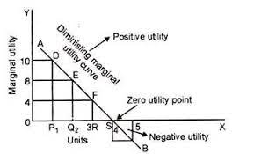

Slide 24
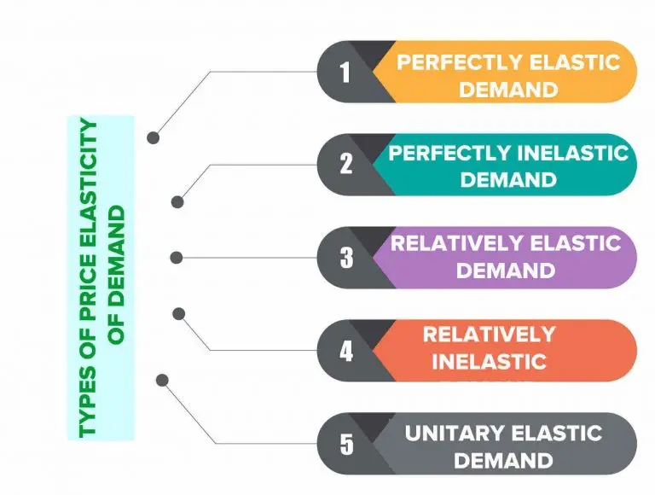
PRICE ELASTICITY OF DEMAND
Price elasticity of demand is a measurement of the change in the consumption of a product in relation to a change in its price. Expressed mathematically, it is:
Price Elasticity of Demand = Percentage Change in Quantity Demanded ÷ Percentage Change in Price

Slide 25
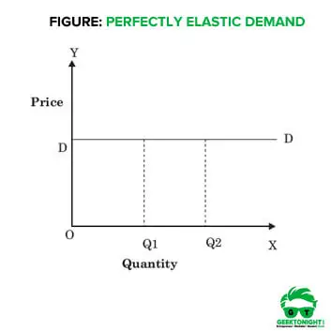
1.Perfectly Elastic Demand When a small change (rise or fall) in the price results in a large change (fall or rise) in the quantity demanded, it is known as perfectly elastic demand.
Under such type of elasticity of demand, a small rise in price results in a fall in demand to zero, while a small fall in price causes an increase in demand to infinity.
Suppose product X is manufactured by a large number of sellers in the market. If a person wants to buy the product X, he could choose among different firms for the purchase. Let’s say, firm A increased the price of product X, above market equilibrium. As a result, the demand for the product X for the firm would decrease to a great extent as the same product is available with other sellers too at cheaper prices. Thus, the demand for product X of the firm A is perfectly elastic.

Slide 26
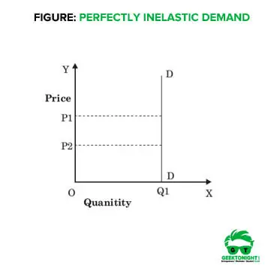
2.Perfectly Inelastic Demand When a change (rise or fall) in the price of a product does not bring any change (fall or rise) in the quantity demanded, the demand is called perfectly inelastic demand.

Slide 27
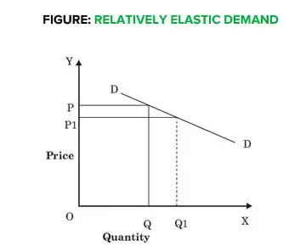
3.Relatively Elastic Demand When a proportionate or percentage change (fall or rise) in price results in greater than the proportionate or percentage change (rise or fall) in quantity demanded, the demand is said to be relatively elastic demand. In other words, a change in demand is greater than the change in price.
PRICE OF PEN (₹ PER PEN) | QUANTITY DEMANDED
25 | 50
20 | 100

Slide 28
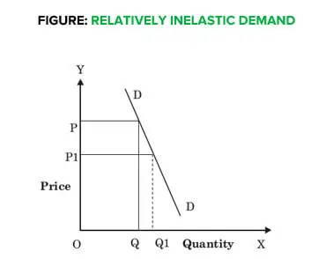
4.Relatively Inelastic Demand When a percentage or proportionate change (fall or rise) in price results in less than the percentage or proportionate change (rise or fall) in demand, the demand is said to be relatively inelastic demand. In other words, a change in demand is less than the change in price.
PRICE OF MILK(₹ PER LITRE) | QUANTITY DEMANDED
15 | 90
20 | 85

Slide 29
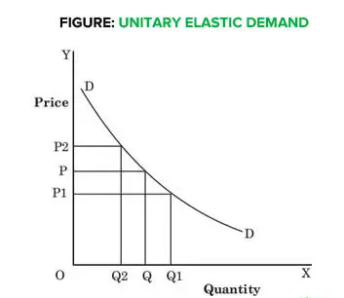
5.Unitary Elastic Demand Unitary elastic demand occurs when a change (rise or fall) in price results in equivalent change (fall or rise) in demand.

Slide 30
THEORY OF DEMAND AND SUPPLY
The Law of Demand (negative relationship of price and demand and this law is from consumer’s perspective- affordability)
The Law of Demand expresses the nature of functional relationship between the price of a commodity and its quantity demanded.
It simply states that demand varies inversely to the changes in price i.e. demand for a commodity expands when price falls and contracts when price rises.
“Law of Demand states that people will buy more at lower prices and buy less at higher prices, other things remaining the same.”
It is assumed that other determinants of demand are constant and ONLY PRICE IS THE VARIABLE AND INFLUENCING FACTOR.

Slide 31
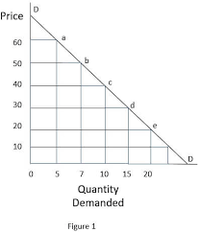
The law of demand is based on the following main assumptions:—
1. Consumers income remain unchanged.
2. Tastes and preferences of consumers remain unchanged.
3. Price of substitute goods and complementary goods remain unchanged.
4. There are no expectations of future changes in the price of the commodity.
5. There is no change in the fashion of the commodity etc.

Slide 32
Reasons for the law of demand are as follows:—
1. The Law of Diminishing Marginal Utility: According to this law, other things being equal as we consume a commodity, the marginal utility derived from its successive units go on falling. n Hence, the consumer purchases more units only at a lower price. A consumer goes on purchasing a commodity till the marginal utility of the commodity is greater than its market price and stops when MU = Price i.e. when consumer is at equilibrium. When the price of the commodity falls, MU of the commodity becomes greater than price and so consumer start purchasing more till again MU = Price. It therefore, follows that the diminishing marginal utility implies downward sloping demand curve and the law of demand operates.
2. Change in the number of consumers: Many consumers who were unable to buy a commodity at higher price also start buying when the price of the commodity falls. Old customers starts buying more when price falls.
3. Various uses of a commodity: Commodity may have many uses. The number of uses to which the commodity can be put will increase at a lower price and vice versa.
4. Income effect: When price of a commodity falls, the purchasing power (i.e. the real income) of the consumer increases. Thus he can purchase the same quantity with lesser money or he can get more quantity for the same money. This is called income effect of the change in price of the commodity

Slide 33
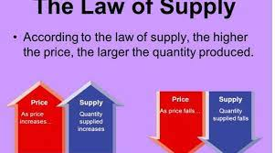
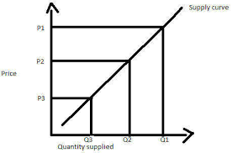
LAW OF SUPPLY

Slide 34
The law of supply states that an increase in the price of goods or services results in an increase in the quantity that suppliers make available to the market.
Existing suppliers increase production of higher-priced goods to maximize profits, while new suppliers may also enter the market.
The law of supply assumes that all other factors remain constant. In practice, many other factors can play into supply decisions, including rising production costs and market competition.
The owner of a coffee shop notices that sandwich prices are rising. To boost profits, the owner starts making more sandwiches for sale.
A movie studio sees that major theaters are charging higher prices for blockbuster films, so it begins greenlighting more projects to develop star-studded action movies.
Noticing that the price of organic vegetables is increasing faster than the price of conventionally produced crops, a farmer starts the process of gaining organic certification.

Slide 35
Assumptions of law of supply
The assumptions of the law of supply are as under:
No change in cost of production
It assumed that there is no change in cost of production because of the profit decreases with the increase in cost of production and it causes the decrease in supply. If price of a commodity decreases and cost of production also decreases, at the same time, the quantity supplied does not decrease and profit remains constant.
No change in technology
It is also assumed that technique of production does not change. If better methods of production are invented, profit increases at the previous price. The sellers increase supply and law of supply does not operate.
No change in climate
It is also assumed that there is no change in climatic situation. For example, at any place flood or earth quake occurred. The supply of goods decreases at that place at previously prevailing price.
No change in prices of substitutes
If the prices of substitutes of a commodity fall then the tendency of consumers diverts to substitutes therefore, the supply of a commodity falls without any change in price.

Slide 36
Reason for Law of Supply
The main reasons behind the law of supply are as follows:
1. Profit Motive:
Maximising profits is the primary goal of producers when they supply a good or service. Their profits grow when the price of a commodity rises without a change in costs. Therefore, by increasing production, manufacturers increase the commodity’s supply. On the other hand, as price fall, supply also declines since low price result in lower profit margins.
2. Change in Number of Firms:
When the price of a specific commodity increases, potential producers are encouraged to enter the market and produce the good to make money. The market supply rises as the number of businesses increases. However, once the price begins to decline, some businesses that do not anticipate making any money at a low price may stop production or cut it back. As the number of businesses in the market declines, it decreases the supply of the given commodity.
3. Change in Stock:
When the price of an item rises, sellers are eager to supply additional things from their stocks. However, the producers do not release significant amounts from their stock at a significantly cheaper price. They work on building up their inventory in anticipation of potential price increases in the future.

Slide 37
THEORY OF DEMAND AND SUPPLY(point of equilibrium)
The law of supply and demand is the theory that prices are determined by the relationship between supply and demand. If the supply of a good or service outstrips the demand for it, prices will fall. If demand exceeds supply, prices will rise.
Theoretically, a free market will move toward an equilibrium(mutual point) quantity and price where supply and demand intersect. At that point, supply exactly matches the demand — suppliers produce just enough of a good or service, at the right price, to satisfy everyone's demands.
If a supplier wants more money than the customer is willing to pay, items will most likely stay on the shelf. If the price is set too low, customers will be eager to buy the items, but each item will be less profitable.

Slide 38
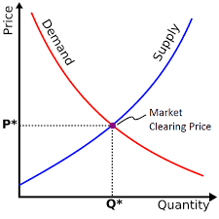
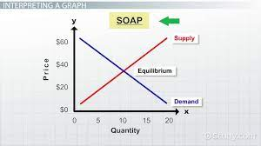

Slide 39
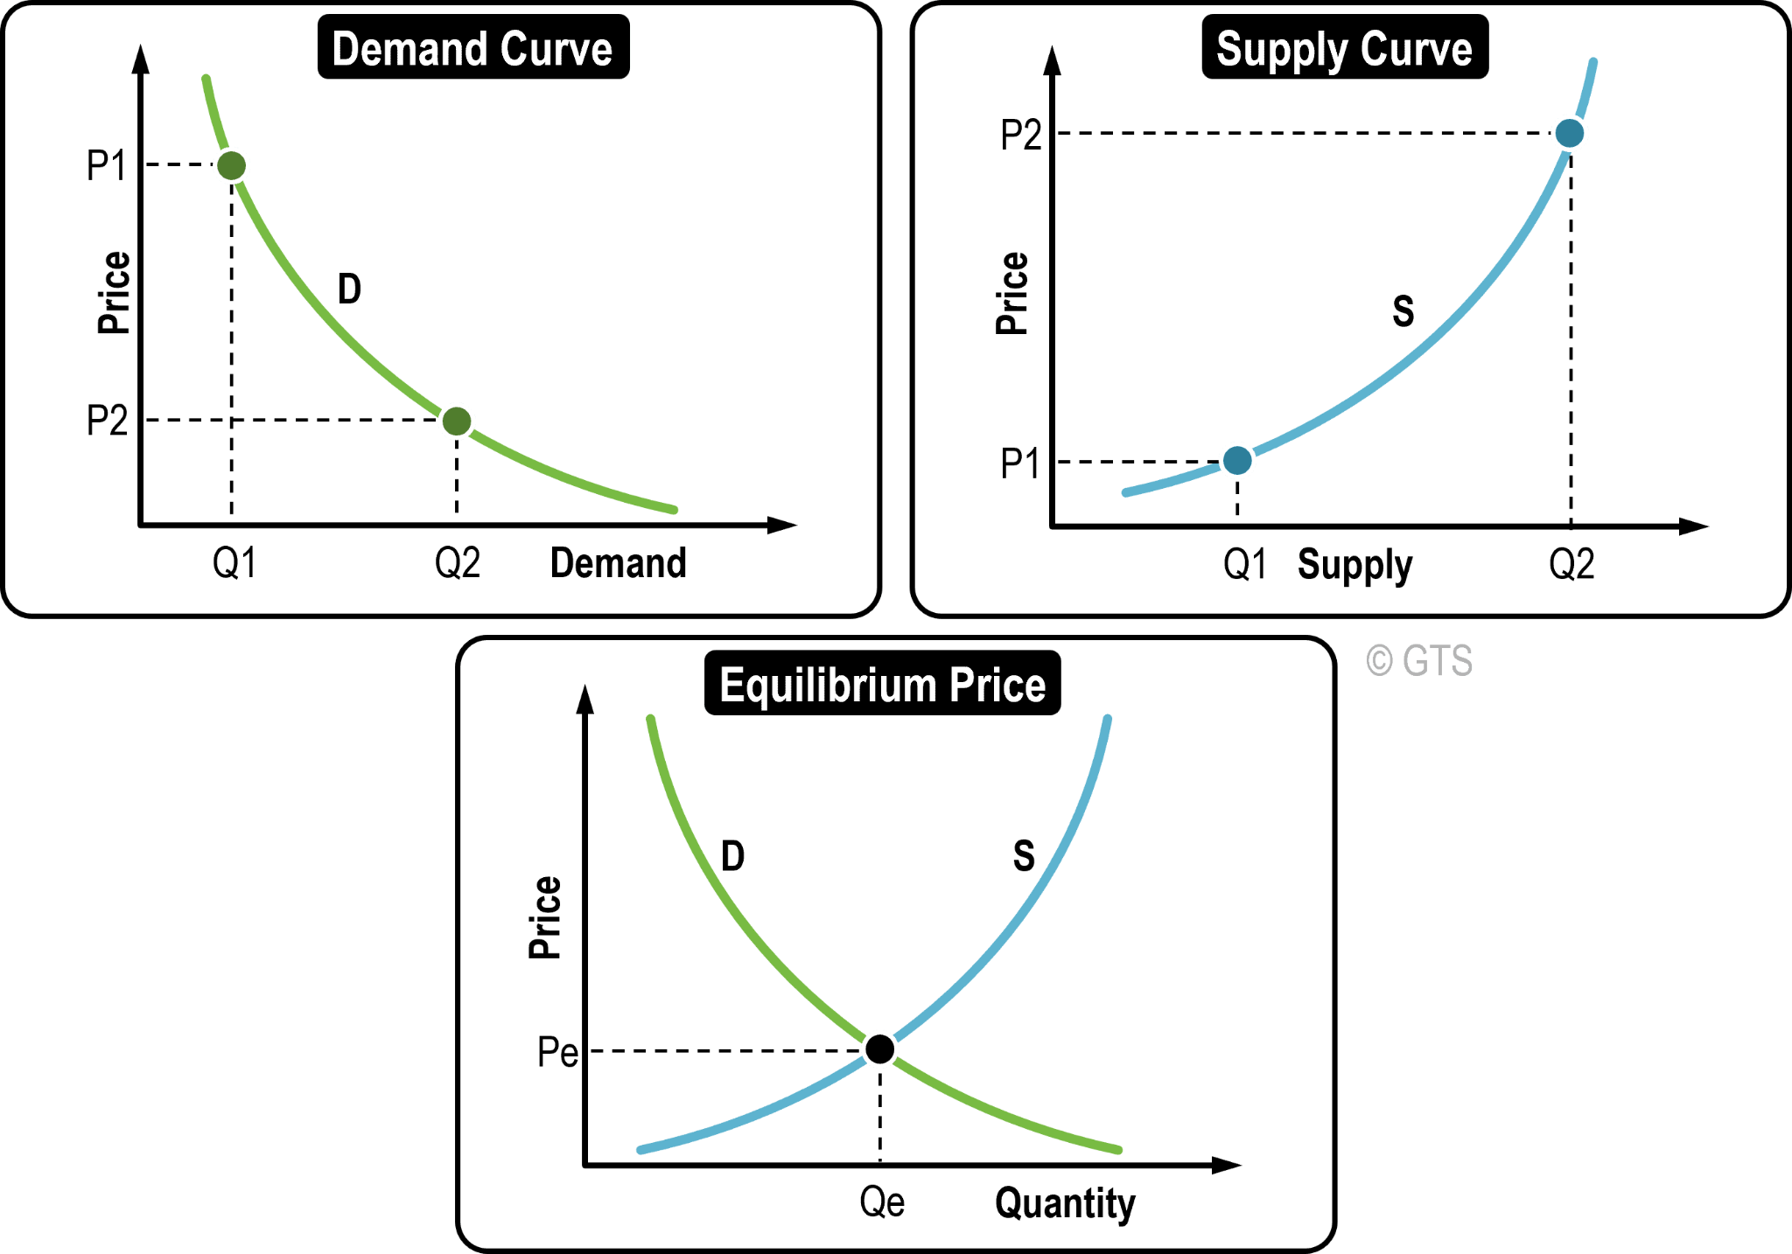

Slide 40
Meaning and types of costs
Cost refers to the total expenditure made on inputs or resources that are used for the production of final goods or services. The resources used by a firm are limited in nature and thus require efficient allocation to maximise the firm’s profit. The cost or economic cost of a firm consists of all the expenses it faces, can manage, and are beyond its control. For example, cost of labor, capital, and raw materials.

Slide 41
1.Direct Costs
Direct costs are related to producing a good or service. A direct cost includes raw materials, labor, and expense or distribution costs associated with producing a product. The cost can easily be traced to a product, department, or project.
For example, Ford Motor Company (F) manufactures cars and trucks. A plant worker spends eight hours building a car. The direct costs associated with the car are the wages paid to the worker and the cost of the parts used to build the car.
2.Indirect Costs
Indirect costs, on the other hand, are expenses unrelated to producing a good or service. An indirect cost cannot be easily traced to a product, department, activity, or project. For example, with Ford, the direct costs associated with each vehicle include tires and steel.
However, the electricity used to power the plant is considered an indirect cost because the electricity is used for all the products made in the plant. No one product can be traced back to the electric bill. Some other examples- advertising campaigns, promotional events etc.

Slide 42
3.Fixed Costs
Fixed costs do not vary with the number of goods or services a company produces over the short term. For example, suppose a company leases a machine for production for two years. The company has to pay $2,000 per month to cover the cost of the lease, no matter how many products that machine is used to make. The lease payment is considered a fixed cost as it remains unchanged.
4.Variable Costs
Variable costs fluctuate as the level of production output changes, contrary to a fixed cost. This type of cost varies depending on the number of products a company produces. A variable cost increases as the production volume increases, and it falls as the production volume decreases.
For example, a toy manufacturer must package its toys before shipping products out to stores. This is considered a type of variable cost because, as the manufacturer produces more toys, its packaging costs increase, however, if the toy manufacturer's production level is decreasing, the variable cost associated with the packaging decreases.

Slide 43
5.Opportunity Costs
Opportunity cost is the benefits of an alternative given up when one decision is made over another. This cost is, therefore, most relevant for two mutually exclusive events. In investing, it's the difference in return between a chosen investment and one that is passed up. For companies, opportunity costs do not show up in the financial statements but are useful in planning by management.
For example, a company decides to buy a new piece of manufacturing equipment rather than lease it. The opportunity cost would be the difference between the cost of the cash outlay for the equipment and the improved productivity versus how much money could have been saved in interest expense had the money been used to pay down debt.
6.Sunk Costs
Sunk costs are historical costs that have already been incurred and will not make any difference in the current decisions by management. Sunk costs are those costs that a company has committed to and are unavoidable or unrecoverable costs. Sunk costs are excluded from future business decisions.

Slide 44
7.Controllable Costs
Controllable costs are expenses managers have control over and have the power to increase or decrease. Controllable costs are considered when the decision of taking on the cost is made by one individual. Common examples of controllable costs are office supplies, advertising expenses, employee bonuses, and charitable donations. Controllable costs are categorized as short-term costs as they can be adjusted quickly.

Slide 45
LAW OF VARIABLE PROPORTION
It is referred to as the law which states that when the quantity of one factor of production is increased, while keeping all other factors constant, it will result in the decline of the marginal product of that factor.
When variable factor is increased while keeping all other factors constant, the total product will increase initially at an increasing rate, next it will be increasing at a diminishing rate and eventually there will be decline in the rate of production.
Stages of Law of Variable Proportion
The Law of Variable proportions has three stages, which are discussed below.
First Stage or Stage of Increasing returns: In this stage, the total product increases at an increasing rate. This happens because the efficiency of the fixed factors increases with addition of variable inputs to the product.
Second Stage or Stage of Diminishing Returns: In this stage, the total product increases at a diminishing rate until it reaches the maximum point. The marginal and average product are positive but diminishing gradually.
Third Stage or Stage of Negative Returns: In this stage, the total product declines and the marginal product becomes negative.

Slide 46
Assumptions of Law of Variable Proportion
Law of variable proportion holds good under certain circumstances, which will be discussed in the following lines.
Constant state of Technology: It is assumed that the state of technology will be constant and with improvements in the technology, the production will improve.
Variable Factor Proportions: This assumes that factors of production are variable. The law is not valid, if factors of production are fixed.
Homogeneous factor units: This assumes that all the units produced are identical in quality, quantity and price. In other words, the units are homogeneous in nature.
Short Run: This assumes that this law is applicable for those systems that are operating for a short term, where it is not possible to alter all factor inputs.

Slide 47
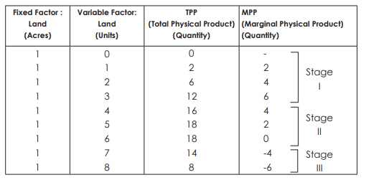
I – MPP increasing
II – MPP decreasing but remaining positive
III – MPP continuing to decrease and becoming negative
I – MPP increasing
II – MPP decreasing but remaining positive
III – MPP continuing to decrease and becoming negative
I – MPP increasing
II – MPP decreasing but remaining positive
III – MPP continuing to decrease and becoming negative

Slide 48
The law of variable proportion is an important and widely used law in economics. IT not only paves the path for controlled production but also shows the producers why their productions may have halted. The law also offers insight into the optimal amount of inputs that are required to control a given amount of output.
The producers of goods and services can be benefited from the use of this law. As it offers the idea of variables that must be altered to get the desired amount of output, producers can use this law on their behalf. Moreover, in the case of two variable productions, producers can realize the points of increasing, diminishing, and negative outputs. Thereby they can limit the wastage of resources and increase the output to the maximum level.
AD

Slide 49
MEANING AND TYPES OF MARKET STRUCTURE
Market structure, in economics, refers to how different industries are classified and differentiated based on their degree and nature of competition for goods and services. It is based on the characteristics that influence the behavior and outcomes of companies working in a specific market.
Market structures can be understood well by closely examining an array of factors or features exhibited by different players. It is common to differentiate these markets across the following seven distinct features.
The industry’s buyer structure
The turnover of customers
The extent of product differentiation
The nature of costs of inputs
The number of players in the market
The largest player’s market share

Slide 50
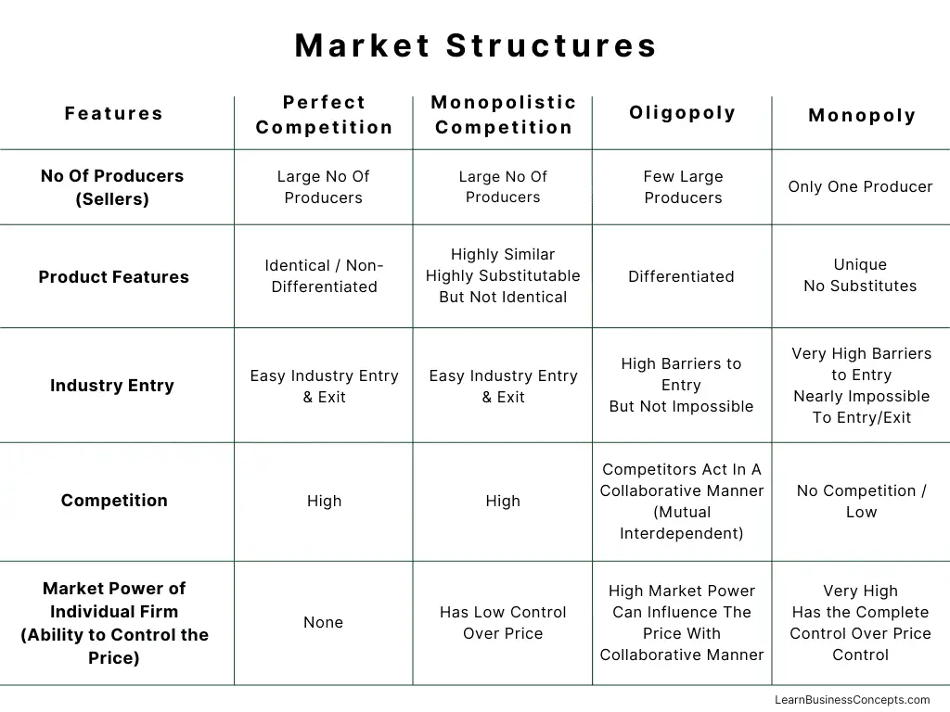

Slide 51
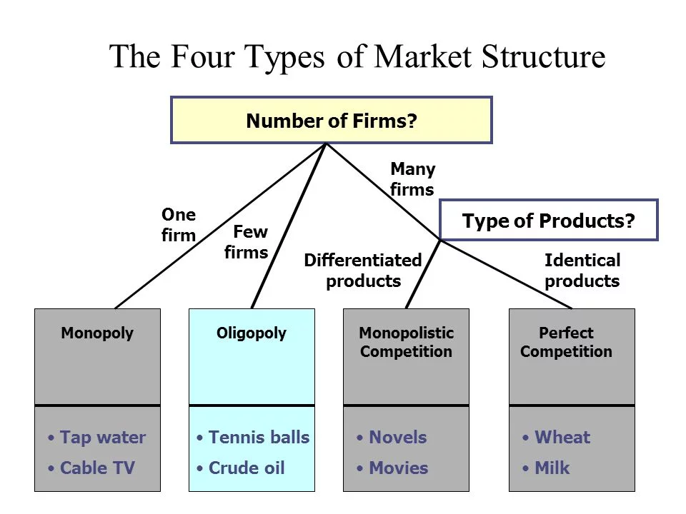

Slide 52
Monopoly:
A monopolistic market is a market formation with the qualities of a pure market. A pure monopoly can only exist when one provider gives a specific service or a product to numerous customers. In a monopolistic market, the imposing business organisation, or the controlling organisation, has the overall control of the entire market, so it sets the supply and price of its goods and services. For example, the Indian Railway, Google, Microsoft, and Facebook.
Oligopoly:
An oligopoly is a market form with a few firms, none of which can hold the others back from having a critical impact. The fixation or concentration proportion estimates the piece of the market share of the biggest firms. For example, commercial air travel, auto industries, cable television, etc.

Slide 53
Perfect competition:
Perfect competition is an absolute sort of market form wherein all end consumers and producers have complete and balanced data and no exchange costs. There is an enormous number of makers and customers rivalling each other in this sort of environment. For example, agricultural products like carrots, potatoes, and various grain products, the securities market, foreign exchange markets, and even online shopping websites, etc.
Monopolistic competition:
Monopolistic competition portrays an industry where many firms offer their services and products that are comparative (however somewhat flawed) substitutes. Obstructions or barriers to exit and entry in monopolistic competitive industries are low, and the choices made of any firm don’t explicitly influence those of its rivals. The monopolistic competition is firmly identified with the business technique of brand separation and differentiation. For example, hairdressers, restaurant businesses, hotels, and pubs.

Slide 54
NATIONAL INCOME AND RELATED AGGREGATES
National Income is the aggregate value of all goods and services produced by firms in a given financial year. It can be stated that when the aggregate revenue generated by the firms is paid out to factors of production, it equals aggregate income or National Income. There are different variants or aggregates of National Income and each of the aggregates has a specific meaning, use, and method of measurement. These aggregates are as follows:
Gross Domestic Product at Market Price (GDPMP)
Gross Domestic Product at Factor Cost (GDPFC)
Net Domestic Product at Market Price (NDPMP)
Net Domestic Product at Factor Cost (NDPFC)
Gross National Product at Market Price (GNPMP)
Gross National Product at Factor Cost (GNPFC)
Net National Product at Market Price (NNPMP)
Net National Product at Factor Cost (NNPFC

Slide 55
1. Gross Domestic Product at Market Price (GDPMP) GDPMP refers to the gross market value of all the final goods and services produced during a year within the domestic territory of a country. Gross in GDPMP means that the total value of final goods and services includes depreciation, i.e., no provision has been made for it.
Domestic in GDPMP means that the final goods and services produced are located within the domestic boundaries of the country.
Product in GDPMP indicates that only final goods and services are included.
Market Price in GDPMP means that the amount of indirect taxes paid is included in GDP; however, the subsidies are excluded from it.
2. Gross Domestic Product at Factor Cost (GDPFC) GDPFC refers to the gross money value of all the final goods and services produced during a year within the domestic territory of a country. It can be determined as:
GDPFC = GDPMP – Net Indirect Taxes

Slide 56
3. Net Domestic Product at Market Price (NDPMP)
NDPMP refers to the net market value of all the final goods and services produced during a year within the domestic territory of a country. It can be determined as:
NDPMP = GDPMP – Depreciation
4. Net Domestic Product at Factor Cost (NDPFC)
NDPFC refers to the net money value of all the final goods and services produced during a year within the domestic territory of a country. It can be determined as:
NDPFC = GDPMP – Net Indirect Taxes – Depreciation
NDPFC is also known as Domestic Factor Income or Domestic Income.

Slide 57
5. Gross National Product at Market Price (GNPMP)
GNPMP refers to the gross market value of all the final goods and services produced during a year by the normal residents of a country. It can be determined as:
GNPMP = GDPMP + Net Factor Income from Abroad
6. Gross National Product at Factor Cost (GNPFC)
GNPFC refers to the gross money value of all the final goods and services produced during a year by the normal residents of a country. It can be determined as:
GNPFC = GNPMP – Net Indirect Taxes

Slide 58
7. Net National Product at Market Price (NNPMP)
NNPMP refers to the net market value of all the final goods and services produced during a year by the normal residents of a country. It can be determined as:
NNPMP = GNPMP – Depreciation
8. Net National Product at Factor Cost (NNPFC)
NNPFC refers to the net money value of all the final goods and services produced during a year by the normal residents of a country. It can be determined as:
NNPFC = GNPMP – Net Indirect Taxes – Depreciation
NNPFC is also known as National Income.

Slide 59
INFLATION AND ITS TYPES
Inflation means a sustained increase in the general price level. The main two types of inflation are
Demand-pull inflation – this occurs when the economy grows quickly and starts to ‘overheat’ – Aggregate demand (AD) will be increasing faster than aggregate supply (LRAS).
Cost-push inflation – this occurs when there is a rise in the price of raw materials, higher taxes, e.t.c
We can also categorise inflation by how fast the price increases are, such as:
Disinflation – a falling rate of inflation
Creeping inflation – low, but consistently creeping up.
Walking/moderate inflation – (2-10%)
Running inflation (10-20%)

Slide 60
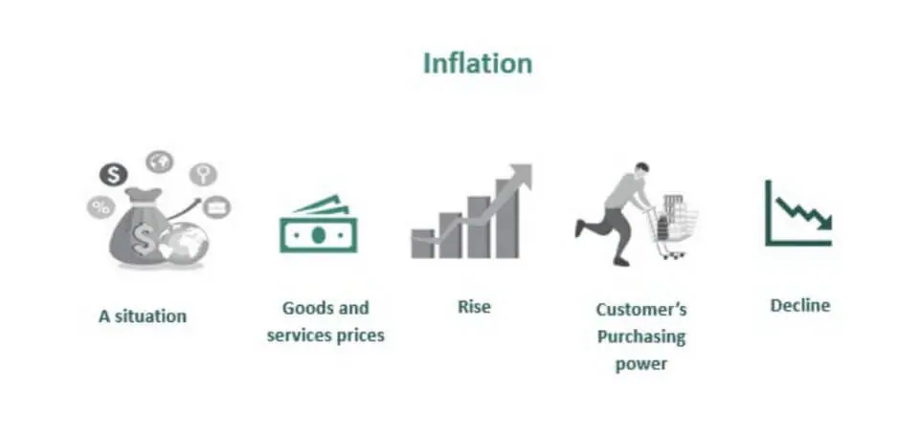

Slide 61
1. Demand-pull inflation This occurs when AD increases at a faster rate than AS. Demand-pull inflation will typically occur when the economy is growing faster than the long-run trend rate of growth. If demand exceeds supply, firms will respond by pushing up prices.
2. Cost-push inflation This occurs when there is an increase in the cost of production for firms causing aggregate supply to shift to the left. Cost-push inflation could be caused by rising energy and commodity prices.
3. Wage Push Inflation Rising wages tend to cause inflation. In effect, this is a combination of demand-pull and cost-push inflation. Rising wages increase costs for firms, and so these are passed onto consumers in the form of higher prices.
4.Creeping Inflation In the initial stage, the inflation rate is around 2%, 3%, or 5%. At this point, the prices rise at a very minimal rate gradually. However, ignoring them can cause prices to rise.

Slide 62
5.Galloping Inflation Galloping inflation occurs when the rate is between 20-1000%. In such situations, there is too much instability within the economy. As a result, the governing bodies fail to bring situations within control. For example, in the 1990s, Russia faced a galloping situation where the prices of food and goods increased severely. In 1993, the rate in Russia was 839.21 %.
7.Hyperinflation Hyperinflation occurs when the rate is above 1000%. At this stage, the value of money depreciates faster.

Slide 63
MEANING AND PHASES OF BUSINESS CYCLE
A business cycle is a cycle of fluctuations in the Gross Domestic Product (GDP) around its long-term natural growth rate. It explains the expansion and contraction in economic activity that an economy experiences over time.
A business cycle is completed when it goes through a single boom and a single contraction in sequence. The time period to complete this sequence is called the length of the business cycle.
A boom is characterized by a period of rapid economic growth whereas a period of relatively stagnated economic growth is a recession.

Slide 64
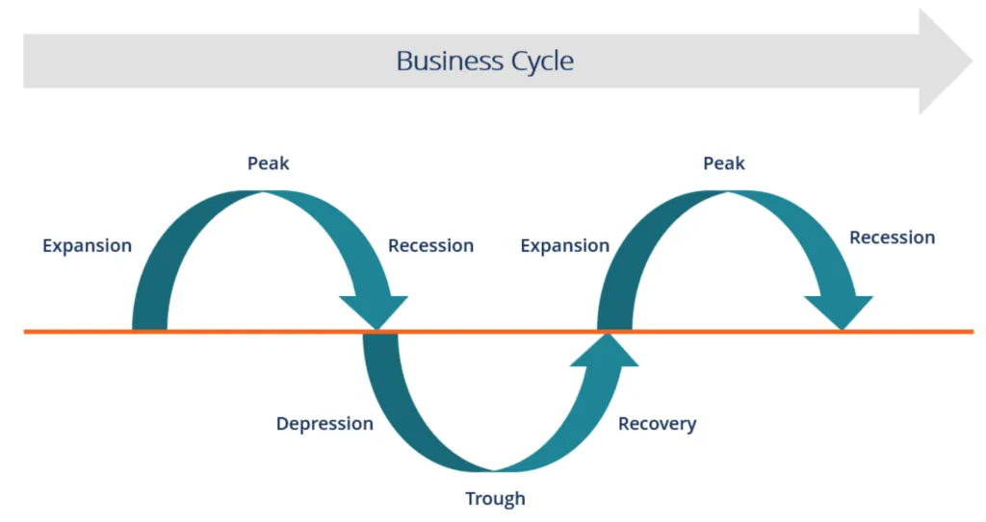

Slide 65
1. Expansion
The first stage in the business cycle is expansion. In this stage, there is an increase in positive economic indicators such as employment, income, output, wages, profits, demand, and supply of goods and services. Debtors are generally paying their debts on time, the velocity of the money supply is high, and investment is high. This process continues as long as economic conditions are favorable for expansion.
2. Peak
The economy then reaches a saturation point, or peak, which is the second stage of the business cycle. The maximum limit of growth is attained. The economic indicators do not grow further and are at their highest. Prices are at their peak. This stage marks the reversal point in the trend of economic growth. Consumers tend to restructure their budgets at this point.

Slide 66
3. Recession
The recession is the stage that follows the peak phase. The demand for goods and services starts declining rapidly and steadily in this phase. Producers do not notice the decrease in demand instantly and go on producing, which creates a situation of excess supply in the market. Prices tend to fall. All positive economic indicators such as income, output, wages, etc., consequently start to fall.
4. Depression
There is a commensurate rise in unemployment. The growth in the economy continues to decline, and as this falls below the steady growth line, the stage is called a depression.
5. Trough
In the depression stage, the economy’s growth rate becomes negative. There is further decline until the prices of factors, as well as the demand and supply of goods and services, contract to reach their lowest point. The economy eventually reaches the trough. It is the negative saturation point for an economy. There is extensive depletion of national income and expenditure.

Slide 67
6. Recovery
After the trough, the economy moves to the stage of recovery. In this phase, there is a turnaround in the economy, and it begins to recover from the negative growth rate. Demand starts to pick up due to low prices and, consequently, supply begins to increase. The population develops a positive attitude towards investment and employment and production starts increasing.
Employment begins to rise and, due to accumulated cash balances with the bankers, lending also shows positive signals. In this phase, depreciated capital is replaced, leading to new investments in the production process. Recovery continues until the economy returns to steady growth levels.
This completes one full business cycle of boom and contraction. The extreme points are the peak and the trough.

Slide 68
THANK YOU

