Slide 1

UNIT – IV Exception Handling & Multithreading

Slide 2

Exception Handling in Java
What is Exception in Java?
Dictionary Meaning: Exception is an abnormal condition.
“An exception is an event that disrupts the normal flow of the program.”
What is Exception Handling?
The Exception Handling in Java is one of the powerful mechanism to handle the runtime errors (such as ClassNotFoundException, IOException, SQLException, RemoteException, etc.) so that normal flow of the application can be maintained.

Slide 3
An exception normally disrupts the normal flow of the application that is why we use exception handling to maintain the normal flow of the application. Let's take a scenario:
statement 1;
statement 2; //exception occurs
statement 3;
statement 4;
Suppose there are 4 statements in your program and an exception occurs at statement 2, the rest of the code will not be executed i.e. statement 3 and 4 will not be executed. If we perform exception handling, the rest of the statement will be executed. That is why we use exception handling in Java.

Slide 4
Hierarchy of Java Exception classes
The java.lang.Throwable class is the root class of Java Exception hierarchy
Which is inherited by two subclasses: Exception and Error.
A hierarchy of Java Exception classes are given in next slide:

Slide 5
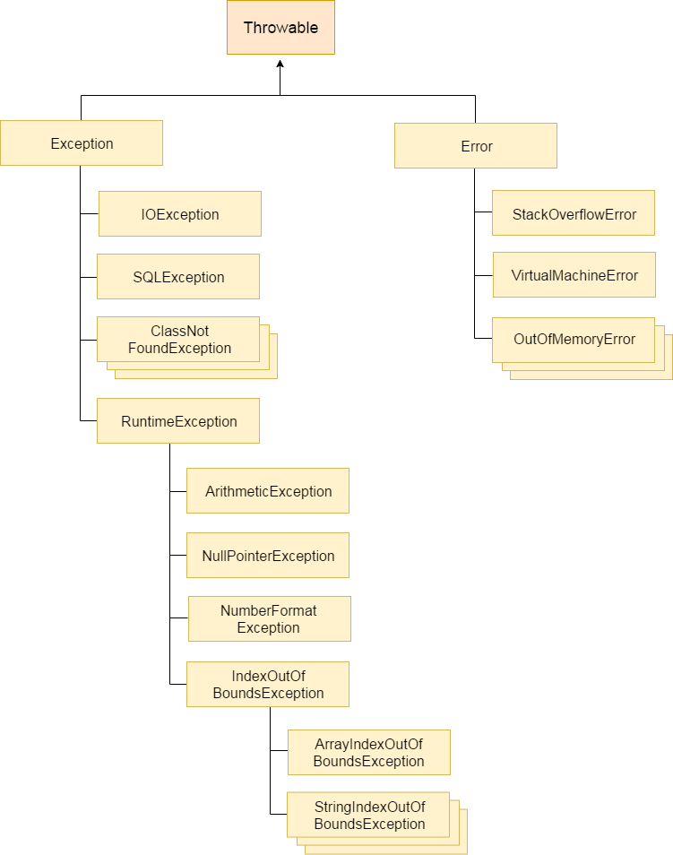
Checked Exceptions
UnChecked Exceptions

Slide 6
Types of Java Exceptions
There are mainly two types of exceptions: checked and unchecked. Here, an error is considered as the unchecked exception. According to Oracle, there are three types of exceptions:
Checked Exception
Unchecked Exception
Error

Slide 7
Difference between Checked and Unchecked Exceptions
1) Checked Exception
The classes which directly inherit Throwable class except RuntimeException and Error are known as checked exceptions e.g. IOException, SQLException etc. Checked exceptions are checked at compile-time.
2) Unchecked Exception
The classes which inherit RuntimeException are known as unchecked exceptions e.g. ArithmeticException, NullPointerException, ArrayIndexOutOfBoundsException etc. Unchecked exceptions are not checked at compile-time, but they are checked at runtime.
3) Error
Error is irrecoverable e.g. OutOfMemoryError, VirtualMachineError, AssertionError etc.

Slide 8
Java Exception Handling Example
public class Test
{
public static void main(String args[])
{
try
{
int data=100/0; //code that raise exception
}
catch(ArithmeticException e)
{
System.out.println(e);
}
//rest code of the program
System.out.println("rest of the code...");
}
}
Output:
Exception in thread main java.lang.ArithmeticException:/ by zero
rest of the code...

Slide 9
Java Exception Keywords
Keyword | Description
try | The "try" keyword is used to specify a block where we should place exception code. The try block must be followed by either catch or finally. It means, we can't use try block alone.
catch | The "catch" block is used to handle the exception. It must be preceded by try block which means we can't use catch block alone. It can be followed by finally block later.
finally | The "finally" block is used to execute the important code of the program. It is executed whether an exception is handled or not.
throw | The "throw" keyword is used to throw an exception.
throws | The "throws" keyword is used to declare exceptions. It doesn't throw an exception. It specifies that there may occur an exception in the method. It is always used with method signature.

Slide 10
Common Scenarios of Java Exceptions
There are given some scenarios where exceptions may occur. They are as follows:
A scenario where ArithmeticException occurs
If we divide any number by zero, there occurs an ArithmeticException.
int a=50/0;//ArithmeticException
A scenario where NullPointerException occurs
If we have a null value in any variable, performing any operation on the variable throws a NullPointerException.
String s=null;
System.out.println(s.length()); //NullPointerException

Slide 11
A scenario where NumberFormatException occurs
The wrong formatting of any value may occur NumberFormatException.
Suppose String variable that has characters, converting this variable into digit will occur NumberFormatException.
String s="abc";
int i=Integer.parseInt(s); //NumberFormatException
A scenario where ArrayIndexOutOfBoundsException occurs
If you are inserting any value in the wrong index, it would result in ArrayIndexOutOfBoundsException as shown below:
int a[]=new int[5];
a[10]=50; //ArrayIndexOutOfBoundsException

Slide 12
Java try-catch block
Java try block
Java try block is used to enclose the code that might throw an exception.
It must be used within the method.
If an exception occurs at the particular statement of try block, the rest of the block code will not execute.
So, it is recommended not to keeping the code in try block that will not throw an exception.
Java try block must be followed by either catch or finally block.

Slide 13
Java catch block
Java catch block is used to handle the Exception by declaring the type of exception within the parameter.
The declared exception must be the parent class exception ( i.e., Exception) or the generated exception type.
However, the good approach is to declare the generated type of exception.
The catch block must be used after the try block only.
You can use multiple catch block with a single try block.

Slide 14
Syntax of Java try-catch
try
{
//code that may throw an exception
}
catch(Exception_class_Name ref)
{
}

Slide 15
Example_1
public class Test
{
public static void main(String[] args) {
try
{
int data=50/0; // throw exception
System.out.println("Hello try block");
}
catch(Exception e)
{
System.out.println("Can't divided by zero"); // displaying the custom message
}
}
}
Output: Can't divided by zero

Slide 16
2. Example_2
public class Test{
public static void main(String[] args) {
try
{
int data=50/0; // throw exception
}
// try to handle the ArithmeticException using ArrayIndexOutOfBoundsException
catch(ArrayIndexOutOfBoundsException e)
{
System.out.println(e);
}
System.out.println("rest of the code");
}
}
Output: Exception in thread "main" java.lang.ArithmeticException: / by zero

Slide 17
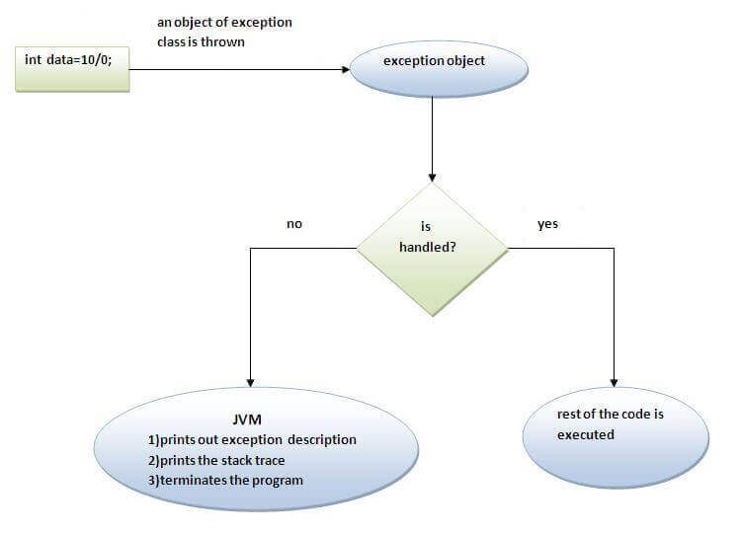
Internal working of java try-catch block

Slide 18
The JVM firstly checks whether the exception is handled or not.
If exception is not handled, JVM provides a default exception handler that performs the following tasks:
Prints out exception description.
Prints the stack trace (Hierarchy of methods where the exception occurred).
Causes the program to terminate.
But if exception is handled by the application programmer, normal flow of the application is maintained i.e. rest of the code is executed.

Slide 19
Java Multi-catch block
A try block can be followed by one or more catch blocks.
Each catch block must contain a different exception handler.
So, if you have to perform different tasks at the occurrence of different exceptions, use java multi-catch block.
Points to remember
At a time only one exception occurs and at a time only one catch block is executed.
All catch blocks must be ordered from most specific to most general, i.e. catch for ArithmeticException must come before catch for Exception.

Slide 20
Example_1
public class Demo
{
public static void main(String[] args)
{
try
{
int a[]=new int[5];
System.out.println(a[10]);
}
catch(ArithmeticException e)
{
System.out.println("Arithmetic Exception occurs");
}
catch(ArrayIndexOutOfBoundsException e)
{
System.out.println("ArrayIndexOutOfBounds Exception occurs");
}
catch(Exception e)
{
System.out.println("Parent Exception occurs");
}
System.out.println("rest of the code");
}
}
Output:
ArrayIndexOutOfBounds Exception occurs
rest of the code

Slide 21
Example_2
public class Demo2
{
public static void main(String[] args)
{
try
{
String s=null;
System.out.println(s.length());
}
catch(ArithmeticException e)
{
System.out.println("Arithmetic Exception occurs"); }
catch(ArrayIndexOutOfBoundsException e)
{
System.out.println("ArrayIndexOutOfBounds Exception occurs");
}
catch(Exception e)
{
System.out.println("Parent Exception occurs");
}
System.out.println("rest of the code");
}
}
Output:
Parent Exception occurs
rest of the code

Slide 22
In this example, we generate NullPointerException, but didn't provide the corresponding exception type.
In such case, the catch block containing the parent exception class Exception will invoked.
Java Nested try block:
The try block within a try block is known as nested try block in java.
Why use nested try block?
Sometimes a situation may arise where a part of a block may cause one error and the entire block itself may cause another error.
In such cases, exception handlers have to be nested.

Slide 23
Syntax:
try
{
statement 1;
statement 2;
try
{
statement 1;
statement 2;
}
catch(Exception e)
{
}
}
catch(Exception e)
{
}

Slide 24
class Example{
public static void main(String args[]){
try{
try{
System.out.println("going to divide");
int b =39/0;
}catch(ArithmeticException e){System.out.println(e);}
try{
int a[]=new int[5];
a[5]=4;
}catch(ArrayIndexOutOfBoundsException e){System.out.println(e);}
System.out.println("other statement);
}catch(Exception e){System.out.println("handled");}
System.out.println("normal flow..");
}
}

Slide 25
Java finally block
Java finally block is a block that is used to execute important code such as closing connection, stream etc.
Java finally block is always executed whether exception is handled or not.
Java finally block follows try or catch block.
If you don't handle exception, before terminating the program, JVM executes finally block(if any).
Why use java finally?
Finally block in java can be used to put "cleanup" code such as closing a file, closing connection etc.

Slide 26
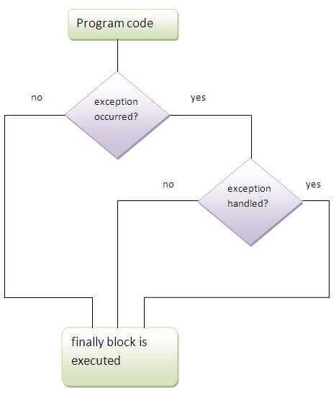

Slide 27
public class Test{
public static void main(String args[]){
try{
int data=25/0;
}
catch(ArithmeticException e)
{
System.out.println(e);
}
finally
{
System.out.println("finally block is always executed");}
System.out.println("rest of the code...");
}
}
Output:Exception in thread main java.lang.ArithmeticException:/ by zero
finally block is always executed
rest of the code...

Slide 28
Java throw keyword:
The Java throw keyword is used to explicitly throw an exception.
java throw keyword example, we have created the validate method that takes integer value as a parameter. If the age is less than 18, we are throwing the ArithmeticException otherwise print a message welcome to vote.
public class Test{
static void validate(int age){
if(age<18)
throw new ArithmeticException("not valid");
else
System.out.println("welcome to vote");
}
public static void main(String args[]){
validate(13);
System.out.println("rest of the code...");
}
}
Output: Exception in thread main java.lang.ArithmeticException:not valid

Slide 29
Difference between final, finally and finalize
No. | Final | finally | finalize
1) | Final is used to apply restrictions on class, method and variable. Final class can't be inherited, final method can't be overridden and final variable value can't be changed. | Finally is used to place important code, it will be executed whether exception is handled or not. | Finalize is used to perform clean up processing just before object is garbage collected.
2) | Final is a keyword. | Finally is a block. | Finalize is a method.

Slide 30
Java final example:
class FinalExample
{
public static void main(String[] args)
{
final int x=100;
x=200;//Compile Time Error
}
}

Slide 31
Java finally example:
class FinallyExample
{
public static void main(String[] args)
{
try
{
int x=300;
}
catch(Exception e)
{
System.out.println(e);
}
finally
{
System.out.println("finally block is executed");
}
}}

Slide 32
Java finalize example:
class FinalizeExample
{
public void finalize()
{
System.out.println("finalize called");
}
public static void main(String[] args)
{
FinalizeExample f1=new FinalizeExample();
FinalizeExample f2=new FinalizeExample();
f1=null;
f2=null;
System.gc();
}
} OUTPUT= finalize called

Slide 33
Java Exception propagation
An exception is first thrown from the top of the stack and if it is not caught, it drops down the call stack to the previous method, If not caught there, the exception again drops down to the previous method, and so on until they are caught or until they reach the very bottom of the call stack. This is called exception propagation.
Note that checked exceptions are not propagated

Slide 34
class TestExceptionPropagation1{
void m(){
int data=50/0;
}
void n(){
m();
}
void p(){
try{
n();
}catch(Exception e){System.out.println("exception handled");}
}
public static void main(String args[]){
TestExceptionPropagation1 obj=new TestExceptionPropagation1();
obj.p();
System.out.println("normal flow...");
}
}
Output: exception handled
normal flow...

Slide 35
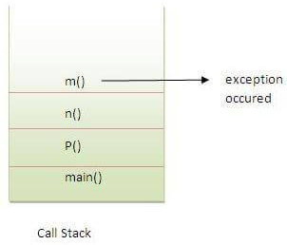
In the above example exception occurs in m() method where it is not handled, so it is propagated to previous n() method where it is not handled, again it is propagated to p() method where exception is handled.
Exception can be handled in any method in call stack either in main() method, p() method, n() method or m() method.

Slide 36
Java throws keyword
The Java throws keyword is used to declare an exception. It gives an information to the programmer that there may occur an exception so it is better for the programmer to provide the exception handling code so that normal flow can be maintained.
Exception Handling is mainly used to handle the checked exceptions. If there occurs any unchecked exception such as NullPointerException, it is programmers fault that he is not performing check up before the code being used.
Syntax of java throws
return_type method_name() throws exception_class_name{
//method code
}

Slide 37
Which exception should be declared with throws?
Ans) checked exception only
Advantage of Java throws keyword
Now Checked Exception can be propagated (forwarded in call stack).
It provides information to the caller of the method about the exception.
Let's see the example of java throws clause which describes that checked exceptions can be propagated by throws keyword. (in next Slide)

Slide 38
import java.io.IOException;
class Testthrows1{
void m()throws IOException{
throw new IOException("device error");
}
void n()throws IOException{
m();
}
void p(){
try{
n();
}catch(Exception e){System.out.println("exception handled");}
}
public static void main(String args[]){
Testthrows1 obj=new Testthrows1();
obj.p();
System.out.println("normal flow...");
}
}
Output: exception handled
normal flow...

Slide 39
Difference between throw and throws in Java
No. | throw | throws
1) | Java throw keyword is used to explicitly throw an exception. | Java throws keyword is used to declare an exception.
2) | Checked exception cannot be propagated using throw only. | Checked exception can be propagated with throws.
3) | Throw is followed by an instance. | Throws is followed by class.
4) | Throw is used within the method. | Throws is used with the method signature.
5) | You cannot throw multiple exceptions. | You can declare multiple exceptions e.g. public void method()throws IOException,SQLException.

Slide 40
Multithreading in Java
Multithreading in Java is a process of executing multiple threads simultaneously.
A thread is a lightweight sub-process, the smallest unit of processing.
Multiprocessing and multithreading, both are used to achieve multitasking.
However, we use multithreading than multiprocessing because threads use a shared memory area.
They don't allocate separate memory area so saves memory, and context-switching between the threads takes less time than process.
Java Multithreading is mostly used in games, animation, etc.

Slide 41
Advantages of Java Multithreading:
It doesn't block the user because threads are independent and you can perform multiple operations at the same time.
You can perform many operations together, so it saves time.
Threads are independent, so it doesn't affect other threads if an exception occurs in a single thread.
Multitasking:
Multitasking is a process of executing multiple tasks simultaneously. We use multitasking to utilize the CPU. Multitasking can be achieved in two ways:
Process-based Multitasking (Multiprocessing)
Thread-based Multitasking (Multithreading)

Slide 42
Process-based Multitasking (Multiprocessing)
Each process has an address in memory. In other words, each process allocates a separate memory area.
A process is heavyweight.
Cost of communication between the process is high.
Switching from one process to another requires some time for saving and loading registers, memory maps, updating lists, etc.

Slide 43
Thread-based Multitasking (Multithreading)
Threads share the same address space.
A thread is lightweight.
Cost of communication between the thread is low.

Slide 44
What is Thread in java?
A thread is a lightweight subprocess, the smallest unit of processing.
It is a separate path of execution.
Threads are independent.
If there occurs exception in one thread, it doesn't affect other threads.
It uses a shared memory area.

Slide 45
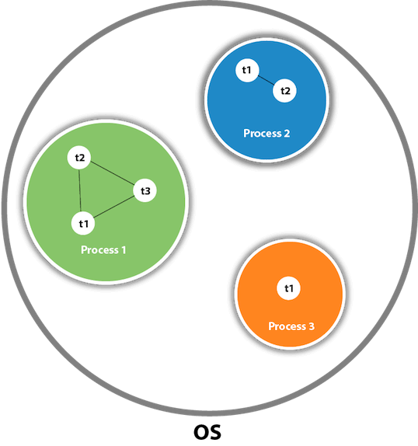

Slide 46
As shown in the previous slide’s figure, a thread is executed inside the process.
There is context-switching between the threads.
There can be multiple processes inside the OS, and one process can have multiple threads.
At a time one thread is executed only.

Slide 47
Life cycle of a Thread (Thread States):
A thread can be in one of the five states.
According to sun, there is only 4 states in thread life cycle in java new, runnable, non-runnable and terminated. There is no running state.
But for better understanding the threads, we are understanding it in the 5 states.
The life cycle of the thread in java is controlled by JVM.
The java thread states are as follows:
New
Runnable
Running
Non-Runnable (Blocked)
Terminated

Slide 48
New: The thread is in new state if you create an instance of Thread class but before the invocation of start() method.
Runnable: The thread is in runnable state after invocation of start() method, but the thread scheduler has not selected it to be the running thread.
Running: The thread is in running state if the thread scheduler has selected it.
Non-Runnable (Blocked): This is the state when the thread is still alive, but is currently not eligible to run.
Terminated: A thread is in terminated or dead state when its run() method exits.

Slide 49
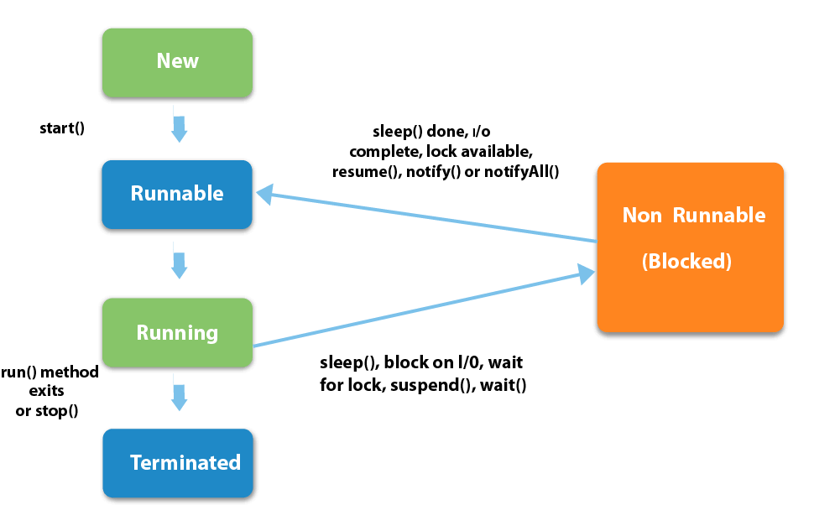

Slide 50
How to create thread?
There are two ways to create a thread:
By extending Thread class
By implementing Runnable interface.

Slide 51
Thread class:
Thread class provide constructors and methods to create and perform operations on a thread.
Commonly used Constructors of Thread class:
Thread()
Thread(String name)
Thread(Runnable r)
Thread(Runnable r, String name)
Starting a thread:
Start() method of Thread class is used to start a newly created thread.

Slide 52
Java Thread Example by extending Thread class
class Multi extends Thread
{
public void run() // tasks of thread
{
System.out.println("thread is running...");
}
public static void main(String args[])
{
Multi t1=new Multi();
t1.start(); // creation of thread
}
}
Output:thread is running...

Slide 53
Runnable interface:
The Runnable interface should be implemented by any class whose instances are intended to be executed by a thread.
Runnable interface have only one method named run()
public void run(): is used to perform action for a thread.

Slide 54
Java Thread Example by implementing Runnable interface
class Multi implements Runnable
{
public void run()
{
System.out.println("thread is running...");
}
public static void main(String args[])
{
Multi m1=new Multi();
Thread t1 =new Thread(m1);
t1.start();
}
}
Output: thread is running...

Slide 55
Note:
If you are not extending the Thread class, your class object would not be treated as a thread object.
So you need to explicitly create Thread class object.
We are passing the object of your class that implements Runnable so that your class run() method may execute.

Slide 56
Sleep method in java
The sleep() method of Thread class is used to sleep a thread for the specified amount of time.
Syntax of sleep() method in java
The Thread class provides two methods for sleeping a thread:
public static void sleep(long miliseconds)throws InterruptedException
public static void sleep(long miliseconds, int nanos)throws InterruptedException

Slide 57
Example of sleep method in java
class TestSleepMethod1 extends Thread{
public void run()
{
for(int i=1;i<5;i++)
{
try{Thread.sleep(500);}catch(InterruptedException e){System.out.println(e);}
System.out.println(i);
}
}
public static void main(String args[])
{
TestSleepMethod1 t1=new TestSleepMethod1();
TestSleepMethod1 t2=new TestSleepMethod1();
t1.start();
t2.start();
}
}
Output:
1
1
2
2
3
3
4
4
As you know well that at a time only one thread is executed.
If you sleep a thread for the specified time, the thread schedular picks up another thread and so on.

Slide 58
Priority of a Thread (Thread Priority):
Each thread has a priority.
Priorities are represented by a number between 1 and 10.
In most cases, thread schedular schedules the threads according to their priority (known as preemptive scheduling).
But it is not guaranteed because it depends on JVM specification that which scheduling it chooses.
3 constants defined in Thread class:
public static int MIN_PRIORITY
public static int NORM_PRIORITY
public static int MAX_PRIORITY
Default priority of a thread is 5 (NORM_PRIORITY). The value of MIN_PRIORITY is 1 and the value of MAX_PRIORITY is 10.

Slide 59
class TestPriority extends Thread
{
public void run(){
System.out.println("running thread priority is:"+Thread.currentThread().getPriority());
}
public static void main(String args[])
{
TestPriority1 m1=new TestPriority1();
TestPriority1 m2=new TestPriority1();
m1.setPriority(Thread.MIN_PRIORITY); //m1.setPriority(6)
m2.setPriority(Thread.MAX_PRIORITY);
m1.start();
m2.start();
}
}
Output:running thread priority is:10
running thread priority is:1

Slide 60
Daemon Thread in Java
Daemon thread in java is a service provider thread that provides services to the user thread.
Its life depend on the mercy of user threads i.e. when all the user threads dies, JVM terminates this thread automatically.
There are many java daemon threads running automatically e.g. gc, finalizer etc.
Points to remember for Daemon Thread in Java
It provides services to user threads for background supporting tasks.
It has no role in life than to serve user threads.
Its life depends on user threads.
It is a low priority thread.

Slide 61
Why JVM terminates the daemon thread if there is no user thread?
The sole purpose of the daemon thread is that it provides services to user thread for background supporting task.
If there is no user thread, why should JVM keep running this thread.
That is why JVM terminates the daemon thread if there is no user thread.

Slide 62
Methods for Java Daemon thread by Thread class
The java.lang.Thread class provides two methods for java daemon thread.
No. | Method | Description
1) | public void setDaemon(boolean status) | is used to mark the current thread as daemon thread or user thread.
2) | public boolean isDaemon() | is used to check that current is daemon.

Slide 63
public class TestDaemonThread1 extends Thread{
public void run(){
if(Thread.currentThread().isDaemon()){//checking for daemon thread
System.out.println("daemon thread work");
}
else{
System.out.println("user thread work");
}
}
public static void main(String[] args){
TestDaemonThread1 t1=new TestDaemonThread1();//creating thread
TestDaemonThread1 t2=new TestDaemonThread1();
TestDaemonThread1 t3=new TestDaemonThread1();
t1.setDaemon(true);//now t1 is daemon thread
t1.start();//starting threads
t2.start();
t3.start();
}
}
Output:
daemon thread work
user thread work
user thread work

Slide 64
Thank You…

