Slide 1
Chapter 5
Software Requirements

Slide 2
Software Requirements
Descriptions and specifications of a system

Slide 3
Objectives
To introduce the concepts of user and system requirements
To describe functional and non-functional requirements
To explain two techniques for describing system requirements
To explain how software requirements may be organised in a requirements document

Slide 4
Topics covered
Functional and non-functional requirements
User requirements
System requirements
The software requirements document

Slide 5
Requirements engineering
The process of establishing the services that the customer requires from a system and the constraints under which it operates and is developed
The requirements themselves are the descriptions of the system services and constraints that are generated during the requirements engineering process

Slide 6
What is a requirement?
It may range from a high-level abstract statement of a service or of a system constraint to a detailed mathematical functional specification
This is inevitable as requirements may serve a dual function
  May be the basis for a bid for a contract - therefore must be open to interpretation
  May be the basis for the contract itself - therefore must be defined in detail
  Both these statements may be called requirements

Slide 7
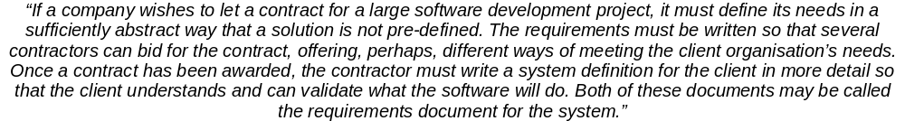
Requirements abstraction (Davis)

Slide 8
Types of requirement
User requirements
  Statements in natural language plus diagrams of the services the system provides and its operational constraints. Written for customers
System requirements
  A structured document setting out detailed descriptions of the system services. Written as a contract between client and contractor
Software specification
  A detailed software description which can serve as a basis for a design or implementation. Written for developers

Slide 9
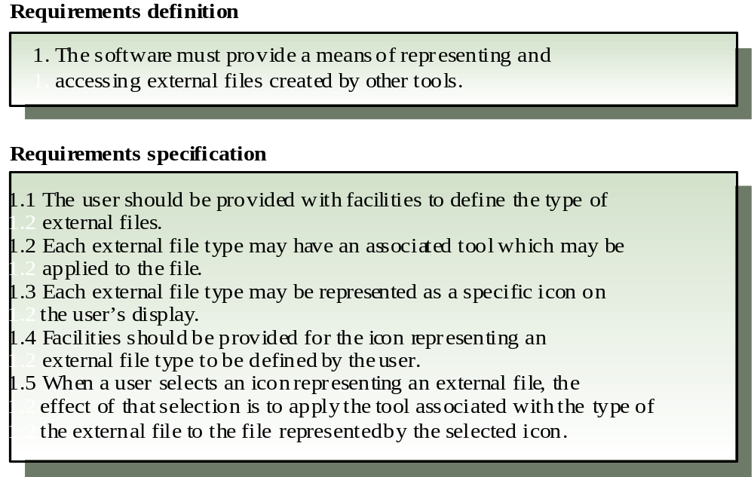
Definitions and specifications

Slide 10
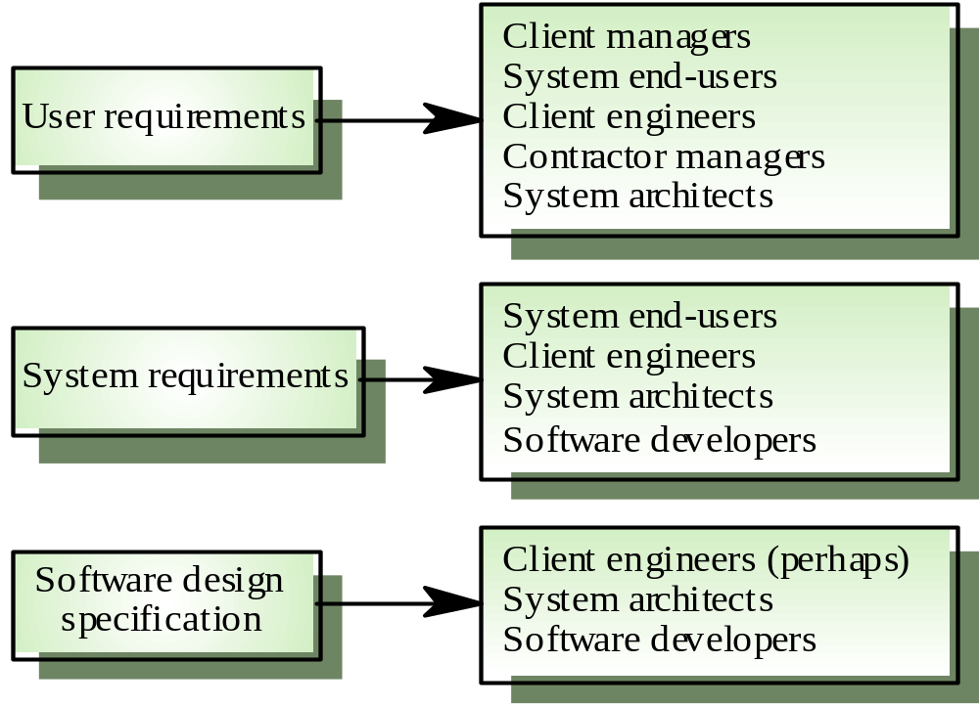
Requirements readers

Slide 11
Functional and non-functional requirements
Functional requirements
  Statements of services the system should provide, how the system should react to particular inputs and how the system should behave in particular situations.
Non-functional requirements
  constraints on the services or functions offered by the system such as timing constraints, constraints on the development process, standards, etc.
Domain requirements
  Requirements that come from the application domain of the system and that reflect characteristics of that domain

Slide 12
Functional requirements
Describe functionality or system services
Depend on the type of software, expected users and the type of system where the software is used
Functional user requirements may be high-level statements of what the system should do but functional system requirements should describe the system services in detail

Slide 13
Examples of functional requirements
The user shall be able to search either all of the initial set of databases or select a subset from it.
The system shall provide appropriate viewers for the user to read documents in the document store.
Every order shall be allocated a unique identifier (ORDER_ID) which the user shall be able to copy to the account’s permanent storage area.

Slide 14
Requirements imprecision
Problems arise when requirements are not precisely stated
Ambiguous requirements may be interpreted in different ways by developers and users
Consider the term ‘appropriate viewers’
  User intention - special purpose viewer for each different document type
  Developer interpretation - Provide a text viewer that shows the contents of the document

Slide 15
Requirements completeness and consistency
In principle requirements should be both complete and consistent
Complete
  They should include descriptions of all facilities required
Consistent
  There should be no conflicts or contradictions in the descriptions of the system facilities
In practice, it is impossible to produce a complete and consistent requirements document

Slide 16
Non-functional requirements
Define system properties and constraints e.g. reliability, response time and storage requirements. Constraints are I/O device capability, system representations, etc.
Process requirements may also be specified mandating a particular CASE system, programming language or development method
Non-functional requirements may be more critical than functional requirements. If these are not met, the system is useless

Slide 17
Non-functional classifications
Product requirements
  Requirements which specify that the delivered product must behave in a particular way e.g. execution speed, reliability, etc.
Organisational requirements
  Requirements which are a consequence of organisational policies and procedures e.g. process standards used, implementation requirements, etc.
External requirements
  Requirements which arise from factors which are external to the system and its development process e.g. interoperability requirements, legislative requirements, etc.

Slide 18
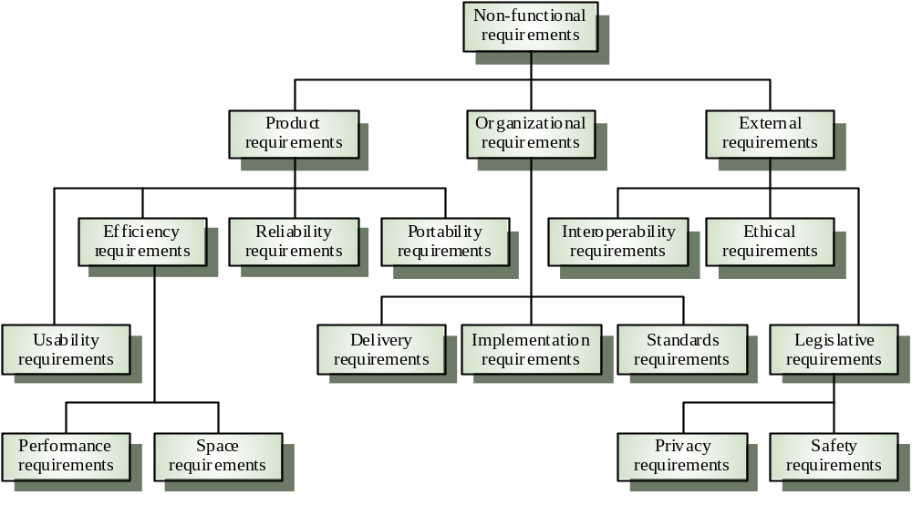
Non-functional requirement types

Slide 19
Non-functional requirements examples
Product requirement
  4.C.8 It shall be possible for all necessary communication between the APSE and the user to be expressed in the standard Ada character set
Organisational requirement
  9.3.2 The system development process and deliverable documents shall conform to the process and deliverables defined in XYZCo-SP-STAN-95
External requirement
  7.6.5 The system shall not disclose any personal information about customers apart from their name and reference number to the operators of the system

Slide 20
Goals and requirements
Non-functional requirements may be very difficult to state precisely and imprecise requirements may be difficult to verify.
Goal
  A general intention of the user such as ease of use
Verifiable non-functional requirement
  A statement using some measure that can be objectively tested
Goals are helpful to developers as they convey the intentions of the system users

Slide 21
Examples
A system goal
  The system should be easy to use by experienced controllers and should be organised in such a way that user errors are minimised.
A verifiable non-functional requirement
  Experienced controllers shall be able to use all the system functions after a total of two hours training. After this training, the average number of errors made by experienced users shall not exceed two per day.

Slide 22
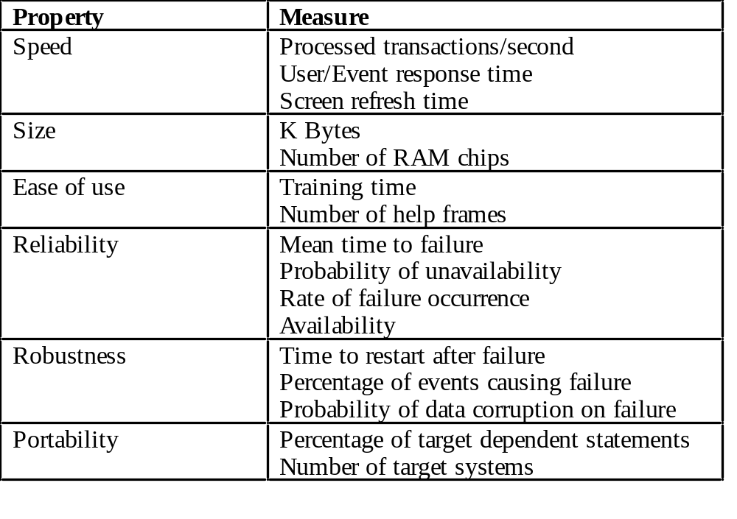
Requirements measures

Slide 23
Requirements interaction
Conflicts between different non-functional requirements are common in complex systems
Spacecraft system
  To minimise weight, the number of separate chips in the system should be minimised
  To minimise power consumption, lower power chips should be used
  However, using low power chips may mean that more chips have to be used. Which is the most critical requirement?

Slide 24
Domain requirements
Derived from the application domain and describe system characterisics and features that reflect the domain
May be new functional requirements, constraints on existing requirements or define specific computations
If domain requirements are not satisfied, the system may be unworkable

Slide 25
Library system domain requirements
There shall be a standard user interface to all databases which shall be based on the Z39.50 standard.
Because of copyright restrictions, some documents must be deleted immediately on arrival. Depending on the user’s requirements, these documents will either be printed locally on the system server for manually forwarding to the user or routed to a network printer.

Slide 26
Train protection system
The deceleration of the train shall be computed as:
  D_{train} = D_{control} + D_{gradient}
where D_{gradient} is 9.81ms² * compensated gradient/alpha and where the values of 9.81ms² /alpha are known for different types of train.

Slide 27
Domain requirements problems
Understandability
  Requirements are expressed in the language of the application domain
  This is often not understood by software engineers developing the system
Implicitness
  Domain specialists understand the area so well that they do not think of making the domain requirements explicit

Slide 28
User requirements
Should describe functional and non-functional requirements so that they are understandable by system users who don’t have detailed technical knowledge
User requirements are defined using natural language, tables and diagrams

Slide 29
Problems with natural language
Lack of clarity
  Precision is difficult without making the document difficult to read
Requirements confusion
  Functional and non-functional requirements tend to be mixed-up
Requirements amalgamation
  Several different requirements may be expressed together

Slide 30
Database requirement
4.A.5 The database shall support the generation and control of
configuration objects; that is, objects which are themselves groupings
of other objects in the database. The configuration control facilities
shall allow access to the objects in a version group by the use of an
incomplete name.

Slide 31
Editor grid requirement
2.6 Grid facilities To assist in the positioning of entities on a diagram,
the user may turn on a grid in either centimetres or inches, via an
option on the control panel. Initially, the grid is off. The grid may be
turned on and off at any time during an editing session and can be
toggled between inches and centimetres at any time. A grid option
will be provided on the reduce-to-fit view but the number of grid
lines shown will be reduced to avoid filling the smaller diagram
with grid lines.

Slide 32
Requirement problems
Database requirements includes both conceptual and detailed information
  Describes the concept of configuration control facilities
  Includes the detail that objects may be accessed using an incomplete name
Grid requirement mixes three different kinds of requirement
  Conceptual functional requirement (the need for a grid)
  Non-functional requirement (grid units)
  Non-functional UI requirement (grid switching)

Slide 33
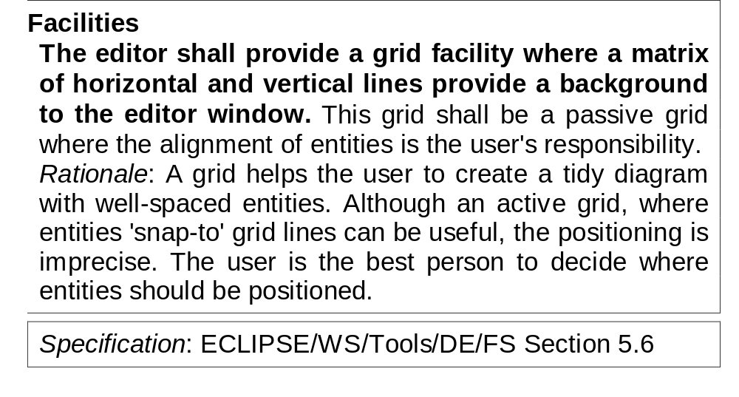
Structured presentation

Slide 34
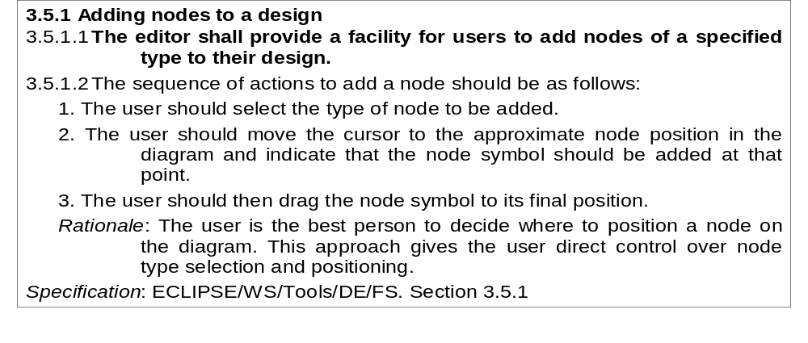
Detailed user requirement

Slide 35
Guidelines for writing requirements
Invent a standard format and use it for all requirements
Use language in a consistent way. Use shall for mandatory requirements, should for desirable requirements
Use text highlighting to identify key parts of the requirement
Avoid the use of computer jargon

Slide 36
System requirements
More detailed specifications of user requirements
Serve as a basis for designing the system
May be used as part of the system contract
System requirements may be expressed using system models discussed in Chapter 7

Slide 37
Requirements and design
In principle, requirements should state what the system should do and the design should describe how it does this
In practice, requirements and design are inseparable
  A system architecture may be designed to structure the requirements
  The system may inter-operate with other systems that generate design requirements
  The use of a specific design may be a domain requirement

Slide 38
Problems with NL specification
Ambiguity
  The readers and writers of the requirement must interpret the same words in the same way. NL is naturally ambiguous so this is very difficult
Over-flexibility
  The same thing may be said in a number of different ways in the specification
Lack of modularisation
  NL structures are inadequate to structure system requirements

Slide 39
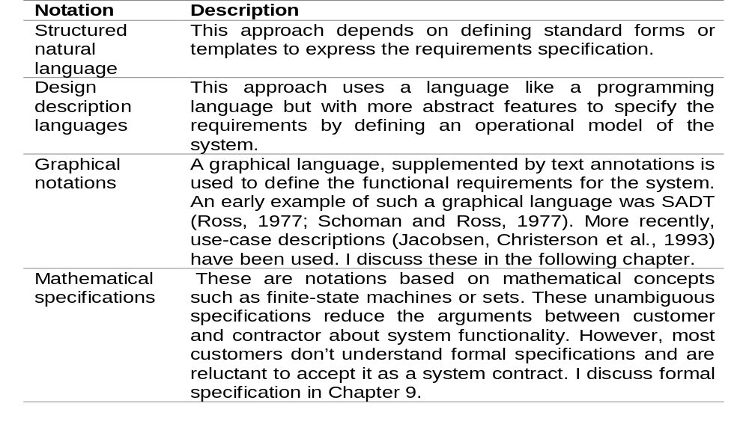
Alternatives to NL specification

Slide 40
Structured language specifications
A limited form of natural language may be used to express requirements
This removes some of the problems resulting from ambiguity and flexibility and imposes a degree of uniformity on a specification
Often bast supported using a forms-based approach

Slide 41
Form-based specifications
Definition of the function or entity
Description of inputs and where they come from
Description of outputs and where they go to
Indication of other entities required
Pre and post conditions (if appropriate)
The side effects (if any)

Slide 42
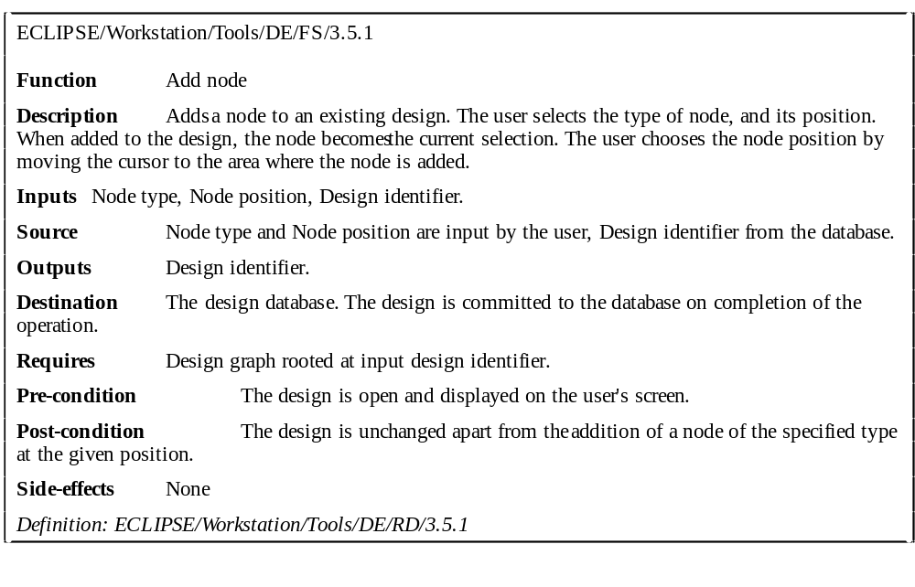
Form-based node specification

Slide 43
PDL-based requirements definition
Requirements may be defined operationally using a language like a programming language but with more flexibility of expression
Most appropriate in two situations
  Where an operation is specified as a sequence of actions and the order is important
  When hardware and software interfaces have to be specified
Disadvantages are
  The PDL may not be sufficiently expressive to define domain concepts
  The specification will be taken as a design rather than a specification

Slide 44
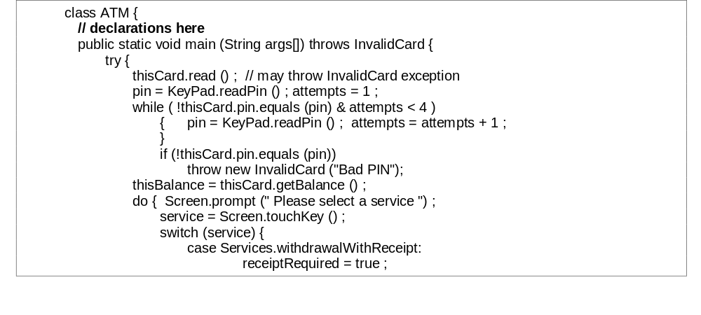
Part of an ATM specification

Slide 45
PDL disadvantages
PDL may not be sufficiently expressive to express the system functionality in an understandable way
Notation is only understandable to people with programming language knowledge
The requirement may be taken as a design specification rather than a model to help understand the system

Slide 46
Interface specification
Most systems must operate with other systems and the operating interfaces must be specified as part of the requirements
Three types of interface may have to be defined
  Procedural interfaces
  Data structures that are exchanged
  Data representations
Formal notations are an effective technique for interface specification

Slide 47
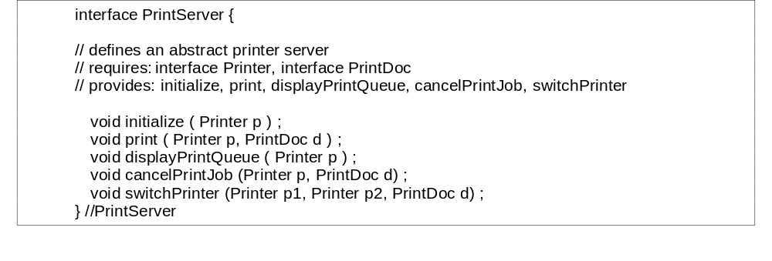
PDL interface description

Slide 48
The requirements document
The requirements document is the official statement of what is required of the system developers
Should include both a definition and a specification of requirements
It is NOT a design document. As far as possible, it should set of WHAT the system should do rather than HOW it should do it

Slide 49
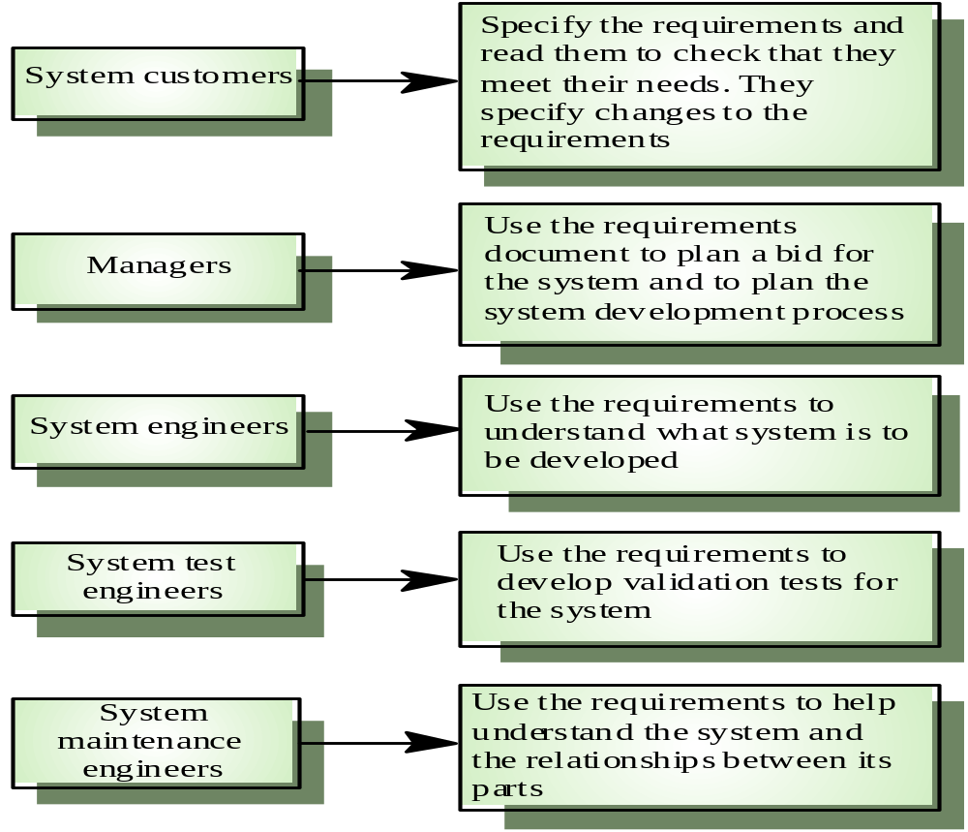
Users of a requirements document

Slide 50
Requirements document requirements
Specify external system behaviour
Specify implementation constraints
Easy to change
Serve as reference tool for maintenance
Record forethought about the life cycle of the system i.e. predict changes
Characterise responses to unexpected events

Slide 51
IEEE requirements standard
Introduction
General description
Specific requirements
Appendices
Index
This is a generic structure that must be instantiated for specific systems

Slide 52
Requirements document structure
Introduction
Glossary
User requirements definition
System architecture
System requirements specification
System models
System evolution
Appendices
Index

Slide 53
Key points
Requirements set out what the system should do and define constraints on its operation and implementation
Functional requirements set out services the system should provide
Non-functional requirements constrain the system being developed or the development process
User requirements are high-level statements of what the system should do

Slide 54
Key points
User requirements should be written in natural language, tables and diagrams
System requirements are intended to communicate the functions that the system should provide
System requirements may be written in structured natural language, a PDL or in a formal language
A software requirements document is an agreed statement of the system requirements

