Slide 1



Staff In-charge: Prof. Swapnil Sir
Institution Name: KJ Somaiya School of Engineering
Revolutionizing Healthcare with Cloud Computing: The Impact of Clinical Decision Support Algorithms
JIYA TRIVEDI 16010122321
VEDANSH SAVLA 16010122323
TISHA MOTANI 16010123808
Div: C
Date:11-04-2025
Notes:
1

Slide 2
Revolutionizing Healthcare with Cloud Computing:
The Impact of Clinical Decision Support Algorithms
An in-depth study
Authors:
Dr. J. Lenin, Anantha Raman Rathinam, Dr. A. Komathi,
A. Kasthuri, Hima Vijayan, C. Srinivasan
⁠Affiliations:
Alliance College of Engineering and Design, KL University, Nadar Saraswathi College,
Vinayaka Mission’s Institute, S.A. Engineering College, Saveetha University
Notes:
1

Slide 3
Overview & Objectives
Overview:
Integration of cloud computing with CDS algorithms is
transforming diagnostic processes.
Focus on key AI technologies: Inference Engines,
Bayesian Networks, Machine Learning, and NLP.

Slide 4
Overview & Objectives
Overview:
Integration of cloud computing with CDS algorithms is
transforming diagnostic processes.
Focus on key AI technologies: Inference Engines,
Bayesian Networks, Machine Learning, and NLP.
Objectives:
Explain the technological synergy and its benefits.
Illustrate system architecture and data-driven decision-making.
Highlight performance, scalability, and personalized patient care.

Slide 5
Background & Motivation
Challenges in Modern Healthcare:
Data overload from various sources (sensors, imaging, records).
Slow, labor-intensive traditional decision-making.
Need for personalized treatment.
Motivation for the Research:
Leverage cloud computing for scalable, real-time data processing.
Enhance diagnostic accuracy through CDS algorithms.

Slide 6
Technological Foundations
Cloud Computing | Clinical Decision Support (CDS) Algorithms

Slide 7


Technological Foundations
Cloud Computing | Clinical Decision Support (CDS) Algorithms
Scalability and accessibility. | AI-driven algorithms: Inference Engines, Bayesian Networks, Machine Learning, NLP.

Slide 8
Technological Foundations
Cloud Computing | Clinical Decision Support (CDS) Algorithms
Scalability and accessibility. | AI-driven algorithms: Inference Engines, Bayesian Networks, Machine Learning, NLP.
Centralized data storage and real-time processing. | Provide rapid, evidence-based recommendations.

Slide 9
Technological Foundations
Cloud Computing | Clinical Decision Support (CDS) Algorithms
Scalability and accessibility. | AI-driven algorithms: Inference Engines, Bayesian Networks, Machine Learning, NLP.
Centralized data storage and real-time processing. | Provide rapid, evidence-based recommendations.
Enhanced data sharing across multiple locations. | Enable data-driven personalized care.

Slide 10
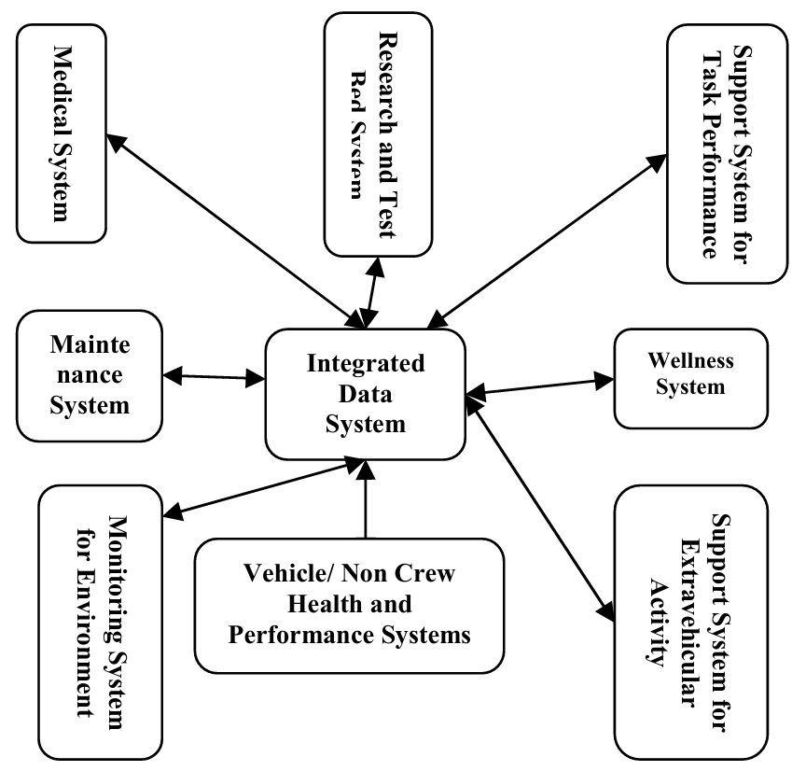
Nominal Crew Health and Performance System Architecture
Fig.(1)
Integration of cloud computing and CDS for real-time healthcare decision support.

Slide 11
Cloud Infrastructure: Centralized, high processing power.
Nominal Crew Health and Performance System Architecture
Data Sources: Patient sensors, clinical notes, imaging.
Inference Engines: Process data to deliver real-time recommendations.
Integration of cloud computing and CDS for real-time healthcare decision support.

Slide 12
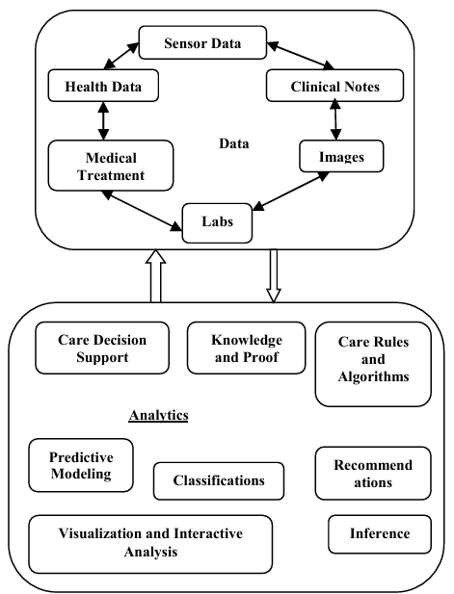
Visual representation of multi-source healthcare data merging into actionable insights.
Data-Driven Decisions in Healthcare
Figure 2

Slide 13

Core Components of CDS Technologies
Inference Engines: | Automate reasoning; support rapid decision-making
Bayesian Networks | Model uncertainty; perform risk assessment.
Machine Learning Algorithms | Recognize patterns; improve predictive analytics.
Natural Language Processing (NLP) | Process unstructured text; enhance patient and clinician interactions.

Slide 14

Core Components of CDS Technologies
Inference Engines: | Automate reasoning; support rapid decision-making
Bayesian Networks | Model uncertainty; perform risk assessment.
Machine Learning Algorithms | Recognize patterns; improve predictive analytics.
Natural Language Processing (NLP) | Process unstructured text; enhance patient and clinician interactions.

Slide 15

Core Components of CDS Technologies
Inference Engines: | Automate reasoning; support rapid decision-making
Bayesian Networks | Model uncertainty; perform risk assessment.
Machine Learning Algorithms | Recognize patterns; improve predictive analytics.
Natural Language Processing (NLP) | Process unstructured text; enhance patient and clinician interactions.

Slide 16

Core Components of CDS Technologies
Inference Engines: | Automate reasoning; support rapid decision-making
Bayesian Networks | Model uncertainty; perform risk assessment.
Machine Learning Algorithms | Recognize patterns; improve predictive analytics.
Natural Language Processing (NLP) | Process unstructured text; enhance patient and clinician interactions.

Slide 17
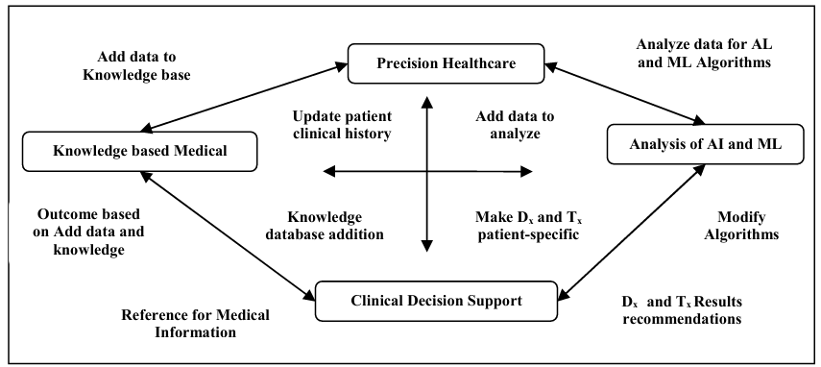
Deep Learning Healthcare System Schematic (Figure 3)
Deep learning enhances the intelligence of CDS systems for precision diagnostics

Slide 18
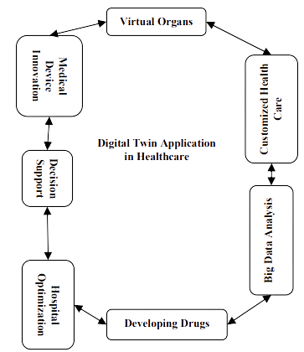

Digital Twin in Healthcare
(Figure 4)
Virtual replicas of patient conditions.
Simulation and optimization of treatment strategies
Real-time feedback and predictive modeling.
Using digital twins to simulate patient-specific scenarios for personalized treatment planning.
Notes:
Accuracy depends on training data.
May not detect highly sophisticated fake news.
Aggregation feature still in development (Future Goal).
4

Slide 19
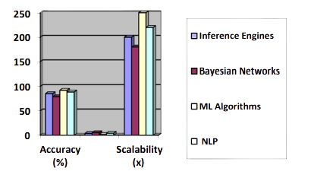
Comparative Analysis of AI Techniques (Figure 5)
Chart comparing the effectiveness and scalability of CDS components in healthcare.
Notes:
Accuracy depends on training data.
May not detect highly sophisticated fake news.
Aggregation feature still in development (Future Goal).
4

Slide 20
Results, Discussion & Implications
Results
Improved diagnostic accuracy.
Enhanced speed of clinical decision-making.
High scalability with cloud-based CDS.
Discussion
Transformative impact on patient-centric care.
Challenges: Data privacy, integration complexity.
Implications
Future directions in Digital Twin applications and enhanced AI integration.
Notes:
10

Slide 21
Conclusion & Future Work
Conclusion
Convergence of cloud computing with CDS algorithms revolutionizes healthcare.
Significant improvements in patient outcomes, diagnostic precision, and treatment personalization.
Limitations
Scaling digital twin applications.
Addressing data security and integration challenges.
Notes:
10

Slide 22
Thank You
Notes:
12

