Slide 1
자기소개
프로필
방승현

Slide 2
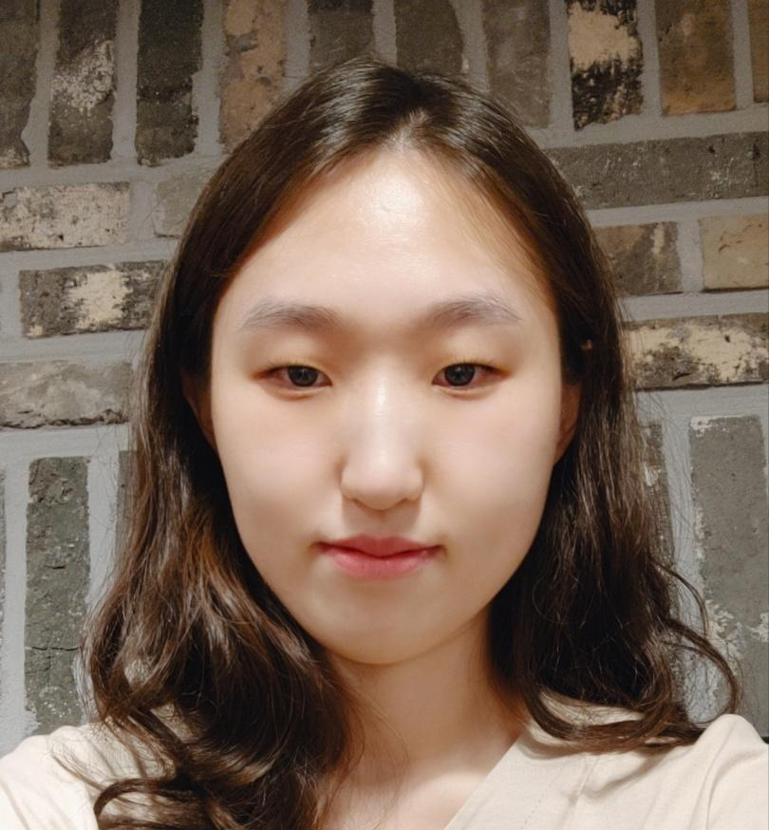


About Me
Major: Statistics (통계학)
Skills: R Studio, Chinese, MS Office
방승현 (Seunghyun Bang)
Birth: 1998/01/08
E-mail: beth532@naver.com

Slide 3
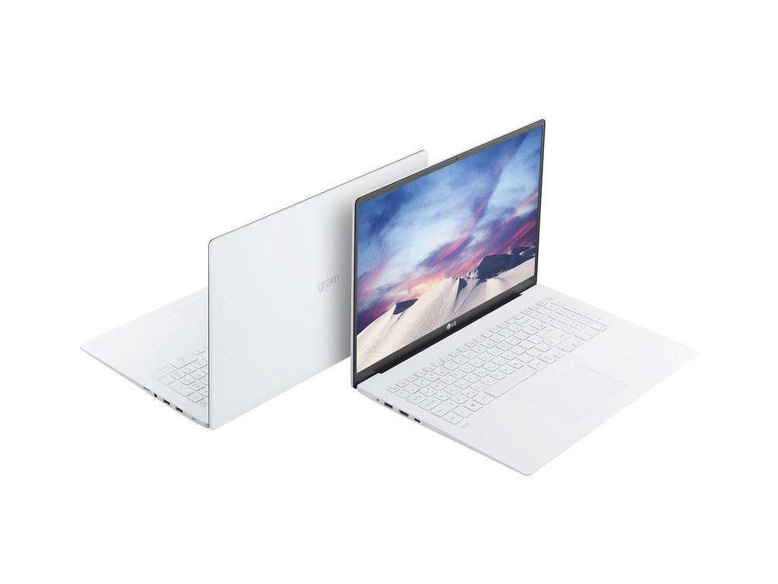
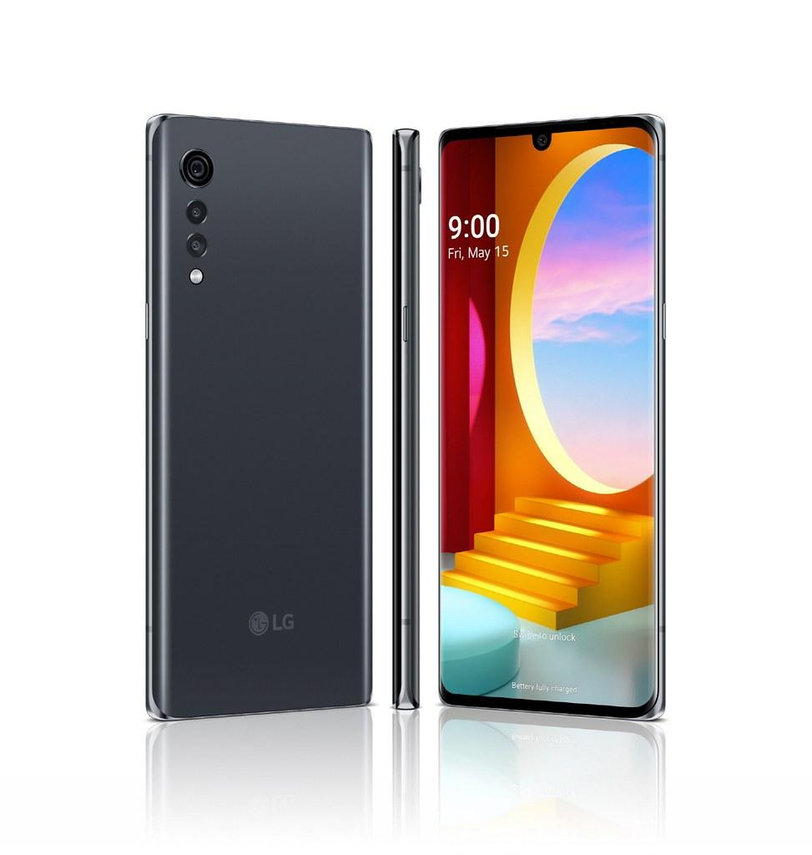
Device
LG Gram
11th Gen Intel(R)
Windows
LG Velvet

Slide 4

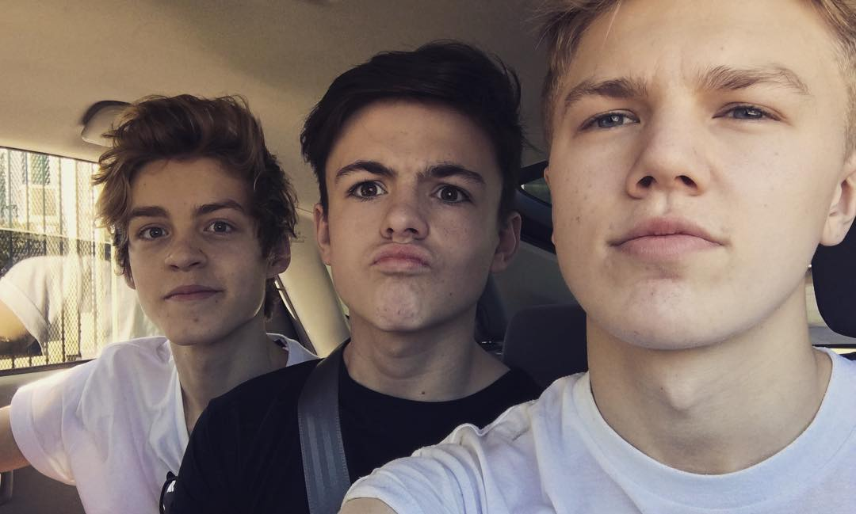
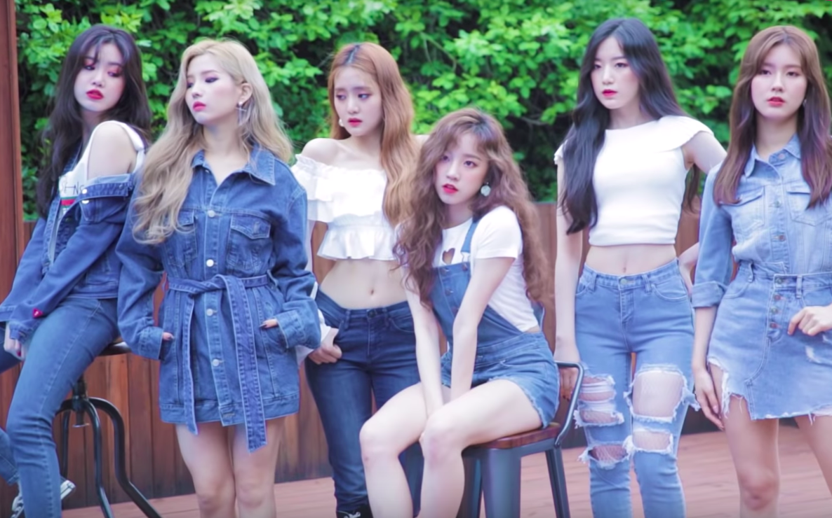
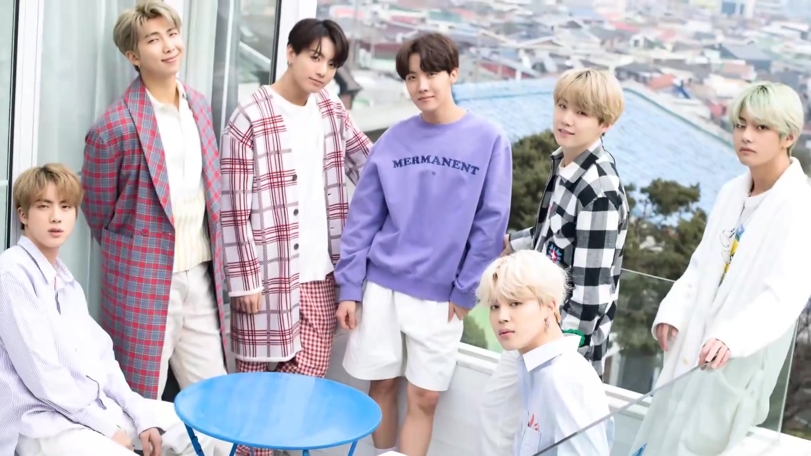
Hobby
Listening Music

Slide 5
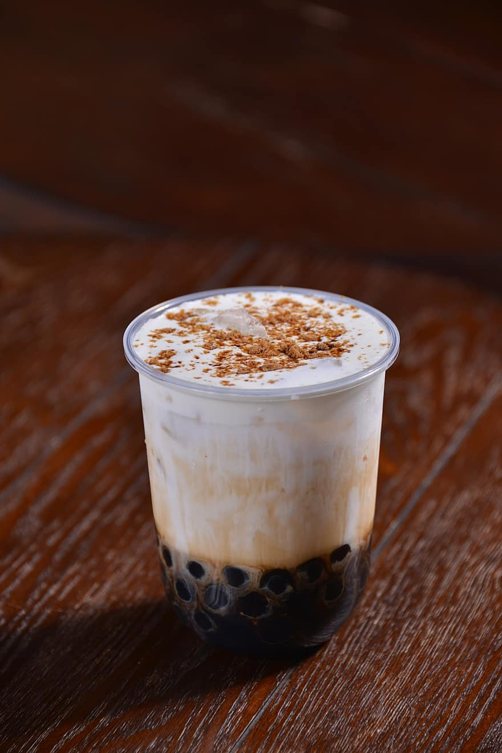

Hobby
Cafe

Slide 6
I believe in…
Every Accomplishment
Starts with the Decision to
“TRY”

Slide 7
Thank You

