Slide 1
Personal Loan: Financial Services
OJT Project Report | June 2026
Name: Bedmutha Jiya Pravin | Class: M.Sc. Statistics (I) Modern College of Arts, Science and Commerce

Slide 2

Market Challenges
Market Competition
The personal loan market is highly competitive with multiple financial institutions offering similar products based on varying fees and structures.
Customer
Evaluation
Clients evaluate processing fees, disbursal time, documentation, and repayment flexibility before selecting a provider.
Analytical Goals
This project aims to optimize loan product design using data-driven analysis and predictive customer surveys.
Feature Optimization
Identifying which product features maximize customer acceptance is a major hurdle for modern financial institutions.

Slide 3
Primary Objectives
@ Identify Influential Factors: Determine key elements affecting customer choice in personal loans.
@ Data Collection: Gather preference data through structured questionnaires and survey responses. @ Predictive Modeling: Convert survey data into binary format for advanced predictive analytics.
@ Product Optimization: Develop strategy recommendations for improving customer satisfaction and acceptance. @ Hands-on Training: Gain practical experience in statistical software and financial service analysis

Slide 4
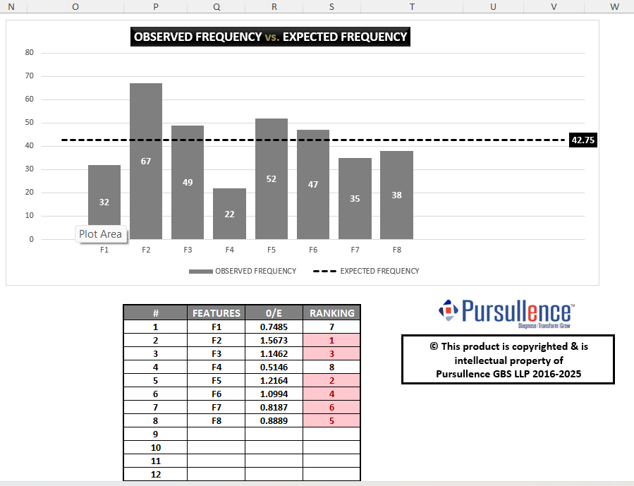
Phase 1 Findings
Influential Attributes
The analysis yielded a Test Statistic of 54.746 and a P-Value of
0.00000, indicating highly significant variation in customer preferences.
Assurance Level: 100% confidence in results. Top Factor: Disbursal Time (F2).
Key Sequence: F2, F5, F3, F6, F8, F7.

Slide 5
Key Loan Attributes
Feature ID | Attribute Name | Description
F2 | Disbursal Time | Speed of fund transfer post-approval
F5 | Documentation | Process convenience and KYC requirements
F3 | Foreclosure | Facility to close loan before tenure
F6 | Repayment Tenure | Flexibility in loan duration
F8 | Insurance | Loan protection coverage benefits
F7 | Interest Structure | Rate calculation and stability

Slide 6
The statistical analysis produced a Test Statistic value of 54.746 and a P-Value of 0.00000, indicating significant variation in customer preferences.
The AI-Predictive Analytics Tool generated an Assurance Level of 100%, indicating high confidence in the obtained results.
Among the eight factors evaluated, F2 emerged as the most influential factor, followed by F5, F3, F6, F8, and F7. 4] These six factors were selected for detailed optimization in Phase 2.
5] Customer preferences can be effectively analyzed and ranked using predictive analytics techniques.

Slide 7


The Optimum Product
C2 D2 E2 F2

Slide 8
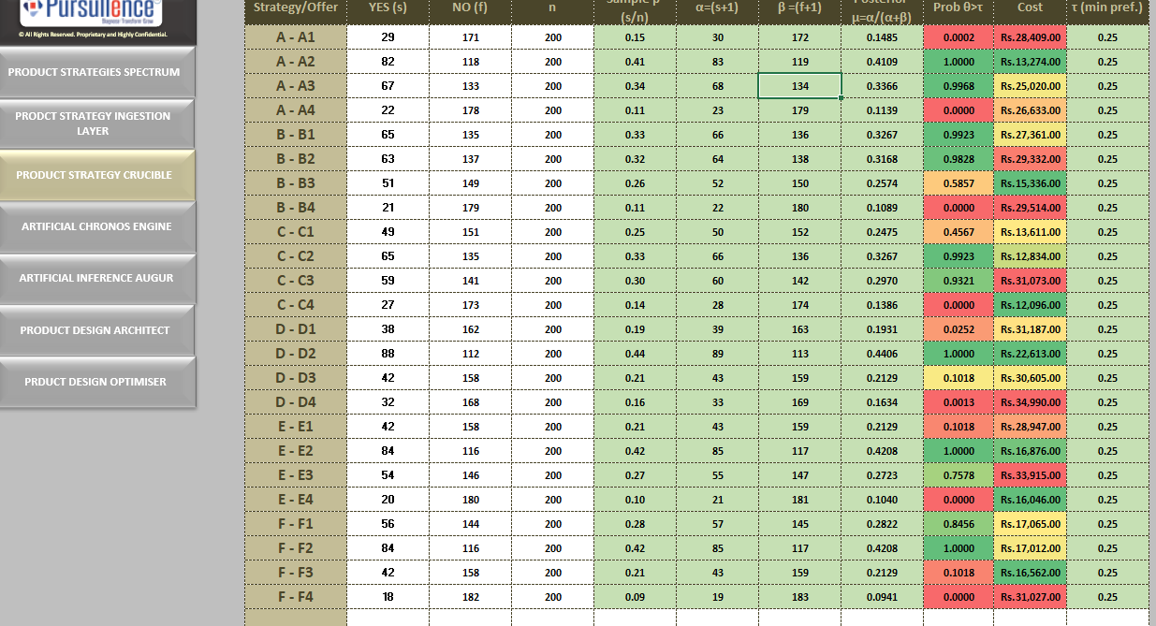
The Probability of theta > tau value represents the probability of actual success rate/attractiveness across entire population more than tau i.e. expected success rate/attractiveness for a given offer.

Slide 9
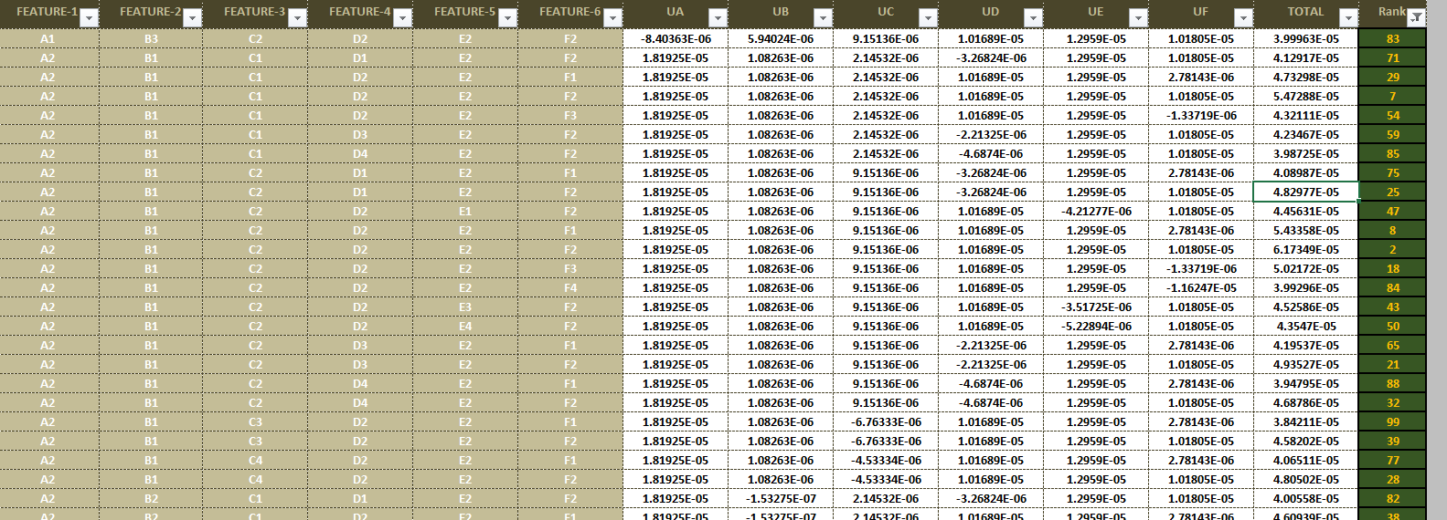
Based on the algorithm for utility scores, under a 2nd layer of a statistical modeling , system has analyzed the data and predicted the "RANKING" for each of 4096 combinations. There are 4096 combinations for 4 offers and 6 features , 4*4*4*4*4*4=4096.
In tool , Ranking goes till total of 4096 rows.
System has given top 100 Ranked combinations of offers across all 6 features.

Slide 10
Implementation Strategies
Based on the findings of the study, financial institutions can implement customer-centric personal loan products by focusing on the features most preferred by customers. The identified high-priority loan attributes should be incorporated into product design and marketing strategies.
Banks and financial institutions can utilize customer preference data to:
Design loan products aligned with customer expectations.
Improve loan approval and disbursal processes.
Offer flexible repayment options.
Develop competitive interest rate structures.
Enhance customer satisfaction and retention.
Use predictive analytics for continuous product optimization.
The implementation of these strategies can help institutions improve product acceptance and gain a competitive advantage in the personal loan market.

Slide 11
Observations
Customers consider multiple factors before selecting a personal loan product.
Interest-related factors and repayment flexibility significantly influenced decision-making.
Convenience-oriented features such as faster disbursal and simplified documentation are highly valued.
Certain loan features received considerably higher preference scores than others.
Customer preferences can be effectively analyzed using predictive analytics techniques.
A2 B3 C2 D2 E2 F2 are found to be the most significant combination among all the studied ones.
Conclusion
The study successfully identified the major factors influencing personal loan selection and analyzed customer preferences regarding various loan features. Through survey-based data collection and predictive analytics, valuable insights were obtained regarding customer expectations from personal loan products.
The results indicate that customers prefer loan products that offer affordability, convenience, flexibility, and transparency. The application of the AI-Predictive Analytics Tool helped in identifying preferred feature combinations and optimizing product offerings. The study demonstrates the
usefulness of data-driven approaches in designing customer-centric financial products and improving business decision-making.

Slide 12
Thank You
"Data-driven analysis provides the roadmap for customer-centric innovation."
Bedmutha Jiya Pravin | M.Sc. Statistics (I) Modern College, Shivajinagar, Pune

