Slide 1

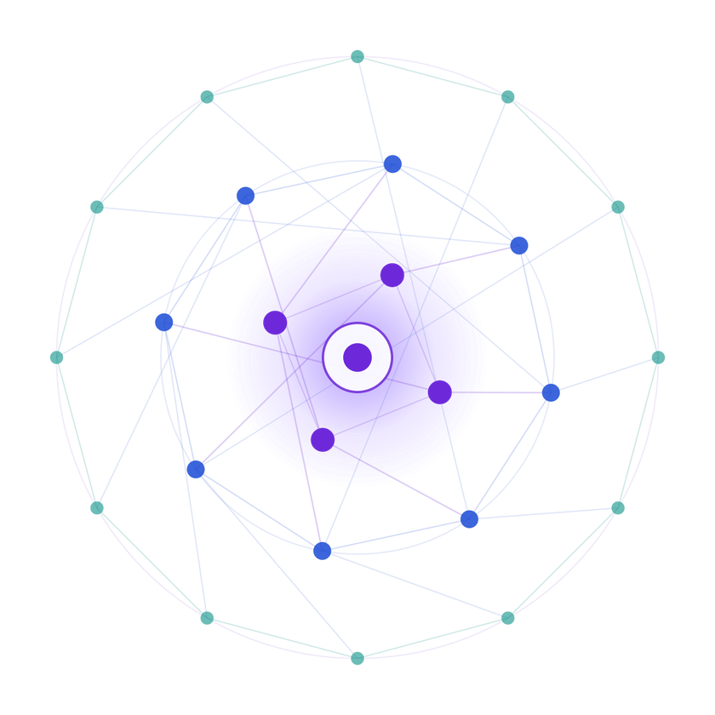
SAMSUNG PRISM
Generative AI
Hackathon
3rd Edition 2026 – 27
  Theme ID - 03 · Teachable Voice Automation
  Team Name -F.R.I.D.A.Y
  College Name -SRM INSTITUTE OF SCIENCE AND TECHNOLOGY
  Member Name & Email 1- NIRBHAY KAUSHIK
(nirbhaykaushik09@gmail.com)
  Member Name & Email 2- JIYA NAMBIAR
(jiya.nambiar2024@gmail.com)
  Member Name & Email 3- MAHIRA BABBAR
(mb9051@srmist.edu.in)
  Member Name & Email 4-VEDANSH MISHRA
(vedanshmishra467@gmail.com)
  Submission Github link - https://github.com/jiyanambiar/teachable-voice-assistant
Notes:
Opening slide for the 3rd edition of the PRISM Generative AI Hackathon. Replace the SAMSUNG PRISM pill with the official PRISM logo image if you have the asset. Confirm the academic year label (2026-27) before circulating.
1

Slide 2
Theme
THEME 03
Scope & constraints
  Android; UI automation or accessibility services, not app-specific APIs
  Two or three third-party apps is enough to prove the idea
  At least one parameterised slot — item, quantity or address
  No credential capture; pause for payment and authentication
Teachable Voice Automation
Problem statement
Voice assistants cannot act inside third-party apps like Amazon or Zomato, so anything past first-party features falls back to a web result. Users already know which taps get the job done — they just have no way to hand that knowledge to the assistant.
What to build
  Let a user speak a command, then record the on-screen steps as they do it once
  Generalise that recording into a reusable flow, not a brittle tap replay
  Match later utterances, including paraphrases and changed values, to the learnt flow
  Replay reliably when screens change, and ask the user only when genuinely stuck
Tech focus
  Speech-to-intent, UI-tree understanding, flow synthesis from one demonstration
  Report learn success, replay success across sessions and paraphrase match accuracy

Slide 3
Existing Solutions & Gaps
Voice assistants
Google Assistant, Siri, Bixby
Gap
Only first-party features and apps that publish app-specific integrations; everything else becomes a web search.
Macro / routine apps
Tasker, MacroDroid, Bixby Routines
Gap
Record taps or hand-built rules. Replay is brittle — breaks when a screen, button or layout changes.
RPA & UI test tools
Enterprise RPA, Appium-style scripts
Gap
Built by developers with scripts and selectors. Not taught by an ordinary user, not driven by voice.
LLM screen agents
Generic mobile UI agents
Gap
Reason step by step on every run: slow, costly, unpredictable, and nothing learnt is reused next time.
The missing piece: a system that learns a task from one demonstration, generalises it with slots, understands paraphrased voice commands, and replays it safely across apps without app-specific APIs.

Slide 4
Our Solutions & Architecture Diagram
1 · LEARN — USER TEACHES ONCE
Voice command
“Order 2 kg onions on Amazon”
Speech-to-intent
Intent, app and slots extracted
Demo recorder
Accessibility service logs UI-tree events
Flow synthesiser
Generalises taps into a step graph with slots
Flow library
Stored per app, per intent
2 · REPLAY — USER JUST SPEAKS
New utterance
“Get me 5 kg rice”
Flow matcher
Paraphrase match + slot fill
Replay engine
Finds targets by meaning, not pixels
Recovery
Re-plans if screen changed
Ask user
Only if stuck; pauses at payment / login
Design rule: no credentials are ever captured — the flow hands control back to the user for payment and authentication.

Slide 5
Demo & Product Walkthrough
1
2
3
4
5
Speak
“Order 2 kg onions on Amazon”. Assistant has no flow yet and offers to be taught.
Teach
User performs the task once: search, select item, set quantity, add to cart.
Learn
Recording becomes a reusable flow; “onions” and “2 kg” become slots.
Reuse
Later: “Get me 5 kg rice” — paraphrase and new values match the learnt flow.
Replay
Runs the flow, adapts to screen changes, stops at payment for the user.
Demo video- https://drive.google.com/file/d/1iSJeKIwWKvyI605R3ch6inuzyzR2DL-t/view?usp=sharing

Slide 6
Tools and tech stack used
Android layer
  Kotlin, Android Studio
  AccessibilityService for UI-tree read and actions
  Foreground service + overlay for record / replay controls
Speech & language
  On-device speech recognition (Android SpeechRecognizer / Whisper)
  LLM for intent and slot extraction
  Sentence embeddings for paraphrase matching
Flow engine
  JSON flow graph: steps, selectors, slots
  Semantic element matching (text, role, position) for replay
  Local store (Room / SQLite) for flows
Evaluation & safety
  Metrics logged per run: learn success, replay success across sessions, paraphrase match accuracy
  Guardrails: no credential capture, confirmation before payment or irreversible actions, user can interrupt any replay

Slide 7
Impact & Use case
1 demo
is all a user needs to teach a task
Any app
with an accessible UI — no vendor integration
0
credentials captured or stored
Use cases
  Reorder groceries: “Order 2 kg onions on Amazon”
  Food delivery: “Get my usual from Zomato”
  Repeat bookings, recharges, address changes
  Chain flows across two apps in one command
Who benefits
  Elderly and first-time smartphone users
  People with visual or motor impairments who need hands-free control
  Busy users with repetitive multi-tap routines
  Any app becomes voice-enabled without waiting for developers

Slide 8
Innovation highlights, results and limitations
Innovation highlights
  Learn from a single demonstration
  Generalises into slot-based flows, not tap replay
  Paraphrase-tolerant matching of new commands
  Self-healing replay when screens change
  Works through accessibility, no app APIs
Results
85 % Learn success
80 % Replay success (across sessions)
90 % Paraphrase match accuracy
Limitations
  Apps with heavy custom-drawn UIs expose a weak accessibility tree
  Major app redesigns may need re-teaching
  Payment and login stay manual by design
  Tested on a small set of apps

Slide 9
What’s next
NOW
NEXT
THEN
LATER
Prototype
Record, generalise and replay on 2–3 apps with slot filling
Robustness
Better recovery from popups, A/B layouts and app updates
Scale
Multi-app chaining, shared flow library, on-device models
Reach
Regional languages and code-mixed speech, accessibility partnerships

Slide 10
Brownie points slide( differentiation)
One demo, real generalisation
Slots and semantic targets, not a coordinate replay.
Voice in, paraphrase-proof
“Get me rice” and “order 5 kg rice” hit the same flow.
Safe by design
No credential capture; pauses at payment and authentication.
Measurable
Learn, replay and paraphrase metrics reported across sessions.

Slide 11
Checklist- Updated on Public GitHub
  Working prototype code — public or shared GitHub repo
https://github.com/jiyanambiar/teachable-voice-assistant
  README with reproducible setup instructions (Y/N)
YES
  Demo video, max 5 minutes (YouTube or Drive link)
https://drive.google.com/file/d/1iSJeKIwWKvyI605R3ch6inuzyzR2DL-t/view?usp=sharing
  Presentation file (PPT or PDF) (Y/N)
YES

Slide 12
Thank you
Organised by the Language AI Team and the PRISM Team, Samsung R&D Institute India
Notes:
Closing slide. Add the Google Form URL and a contact email before sharing. Edition 2 organising team for reference: Language AI - Sourabh Tiwari, Gaurav, Sanjeeth Pothireddy, Gorang Maniar; PRISM - Binny Lakra, Prakhar Chandrakar, Vishu Kumar; Kick-off and mentors - Giridhar Jakki, Deepraj Prabhakar Patkar (Language AI), Srimanu Prasad Nagaraju, Ashish Kumar (Tech Strategy).
12

