Slide 1

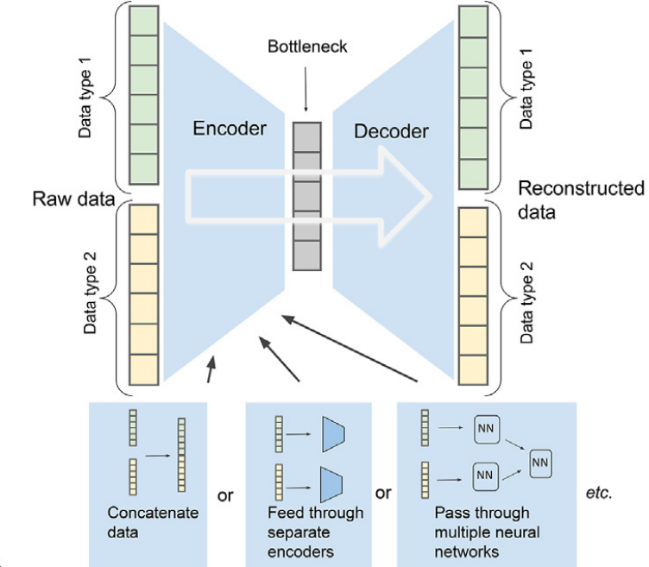
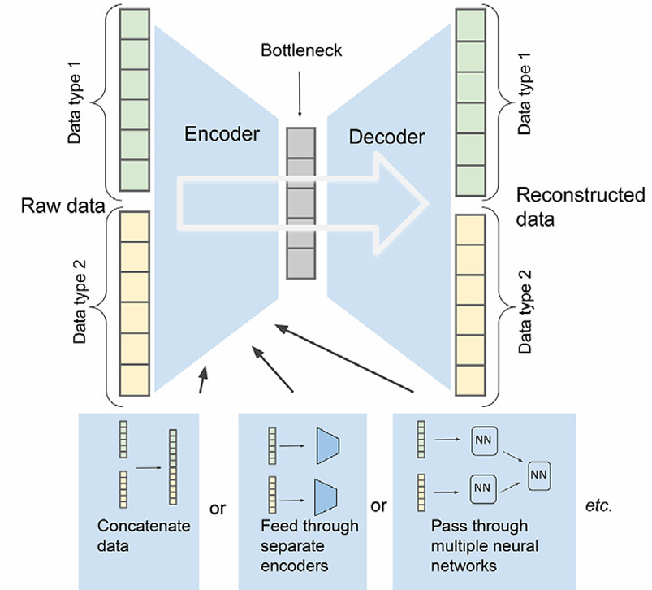
Viva Presentation
Prepared by : Jiyanshu Dhaka (220481)
Mentor : Prof. Dootika Vats
Topic : Dual Autoencoder Model
Dual-Autoencoder Model:
It is a neural network design that processes multiple data types using parallel autoencoders.
Each autoencoder has an encoder that compresses input data into a lower-dimensional latent space and a decoder that reconstructs the input from this latent representation.
In a dual-autoencoder setup, the two encoders map their inputs into a shared latent space, where the highly correlated representations are aligned together.

Slide 2





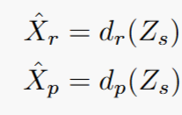
Usage in the Project : Mosaic Data Integration
let be the RNA data matrix, be the Protein data matrix, f( ) be the trained encoder functions and Z be the latent space data matrices after encoding.
Encoding:
By this mapping we get a shared latent representation ensureing that correlated RNA and protein data points align in the same space.
let d( ) be the trained decoder functions, be reconstructed data.
Decoding: Two decoders reconstruct RNA and protein from the shared representation
we use this predicted and original data to find:
Reconstruction Loss to ensures encoders learn meaningful representations.
Alignment Loss to ensures correlated RNA and protein embeddings are close.
After getting final embeddings, we use spectral clustering to obtain the clusters labels of each cell.

Slide 3
Why It Was Necessary and How This Topic Helped:
The features in the RNA and protein datasets are weakly linked, so direct correspondence between genes and proteins was limited.
We tried other Methods for combined data dimension reduction but they gave siginficantly low ARI due to weakly aligned data.
In languages, semantics convey meaning, while in biology, nomenclature serves a similar purpose and can be correlated. Most models do not utilized the informative relation embedded in the nomenclature of RNA and protein.
Intuinalogy:
Analogy:
Thank you

