Slide 1
🏆 AMIHACKS 1.0 HACKATHON PITCH
PlateRelay: "Surplus-to-Shelter"
Real-Time Food Rescue Routing Platform
Eliminating urban food waste via real-time 3-stage perishability cascade, automated NGO matching engine, and dual-OTP chain-of-custody verification.
3-Stage Cascade Engine
Commercial -> Share -> NGO
78 / 100 Match Score
Dynamic Weighted Algorithm
Dual-OTP Security
#4821 Pickup | #9374 Delivery
Dual DB Architecture
SQLite + Mongo Atlas Sync

Slide 2
🔴 PROBLEM STATEMENT
The Urban Food Paradox: Waste vs. Hunger
Slide 2 of 8
🚮 67 Million Tons Wasted
India loses ₹92,000 Crores worth of edible food annually. Commercial kitchens, hostels, weddings, and bakeries throw away edible surplus daily.
⏳ Perishability Clock Barrier
Cooked meals spoil within 2–4 hours. Traditional phone-call networks to NGOs fail because food expires before volunteers can arrive.
🚫 Lack of Smart Logistics
Zero real-time unified platforms exist to route surplus food dynamically between cost-conscious buyers, community members, and shelters.

Slide 3
💡 PROPOSED SOLUTION
PlateRelay: Real-Time 3-Stage Cascade System
Slide 3 of 8
STAGE 1: RESCUE DEAL (50-70% OFF) 🏷️
Commercial resale window allowing food businesses to recover preparation costs while food is super fresh.
STAGE 2: FREE SHARE FEED 🌱
Zero-cost community sharing feed activated automatically as safe consumption time window decreases.
STAGE 3: NGO BULK RESCUE 🤝
Automated direct routing to verified shelters & langars for bulk quantities (≥ 15 portions) or near cutoff time.
⏱️ Safety Countdown Clock Ring: Displays live safe-for timer (e.g., 3h 45m) ensuring zero spoiled food distribution.

Slide 4
✨ KEY FEATURES & INNOVATION
Intelligent Modules & Value Proposition
Slide 4 of 8
🧠 Automated Weighted NGO Matcher
Calculates dynamic match scores (78/100) using Distance (40%) + Capacity Fit (25%) + Urgency (20%) + Preference (15%).
📷 Smart Dish Photo Matcher
Auto-detects dish titles (Momos, Paneer, Biryani, Chole Bhature, Gulab Jamun, Dal Makhani) with direct device photo upload option.
🔒 Dual-OTP Handoff Security
Pickup OTP (#4821) and Delivery OTP (#9374) verify volunteer runner chain-of-custody to eliminate fraud.
🗺️ OpenStreetMap Integration
Live interactive map with custom Leaflet markers for Temples, Langars, and Verified Community Shelters.

Slide 5
🏗️ SYSTEM ARCHITECTURE
Architecture & Tech Stack Breakdown
Slide 5 of 8
[ Donor Form Input (React) ] ──► [ Express REST API (Port 5001) ] ──► [ Perishability Engine ]
│
▼
┌──────────────────────────┐
│ Dual-Database Architecture│
│ • SQLite (database.db) │
│ • Mongo Atlas Cloud Sync │
└──────────────────────────┘
Frontend Layer
React.js, Vite, Tailwind CSS, Lucide Icons, Leaflet Maps
Backend & Engine
Node.js, Express API, Haversine Distance, Weighted Matcher
Database & Storage
SQLite (Zero-setup local) + MongoDB Atlas Cloud Cluster

Slide 6

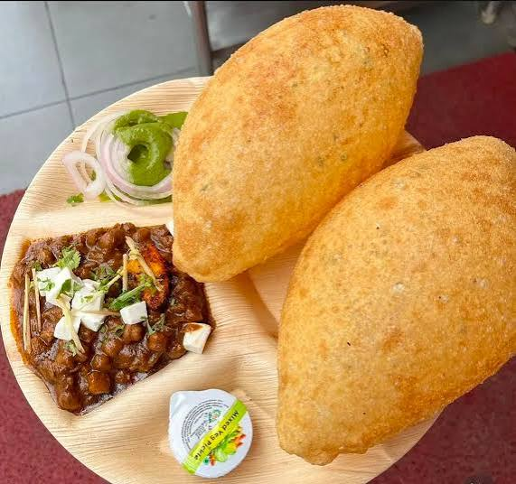

📸 DEMO SCREENSHOTS & GALLERY
Live Platform Workflows & Exact Dish Assets
Slide 6 of 8
1. Dal Makhani Rescue
Exact uploaded Dal Makhani photo with cream swirl & butter.
2. Chole Bhature Rescue
Fluffy bhaturas & paneer chole matched automatically.
3. Gulab Jamun & Sweets
Authentic sweet syrup Gulab Jamun with instant donor handoff.

Slide 7
📊 TECHNICAL IMPLEMENTATION & IMPACT
Simulated Clock & Environmental Analytics
Slide 7 of 8
⏱️ Demo Clock Acceleration Simulator
Built-in simulated time controller allowing hackathon judges to fast-forward hours in real-time and watch listings transition dynamically across Stage 1 → Stage 2 → Stage 3.
🌱 Environmental CO₂e Impact Formula
CO₂e Saved (kg) = Rescued Food Weight (kg) × 2.5
Converts every saved meal into live carbon footprint reduction displayed on the Impact Dashboard.

Slide 8
🔮 FUTURE SCOPE & ROADMAP
Scaling PlateRelay Pan-India
Slide 8 of 8
🤖 AI Demand Forecasting
Predicting mess & restaurant surplus quantities before cooking starts using historical consumption patterns.
🧊 IoT Smart Lockers
Temperature-controlled smart lockers at pickup spots for 24/7 volunteer pickup without donor waiting.
🏢 Municipal & FSSAI Scaling
Partnering with FSSAI (Save Food Share Food) and 50+ municipal corporations for nationwide deployment.

