Slide 1

SWAN
Secure work area network

Slide 2

Content
Problem Statement
Solution
Important use cases
Scope

Slide 3

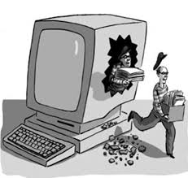

Problem Statement
Today’s world is in need of network which allows secure access of client network from anywhere
IT engineers are in search of jobs which provide them feasibility of working from home
Accessing client data from home increases the risk of cyber attacks.
Not feasible to provide company’s assets configured in secured network to everyone.
Not defined work responsibilities for each individual may lead to internal threats and leak of valuable data in unsecured network.

Slide 4

Solution
Authorizing ip of user.
Adding ip into secure area network for defined time interval.
Logging all activities of user and monitoring it in the given time duration.
Giving user a feasibility to resolve issues and critical requirement from home.
Pre defining user responsibility so that security breaches are minimum.

Slide 5
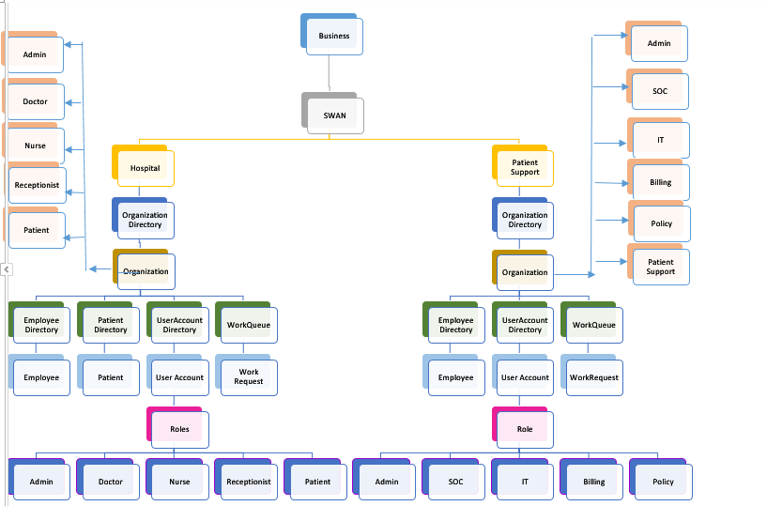
Object Model

Slide 6
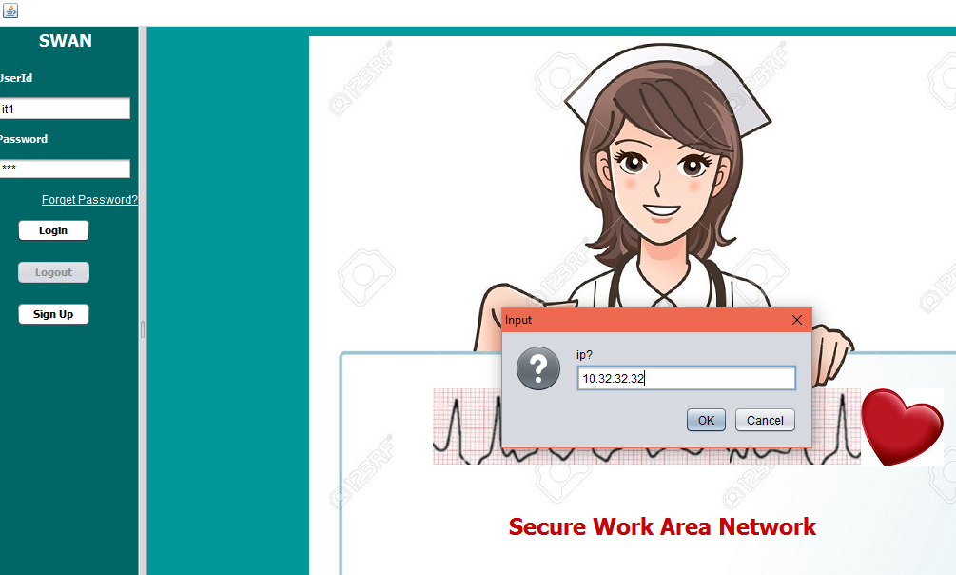
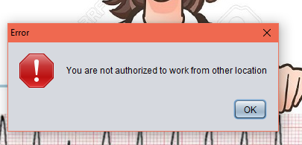
Important use cases
IP authentication when user logs in application

Slide 7
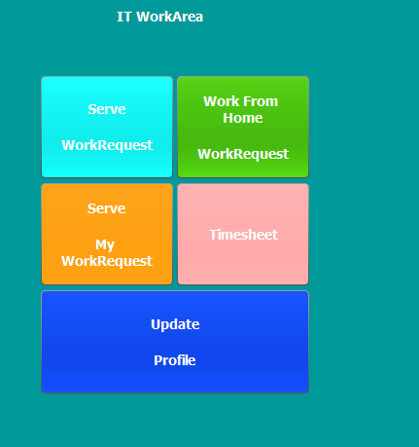
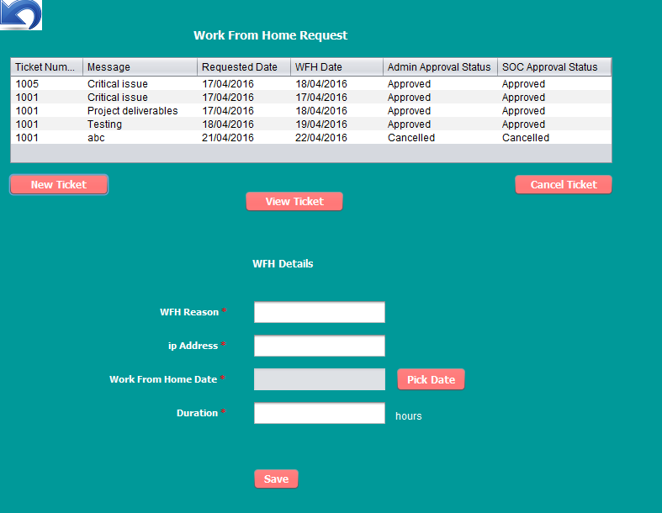
Important use cases(cont)
Raise Work from home request

Slide 8
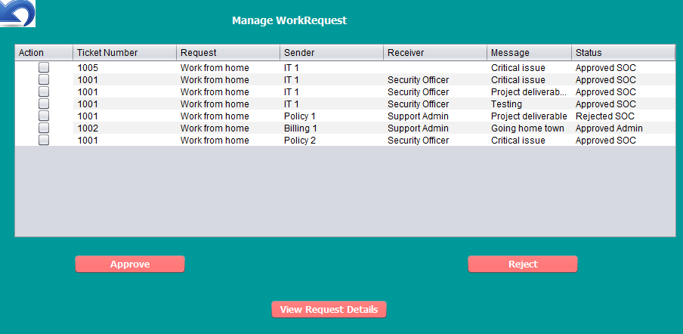
Important use cases(cont)
Organization admin approves the request followed by SOC approval

Slide 9
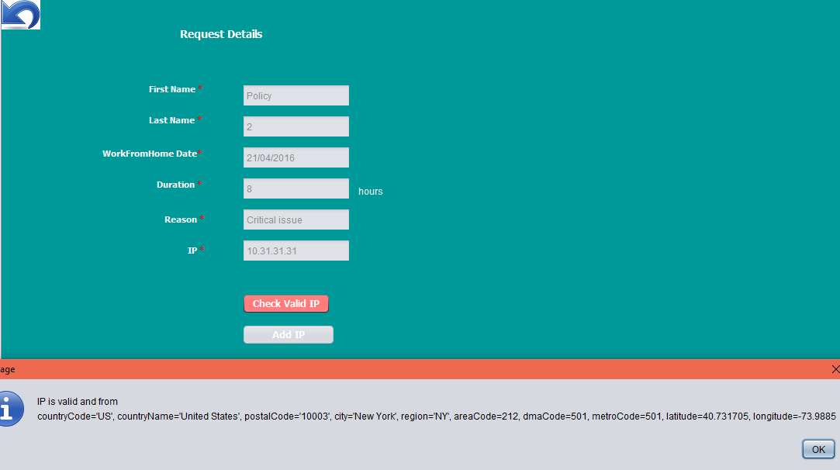
Important use cases(cont)
SOC Adds IP to network after validating
I

Slide 10
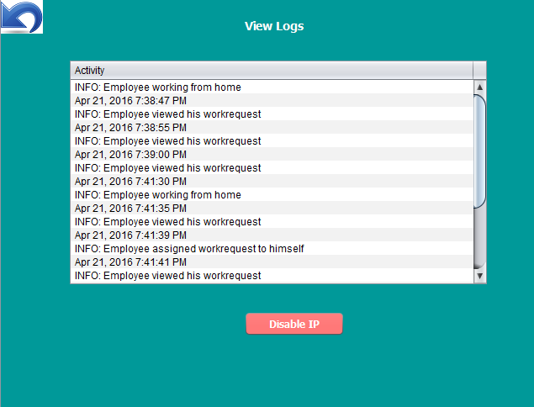
Important use cases(cont)
SOC can view different activities performed by user while working from home and accordingly disable IP

Slide 11
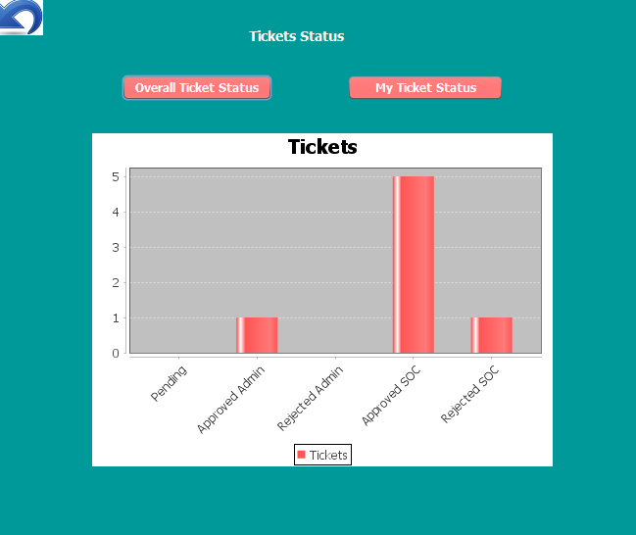
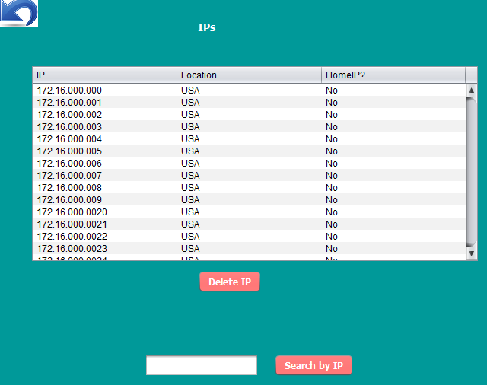
Important use cases(cont)
SOC can view various approval status and Ips added to network

Slide 12
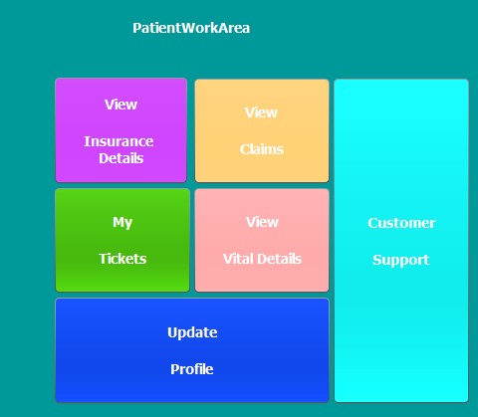
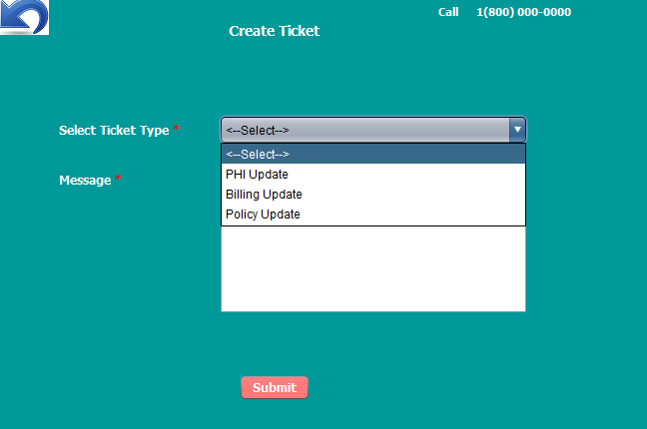
Important use cases(cont)
Patient can raise Tickets for updating PHI , insurance and bill related information. Request is handled by Support team

Slide 13


Scope
Work from home flexibility is increasing now a days to meet with the critical project deliverables and fix important issues.
SWAN can be applied to any domain which would authenticate external ip and provide them a secure work area network.

Slide 14
Thank you
Vijayashree Uppili

