Slide 1

How to create twitter apps for web applications
powered by:

Slide 2
Login to the twitter apps site.
https://apps.twitter.com/

Slide 3
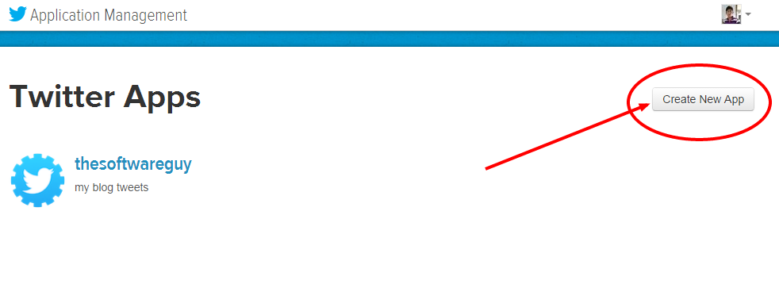
Create a new app

Slide 4
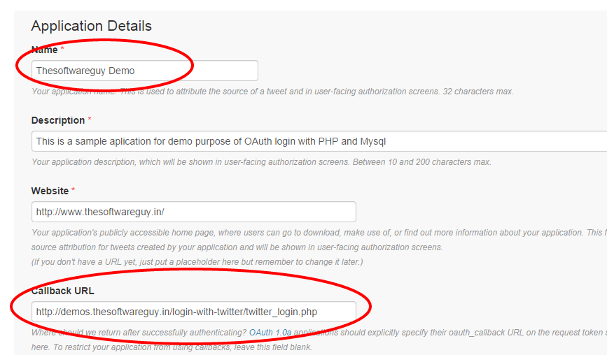
Give application name, site URL and your call back URL and save it.

Slide 5
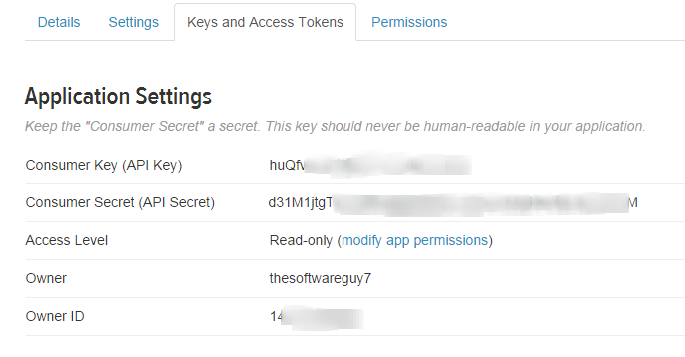
Get your consumer key and secret key in “Key and Access Tab”

Slide 6
Connect with us
website: www.thesoftwareguy.in
facebook: www.facebook.com/Thesoftwareguy7
twitter: www.twitter.com/thesoftwareguy7
google plus: www.plus.google.com/+ThesoftwareguyIn

