Slide 1
Hello, World!
PPT自动化 from python-pptx!

Slide 2
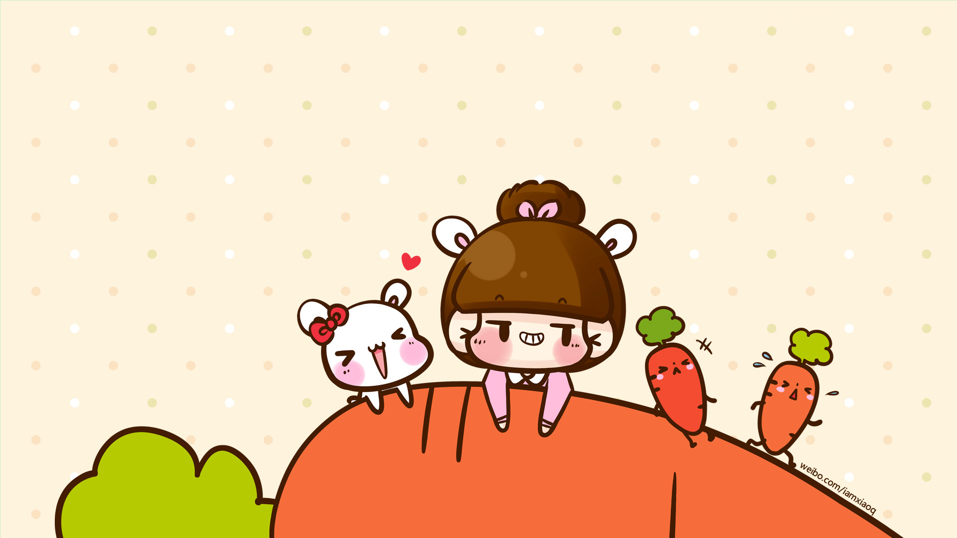
this is a new textbox
this is second paragraph in textbox

