Slide 1
Benefits of the Interactive Marketing How smarter Marketing will boost your sales
Ruben Bru, Director CEE/MEA, EMM
Notes:
1

Slide 2









What We Do
IBM’s Enterprise Marketing Management solutions offers proven web and customer analytics, event detection, cross-channel campaign management, interaction management, online optimization, email marketing , and marketing resource management.
Customer and Partner Success
Product Leadership
Over 2,500 organizations worldwide
Tens of thousands of total users
Extensive service offerings
Local Czech partners
Meeting the needs of:
Cross-channel marketers
Online marketers
Marketing services
The recognized leader in marketing software solutions
Our Mission
To power the success of every marketing organization with innovative technology solutions
Notes:
IBM’s Enterprise Marketing Management software empowers organizations and individuals to turn their passion for marketing into valuable customer relationships and more profitable business outcomes. These solutions integrate and streamline all aspects of online and offline marketing. Including customer and web, analytics, centralized decisioning, cross-channel execution, online optimization, and marketing operations
IBM, Unica, and Coremetrics have a passion for customer success, as demonstrated by hundreds of satisfied customers a cross many industries and around the world
IBM EMM’s partners are dedicated to marketing, and to helping their customers ge t the most of IBM’s products
Our mission remains the same…

Slide 3
Table of Contents
Trends in Marketing, CMO study results
Interactive Marketing by IBM
Benefits illustrated by Customer Stories

Slide 4






















Business’s challenges…and opportunities
Years to reach 50M users:
Tablet
2 Yrs
Channels explode…
The Internet evolves…
Facebook
3 Yrs
The consumer is in control…
Internet
4 Yrs
Network of pages
Network of people
The rate of change accelerates…
TV
13 Yrs
Marketing’s role must evolve…
Notes:
10/25/11
Unica Confidential
4
Marketing is undergoing a fundamental change as power shifts to the consumer, channels proliferate, competition intensifies, and marketing complexity grows.
The internet continues to transform how consumers buy and influence and how companies communicate with and service their customers.
A new marketing role is emerging. It is aware of the customers’ needs and facilitates customer experience with relevant and consistent messages across channels. New marketing is more collaborative and feels like a service.
Accelerating Growth
http://www.businessinsider.com/50-million-us-tablet-users-by-2012-2011-1

Slide 5

2011 – IBM CMO Study
1700+ CMO
64 countries
19 sectors

Slide 6
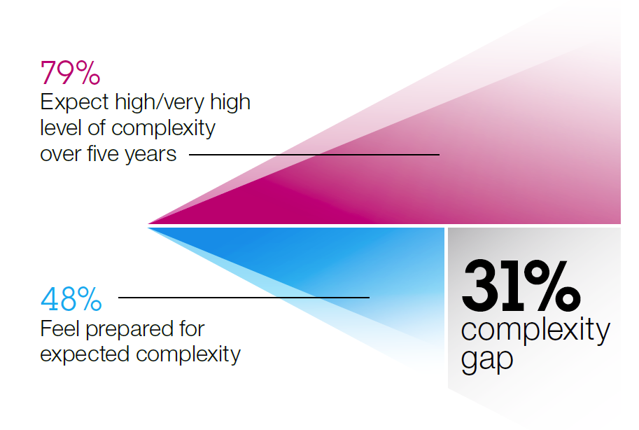
CMOs admit they are not prepared
“From Stretched to Strengthened; Insights from the Global Chief Marketing Study”
www.ibm.com/cmostudy
Notes:
The results of IBM’s groundbreaking Chief Marketing Officer (CMO) study, which was released in 2011, reinforces the observation that marketing is a challenging practice these days. IBM interviewed over 1,700 CMOs from around the world to create this study. The data I will share highlight some of the most important challenges facing CMOs and their marketing organizations today.
In the study, CMOs talked about being challenged by the growing complexity of marketing. As you can see from this graphic, 79% of CMOs expect a high or very high level of complexity in their work as marketers in the next five years. But only 48% of CMOs feel prepared for the complexity they expect. This creates what IBM calls a 31% “complexity gap,” meaning CMOs need help dealing with this complexity.
But what does “complexity” mean, exactly? I will now share some more data with you to help answer that question.

Slide 7
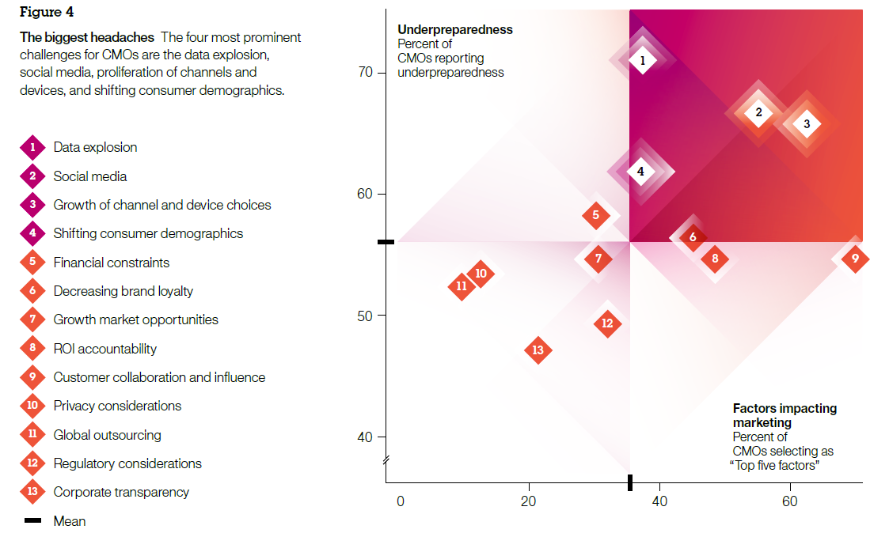
Specific challenges reflect growing complexity
“From Stretched to Strengthened; Insights from the Global Chief Marketing Study”
www.ibm.com/cmostudy
Notes:
IBM asked CMOs to rate specific marketing-related challenges, both in terms of how significantly these challenges can impact marketing success – this is the x-axis of this chart – and in terms of how underprepared they are to deal with these challenges – this is the y-axis of the chart. Challenges that appear in the upper right quadrant of the chart represent those that are both high-impact and which CMOs are the most unprepared for. In other words, these are the most dangerous challenges facing marketing organizations today.
Let me expand part of this diagram, so we can see these top challenges more clearly.

Slide 8
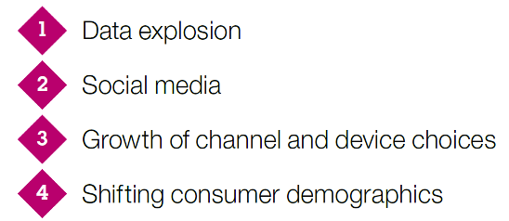
Specific challenges reflect growing complexity
“From Stretched to Strengthened; Insights from the Global Chief Marketing Study”
www.ibm.com/cmostudy
Notes:
You can see that the top four challenges are data explosion, social media, growth of channel and device choices, and shifting consumer demographics. It’s easy to see why CMOs are facing a “complexity gap,” because all of these challenges make marketing much more complicated today that it has ever been before. And it’s only going to get more complicated in the future.

Slide 9
Table of Contents
Trends in Marketing, CMO study results
Interactive Marketing by IBM
Benefits illustrated by Customer Stories

Slide 10
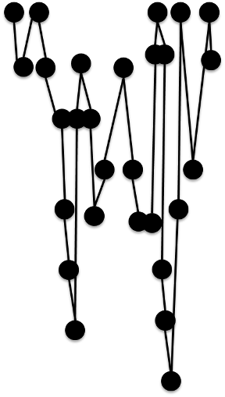








How your customers and prospects behave
some more like this!
Online
Email
Mobile
Call center
Stores
CUSTOMERS & PROSPECTS
Kiosk, ATM, etc.
Point of sale
Postal mail

Slide 11
What your customers and prospects expect
Online
One person behind all the channels, “pulling the strings” and guiding the dialogue & relationship
Email
Mobile
Call center
Stores
CUSTOMERS & PROSPECTS
MARKETER
Kiosk, ATM, etc.
Point of sale
Postal mail

Slide 12
What your customers and prospects actually experience
agenda
data
Online
strategy
tech
SILOS
agenda
data
Email
strategy
tech
SILOS
agenda
data
Mobile
strategy
tech
SILOS
agenda
data
Call center
strategy
tech
SILOS
agenda
data
Stores
strategy
tech
SILOS
CUSTOMERS & PROSPECTS
agenda
data
Kiosk, ATM, etc.
strategy
tech
SILOS
agenda
data
Point of sale
strategy
tech
SILOS
agenda
data
Postal mail
strategy
tech
SILOS

Slide 13

IBM calls what your customers and prospects expect:
Engaging each customer and prospect in a cross-channel dialog that builds upon their past and current behavior

Slide 14
Customer Dialog Framework
Changing Needs
Retention
Retained Loyal
Interactions
Customer Recovery
Acquisition
Up-sell
Cross-sell
Prospect
Win-Back
On-Boarding
Re-boarding
Segmentation
Activation
Brand Activities
Search Campaigns
Customer Experience
Listening, understanding, and speaking over time

Slide 15





How can technology help?
Cross-channel, interactive marketing is like a good conversation.
Marketers need to:
LISTEN AND UNDERSTAND
DECIDE WHAT TO SAY NEXT
…and repeat this over and over again across thousands or millions of customer relationships.
This is hard to do without help from technology!
(only then) SPEAK

Slide 16
Technology framework for cross-channel, interactive marketing
LISTEN
LISTEN AND UNDERSTAND
DECIDE WHAT TO SAY NEXT
DECIDE
SPEAK
(only then) SPEAK
MANAGE

Slide 17
Technology framework for cross-channel, interactive marketing
LISTEN
DECIDE
SPEAK
Awareness
Decisioning
Execution
Identify opportunities and predict marketing outcomes
Decide on the best message or offer to extend, in any channel
Deliver messages and retain a memory of interactions
Operations
Facilitate cross-channel planning, design, execution, and measurement
MANAGE

Slide 18
Specific software capabilities within the framework
Awareness
Decisioning
Execution
Segmentation
Offer Management
Interaction History
Real-time, Behavioral Targeting
Contact Optimization
Email
Inbound Integration
Lead Routing & Monitoring
Distributed Marketing
Search/ Display Ad Management
Web & Digital Analytics
Event Detection
Predictive Analytics
Visual Exploration
Operations
Plans & Budgets
People & Processes
Data & Assets
Measurement & Performance

Slide 19
Technology framework for cross-channel, interactive marketing
LISTEN
LISTEN AND UNDERSTAND
DECIDE WHAT TO SAY NEXT
DECIDE
SPEAK
(only then) SPEAK
MANAGE

Slide 20
Technology framework for cross-channel, interactive marketing
LISTEN
DECIDE
SPEAK
Awareness
Decisioning
Execution
Identify opportunities and predict marketing outcomes
Decide on the best message or offer to extend, in any channel
Deliver messages and retain a memory of interactions
Operations
Facilitate cross-channel planning, design, execution, and measurement
MANAGE

Slide 21
All Processes of Marketing Organizations: Inbound & Outbound & Online & Offline
Awareness
Decisioning
Execution
Segmentation
Offer Management
Interaction History
Real-time, Behavioral Targeting
Contact Optimization
Email
Inbound Integration
Lead Routing & Monitoring
Distributed Marketing
Search/ Display Ad Management
Web & Digital Analytics
Event Detection
Predictive Analytics
Visual Exploration
Operations
Plans & Budgets
People & Processes
Data & Assets
Measurement & Performance

Slide 22
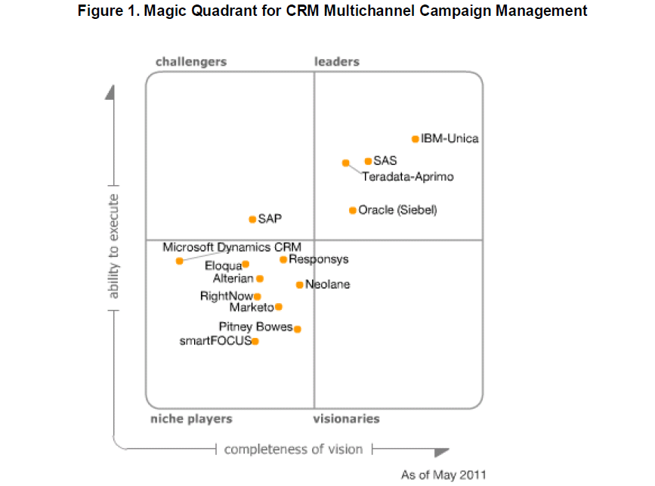
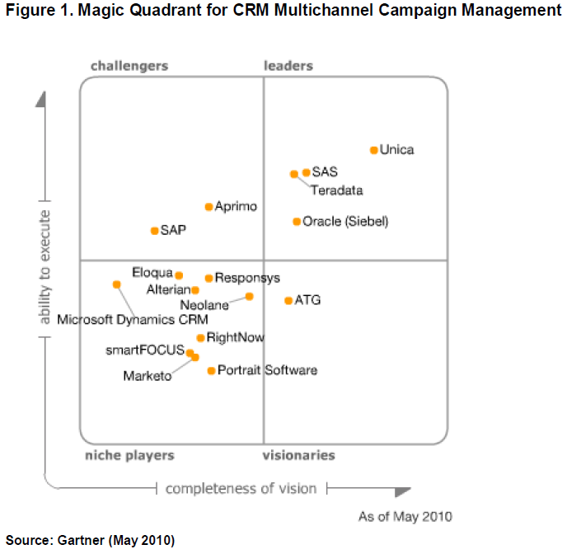
10 Year Market Leader

Slide 23
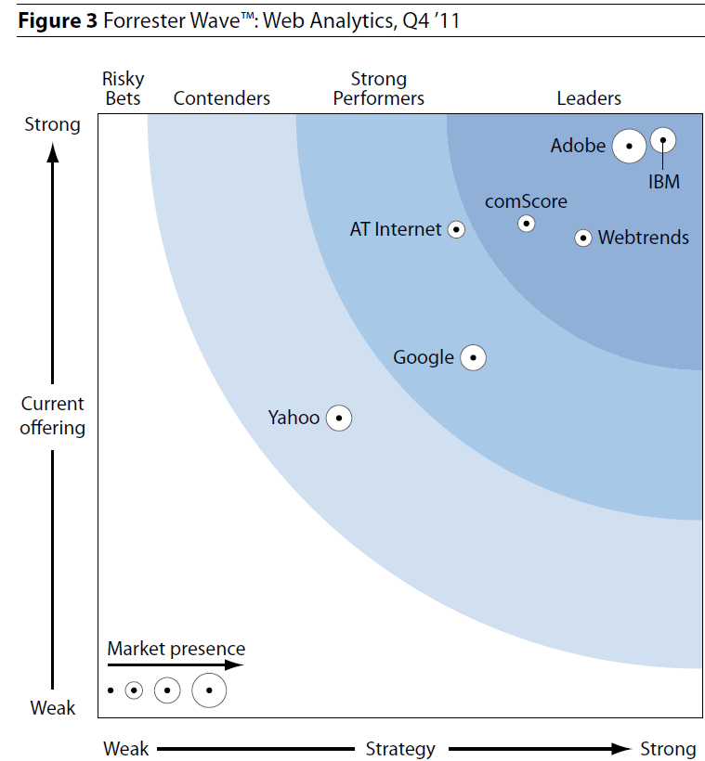
New market leader in Web Analytics

Slide 24
Table of Contents
Trends in Marketing, CMO study results
Interactive Marketing by IBM
Benefits illustrated by Customer Stories

Slide 25














































More than 2500 Organizations Worldwide Depend on IBM’s EMM Solutions
Financial
Telecom
Retail / Catalog
Travel /
Hospitality
Healthcare &
Insurance
B2B / High Tech
Notes:
25
Staples, JC Penney, Cathay Pacific, Virgin Atlantic, Humana, Grainger, all Coremetrics
Rest are Unica

Slide 26
Typical business results reported by EMM users
More effective marketing:
More efficient marketing:
Improved customer value, loyalty & retention
5-15% increase is typical
More campaigns with the same resources
2-5x increase is typical
Higher online marketing ROI
15x-25x increase is typical
Reduced cycle time for marketing efforts
40%-80% reduction is typical
Higher campaign ROI
15-30% increase is typical
Reduced marketing costs
20-40% reduction is typical
Increased response rates
10-50% increase is typical
Lower customer acquisition costs
25%-75% reduction is typical
Increased order value
15-20% increase is typical
Other business metrics
revenue, profit, others vary by industry (assets under management, ARPU, #products owned, etc.)
Notes:
Using EMM has a tremendous positive impact on marketing results. What you see on this slide are the types of results that get reported back to us by marketing organizations that have adopted EMM. In general, EMM improves both the effectiveness and the efficiency of marketing.

Slide 27






























Leading Financial Institutions Rely on IBM EMM Portfolio of Banking Customers

Slide 28































Unica is the Proven Solution for Telecommunications Companies
Spain
Belgium
UK
Germany
Germany
Netherlands
UK
Switzerland
Poland
Ireland
Ireland
Slovakia
UK
France
New Zealand

Slide 29
























































Strong Portfolio of Retail Customers More than 150 and Growing
Notes:
Unica has over 150 retail customers
Department - Macy’s, Neiman Marcus, Nordstrom, Stage, TJX
Discount - BJ’s, Kohl’s, Target
Apparel - Lands' End, L.L. Bean, J. Jill, Victoria Secrets
Specialty Retailers
Electronics - Best Buy, Circuit City, Radio Shack
Home Furnishings and Goods - Linens 'n Things, IKEA, Crate & Barrel
Home Improvement – Lowe’s
Office Supplies – Staples, Corporate Express
Books & CDs - Borders
Sporting Goods and Outdoor - Dick's Sporting Goods, Orvis, REI
Pet – PetSmart
Toys – Toys R Us
B2B - Weargaurd
Manufacturers Selling Direct - Jockey
Grocery & Pharmacy - CVS, Fresh Direct , Carrefour (in Belgium ), Catalina (real-time couponing at the cash register)

Slide 30

So don’t miss the train, call us!

Slide 31
声明：
所有的版权属于原有公司，文件均来自公开渠道
此文件仅供学习使用，任何人不得进行以此为商业目的的行为
如有疑问，请立即删除
学习世界五百强和咨询公司PPT课程请访问如下网站搜索：“司马懿”
百度传课：司马懿PPT学校
网易学堂：司马懿PPT学校
知乎： 司马懿PPT学校
访问地址
https://www.chuanke.com
访问地址
https://study.163.com
访问地址
https://www.zhiu.com

