Slide 1

Adobe Community Help
March 10, 2009

Slide 2
First of all …
THANK YOU!!!

Slide 3
Resources
Resources
http://learn.adobe.com/wiki/display/community/Home
Moderator guidelines
http://learn.adobe.com/wiki/display/community/Moderator+Guidelines
Moderating comments
http://learn.adobe.com/wiki/display/community/1.+Moderating+comments
Example of comments to approve http://learn.adobe.com/wiki/display/community/Examples+of+approved+comments
Example of comments to reject http://learn.adobe.com/wiki/display/community/Examples+of+rejected+comments
When in doubt, do nothing — ask your admin.

Slide 4
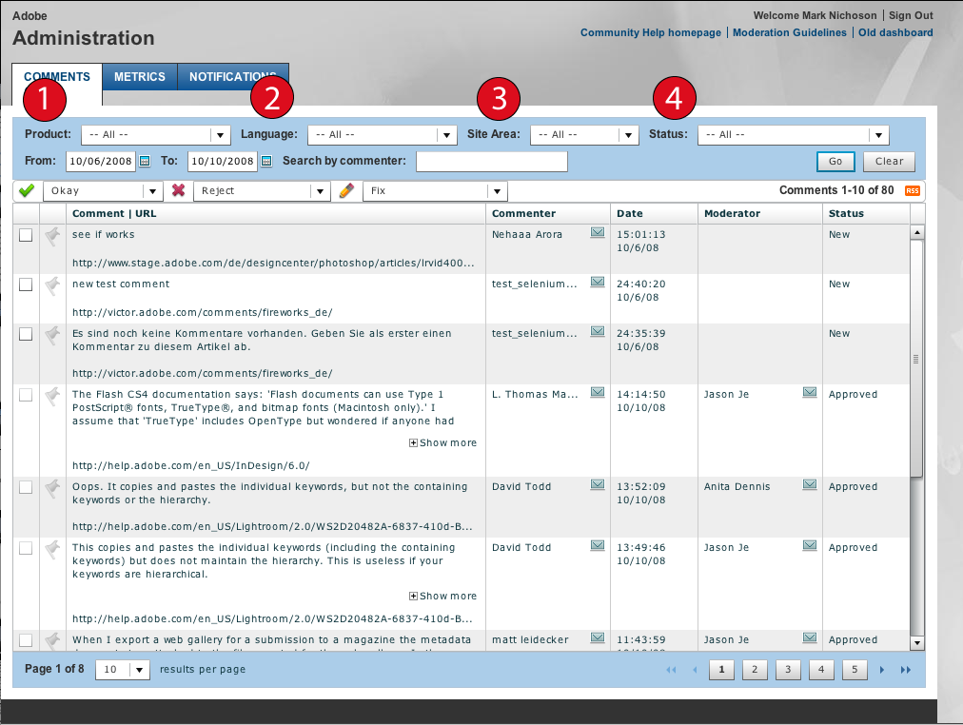
The Dashboard

Slide 5
Dashboard options
Step 1: Product
Choose which product community you want to see
Step 2: Language
Choose the language you wish to see
Step 3: Choose site area
help = documentation and Help pages
devnet = Developer Center
designcenter = Design Center
AHV = Adobe Help Viewer 2 (AIR application)
Step 4: Status
Choose: New
Once the options are set, the dashboard will remember your preferences for next time.

Slide 6
Community points
Status | Description | Notes
Approve | A statement that does not require further action or a community question. The comment is valid, but is not awarded any points because it is not a contribution to the content. Accept all valid questions and statements, unless they meet the criteria for rejecting. | “Great article.”
5 points | Typo or obvious correction. Something readily apparent to any user, regardless of skill. | "The UI is wrong!"
10 points | Minor correction or addition; requires basic understanding of the product/technique described on the page. | Links/URLs, correction to step in tutorial or process ("actually no you can't sharpen first...")
20 points | More complex addition or tip; requires moderate/advanced understanding of the product/technique. | Alternative method, short tip/workaround, mini code example
50 points | Advanced-level addition or tip. | Detailed code example, mini tutorial, or multiparagraph article/sidebar (e.g. "a whole explanation of digital compression that we didn't have before")

Slide 7
Adobe Help Viewer
Allows commenting on any website, including 3rd party sites
To filter in the dashboard, select ‘AHV’ in the Site drop-down.
Comments should be treated the same as any other comment
Accept if the comment is helpful to other users
Reject for all the usual reasons

Slide 8
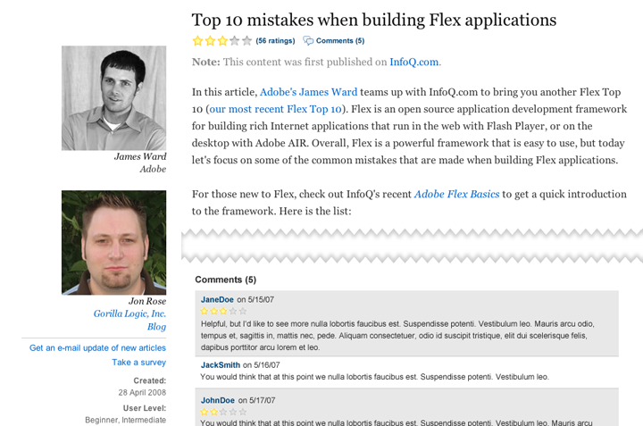
Ratings

Slide 9
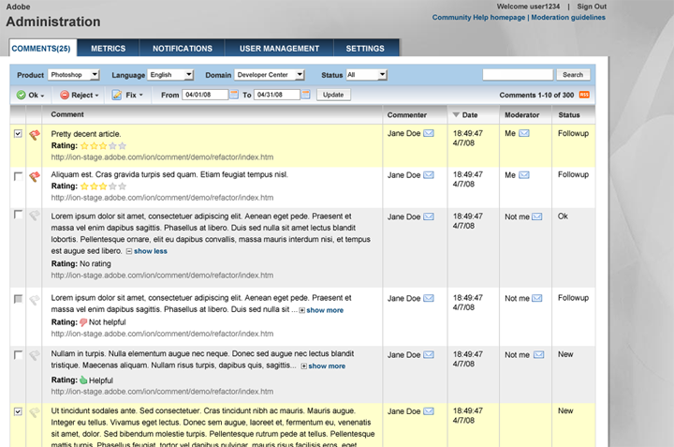
Ratings - dashboard

Slide 10
Adobe Moderator Forum Group
Private forum for Moderators coming in April
Subscribe and post via e-mail (just like Yahoo or Google Groups)
Share questions, best practices, and commune with other moderators

Slide 11
Q/A
Consolidated questions to date
http://learn.adobe.com/wiki/display/community/TCS+moderator+questions

Slide 12


Slide 13
声明：
所有的版权属于原有公司，文件均来自公开渠道
此文件仅供学习使用，任何人不得进行以此为商业目的的行为
如有疑问，请立即删除
学习世界五百强和咨询公司PPT课程请访问如下网站搜索：“司马懿”
百度传课：司马懿PPT学校
网易学堂：司马懿PPT学校
知乎： 司马懿PPT学校
访问地址
https://www.chuanke.com
访问地址
https://study.163.com
访问地址
https://www.zhiu.com

