Slide 1
MSA Storage Channel Training
HP Storage – MSA Sales Plays

Slide 2
Consolidation/Virtualization Background
Opportunity Partner Perspective
MSA P2000 G3 Product Refresher
Sales Plays
Aligning Needs to Offers

Slide 3
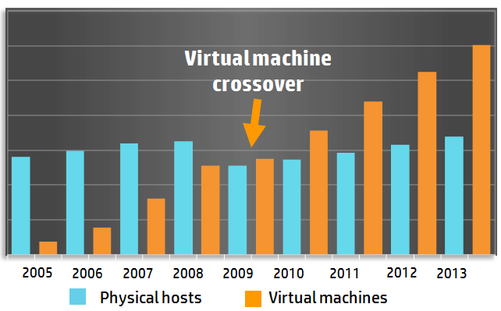
Virtualization growth continues to shape IT - Opportunity
Companies are adopting or expanding virtualization- regardless of size
17.5
15.0
12.5
10.0
7.5
5.0
2.5
0
80% of applications will be virtualized by 2015¹
SMB adoption rate is the fastest growing virtualization adoption segment - 21% to 50% higher than enterprise³
Customers adopting/expanding virtualization – Once journey starts…it builds
SMB challenges are the same as enterprise just different in size
Millions
1. IDC, WW Server Virtualization Shipment Forecast, 2005–2013.
2. Gartner, 2012
3 Acronis Global Disaster Recovery Index 2012 survey of SMB IT managers in 18 countries
4. Enterprise Strategy Group - Virtual Computing Infrastructure 2012
Notes:
Virtualization of IT resources delivers a wide range of benefits. It can help an IT organization increase agility, operate more efficiently, cut costs, simplify application deployment and management, improve availability, and establish a foundation for a cloud environment. Benefits like these have turned virtualization into a now-dominant computing paradigm.
It’s clear to see from the statistics just how important virtualization has become and some of the directions it’s taking:
According to IDC, 80% of applications will be virtualized by 2015¹
According to Gartner, VM density per core will rise to 8.4 in 2013²
According to IDC, 73% of customers are currently using or planning to use private cloud³
And according to Enterprise Strategy Group, 36% of customers currently prefer a fully integrated virtualized solution⁴
1. IDC, WW Server Virtualization Shipment Forecast, 2005–2013.
2. Gartner, 2012
3 “Cloud Computing Attitudes” IDC, April 2010
4. Enterprise Strategy Group - Virtual Computing Infrastructure 2012

Slide 4
Why Virtualize? Customer reported benefits of server virtualization
63% have reduced IT capital costs
58% have improved disaster recovery capabilities
57% have reduced IT operational costs
57% have improved server utilization and resource optimization
56% have reduced the time to provision new servers
53% have improved application availability
These benefits apply to customers of all sizes (Enterprise to SMB)
Source: Enterprise Strategy Group "The Evolution of Server Virtualization" November 2010

Slide 5
Virtualization and storage opportunity
Why resellers should care
Virtualization drives lots of hardware and services
For every $1 of VMware licenses sold there are $15 of hardware and services sold ¹
As a company's virtualization adoption evolves, it creates new sales opportunities
Today's project may be POC or test/dev applications - tomorrow customer may do tier 1 applications - next they may tackle disaster recovery, next year maybe VDI
Where there is x86 virtualization, there is storage
41% of all external storage in 2010 was deployed in virtualized x86 environments growing to 50% by 2014²
Virtualization drives more SAN purchases – Start at entry Virt/SAN and grow
Customers deploying virtualization increased their use of SAN storage by 35%³
¹VMware 2011 channel partner survey
²IDC
³ESG Research: 2010 Server Virtualization Survey August 2010

Slide 6
Why HP Solutions for virtualization
A Full Spectrum of products, virtualization integration, and solutions
Experience and brand recognition - more virtualization software runs on HP servers than any other brand
Products you need to win
Complete integration to reduce risk and increase automation/efficiency
Complete solutions to increase deal size and margins
Entry - HP MSA P2000
Mid-range - HP StoreVirtual 4000
Backup/Recovery - HP StoreOnce
HP StoreVirtual P4000, P4800
Cloud, Enterprise Consolidation - HP 3PAR
VMware vSphere, VMware View, VMware vCloud
Microsoft Hyper-V, Microsoft Windows Server 2008 R2 and 2012
Citrix XenServer, XenDesktop
HP servers, networking, management software
HP VirtualSystem
Reference Architectures
Smart Bundles
Partner and/or HP delivered services
Get the most out of virtualization with HP Storage – From Entry to Enterprise

Slide 7
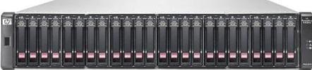
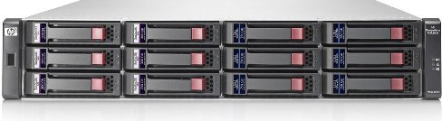
HP’s MSA Storage P2000 G3 Product Family
Quick Family Overview

Slide 8
P2000 G3 - State of the Union
Industry Leading Entry-Level Smart Array Architecture
5 Controllers provide support for latest storage interfaces 6Gb SAS, 1GbE and 10GbE iSCSI, 8Gb FC, Combo (8Gb/1GbE)
Wide range HDD support – LFF/SFF, 7.2k to 15k today
Dual Controller design, “Data in Place" Upgrades
Enhanced integration to support simplicity/management
Tight integration with server platforms (HP and others)
Virtualization Platforms – VMware, Hyper-V
Management Platforms – Web-based SMU interface, SMI-S 1.5

Slide 9




P2000 G3 - Building on a Winning Platform
State of the Art Flexible Architecture P2000 G3 MSA has shaped the Low-End SAN Segment since its introduction
Mid-Range Features – Entry-Level Budget P2000 continues to deliver new functionality Robust list of std features
HA/DR Bundled-in Controller-based snapshots Local Snapshots (64 std, 512 opt) Volume Copy (std) Remote Replication (opt)
Hypervisor Integration & Management Tools Widespread interoperability Fleet management toolset Heavy investments in hypervisor integration
9
Notes:
P2000 G3 Modular Smart Array represents the culmination of years of leadership from HP in the entry-level primary storage market segment.

Slide 10



Architected for the Future: P2000 Leadership
3 Generations of Market Leadership
Entry-Level Budget Mid-Range Features
Respond to Changes = Improved ROI
Integrate decades of leadership, lessons-learned, HP continues to lead the industry
Deliver an industry leading, scalable architecture with attractive entry point
Scale and evolve as your needs change. Unmatched upgrade path: G1 to G3 Data-in-Place upgrades

Slide 11


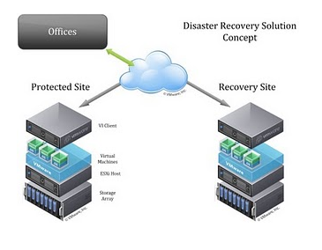


Converged Infrastructure: P2000 Leadership
Entry Shared Storage
HA Infrastructure and DR Features
Virtualization and Application Support
Consolidation
Storage can be used across many different applications and lines of business. Leverage SAS, FC and iSCSI infrastructures to meet your needs
Connectivity
Create HA Storage infrastructure to minimize single path failures
DR Feature Support
Controller-based snapshots and remote replication (local or remote)
Fully integrated with leading Hypervisors
VMware and Hyper-V
Application Workhorse
Microsoft Business apps –
Exchange, SQL, SharePoint
SAP, Oracle

Slide 12
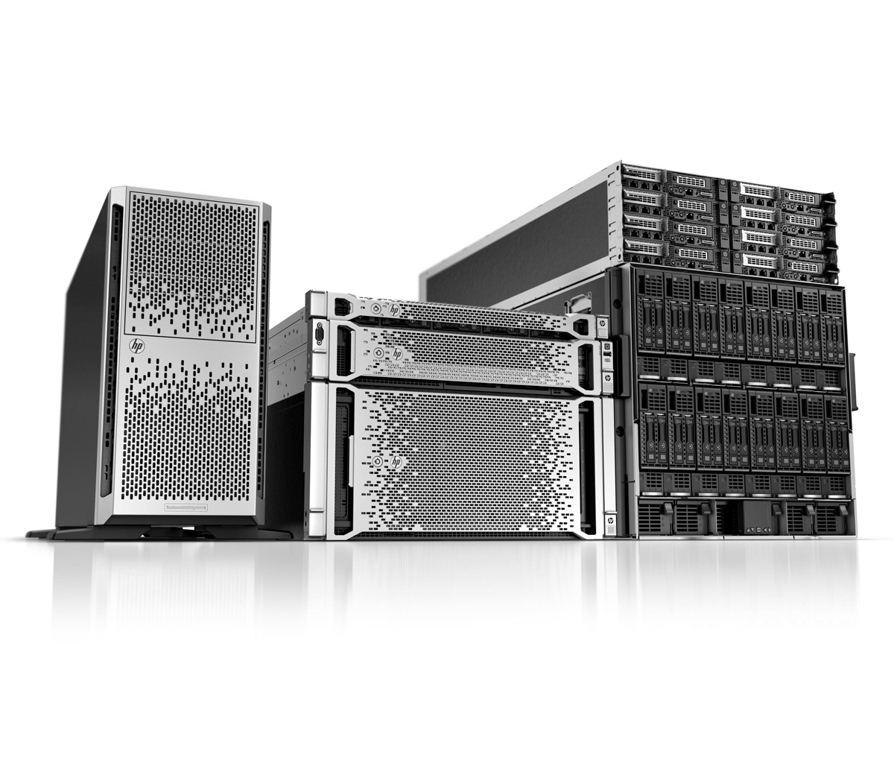
HP Servers & Storage: Better Together for 15 years…and counting
+
Gen8 Server innovations drive numerous refresh opportunities – for Servers AND Storage!
DAS to SAN transitions – to support virtualization
SAN refresh – to support newer server interconnects (8Gb FC, 10GbE iSCSI and 6Gb SAS)
Improved HDD densities, performance, reliability (LFF->SFF, higher capacities, SAS vs SATA or SCSI, 7200-15K rpm rotational speeds)

Slide 13



P2000 G3 Platform – 4 Clicks to a Config (1/4)
1
FIVE Controllers
FC/1Gb iSCSI Combo
10GbE iSCSI
8Gb FC
6Gb SAS
1GbE iSCSI
Choose a protocol to match your
environment
1
Printable Cheat Sheet included in Background Slides
Notes:
1/5/2018
HP template
13

Slide 14
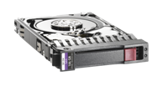
P2000 G3 Platform – 4 Clicks to a Config (2/4)
1
FIVE Controllers
FC/1Gb iSCSI Combo
10GbE iSCSI
8Gb FC
6Gb SAS
1GbE iSCSI
2
Match Disk Drives to Apps
Applications
LFF or SFF SAS drives
MDL SAS drives*
MDL SATA drives
Up to 96 3.5” LFF Drives
Up to 149 2.5” SFF Drives
2
Performance or capacity?
Mix and match MDL SAS and/or Enterprise SAS drives
LFF for capacity and/or SFF for performance
Printable Cheat Sheet included in Background Slides
Notes:
1/5/2018
HP template
14

Slide 15


P2000 G3 Platform – 4 Clicks to a Config (3/4)
1
FIVE Controllers
FC/1Gb iSCSI Combo
10GbE iSCSI
8Gb FC
6Gb SAS
1GbE iSCSI
2
SFF/LFF Disk Drives
Applications
LFF or SFF SAS drives
MDL SAS drives*
MDL SATA drives
Up to 96 3.5” LFF Drives
Up to 149 2.5” SFF Drives
3
Choose array enclosure
P2000 G3 SFF Array – up to 24 2.5” HDDs
OR
P2000 G3 LFF Array – up to 12 3.5” HDDs
3
Choose the P2000 Base Chassis
Match it to your primary drive requirement
24 bay Small Form Factor or 12 bay Large Form Factor
Note – Expansion Shelves can be mixed (SFF and/or LFF)
Notes:
1/5/2018
HP template
15

Slide 16
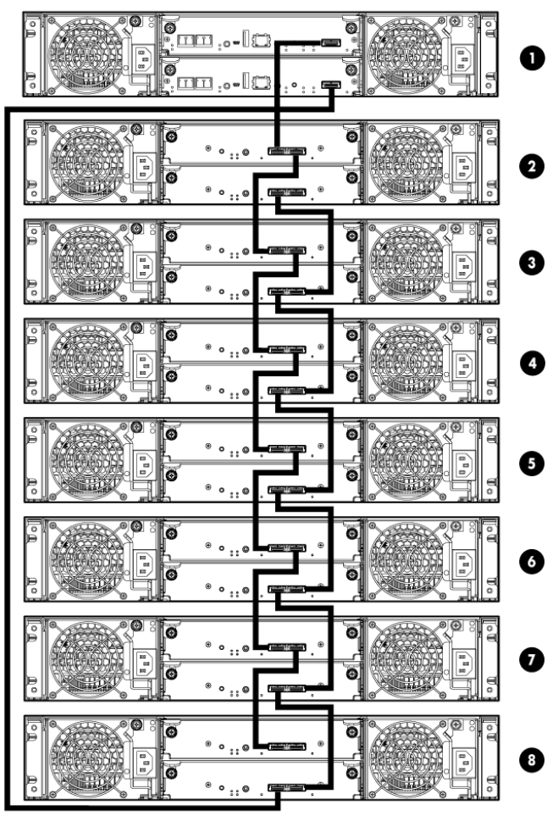

P2000 G3 Platform - 4 Clicks to a Config (4/4)
1
Controllers
FC/1Gb iSCSI Combo
10GbE iSCSI
8Gb FC
6Gb SAS
1GbE iSCSI
Expansion – Add up to max of seven additional LFF enclosures
and/or
max of five additional SFF enclosures
2
SFF/LFF Disk Drives
Applications
SAS drives
MDL SAS drives*
MDL SATA drives
Up to 96 3.5” Drives
Up to 149 2.5” Drives
3
P2000 Base Array Enclosures
P2000 G3 Array 2.5” 24 Drives
OR
P2000 G3 Array 3.5” 12 Drives
4
4
Add expansion shelves
D2700 2.5” SFF JBOD (max 5)
AND/OR
P2000 3.5” LFF JBOD (max 7)
Notes:
1/5/2018
HP template
16

Slide 17
Consolidation/Virtualization Sales Plays
Decision Tree
MSA Friendly?
Virtualization Stage ?’s
Sizing and Performance Stage?
Consolidation Evolution?
Offers/Plays
Installed Base
Not Virtualizing – Consolidation Only
Virtualization First-Timers (1st POC Stage)
Entry Virtualization

Slide 18
Opening Question – Are you an HP MSA Customer?
Sales opportunities based on Familiarity with HP MSA
Yes
No
What type of storage infrastructure do you have?
Which Generation MSA do you have? Or roughly when was the product purchased?
Which controller(s) or interface type?
Vendor? Interface? Capacity?
Goal - Looking for age of existing equipment and initiatives which could drive a refresh
Plan to reuse or upgrade?
Goal - Gauge Upgradeability of older MSA equip
Installed Base Plays/Offers
Net-New Plays/Offers

Slide 19
MSA Installed Base Scenarios - Upgrade
There are >330,000 MSA units in the field – Many of them just running away
Upgrading your existing MSA to get more features, more capacity and more reliability. Options?
MSA 500/1000/1500 units require a technology refresh and can not be upgraded to P2000 G3
The advancements in Fibre Channel and iSCSI will lead to a dramatic performance boost across the board for older MSA units
New P2000 G3 units allow many more interface options
8Gb FC, 1GbE and 10GbE iSCSI, 6Gb SAS and an FC/iSCSI Combo controller
Support for newer modern HDDs offer flexibility and options
LFF SAS-Midline for high capacity requirements
SFF Enterprise SAS drives to push performance
New features (local and remote sanps) and hypervisor integration are available on P2000 G3
P2000 G1, G2 units can be field upgraded to P2000 G3 to unlock the power of the latest generations
Newer interfaces (8 Gb FC and 10 GbE iSCSI) offer excellent performance at nice price points
Newer HDDs offer a big performance boost (3Gb->6Gb SAS, faster HDD RPMs and better reliability)
BladeSystem can be connected with 6Gb Switched SAS offers great performance and value
Newer servers support newer and faster HBA’s

Slide 20
Installed Base Upgrade Exploratory Questions
Prospect indicates that they are an MSA customer. We want to:
Explore age of MSA unit to gauge upgrade options
Once the MSA specifics are understood, continue on with exploratory questions. Consolidation and virtualization initiatives are relative in most all IT organizations
What to ask | Why to ask
Are you interested in upgrading any of your MSA hardware? | Many MSA customer are using older units for a specific task and do not want to upgrade it. They may be interested in a new P2000 G3 array to support consolidation and/or virtualization initiatives
Can you give me the Model Number from any of your MSA equipment (array or JBODs)? | Asked to understand options (see the MSA Upgrade Matrix
What host connect interface does your MSA subsystem have? | Asked to understand options (see the MSA Upgrade Matrix
Do you know what vintage, capacities and interfaces the HDDs which are being used carry? | Asked to understand options (see the MSA Upgrade Matrix
Is this MSA sub-system being used now? Comments on how? Applications sharing the device? Traditional or virtual? Growth trends? Issues? Other comments? | Many MSA customers use the MSA in “set and forget” mode. They get it setup and it runs for years without touching it. Many times, you will find that this conversation will move to a “deal” on a new MSA P2000 G3 unit.
Refer to P2000 Upgrade Matrix for upgrade options

Slide 21
MSA Array and JBOD To/From Upgrade Matrix

Slide 22
Describe your virtualization plans
Sales Scenarios based on virtualization maturity model
1
Virtualization 1st Timers
Entry Virtual Environments
1-3 years virtualization experience
First virtualization project, POC is often 1st step
<1 year in server virtualization
Often welcome expert help in planning & sizing
POC project is done. Needs are better understood
No Plan to Virtualize Now
Traditional Consolidation play
Future proof for Virtualization later
Ready to virtualize more servers/applications
2
3

Slide 23
Sales Scenario #1 - Consolidate
Not virtualizing today – Consolidate now but future-proof me for virtualization
Sales Play #1: Consolidation from physical server/DAS model to Shared Storage (SAN)
Shared storage transitions will require planning – both sizing and deployment plans
Align host interface choice and SAN infrastructure to performance and budget requirements
Configure P2000 to meet those needs, leverage interface and HDD flexibility
LFF SAS-Midline for high capacity requirements
SFF Enterprise SAS drives to push performance
Position SAN features such as snapshots to boost DR/BC efficiencies
Sales Play #2: Using an older SAN, refresh and expand its capabilities
Newer interfaces (8 Gb FC and 10 GbE iSCSI) offer excellent performance at nice price points
Newer HDDs offer a big performance boost (3Gb->6Gb SAS, faster HDD RPMs and better reliability)
BladeSystem connect with 6Gb Switched SAS offers great performance and value
Newer servers support newer and faster HBA’s

Slide 24
Consolidate/Future-Proof – Exploring Questions
Customer wants to consolidation from multiple physical servers/each with DAS storage to Shared Storage (SAN) model
Gather requirements, cust preferences, SAN experience – Gain Credibility, Be a trusted advisor
What to ask | Why to ask
How many servers with DAS are targeted for the consolidation transition? Do you plan to virtualize at some point? When? | This will help define the required host connections and performance requirements. The P2000 G3 can support 32 redundant connections. Typical consolidation efforts involve 4-10 servers. If yes on virtualize question, you are looking for a timeframe. I now, go to next play. If next year, we talk about future-proofing for virt.
Do you have a SAN interconnect preference? Fibre Channel, iSCSI or SAS Is there existing SAN infrastructure you want to reuse? | Looking for existing preference. FC is common for high speed, IOPS intensive applications, iSCSI comes in two versions (1GbE/10GbE) – 1GbE allows SAN capabilities across very inexpensive TCP/IP infrastructure, 10GbE offers excellent performance on more expensive 10GbE links, 6Gb SAS is an excellent choice if long distances are not required and/or if a small number of hosts are involved. BladeSystem offers a 6Gb Switched SAS option
Are the performance requirements for each application migrating to the SAN understood? Also, probe on relative access characteristics of each. | This will help define the HDD type and RAID config of each of the volumes we will be creating on the SAN. Applications with large capacities of infrequently changing data may be able to leverage new high Capacity SAS-Midline drives (lower close/GB). SFF Ent SAS is the trend for Performance requirements. New RAID types facilitate many option in volume creation to meet IOPS requirements
What is the current backup strategy? Will that change with the transition to SAN? | Backups are critical in a SAN environments. The transition typically offers an opportunity to leverage snapshots (disk-based copies) and potentially even new backup technologies Like HP’s StoreOnce which leverage deduplication.

Slide 25
Consolidate/Future-Proof – with MSA P2000
Key P2000 G3 Product Attributes for Consolidation
Feature/Attribute | Why it’s a good fit | Considerations
Granular Scalability | Expansion of the system can be done in very small increments to closely match needs Match HDD attributes to application needs SAS-midline for $/GB or Ent-SAS for performance | P2000 allows customers to mix-match SFF and LFF HDDs by offering both LFF/SFF base units and expansion shelves Add one or more HP’s supported HDDs
Host Interface/SAN Choices | Avoids religious discussions about FC/iSCSI Differentiated Combo controller offers FC for local SAN and iSCSI for remote DR capability SAS offers high performance, inexpensive interface for certain scenarios | Ask for preference and proceed If no preference, guide based on distance and performance requirements
One HP – Better Together | P2000 Management is similar to Smart Array | Cuts the learning curve time down
Investment Protection | Customers moving to consolidation need to leverage and grow the device to save money across more years | Upgradeability is key. P2000 data-in-place upgrades are unheard of in the entry level P2000 allows G1-G2->G3 AND allows users to switch interfaces (FC->iSCSI, etc)
Hypervisor Integration | When it is time to Virtualize, you are set | Features in P2000 G3 make this a great entry-level virtualization platform

Slide 26
Sales Scenario #2 – Begin to Virtualize
Modernize Storage for Virtualization Beginners (1st Timers)
Sales Play #1: DAS to SAN migration – for customers new to virtualization
Virtualization requires a SAN for Availability and to support advanced features, almost a must
For Clients not familiar with SANs, storage must be easy to configure & manage
1st Timers typically lack experience with virtualization, storage must integrate with hypervisors
Clients typically need help understanding their workloads and sizing requirements
Most customers will start with a Proof of Concept (POC) and a single or limited # of applications
Sales Play #2: Upgrade existing MSA to support virtualization initiatives
Existing MSA Customers will want to upgrade to G3 controllers before moving to POC
Clients typically need help understanding their workloads and sizing requirements
Most customers will start with a Proof of Concept (POC) and a single or limited applications
Clients may want to add storage capacity specifically for POC. Modern, high performance HDDs

Slide 27
Virtualization Beginners with DAS– Exploring Questions
Need to move to Shared Storage for first Virtualization Project
Sales Play #1- DAS to SAN Migration
Currently have DAS or limited file sharing
Need to transition to storage that meets server virtualization requirements
Need to address storage systems, networking, and server HBA’s
What to ask | Why to ask
Have you done any sizing or performance modeling on this first virtualization project? How many servers are targeted in POC? Which Application(s)? | Existing HW may need refreshed to support objectives of POC. Help develop a plan for a successful POC project. Check App compatibility
Have you selected a hypervisor? | Key in understanding requirements, compatibility and features which can be leveraged for POC and next phase
Have you considered a backup and DR/BC strategy for the POC? | Specific features like VMware SRM, Microsoft Live Migration may require advanced shared storage solutions
Assuming the POC is successful, do you have a plan for the second/third wave of apps/servers? | Exploring this area will at least plant the planning seed for the hardware and features which will be required after POC
Notes:
Note: We will plan to cover the why you need a SAN for virtualization in the solution guide. For this presentation, that is a much deeper discussion than there is allotted time.

Slide 28
Virtualization Beginners with SAN – Exploring Questions
Explore existing SAN and POC project with Virtualization First-Timers
What to ask | Why to ask
Do you currently have a SAN that you plan to use with virtualization? | Need to understand the existing SAN parameters. How old? What interfaces, expandability, hypervisor compatibility, etc? Many older SANs are not worth upgrading to move to virtualization, more cost effective to buy a new entry SAN. MSA P2000 versions can be upgraded Some virtualization features require integration with array controllers
What are your top concerns with storage for use with virtualization? | Cost often plays a factor in storage decisions, availability and performance are also major concerns, a balance must be achieved to meet all these
What features do you plan to use with virtualization? | Specific features like VMware SRM, VAAI and Microsoft Live Migration require advanced shared storage solutions
How will virtualization affect your backup and DR/BC strategy? | Many customers don’t think about optimizing and adapting backup & DR/BC strategies to support virtualization

Slide 29
Virtualization Beginners – HP P2000 G3
HP P2000 Considerations when moving from DAS to SAN for VM POC
Other Potential Solution Components:
New Gen 8 HP ProLiant or BladeSystems Servers
SAN Network Infrastructure – HP ProCurve SAN or iSCSI
P2000 | Why it’s a good fit | Considerations
Choose from 3 Host Interfaces for SAN | Very affordable entry-level SAN Multi-protocol support FC & iSCSI SAS offers excellent performance in local environments | 8Gb FC is very affordable and good for campus implementations iSCSI can offer nice distance and cost balance (VMs may need 10GbE for performance)
HDD Considerations | Match HDD type and RAID set selections to performance requirements | SFF SAS HDDs offer solid performance and RAID options – great for virtualization use cases LFF HDDs offer Ent 15k RPM and new high capacity 7200 RPM versions
G3 Hypervisor Integration | P2000 carries hypervisor support and feature integration for VMware or Hyper-V | VM Setup and Maintenance is simplified through hypervisor integration Management through HP’s Insight Control Manager plug-in for VMware is key – and free
G3 HA/DR/BC Features | Both hypervisor platforms have support for snapshot management of virtual machine images Backup DR/BC are sometimes tackled as a second phase of the POC | Investigate DR/BC features like SRM Develop an implementation plan which parallels the VM POC and next phases

Slide 30
Sales Scenario #3
Entry Virtualization Environments
Sales Play #1: Expand Virtualization initiative looking to lower costs and become more efficient
Virtualization POC finished. Address learnings. Continue to Phase 2
Looking to drive better resource utilization, higher VM efficiencies, and all apps virtualized
More VMs will consume more storage capacity and performance – Planning is key
Next Phase may require SAN capacity upgrades or optimization of SAN volumes
Planning is easier as the unknowns and surprise elements of POC are now better understood
Sales Play #2: Virtualization customers wanting to improve DR/BC
Virtualization opens the door for improving and optimizing DR/BC methods
Virtualization can drive the cost of DR/BC down and the efficiency up

Slide 31
Virtualization Beginners – Exploring Questions
Need to Upgrade SAN to Expand Virtualization
Legacy storage that is not optimized for virtualization
Need upgrade to meet demands for increased number of virtual machines
What to ask | Why to ask
How long have you been virtualized, what is your percentage and VM density? | This will determine their maturity level with virtualization and how far they have gotten with it
What types of applications have you virtualized? | Most beginners virtualize the easy stuff like non-critical apps, dev/test servers, file/print servers because they lack confidence in their current infrastructure’s performance and availability
What obstacles and challenges have you encountered with virtualization? | Knowing a customers challenges can help us better position HP storage to overcome those challenges and eliminate any obstacles
Based on your experiences to date what concerns do you have about the next steps? | Customers often get stuck with virtualization and need help to continue on, often times their current infrastructure is the cause of this

Slide 32
Entry-Level Virtualization – Exploring Questions
Customers have done a virtualization POC. It is time to Virtualize more servers/apps
Planning for the transition should include capacity and performance planning
It is a good time to optimize storage and increase efficiency, improves ROI and TCO
What to ask | Why to ask
Is your host compute platform up to date and ready to scale ? | Fast growing virtual environments can quickly consume compute and storage resources. Often, this is a good time to make sure Server platform is refreshed
What were your key learnings during the POC? | Help address the problems or concern areas from POC
How many more apps are you planning to virtualize? | Customers often try to go from POC (1 or 2 apps) to everything too fast. Help with the plan/process
Have you studied the capacity and performance requirements for each of the apps you plan to virtualize in this stage? | You are gauging the project size, scope and looking for opportunities to add value by helping develop the full plan
What is your current VM density and VM capacity footprint? Opportunity for consulting services for partners | VM density (# VMs/host) is the measuring stick to how efficiently they are using resources, VM capacity is the amount of disk that VMs consume on storage

Slide 33
Entry-Level Virtualization – Exploring Questions
Customers want/need to improve Business Continuance / Disaster Recovery
Each VM needs to have DR/BC plan built into its transition plan
Features in hypervisor, SAN and Backup SW make this seamless. DR/BC POC is good suggestion
Can introduce new BC/DR or simplify with less expensive solution
What to ask | Why to ask
Do you currently have a BC/DR plan in place? | Many customers do not have a BC/DR plan beyond backups due to high cost and complications, virtualization is an enabler that can change this
Have you changed your BC/DR methods since implementing virtualization? | Legacy backup methods do not work well in virtual environments and are very inefficient, disk to disk backup is very popular in virtual environments
How long can you afford to have your virtual environment unavailable? | This will drive the solution needed and determine if they need a replicated backups, stretched cluster (vMSC) or storage replication (SRM)
How much capacity and retention do your current backups have? | Backups are money pits, virtualization makes this worse due to VM sprawl, highly efficient de-dupe is required to drive down costs and backup windows

Slide 34
Entry Virtualization – HP P2000 G3
HP P2000 features can simplify the transition to a virtual world
Other Potential Solution Components:
New Gen 8 HP ProLiant or BladeSystems Servers
SAN Network Infrastructure – HP ProCurve SAN or iSCSI
P2000 | Why it’s a good fit | Considerations
G3 Hypervisor Integration | P2000 carries hypervisor support and feature integration for VMware or Hyper-V | VM Setup and Maintenance is simplified through hypervisor integration
G3 Virtualization Management Tools | More management can be done at the hypervisor level, saving time, simplifying resource allocation | Leverage available plug-ins and add-ons for VMware and/or Hyper-V. Insight Control
G3 Hypervisor Efficiency Features | Many new hypervisor features facilitate easier day to day tasks and boost VM performance | Features like VAAI, VASA can boost performance and simplify management tasks
G3 HA/DR/BC Features | Both hypervisor platforms have support for snapshot management of virtual machine images Backup DR/BC are sometimes tackled as a second phase of the POC | Investigate DR/BC features like SRM Develop an implementation plan which parallels the VM POC and next phases

Slide 35
Aligning Consolidation/Virtualization Sales Plays with HP Offers
Offers/Plays
Installed Base
Not Virtualizing – Consolidation Only
Virtualization First-Timers (1st POC Stage)
Entry Virtualization

Slide 36
General Offer Descriptions
Sales Scenarios based on virtualization maturity model
Demand Gen Offers
Virtualization 1st Timers
Several pre-configured 6Gb SAS P2000 G3 models for speed, cost effectiveness to support consolidation
Several pre-configured 6Gb SAS P2000 G3 models for speed, cost effectiveness to support consolidation
Consolidation
Several pre-configured 6Gb SAS P2000 G3 models for speed, cost effectiveness to support consolidation
Installed Base Plays
Pre-P2000 MSA Upgrade Options
P2000 Generational and Interface Upgrades
Entry Virtualization Environments
Build a cost effective 8Gb Fibre Channel SAN with P2000 FC models
Build a cost effective 8Gb Fibre Channel SAN with P2000 FC models
Build a cost effective 8Gb Fibre Channel SAN with P2000 FC models

Slide 37
Regional Offers - AMS
Slide “builds” – View in Slide Show Mode
Virtualization 1st Timers
BV919B HP P2000 G3 iSCSI 12x300 SAS SFF Bundle 3.6TB’s
Consolidation
BV917B HP P2000 G3 SAS 12x300GB SAS SFF Bundle 3.6TB’s
Installed Base Plays
Pre P2000 vintage MSA customers – Tech Refresh to P2000 G3 unit
Entry Virtualization Environments
BV918B HP P2000 G3 SAS 12x600GB SAS SFF Bundle 7.2TB’s
BV903B HP P2000 G3 FC 24x600GB SAS SFF Bundle 14.4 TB’s
BV914B HP P2000 G3 FC 12x600GB SAS SFF Bundle 7.2TB’s
BV903B HP P2000 G3 FC 24x600GB SAS SFF Bundle 14.4TB’s
P2000 G1/G2/G3 units – Upgrade controllers, capacity
QR517B HP P2000 G3 FC 24x900GB SAS SFF Bundle 1.6TB’s
BV903B HP P2000 G3 FC 24x600GB SAS SFF Bundle14.4TB’s
BV920B HP P2000 G3 iSCSI 12x600 SAS SFF Bundle 7.2TB’s
Get your virtualization journey started today!
Virtualization requires a modern SAN for availability. The P2000’s latest iSCSI and FC models are a great starting point…and they are a more affordable than ever!
• 1GbE iSCSI P2000 G3 models provide:
Solid performance - Use TCP/IP network infrastructure – several DR options
The latest 8Gb Fibre Channel P2000 G3 models offer:
Excellent performance - Cost effective connectivity into existing 4Gb/8Gb SANs
Tech Refresh Options - Options focus on several popular P2000 G3 array configurations
BV919B HP P2000 G3 iSCSI 12x300GB SAS SFF Bundle 3.6TB’s
BV914B HP P2000 G3 FC 12x600GB SAS SFF Bundle 7.2TB’s
BV903B HP P2000 G3 FC 24x600GB SAS SFF Bundle 14.4TB’s
P2000 G1/G2/G3 controller upgrades and capacity upgrades
Controller Upgrades for: 8Gb FC, 1Gbe/10GbE iSCSI and 6Gb SAS controllers
Users can couple controller upgrades with 6TB or 15TB Capacity expansion chassis
Controllers
Two AP836B HP P2000 G3 MSA Fibre Channel Controller
Two AW595B HP P2000 G3 10GbE iSCSI MSA Controller
Two BK829B HP P2000 G3 iSCSI MSA Controller
Two AW592B HP P2000 G3 SAS MSA Controller
Add 6TB Capacity Expansion to any controller upgrade - (HP D2700 w/10 600GB 10K SFF HDD Bundle - BK783A)
Add 15TB Capacity Expansion to any controller upgrade - (HP D2700 w/25 600GB 10K SFF HDD Bundle - BK768A)
Continue your virtualization journey with a modern HP P2000 G3 array Leverage the P2000’s hypervisor integration and speed up your VM deployment process
• 1GbE iSCSI P2000 G3 models provide:
Solid performance - Use TCP/IP network infrastructure – several DR options
The latest 8Gb Fibre Channel P2000 G3 models offer:
Excellent performance - Cost effective connectivity into existing 4Gb/8Gb SANs
Consolidation is simple with HP P2000 G3 arrays Leverage the latest host interfaces and move to shared storage
• HP’s 6Gb SAS P2000 models are:
Lightning fast - Inexpensive to implement - Doesn’t require SAN infrastructure
HP’s 8Gb Fibre Channel P2000 models are:
Not just for the enterprise. Build an affordable 8Gb FC SAN
Future Proof your infrastructure for virtualization later

Slide 38
Regional Offers - EMEA
Slide “builds” – View in Slide Show Mode
Virtualization 1st Timers
QW952B HP P2000 G3 iSCSI 12x300GB SAS SFF Bundle 3.6 TB’s
QW952B HP P2000 G3 iSCSI 12x300GB SAS SFF Bundle 3.6 TB’s
Consolidation
QW951B HP P2000 G3 SAS 12x300GB SAS SFF Bundle 3.6TB’s
Installed Base Plays
Pre P2000 vintage MSA customers – Tech Refresh to P2000 G3 unit
Entry Virtualization Environments
BV918B HP P2000 G3 SAS 12x600GB SAS SFF Bundle 7.2TB’s
BK716B HP P4300 G2 7.2TB SAS Starter SAN
BV914B HP P2000 G3 FC 12x600GB SAS SFF Bundle 7.2 TB’s
BK716B HP P4300 G2 7.2TB SAS Starter SAN
P2000 G1/G2/G3 units – Upgrade controllers, capacity
BV903B HP P2000 G3 FC 24x600GB SAS SFF Bundle 14.4TB’s
BV914B HP P2000 G3 FC 12x600GB SAS SFF Bundle 7.2 TB’s
Get your virtualization journey started today!
Virtualization requires a modern SAN for availability. The P2000’s latest iSCSI and FC models are a great starting point…and they are a more affordable than ever!
• 1GbE iSCSI P2000 G3 models provide:
Solid performance - Use TCP/IP network infrastructure – several DR options
The latest 8Gb Fibre Channel P2000 G3 models offer:
Excellent performance - Cost effective connectivity into existing 4Gb/8Gb SANs
Tech Refresh Options - Options focus on several popular P2000 G3 array configurations
BV919B HP P2000 G3 iSCSI 12x300GB SAS SFF Bundle 3.6TB’s
BV914B HP P2000 G3 FC 12x600GB SAS SFF Bundle 7.2TB’s
BV903B HP P2000 G3 FC 24x600GB SAS SFF Bundle 14.4TB’s
P2000 G1/G2/G3 controller upgrades and capacity upgrades
Controller Upgrades for: 8Gb FC, 1Gbe/10GbE iSCSI and 6Gb SAS controllers
Users can couple controller upgrades with 6TB or 15TB Capacity expansion chassis
Controllers
Two AP836B HP P2000 G3 MSA Fibre Channel Controller
Two AW595B HP P2000 G3 10GbE iSCSI MSA Controller
Two BK829B HP P2000 G3 iSCSI MSA Controller
Two AW592B HP P2000 G3 SAS MSA Controller
Add 6TB Capacity Expansion to any controller upgrade - (HP D2700 w/10 600GB 10K SFF HDD Bundle - BK783A)
Add 15TB Capacity Expansion to any controller upgrade - (HP D2700 w/25 600GB 10K SFF HDD Bundle - BK768A)
Continue your virtualization journey with a modern HP P2000 G3 array Leverage the P2000’s hypervisor integration and speed up your VM deployment process
• 1GbE iSCSI P2000 G3 models provide:
Solid performance - Use TCP/IP network infrastructure – several DR options
The latest 8Gb Fibre Channel P2000 G3 models offer:
Excellent performance - Cost effective connectivity into existing 4Gb/8Gb SANs
Consolidation is simple with HP P2000 G3 arrays Leverage the latest host interfaces and move to shared storage
• HP’s 6Gb SAS P2000 models are:
Lightning fast - Inexpensive to implement - Doesn’t require SAN infrastructure
HP’s 8Gb Fibre Channel P2000 models are:
Not just for the enterprise. Build an affordable 8Gb FC SAN
Future Proof your infrastructure for virtualization later

Slide 39
Regional Offers - APJ
Slide “builds” – View in Slide Show Mode
Virtualization 1st Timers
BV920B HP P2000 G3 iSCSI 12x600 SAS SFF Bundle 3.6TB’s
BV919B HP P2000 G3 iSCSI 12x300 SAS SFF Bundle 3.6TB’s
Consolidation
BV917B HP P2000 G3 SAS 12x300GB SAS SFF Bundle 3.6TB’s
Installed Base Plays
Pre P2000 vintage MSA customers – Tech Refresh to P2000 G3 unit
Entry Virtualization Environments
BV918B HP P2000 G3 SAS 12x600GB SAS SFF Bundle 7.2TB’s
BV903B HP P2000 G3 FC 24x600GB SAS SFF Bundle 14.4 TB’s
BV914B HP P2000 G3 FC 12x600GB SAS SFF Bundle 7.2TB’s
BV903B HP P2000 G3 FC 24x600GB SAS SFF Bundle 14.4TB’s
BV903B HP P2000 G3 FC 24x600GB SAS SFF Bundle 7.2TB’s
QR517B HP P2000 G3 FC 24x900GB SAS SFF Bundle 14.4TB’s
P2000 G1/G2/G3 units – Upgrade controllers, capacity
Get your virtualization journey started today!
Virtualization requires a modern SAN for availability. The P2000’s latest iSCSI and FC models are a great starting point…and they are a more affordable than ever!
• 1GbE iSCSI P2000 G3 models provide:
Solid performance - Use TCP/IP network infrastructure – several DR options
The latest 8Gb Fibre Channel P2000 G3 models offer:
Excellent performance - Cost effective connectivity into existing 4Gb/8Gb SANs
Tech Refresh Options - Options focus on several popular P2000 G3 array configurations
BV919B HP P2000 G3 iSCSI 12x300GB SAS SFF Bundle 3.6TB’s
BV914B HP P2000 G3 FC 12x600GB SAS SFF Bundle 7.2TB’s
BV903B HP P2000 G3 FC 24x600GB SAS SFF Bundle 14.4TB’s
P2000 G1/G2/G3 controller upgrades and capacity upgrades
Controller Upgrades for: 8Gb FC, 1Gbe/10GbE iSCSI and 6Gb SAS controllers
Users can couple controller upgrades with 6TB or 15TB Capacity expansion chassis
Controllers
Two AP836B HP P2000 G3 MSA Fibre Channel Controller
Two AW595B HP P2000 G3 10GbE iSCSI MSA Controller
Two BK829B HP P2000 G3 iSCSI MSA Controller
Two AW592B HP P2000 G3 SAS MSA Controller
Add 7.5TB Capacity Expansion to any controller upgrade - (HP D2700 w/25 300GB 10K SFF HDD Bundle – AW525A)
Add 15TB Capacity Expansion to any controller upgrade - (HP D2700 w/25 600GB 10K SFF HDD Bundle - BK768A)
Continue your virtualization journey with a modern HP P2000 G3 array Leverage the P2000’s hypervisor integration and speed up your VM deployment process
• 1GbE iSCSI P2000 G3 models provide:
Solid performance - Use TCP/IP network infrastructure – several DR options
The latest 8Gb Fibre Channel P2000 G3 models offer:
Excellent performance - Cost effective connectivity into existing 4Gb/8Gb SANs
Consolidation is simple with HP P2000 G3 arrays Leverage the latest host interfaces and move to shared storage
• HP’s 6Gb SAS P2000 models are:
Lightning fast - Inexpensive to implement - Doesn’t require SAN infrastructure
HP’s 8Gb Fibre Channel P2000 models are:
Not just for the enterprise. Build an affordable 8Gb FC SAN
Future Proof your infrastructure for virtualization later

Slide 40
Thank You

Slide 41
Back Up
Slides

Slide 42
Printable MSA Cheat Sheet
P2000 G3 Platform – 4 Clicks to a Config
1
Five Controller Choices
FC/1Gb iSCSI Combo
10GbE iSCSI
8Gb FC
6Gb SAS
1GbE iSCSI
Expansion – Add up to max of seven additional LFF enclosures
and/or
max of five additional SFF enclosures
2
SFF/LFF Disk Drives
Applications
SAS drives
MDL SAS drives*
MDL SATA drives
Up to 96 3.5” Drives
Up to 149 2.5” Drives
3
P2000 Base Array Enclosures
P2000 G3 Array 2.5” 24 Drives
OR
P2000 G3 Array 3.5” 12 Drives
4
Add expansion shelves
D2700 2.5” SFF JBOD (max 5)
AND/OR
P2000 3.5” LFF JBOD (max 7)
Notes:
1/5/2018
HP template
42

Slide 43
声明：
所有的版权属于原有公司，文件均来自公开渠道
此文件仅供学习使用，任何人不得进行以此为商业目的的行为
如有疑问，请立即删除
学习世界五百强和咨询公司PPT课程请访问如下网站搜索：“司马懿”
百度传课：司马懿PPT学校
网易学堂：司马懿PPT学校
知乎： 司马懿PPT学校
访问地址
https://www.chuanke.com
访问地址
https://study.163.com
访问地址
https://www.zhiu.com

