Slide 1
HP Enterprise Group Marketing Channel Implementation Guide
Global EG MSA 4132004#4
Sally Chasanoff – Channel Campaign Manager
August 1, 2013

Slide 2
Content
Contacts
Campaign Overview
- Background
- Concept
- Messaging
Campaign Tactics
- Communication tools & tactics
- Translations
- CTA’s/Sales readiness
- Sample of available tactics

Slide 3
Contacts
Global:
HP WW Campaign Manager: Sally Chasanoff
Regional:
EMEA: Marjolein Weel
AMS: Lynn Defrees
APJ: Carolyn Drury

Slide 4
Campaign Overview
Background
Concept
Messaging
Proof Points

Slide 5
Campaign background
Initiative supported:
HP Just Right IT partner transactional promotion
Objectives:
Demonstrate the simplicity and value of HP MSA family of products for customers who want to manage their data growth by consolidating their storage.
Target audience:
CIO, Data Center Manager, Technology Influencers, CFO
Products:
HP MSA family
Primary: HP MSA 2000 for a shared storage solution and HP MSA 2040 for increased storage performance as your business expands.
Secondary: HP Technology Services helps customers maximize their storage investment.
CTA:
Core CTA: Contact us
Optional CTA: View family data sheet: “HP P2000 G3 Modular Smart Arrays”
Optional CTA: View data sheet: “HP MSA 2040 Storage”

Slide 6
Campaign concept (1/2)
Value Proposition:
The HP MSA 2000 and the new HP MSA 2040 are designed for efficient storage consolidation at affordable prices with the ability to upgrade as your business expands.
HP MSA 2000 balances low entry price point with array capacity.
HP MSA 2040 provides the right solution when optimal performance is a requirement.
Customer Insight/Rationale:
Small to mid-size businesses have limited but knowledgeable staffs and taxed IT budgets, which can make it difficult to efficiently consolidate storage.
“I want to consolidate, but I’m not sure where to start. I need a shared storage solution that’s right for me.”

Slide 7
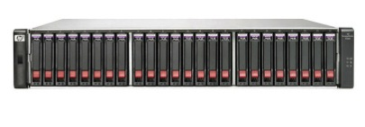
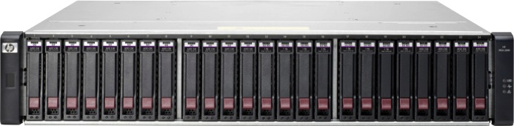
Campaign concept (2/2)
Headline:
Virtualize, consolidate, and simplify with MSA
Subhead:
Get simple, high-performance SAN storage
Imagery:
HP MSA 2000
HP MSA 2040

Slide 8
Message map
JRIT message | Technology made easy for your growing business
Campaign Message | The HP MSA 2000 and the new HP MSA 2040 are designed for efficient storage consolidation at affordable prices with the ability to upgrade as your business expands.
Campaign Headline | Virtualize, consolidate, and simplify with MSA
Subheadline | Get simple, high performance SAN storage
Customer pain points | Limited IT resources IT sprawl Energy costs Protection of existing investments Increasing workloads
HP’s solution to pain points | The HP MSA family of products provide small and mid-size businesses with a pain to efficient storage consolidation. Easy to manage—intuitive user interface and storage management utility don’t require high-level expertise. Reduce IT footprint and save energy—Virtualization means more machines on less hardware. Protect existing investments—Customers can easily move disk drives from HP MSA 2000 to HP MSA 2040. Maximize resources—Simple management interface is familiar to server administrators who work with HP ProLiant and HP BladeSystem servers. High performance—HP MSA 2040 features offers 16 Gb Fibre Channel connectively with the industry’s best price performance.

Slide 9
Co-branded campaign tactics
Communication Tools & Specifications
Translations
CTA’s/Sales Readiness
Sample of Available Tactics

Slide 10
Communication tools & tactics
All tactics can be found on Partner Marketing Center here, Marketing Depot here, and Comoda here :
Folder: Global EG ISS 4132004#3
Link: https://www.hppreferredpartners.com/campaigns/detail-view.hp?content_id=1120
Demand
generation
eDM from distributor to
reseller (generic on JRIT)
eDM from reseller to
customer (by product/BU)
DM postcard from reseller to customer (by product/BU)
Sales and
marketing
tools
Channel training
PowerPoint®
(by product/BU)
Telescript
Value proposition
(printed and filmed)
Customer overview
(by product/BU)
Other
Channel
announcement email
Channel
Implementation guide
Copy deck
(translated)
Campaign
Introduction video

Slide 11
Overview of available tactics
All tactics can be found on PMC, Marketing Depot, and Comoda.
Category | Tactics | Specifications
Direct Marketing | eDM | JPG, source file
 | Postcard | JPG, source file
Sales and Marketing Tools | Channel training presentation (by product/BU) | PowerPoint®
 | Customer overview (by product/BU) | PowerPoint
 | Telescript | 8.5” x 11” Word document
 | Value proposition (printed and filmed) | PDF
Other | Channel implementation guide | PowerPoint
 | Channel announcement email | JPG, source file
 | Copy deck (translated) | 8.5” x 11” Word document
 | Campaign introduction video | www.hp.com/go/promo/transactional

Slide 12
Campaign CTA
Gated and non-gated CTAs
Core CTA (gated)
Contact us
Optional gated CTA
View family data sheet: “HP P2000 G3 Modular Smart Arrays”- here
View data sheet: “HP MSA 2040 Storage”- here

Slide 13
Translations
Translations need to be carefully checked and amended, for example, CTA (call to action).
Copy decks are available for translation on August 1, 2013.
Global EG ISS 4132004#4
Link: https://www.hppreferredpartners.com/campaigns/detail-view.hp?content_id=1120

Slide 14
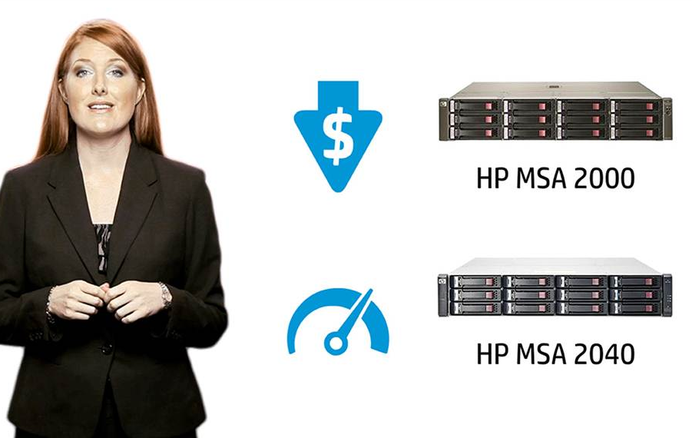
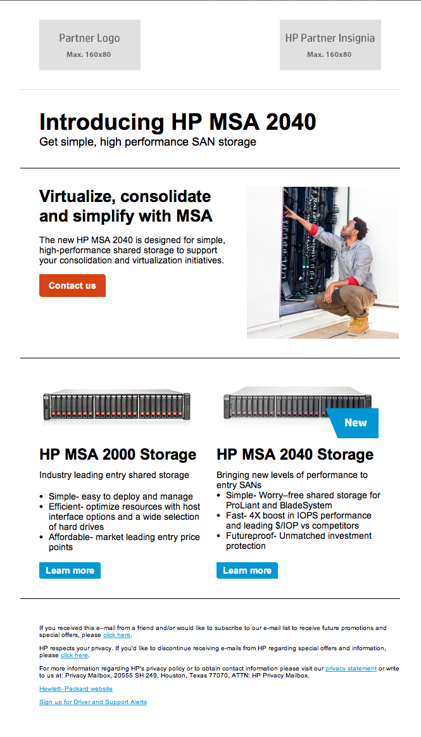

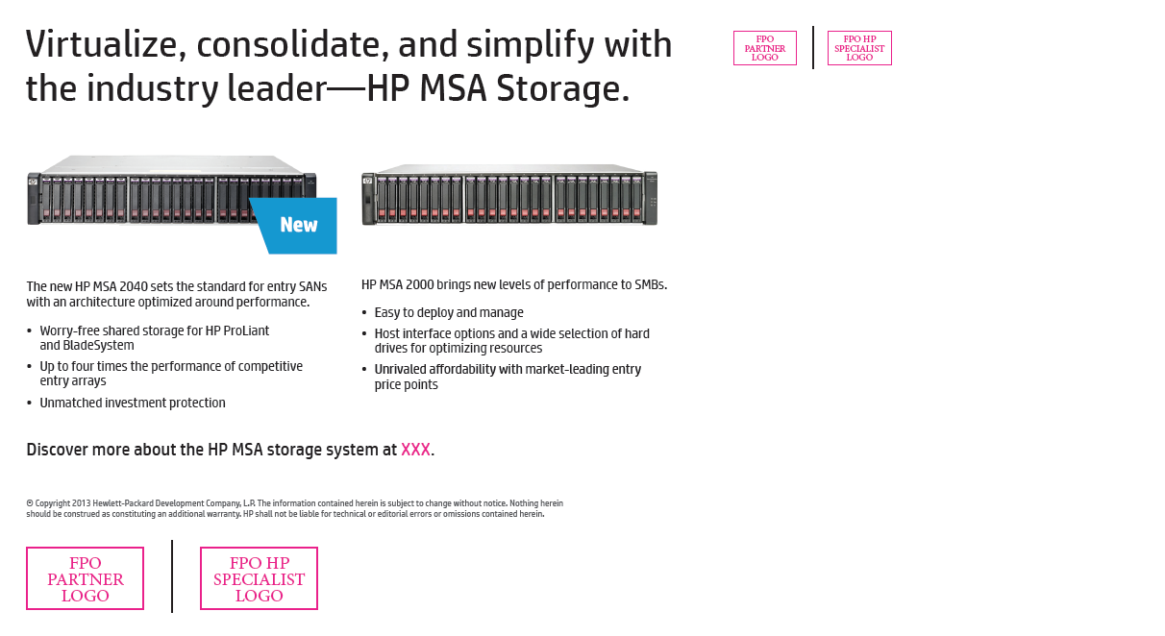
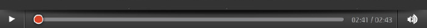
Sample of available tactics (1/2)
Video
eDM
Postcard

Slide 15
End
PowerPoint is a U.S. registered trademark of Microsoft Corporation.

Slide 16
声明：
所有的版权属于原有公司，文件均来自公开渠道
此文件仅供学习使用，任何人不得进行以此为商业目的的行为
如有疑问，请立即删除
学习世界五百强和咨询公司PPT课程请访问如下网站搜索：“司马懿”
百度传课：司马懿PPT学校
访问地址
https://www.chuanke.com
网易学堂：司马懿PPT学校
访问地址
https://study.163.com
知乎： 司马懿PPT学校
访问地址
https://www.zhiu.com

