Slide 1

Risk Assessment and Decision Support for Security Policies IEEE Policy 2011 Symposium Marco Casassa Mont (marco.casassa-mont@hp.com), Richard Brown (richard.brown@hp.com ) Cloud & Security Lab, HP Labs Bristol, UK

Slide 2
Outline
Addressed Problem
Risk Assessment and Decision Support for Security Policies
Approach: Security Analytics
Case Study on Identity and Access Management (IAM)
Conclusions

Slide 3
Outline
Addressed Problem
Risk Assessment and Decision Support for Security Policies
Approach: Security Analytics
Case Study on Identity and Access Management (IAM)
Conclusions

Slide 4
Key Problem
How to provide Strategic Decision Makers (e.g. CIOs/CISOs) with Risk Assessment and Decision Support Capabilities when dealing with their Strategic Security Policies?
Key Related Questions:
What business and security risks is the organisation exposed to due to the security policies and related operational processes currently in place?
How effectively are these policies enforced at the operational level?
What is the impact of a change in policy or a change in the threat environment?

Slide 5
Outline
Addressed Problem
Risk Assessment and Decision Support for Security Policies
Approach: Security Analytics
Case Study on Identity and Access Management (IAM)
Conclusions

Slide 6
Strategic Security Policies
Complex activity
Different priorities for different stakeholders:
CISOs, CIOs, Risk Managers, Compliance Managers, Business Managers …
Taking into accounts trade-offs between:
Security Risks, Productivity, Business Availability, Compliance, Cost …
Authentication Policies
Access Management Policies
Vulnerability and Threat Management Policies
Data Protection Policies
Web Access Policies
Security Monitoring Policies
Policies about Access to Physical Sites
…

Slide 7
Decision Making Process in IT Security
Increasing demand for a more rigorous, scientific approach to the security decision making process and risk assessment
Provide Evidence to justify policy decision and attract investments
Provide Insights about impact of policy decisions at the operational level
Explore in advance the impact of various options, by means of What-if Analysis
Current risk assessment approaches, based on ISO 2700x, provide generic guidelines and coarse grained analysis. But they still need to be instantiated within operational environments

Slide 8
Outline
Addressed Problem
Risk Assessment and Decision Support for Security Policies
Approach: Security Analytics
Case Study on Identity and Access Management (IAM)
Conclusions

Slide 9

Security Analytics
Putting the Science into Information Security Management
Notes:
Most security strategy, policy and investments decisions are based on intuition and best practices.
Security Analytics is about using scientific methods to make security management rigorous and evidence based.
no need to spend a long time talking – move to next slide for what it means
soundbite desc. of SA
5 January 2018
HP Confidential
9

Slide 10

Security Analytics:
Integrating Scientific Knowledge
Security/Systems Domain knowledge
Economic Theory
(utility, trade offs, externalities, information asymmetry, incentives)
Applied Mathematics
(probability theory, queuing theory, process algebra, model checking)
Analytics Process Model & Rules
Empirical Studies
(Grounded theory, discourse analysis, cognitive science)
Experiment and Prediction
(Discrete event modelling and simulation)
Business Knowledge
Notes:
Today most security teams have good knowledge about IT and are working hard to align this with business knowledge.
We are looking to take this further to make business aligned security decisions based on simulation and prediction. To support this we are using appropriate economic and mathematical tools
5 January 2018
HP Confidential
10

Slide 11

An Example: Vulnerability Management
How do we evaluate the effectiveness of our vulnerability management processes and policies?
when we have a combination of protections and processes: patch management, AV, HIPS, emergency escalation, temporary workarounds
How do we estimate in advance the impact on overall protection of a change in policy or the addition of a new security mechanism?

Slide 12

The Solution: Build a model
Stochastic model of threat environment
Process model of organization’s protections
Validate with experts and against known data sources
Select a metric
e.g. Time until “risk mitigated”
Execute the model as a discrete event simulation
~100K vulnerabilities
check for sensitivities in parameters
Adjust the model to reflect proposed changes in policy and see how well the changes perform

Slide 13
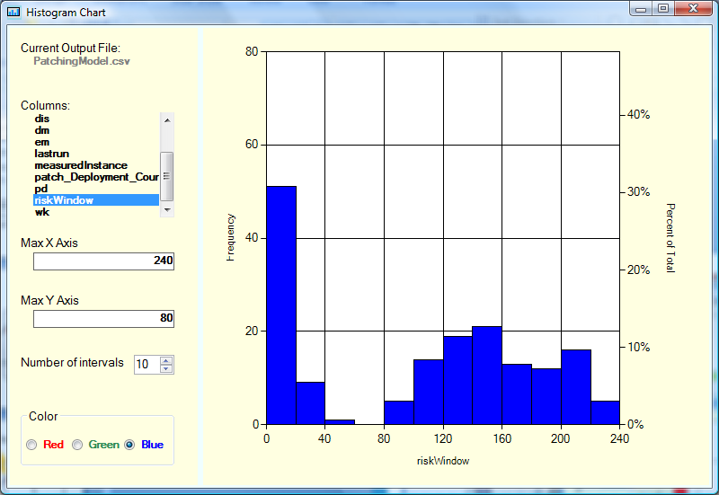
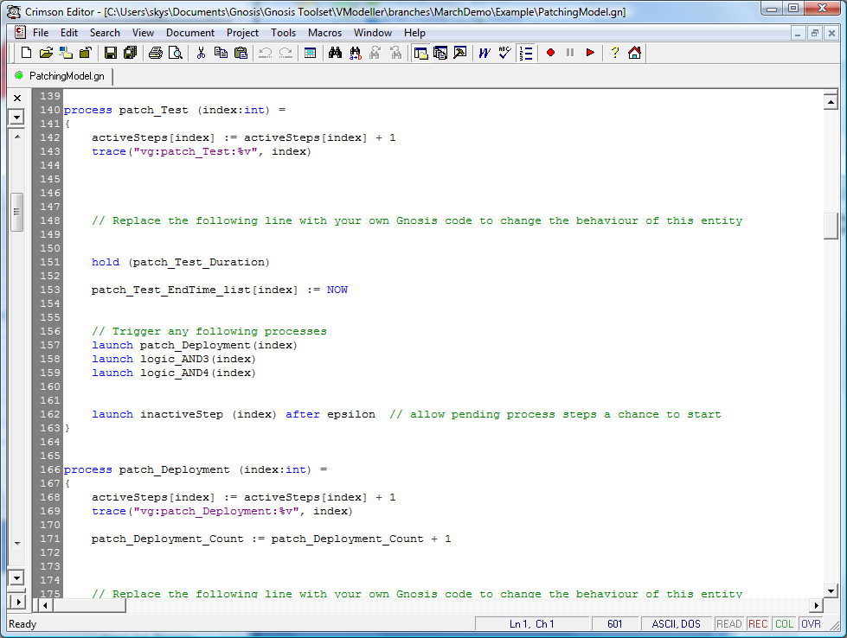
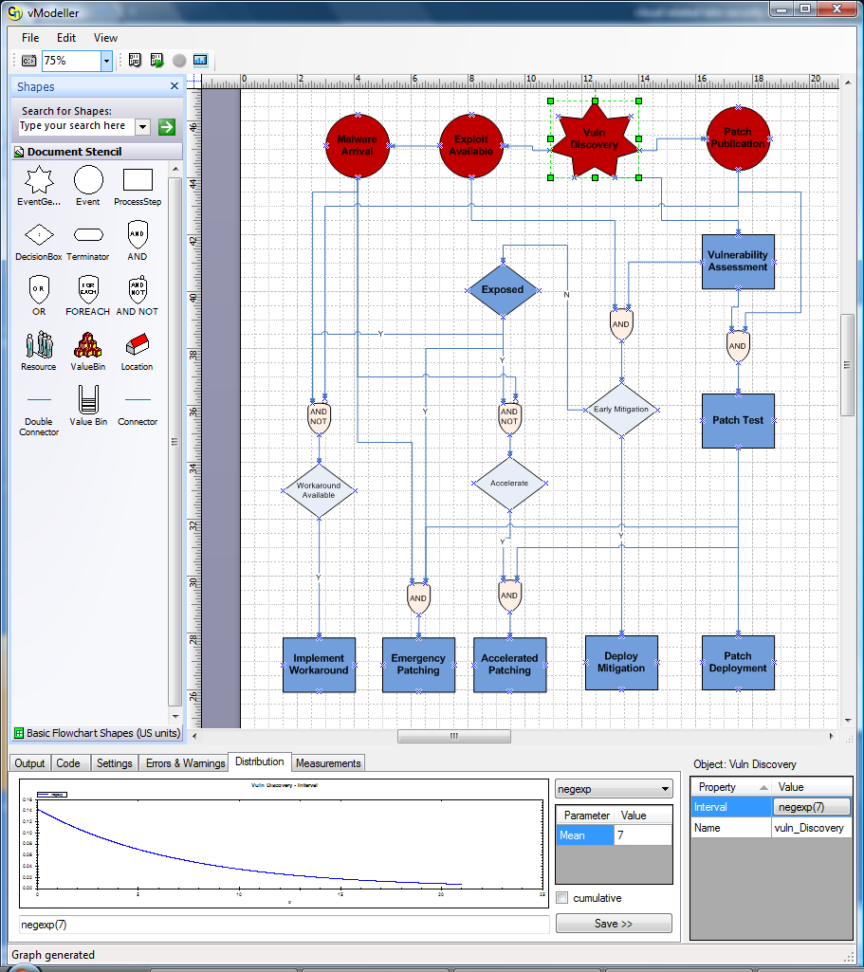
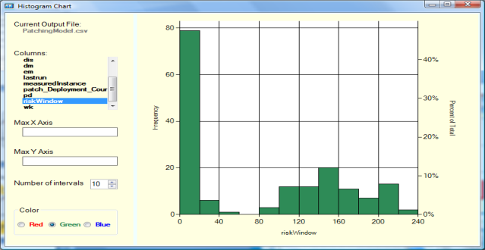
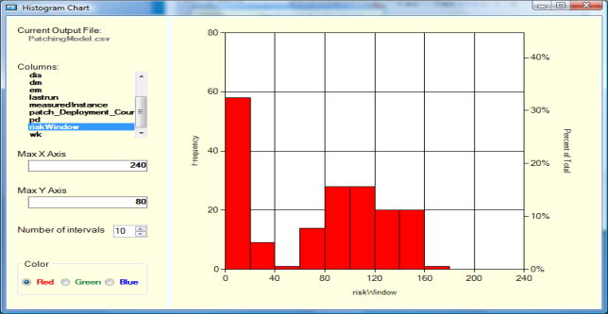
Security analytics tools
Current Risk Window
Risk Window with HIPS investment
Generate Simulation/
Experiment results
Generate code for the underlying Gnosis Engine
Risk Window with Patch Investment
Notes:
Use this slide if running an actual demo proves to be too difficult logistically
5 January 2018
HP Confidential
13

Slide 14
PACKAGED SECURITY ANALYTICS
Transforming security management to one based on scientific rigour
Iterative consultancy engagement approach to define the problem and explore possible solutions and their tradeoffs
Generation of full report including a summary of the analysis performed and recommendations
Discovery
Modelling
Iteration
Decision
Analysis
Notes:
This is part of an ongoing ambitious research programme, and our first deliverable is to offer a packaged Security Analytics services engagement, together with the tools and methodology, for both Vulnerability and Threat Management, and also for Identity and Access Management.
Starting with an initial workshop to explore your unique security challenges and identify the strategic priorities, appropriate models will be created and explored to determine the possible outcomes of key security decisions which are available to you. At the end of the exercise you will receive a full report documenting the challenges addressed, the options explored and conclusions drawn.
Discovery
Understand and formally scope target of assessment, boundaries, context, dependencies and constraints. Identify org’s preferences that may influence future choices. Identify shareholders, secure ‘buy-in’ at an organisation level.
Modelling
Construct model. Identify interdependencies and supporting information required for the model to be produced. Iterate to refine detailed understanding and improve the model sufficiently well for all stakeholders to have high confidence in the analysis stages that follow. Identify key metrics which should be explored in the next phase through scenarios/what-if experiments.
Scenario building
Develop and explore 2 or 3 scenarios/what-if experiments and make appropriate changes to the model to reflect these scenarios. Research any areas where the model requires more detailed information. Run simulations and examine the impact on the key metrics agreed in the first phase. Re-examine and refine model on an iterative basis to achieve the most accurate predictions. Explore implementation options where the model highlights a scenario as being optimal.
Analysis and Recommendations
Review findings against originally stated problem. Document shared understating, including evidence-based justification. Gather supporting information, e.g. costs, impact on other org's priorities and business units, whether academic or administrative. Prepare communication for stakeholders.
Deliverables
The key outputs from each stage of the engagement are highlighted above. Specifically, the security analytics engagement with the client, which as already agreed will focus on an area of vulnerability and threat management (VTM), will deliver:
An initial document, prepared during pre-engagement, which describes: the target of evaluation, anticipated allocation of client and HPIS and resources during the main stages of the engagement, the scope of the analysis, assumptions, and client priorities and value points.
Detailed examination of the target of evaluation, client current practices and priorities in the specified area, refinement of scope and assumptions. As part of this stage, HPIS will review current client information security (IS) management policies, standards and operating procedures.
Two or three fully documented security analytic models, developed in partnership with client during the modelling and scenario building stages.
Documented results, including explanatory narratives added by HPIS consultant, of the findings that arise from using the model to examine a set of operating scenarios.
The engagement will conclude with HPIS consultants helping client fully understand the outcome of the engagement. In addition, HPIS will help client formulate a set of internal communications that client can use internally in support of ongoing change-planning activities. HPIS will help client target cost savings, risk reduction or compliance, as instructed by client, and to examine the tradeoffs from adopting one or more of the options that security analytics identifies.
5 January 2018
HP Confidential
14

Slide 15
Outline
Addressed Problem
Risk Assessment and Decision Support for Security Policies
Approach: Security Analytics
Case Study on Identity and Access Management (IAM)
Conclusions

Slide 16
IAM Case Study
Applying Security Analytics for risk assessment and decision support
Focus on access management processes and related policies
Jointly carried out with a major HP customer in the UK Government

Slide 17
IAM Case Study: Problem Setting
What is the Risk Exposure for the organisation due to their current access management policies and their implementation at the operational Level?
What would be the consequences of changing these policies?
Specifically, what is the impact of investing in IAM Automation?
Notes:
17

Slide 18
Company (IT) Organisation

Slide 19
Agreed Approach
Focus on:
Specific Critical Application:
CRM Service and Customer Information Database
Provisioning and Deprovisioning Processes

Slide 20
Relevant Security Policies
P1: All users’ accounts and access rights must be approved both by managers and security teams;
P2: User accounts should be configured according to best security practices;
P3: Managers should immediately notify the security team when their employees leave or change their role;
P4: Unnecessary user accounts and access rights should be removed as soon as possible.

Slide 21
Access Management Processes
Users can Join & Leave the Organisation; Change their Roles
Different types of Accounts: Normal Users, Super Users, Shared Accounts

Slide 22
IAM Case Study
Model and Analysis of CRM Provisioning Process

Slide 23
Security Analytics Models
Analysis and Modelling of Current CRM Provisioning Process
Analysis and Modelling of CRM Provisioning Process with IAM Automation
→ Comparing and Contrasting Results Obtained from Simulations

Slide 25
Results for Current CRM Provisioning
Average Number of Provisioning Requests (per Year): 133 of which 19 Super User Accounts and 14 Shared Accounts
NOTE: Only 15% lock-out controls are set

Slide 26
Results for Current CRM Provisioning

Slide 27
Analysis of Results
The results gave an indication of the potential risk exposure of the organization and policy failures.
Long provisioning times can induce people in misbehaving, such as bypassing the process or inducing managers to hold into credentials, as previously explained.
Failures in implementing security controls (i.e. lock-out control) are in violation of Policy P2 (User accounts should be configured according to best security practices).

Slide 28
Results for CRM Provisioning with IAM Automation
Assumptions
- Usage of Role-based
Access Control
Preapproved Roles
Passive Approval
for normal situations
(majority of cases …)
- Automated Config.
Sensitivity Analysis
for Passive Approval
(Duration of this Step)
- Case #1: 1 day
- Case #2: 2 days
- Case #3: 5 days

Slide 29
IAM Case Study
Model and Analysis of CRM Deprovisioning Process

Slide 30
Security Analytics Models
Analysis and Modelling of current CRM Deprovisioning Process
Analysis and Modelling of CRM Deprovisioning Process with IAM Automation
→ Comparing and contrasting results obtained from simulations

Slide 32
Results for Current CRM Deprovisioning
Average Number of Deprovisioning Requests (per Year): 129.
Number of Failures (Hanging Accounts): 49 of which 7 involving Super Users and 5 involving Shared Accounts.
Number of Locked-out Accounts (after 45 days) without Removal: 6
NOTE: 15% lock-out controls are set

Slide 33
Analysis of Results
These results highlight the current failure in implementing policies P3 and P4 and the consequent high level of risk exposure for the organization. It is important to notice that failures in correctly implementing policy P2, at the provisioning level, has also a negative impact at the deprovisioning level.
A major issue is that these policies are too abstract: they do not set precise goals and constraints. This is reflected in the relaxed implementation of the various processes.
ACTION: What-if Analysis about:
Improving Implementation of Policy P2
Introducing IAM Automation

Slide 34
Results for Current CRM Deprovisioning
What-if Analysis
Exploring impact
of different settings
for lock-out controls
(set on 30 days):
0% Lock-out set
(current state)
- 50% Lock-out set
- 100% Lock-out set
In case of 100% lock-out, failures can still happen as cannot be handled by the lock-out control
(e.g. case of shared accounts or user keeping accessing their accounts)
On average (per year), there are 14 hanging accounts, of which 2 Super Users and 5 shared account

Slide 35
Results for CRM Deprovisioning with IAM Automation
Assumptions
Usage of Automated
HR Notification
(with some delays)
Automated Removal
of Accounts
Sensitivity Analysis for
“Elapsed Time To Begin
Deprovisioning”
(Duration of this Step)
- Case #1: 1 day
- Case #2: 2 days
- Case #3: 5 days

Slide 36
IAM Case Study - Final Remarks
Our case study was successfully completed in 3 months and produced a full Security Analytics Report, followed by a presentation of our findings to the customer
Based on input received from the customer, Security Analytics helped them to ground the analysis of their risks and explore the implications of making investments or modify their policies
It provided the decision makers with scientific evidence to support their decision making process in order to address current risks and improve their current access management processes
Additional actions might be taken by the customer to refine their current access policies to mandate more specific constraints and goals

Slide 37
Outline
Addressed Problem
Risk Assessment and Decision Support for Security Policies
Approach: Security Analytics
Case Study on Identity and Access Management (IAM)
Conclusions

Slide 38
Conclusions
We presented our work on Security Analytics to Provide Risk Assessment ad Decision Support to Strategic Decision Makers when Dealing with their Strategic Security Policies
Probabilistic modeling and simulation tools have been used to explore the risk exposure of an organization at the operational level and the implications of specific security policies. What-if analysis was carried out to explore decision options
We described how this methodology has been successfully used in a case study, in the space of user access management, jointly carried out with a customer and how this informed potential investments and policy changes

Slide 39
Q&A

Slide 40
声明：
所有的版权属于原有公司，文件均来自公开渠道
此文件仅供学习使用，任何人不得进行以此为商业目的的行为
如有疑问，请立即删除
学习世界五百强和咨询公司PPT课程请访问如下网站搜索：“司马懿”
百度传课：司马懿PPT学校
网易学堂：司马懿PPT学校
知乎： 司马懿PPT学校
访问地址
https://www.chuanke.com
访问地址
https://study.163.com
访问地址
https://www.zhiu.com

