Slide 1
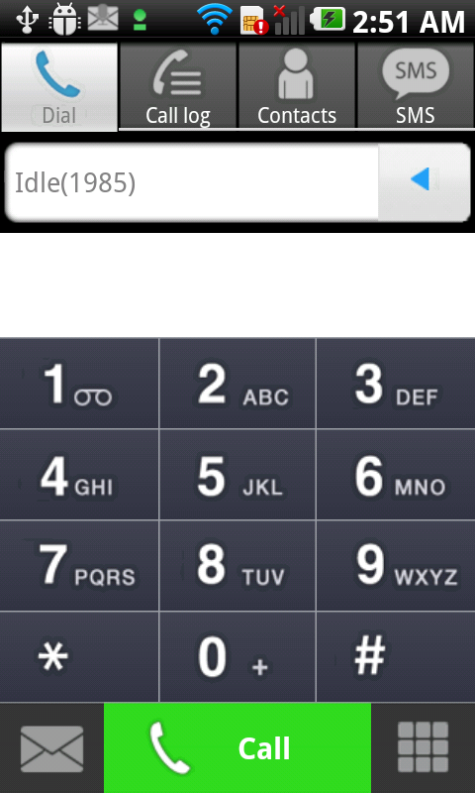
iPECS Communicator
ES) Product Planning Team
Doc v5.0
2012-06-29

Slide 2



Market Trends
Increasing mobility in smart work environment
A Mobile Society
Evolving to Smart Work
Increasing Mobile Office
By 2013, mobile devices will exceed desktop end points. Gartner
Changes in the way we prefer to communicate
Ubiquity & availability of mobile devices
Work anytime, anywhere, & from any device
Nearing 1 million mobile applications for smart phones and tablets by end of 2012
Government and enterprise lead smart work service
Desire to use personal mobile devices for work
Mobile UC service
Number of mobile worker will be increased to 1.2B in 2013 from 1B in 2010

Slide 3

LG-Ericsson mobility helps reducing costs
The LG-Ericsson mobile communicator extends the power of a desk phone and unified communications to existing mobile sets and thus allow free communication from any location (office, home, hotspots) by enabling access to Wi-Fi network simply and cost effectively.
The reduction in minutes allow the mobile users to use less minutes and reduce their subscription costs by shifting cellular minutes to Wi-Fi minutes.

Slide 4

iPECS Communicator Overview
The iPECS Communicator is the
Enterprise SIP Mobile Client
designed to maximize productivity
and reduce cost by shifting existing
calls normally placed on cellular
network to free Wi-Fi or WLAN

Slide 5
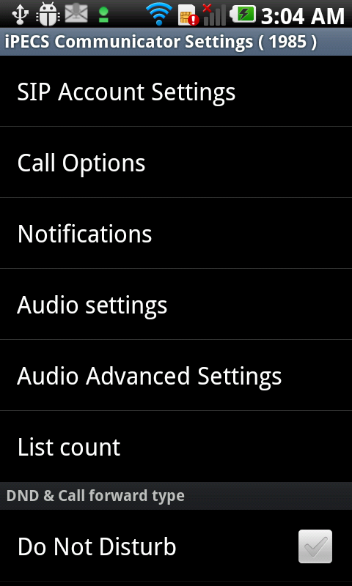
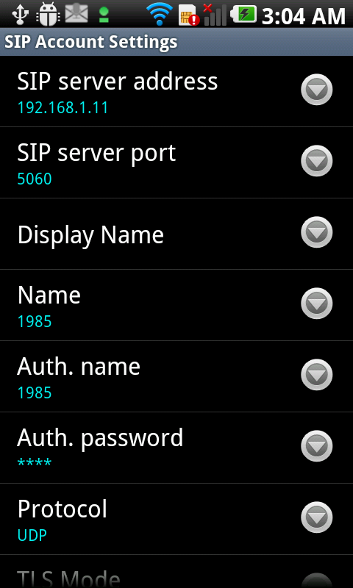
iPECS Communicator Overview
SIP Client S/W for smart phone, designed for mobile worker
Applied proven call technologies of No.1 domestic and leading global markets over the past 40 years
Various features and high quality voice that integrate with iPECS Platforms
Android and iOS
Available in Q2 and Q3, 2012
< iPECS Communicator for Android >

Slide 6

iPECS Communicator Value Proposition
Enterprise mobility with seamless business communication through mobile phone, reduces costs
Various features that integrate with the iPECS call control platform: iPECS-LIK and CM*
Secure mobile communications with media and signaling encryption
Better voice communication experience with high quality voice
* iPECS-MG will be supported later

Slide 7




iPECS Communicator Value Proposition
Lowest Total Cost of Ownership (TCO):
Seamless business communication through mobile phone with less cost
IP based communications
Communication cost reduction using SIP client instead of cellular phones within the building
Seamless business grade communication even out of office
Increased connectivity for the mobile workers
Carrier
Network
iPECS Call Platforms
Free Internal Call
Enterprise
IP Network
Cellular on WLAN
IP Phone
PC
External zone
Internal zone

Slide 8
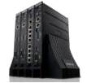
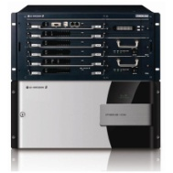
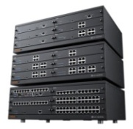
iPECS Communicator Value Proposition
Various features integrating with iPECS Platforms
From small business to large enterprise IP PBX
Easy and flexible calls with office desktop phones by integrating with the iPECS platform
Make, Answer, Hold and Transfer
Do Not Answer (Do Not Disturb), Call Pick up
Select how the call will be placed: over the cell network or as a SIP call
Call Hold, Call retrieve and MoH
Flexible conference call
SMS message
Phone book management
Add or modify contact number by searching the phone directory that is registered on the phone or by importing phone’s contact number
Search contacts by entering the first letter(s) of a contact name
CID look up
iPECS-LIK
iPECS-CM
iPECS-MG*
*iPECS-MG support schedule will be released later

Slide 9
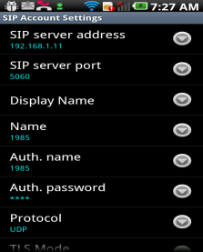
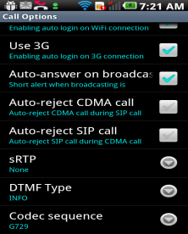
iPECS Communicator Value Proposition
Secure Mobile Business Communication
Signal and packet encryption
Global standard AES encryption algorithm support
TLS/sRTP for signaling and media encryption
Support for iPhone in Q3, for Android in the next release
User license required
Download software form the App Store (Apple) or from the Google Play (Android) and purchase a license for each registered user
With the user license, iPECS Call Platform check and verify if the proper user or not
iPECS Call Platforms
Registration request
Check the information and encrypted message for authentication

Slide 10
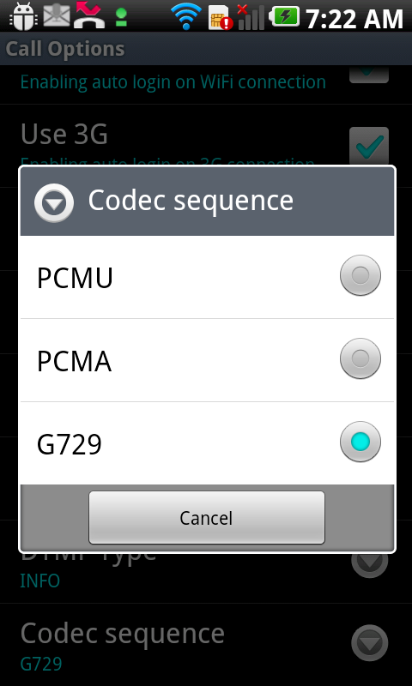
iPECS Communicator Value Proposition
Better voice communication experience with high quality voice
Codec support
G.711 (PCMU/PCMA)
G.729
Codec priority selection and changes
High quality of voice communication through network loss and voice correction
Network loss correction via PLC*/AJB*
Voice correction: Noise/Echo Cancellation, Handling and VAD*
<Note>
* PLC (Packet Loss Concealment)
* AJB (Adaptive Jitter Buffer): to minimize delay and buffer
* VAD (Voice Activity Detection): a technique used in speech processing in which the presence or absence of human speech is detected to avoid unnecessary coding/transmission of silence packet

Slide 11
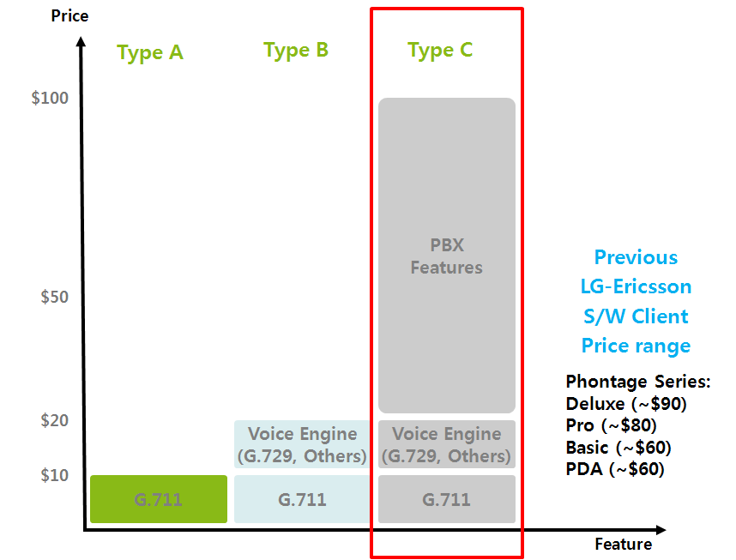
iPECS Communicator Positioning
iPECS Communicator is positioned as advanced product with PBX feature like other telephony vendors
MSRP
iPECS
Communicator

Slide 12
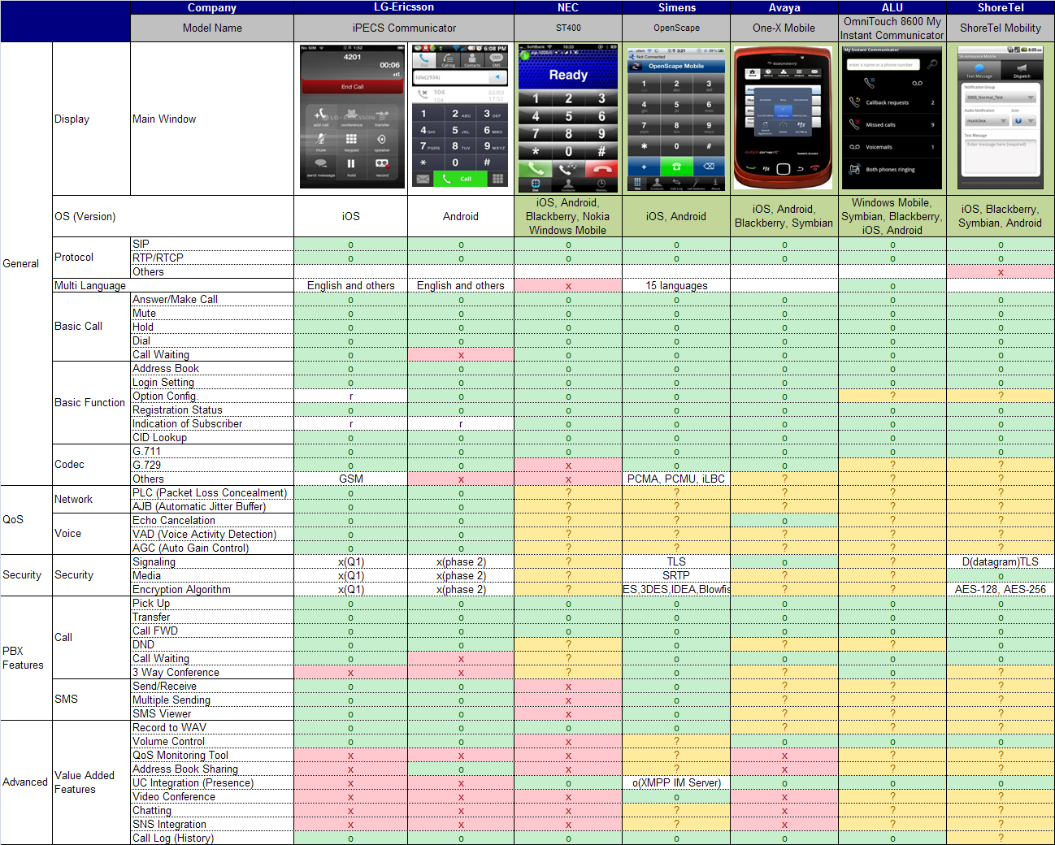
Competitive Analysis
Products from major competitors have similar level of basic features. But only LG-Ericsson and one other vendor offer SMS supplementary features.

Slide 13
Competitive Analysis
Major telephony vendors have pricing that protects low-end IP phone revenue ⬅ Mobile client SIP license is $130~230 (MSRP)
*Telephony vendors offer 10~40% D/C from MSRP
*Open Stack SIP client is free but has feature & system limitations.
*General SIP client has limited features and SIP server supports.

Slide 14
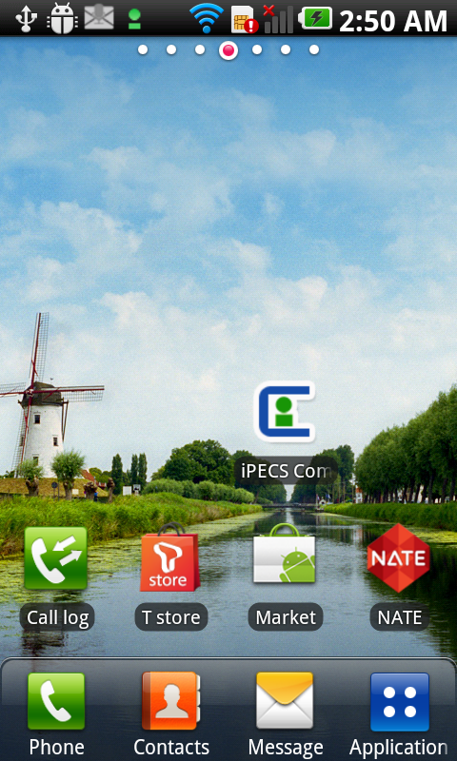
Hardware and Software Requirements
Hardware
Android
OS: Android 2.3 or higher
CPU: 1Ghz or higher
Resolution : 480 * 800
Available from the Google Play*
Apple iPhone
OS: iOS 4.0 or higher
Available from App Store
Software license
* Note: Currently downloadable from the web site. Please refer to the manual for the link.
Affordable market will be released later.
System | S/W Version (For Android Version) | License Name |  | Remark
 |  | iOS | Android
iPECS-CM | 3.0 or higher | CML-COMI | CML-COMA | CML-IPEXT is required 1 copy / 1 user
iPECS-LIK | 6.0 or higher | LIK-COMI | LIK-COMA | 1 copy / 1 user

Slide 16
Change history
2012-06-11: minor format change
2012-06-29: release time change

Slide 17
声明：
所有的版权属于原有公司，文件均来自公开渠道
此文件仅供学习使用，任何人不得进行以此为商业目的的行为
如有疑问，请立即删除
学习世界五百强和咨询公司PPT课程请访问如下网站搜索：“司马懿”
百度传课：司马懿PPT学校
https://www.chuanke.com
网易学堂：司马懿PPT学校
https://study.163.com
知乎： 司马懿PPT学校
https://www.zhiu.com

