Slide 1
Sustainability Scorecard Training
P&G Sustainability Overview
Audience: P&G Relationship Owners + P&G External Business Partners

Slide 2



The Power of P&G’s Purpose: Touch and improve lives, now and for generations to come.
Notes:
P&G's purpose is to touch and improve lives, now and for generations to come. This inspires and guides everything we do.

Slide 3


Leadership Commitment
“Sustainability is at the heart of P&G’s business model. We design our strategies and plans to ensure that the work we do makes a meaningful difference by bringing the power and scale of our brands to solve real problems facing the world.”
Bob McDonald Retiring Chairman of the Board, President and Chief Executive Officer

Slide 4


P&G Defines Sustainability Broadly…
Sustainability
… better quality of life for everyone, now and for generations to come
Social
Responsibility
Environmental
Responsibility
Notes:
4
At P&G, we define sustainability broadly. It is about ensuring a better quality of life for everyone now and for generations to come. For us that broad definition encompasses both environmental and social responsibility.

Slide 5




P&G’s Sustainability Framework
Ensuring a better quality of life for everyone, now and for generations to come.
Our
Programs:
Environmental
Sustainability
Social
Responsibility
Our
Enablers:
Employees
Stakeholders
Notes:
It’s not just about “green” products tied to a current consumer movement, but a systemic approach covering our total supply chain, from raw materials to manufacturing processes to the Consumer. It also extends to the communities we touch all around the world.
And, importantly, sustainability efforts must be tied to the bottom line.
Our sustainability framework focuses us clearly on both social and environmental programs as well as on our key enablers to deliver these program – our employees and stakeholders. It is grounded in our desire to grow responsibly, holds us accountable to consistent & measurable improvement, and guides the goals and commitments we set.

Slide 6
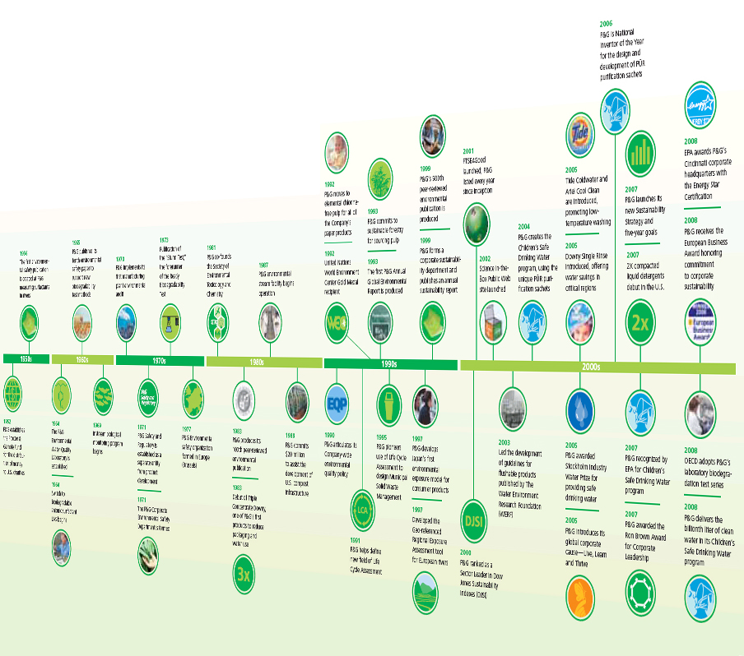






Strong Sustainability Heritage
Published our first environmental safety publication (1956)
Developed first test to evaluate chemical biodegradability (1973)
Co-founded the Society of Environmental Toxicology and Chemistry (1981)
Pioneered the use of Life Cycle Assessment (1990s)
One of the first corporate sustainability departments and sustainability report (1999)
Introduced global corporate cause: Live, Learn and Thrive™ (2005)
Announced new Long-Term Environmental Sustainability Vision and 2020 Goals (2010)
Notes:
6

Slide 7


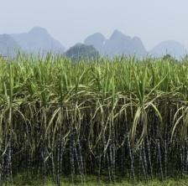


Long-Term Vision
Powering our plants with 100% renewable energy
Using 100% renewable or recycled materials in all products and packaging
Having zero consumer or manufacturing waste go to landfills
Designing products that delight consumers while maximizing the conservation of resources
Notes:
P&G has a desire to not only address but actually help solve environmental issues. This is why we developed our new environmental vision for sustainability at P&G – a series of long-term endpoints that will guide all sustainability decisions and goal-setting within the organization. It will influence the products we develop, how they are produced and distributed, and how we help educate the consumer to use our products.
7

Slide 8





Environmental Program
Environmental
Sustainability
Products
Operations
Notes:
Our environmental program focuses on two areas, products and operations

Slide 9

2020 Goals for Products
Replace Petroleum-Based Materials with Sustainably Sourced Renewable Materials | 25%*
Cold Water Washing | 70% of total washing machine loads
Packaging Reduction | 20% (per consumer use)*
Consumer solid waste | Pilot studies in both developed and developing markets to understand how to eliminate landfilled/ dumped consumer solid waste
* vs. 2010 baseline

Slide 10

Sustainable Innovation Products
Products with a significantly reduced (>10%) environmental footprint vs. previous or alternative products…and no trade-offs for the consumer
Notes:
10

Slide 11

2020 Goals for Operations
Renewable Energy Powering our Plants | 30%
Manufacturing Waste | < 0.5% (disposed)
Truck Transportation Reduction | 20% (km/unit of volume)*
* vs. 2010 baseline

Slide 12
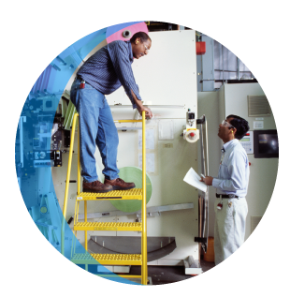




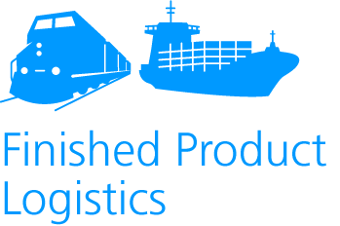
Operational Improvements End-to-End Strategy

Slide 13
Why does External Business Partner Sustainability Matter?
P&G’s network of external business partners (suppliers, agencies, etc.) is critical to our mission to touch and improve lives around the world. This is especially true regarding our commitments in environmental and social responsibility.
Consumers around the world rely on P&G brands for their superior performance and value. For that reason, we want external business partners to participate with us in open innovation, and to help us improve competitive advantage and maintain standards of excellence for both companies. At P&G, successful partnerships require a respect for the environment and sustainability, and we seek those values in all of our partners.
In social sustainability, we expect all of our external business partners to comply with our Sustainability Guidelines for Suppliers (see http://www.pgsupplier.com/en/pg-values/sustainability.shtml for details).
In the area of environmental sustainability, we collaborate closely with our external business partners because they are P&G’s key source of materials, packaging, systems, services. Product life cycle studies show that the our supply chain can be a significant contributor to the overall environmental footprints of many P&G products. Therefore, external business partners can be critical for improving the environmental sustainability of our end-to-end supply chain as well as an important resource for developing P&G’s sustainable innovation products. We also learn from each other’s best practices as we navigate the emerging field of environmental sustainability for products and operations together.
For more on P&G’s sustainability approach and programs – please visit http://www.pg.com/sustainability

Slide 14
P&G’s Sustainability Approach with External Business Partners:
Collaboration is Key
Commercialize 360
Sustainable Innovation
Measure Progress in a Simple, Consistent Way
Link and Leverage
to Drive Best Practices
External business partners are P&G’s key source of materials, packaging, systems, and services needed to develop P&G’s sustainable innovation products.
Product life cycle studies show that our supply chain can be a significant contributor to the overall environmental footprints of many P&G products.
By improving their footprints, our external business partners help P&G lower its footprint and deliver better value with no trade-offs.
Sustainability success requires strong collaboration between our external business partners and key internal P&G customers— R&D, Marketing, Product Supply,
PS&RA, etc.
Use a few simple measures where P&G and our external business partners can make a meaningful difference.
Leverage existing standard approaches and data.
Measures are based in science and include full life cycle perspective.
Measures support total best value—improving sustainability without trade-offs.
Our external business partners are rewarded for collaborating to improve their and P&G’s sustainability (via business awards).
Sustainability is part of our sourcing value equation and integrated into our sourcing strategies.
Benchmark with external business partners to identify best practices and reapply across the supply chain.
Leverage our P&G Supplier Sustainability Board to guide our efforts and tap opportunities.
Connect external business partner capabilities to deliver unique sustainability improvements.
Build tracking capabilities and create a shared library of best practices and success stories.
Partner with external business partners to influence how Consumers and Stakeholders define success in Sustainable Development and Designing for the Environment.
Proactively influence key industries to drive end-to-end sustainability improvements and value creation.
Create forums to share insight, trends and approaches and ensure common understanding of sustainability goals and metrics.

Slide 15
Social Sustainability Initiatives
Third-Party Supplier Audit Program
P&G has a long history of ensuring our supply chain is responsible in all key areas of corporate social responsibility; areas such as: child labor, working conditions, wages, health and safety, environmental and ethical behaviors.
We have transitioned to a more comprehensive social sustainability process using third-party auditing firms and an industry standard platform. This enables any audited external business partner to share their results with all of their customers saving costs and optimizing resources.
This new robust and efficient auditing process ensures, in a collaborative way, that our partners adhere to P&G’s social sustainability guidelines and promote best practices in all key areas.
For further information on the third-party audit program, please contact Pierre Vignaud (vignaud.pv@pg.com).

Slide 16
Environmental Sustainability Initiatives
Supply Chain Environmental Sustainability Scorecard
In May 2010, P&G launched the Supply Chain Environmental Sustainability Scorecard and rating process to measure and improve the environmental sustainability of our key external business partners. The scorecard assesses their environmental footprint and encourages continued improvement by measuring energy use, water use, waste disposal and greenhouse gas emissions on a year-to-year basis. The overall goal is to encourage year-on-year improvement—regardless of size or existing capability.
The scorecard is the result of several years of close collaboration with our Supplier Sustainability Board, which includes more than 20 leading external business partners from our global supply chain as well as experts from P&G. The scorecard is built on accepted worldwide measurement standards and sound science, including protocols from the World Resources Institute (WRI), the World Business Council for Sustainable Development (WBCSD) and the Carbon Disclosure Project (CDP).
P&G Relationship Owners (ROs) use the scorecard to determine their external business partner’s sustainability rating in P&G’s annual performance management process. ROs/Buyers also use the scorecard to gather comparable sustainability results for use in best total value business award decisions. P&G’s broader supply base is also encouraged to use the scorecard to guide their improvement focus.
The scorecard is considered “open source” for everyone in industry to use in their supply chains. In addition, to enable other companies to more purposefully focus on improving their environmental footprint without investing in the development of analysis software, we have also made our Supply Chain Environmental Sustainability Scorecard Analysis Tool publicly available. The Excel-based tool enables companies to measure and interpret key environmental sustainability metrics across their supply chains and identify progress as well as opportunities for improvement. The 2013 version of the scorecard and analysis tool are available for download at http://www.pgsupplier.com/en/current-suppliers/environmental-sustainability-scorecard.shtml.

Slide 17




















P&G Supplier Sustainability Board Partners

Slide 19
声明：
所有的版权属于原有公司，文件均来自公开渠道
此文件仅供学习使用，任何人不得进行以此为商业目的的行为
如有疑问，请立即删除
学习世界五百强和咨询公司PPT课程请访问如下网站搜索：“司马懿”
百度传课：司马懿PPT学校
https://www.chuanke.com
网易学堂：司马懿PPT学校
https://study.163.com
知乎： 司马懿PPT学校
https://www.zhiu.com

