Slide 1


Oracle PartnerNetwork Specialized Program Overview for Customers
May 2012
Notes:
Welcome and thank you for joining us today!
Today we’ll talk about Oracle’s offering for partners and the great revenue opportunities when joining our partner ecosystem.

Slide 2

Partners are Critical to Oracle’s Success
MORE THAN 40%
OF ORACLE REVENUE
WORLDWIDE
IS THROUGH
PARTNERS
MORE THAN 80%
OF ORACLE
TRANSACTIONS
WORLDWIDE
ARE THROUGH
PARTNERS
Notes:
Partners are a critical channel for our comprehensive product portfolio.
More than 40% of our revenue is through partners, and over 80% of the transactions are through partners.
Clearly central to Oracle’s strategy.
And, Over the past three years, Oracle’s indirect revenue has grown faster than Oracle’s direct revenue.
We’ve got a growing channel ecosystem with tremendous partner opportunity.

Slide 3
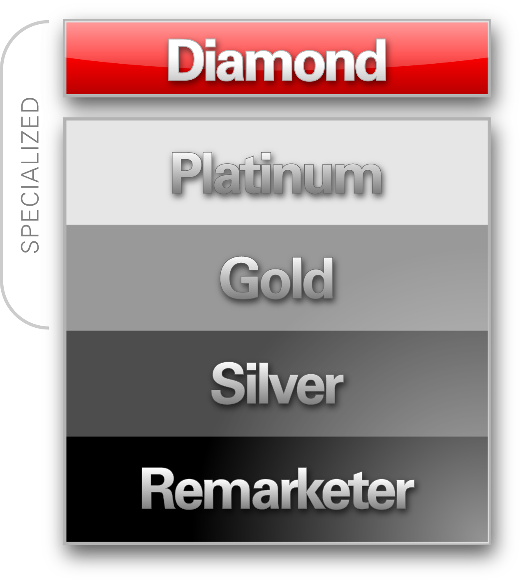

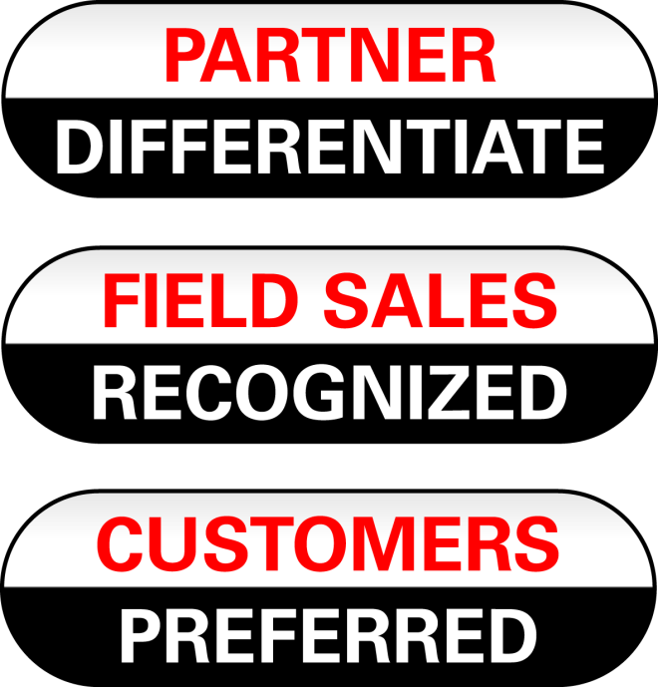
Notes:
3
The OPN program is flexible and designed to evolve with our partners’ business needs. We offer Specialized partner programs on several levels, increasing partner benefits and visibility at each level.
As we consider the Oracle PartnerNetwork program and how we work with our partners, we look at delivering value to three groups: our Oracle internal sales force, our community of partners, and our end customers.
Oracle PartnerNetwork (OPN) Specialized is the latest version of Oracle's partner program that provides partners with tools to better develop, sell, and implement Oracle solutions.
Specialized partners are preferred by Oracle and recognized by customers.
OPN Specialized offers resources to train and support specialized knowledge of Oracle products and solutions and has evolved to recognize Oracle‘s growing product portfolio, partner base, and business opportunity.
Key to the latest enhancements to OPN is the ability for partners to differentiate through certified Specializations. Specializations are achieved through competency development, business results, expertise, and proven success.
Brief overview of levels:
The entry level is our Remarketer program, through our Value Added Distributors we allow partners to resell our 1-Click mid-market solutions; with no contract or fees; and provides access to online training and sales tools.
The Silver level also focuses on the 1-Click products, PLUS it has a wealth of Oracle engagement benefits including access to the Partner Business Center, Support, enhanced educational offerings and development licenses for ISVs.
The Gold level is the primary entry point for most Sun partners migrating to OPN; and for existing OPN partners choosing to expand there capabilities; as it provides access to Oracle's Sun hardware products, and where they may apply to resell Oracle Applications. Key benefits include all of the Silver level benefits + this is the first level where partners are eligible for specialization.
The Platinum level is for Specialized partners showing a breadth of expertise with 5 or more specializations. Key benefits include all of the Gold level benefits + an extensive support and enablement benefits.
Lastly, our Diamond level is newest addition designed to reward those global partners that provide the most significant value added services to our joint customers (i.e. not just revenue to Oracle). Key benefits include all of the Platinum level benefits + formal recognition as a Diamond Level partner; membership fee is at Platinum level– and an array of exclusive engagement and enablement benefits.

Slide 4
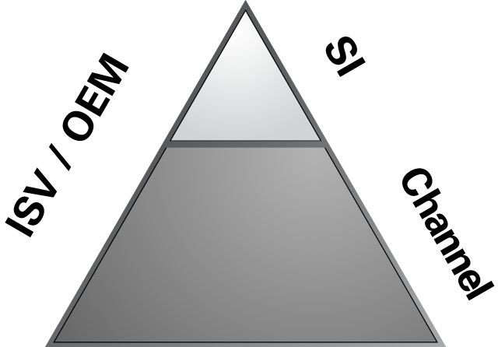

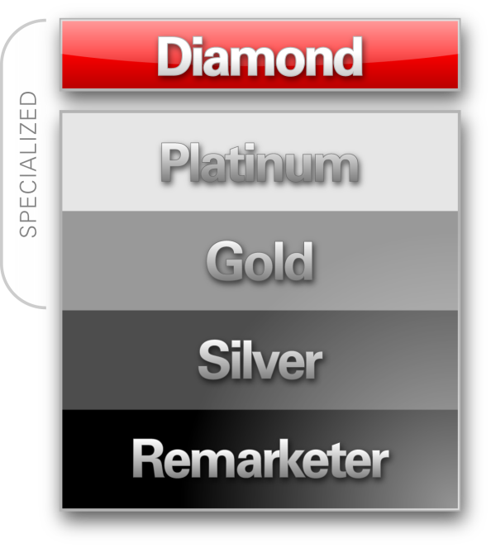

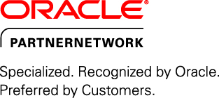

The Evolution of OPN Specialized
ISV / OEM Innovation
SIs Specialization
Channel Oracle Stack
2008 | 2009 | 2010 | 2011
Notes:
Oracle PartnerNetwork Specialized was launched in 2009 as a result to incorporate all the resources available from the Enablement 2.0 platform.
We announced Specialization as the key for our partners to differentiate in the marketplace , be recognized by Oracle and preferred by customers.
With time, we heavily invested in improving the resources for our partner community, with a program that can help you grow your business with a membership level that is appropriate to your business model.
Where we are going today?
We want to To Build the Most Admired Partner Ecosystem in the Industry
ISV / OEM Partners:
Evolve from silos of technology to Strategic Architecture and Engineering Partner
Platform of Choice
Systems Integrators
Evolve from traditional tactical engagement to innovative strategic offerings
Solutions Environment in which SIs Compete
Channels
Evolve from product focused VARS to cross-stack solution providers
Hardware & Software Engineered to Work Together

Slide 5

OPN Specialized
Differentiate by Achieving Specialization
Offers Oracle partners the opportunity for increased recognition through specialization
Differentiate from the competition
Get Recognized by Oracle
Differentiate
Be Preferred by Customers

Slide 6
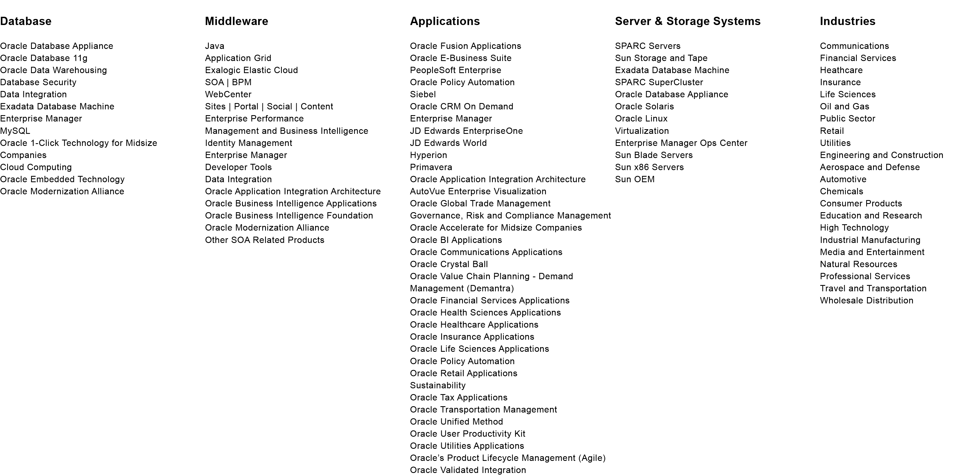
80+ Specializations
Notes:
We currently have more than 80 Available Specializations.
Embrace our portfolio and focus on building a competitive differentiator for your business through our Specialization Program.
Differentiate in the marketplace, be listed in our new featured Solutions Catalog, get special Advertising and Marketing contents. Specialized logo and PR.

Slide 7
Advanced Specialization
Step 2: Advanced Specialization
Additional differentiation for specialized partners
Extended capacity of skilled implementation resources
Promote Depth of Expertise (50 Implementation Specialists)
Step 1: Specialization
Get Recognized by Oracle
Differentiate
Be Preferred by Customers

Slide 8

“The Oracle Partner program provides partners with sales, marketing an training support that is unparalleled in the industry. Oracle's Partner Program supports partners to become specialists in Oracle products and partner services.”
Frank J. Vukmanic, Senior Vice President & General Manager, V-Soft
SILVER
Partners with a desire to invest and grow with Oracle
Resell Oracle’s 1-Click Ordering products, targeting midsize companies
Technical support, demonstration licenses and educational discounts
Support from Oracle Partner Business Center
Notes:
Partners at the Silver level engage with Oracle around Oracle 1-Click Ordering products. This set of products is designed to serve SMB / midsize customers. At this level of Oracle PartnerNetwork, partners can access development licenses, enablement resources and support for this set of products. With a signed distribution agreement, they can also resell the Oracle 1-Click Ordering products. These partners receive direct Oracle support through and access to the Partner Business Center. It’s a great first step for partners who are willing to make an investment in Oracle.

Slide 9
“OPN Specialized addresses the current realities and needs of Oracle Partners and the market in which they operate. There are now clear paths to differentiation through specialization, and incentives to guide partners to take advantage of these. The new OPN is a good fit for Oracle’s ever-expanding offering.”
Aydin Ersoz, Co-CEO, iNNOVA Bilisim Cozumleri A.S.
GOLD
Leveraging Enablement 2.0 to become Specialized
Access broad base of enablement tools & resources
Resell all Oracle technology & hardware products
Eligible to resell Oracle Applications
Eligible for Specialization
Notes:
The Gold level is the first level where partners can distribute the complete technology stack and is also the first level where a partner can specialize. At this level, partners are able to access education, development, marketing, sales and implementation resources across the broad spectrum of Oracle products. Once a distribution agreement is executed, partners may sell all technology products and they may apply to resell Oracle applications and hardware products.
The ability to specialize is critical to partners at this level, since specialization helps partners differentiate themselves so they can be recognized for their skills and capabilities. To specialize in a specific product or solution, the partner must meet stringent business and competency criteria. In addition, they may qualify for Advanced Specialization once they have 50 or more Oracle Certified Implementation Specialists on staff that have become certified. With these specializations providing information about a partner’s areas of expertise, customers can locate, secure and retain the right partner to develop and implement business solutions for the particular needs of their business. Customers select specialized partners since they know that these partners have the training, knowledge, experience and commitment to help their business succeed.

Slide 10
“The focus Oracle PartnerNetwork has placed on Specialization provides us with the ability to select qualified partners who have demonstrated expertise in a specific product or solution; this program eliminates the guesswork and helps ensure we find the right partner to fit our needs.”
Dave Lyons, Director, Information Technology,
Baptist General Convention of Texas
PLATINUM
Premium level representing depth of skill and breadth of portfolio
Elite level for Specialized partners
Expertise in multiple Oracle solutions
Dedicated support from the Oracle Partner Business Center
Notes:
The Platinum level is designed to showcase Oracle’s top partners. Platinum partners must have five specializations, exhibiting a high level of commitment to Oracle and to developing their skills. These partners are recognized for their expertise in a broad range of products and technology, receiving extensive support and enablement benefits from Oracle. Customers working with Platinum level partners will benefit from the partners’ breadth of Oracle knowledge and capability to deliver the right solutions for the customer’s business.

Slide 11
“The Oracle Partner program provides partners with sales, marketing an training support that is unparalleled in the industry. Oracle's Partner Program supports partners to become specialists in Oracle products and partner services.”
Frank J. Vukmanic, Senior Vice President & General Manager, V-Soft
DIAMOND
Prestigious level representing depth of skill, breadth of portfolio and extent of capacity
Elite level for Specialized partners
Expertise in multiple Oracle solutions
Highest level of support & investment from Oracle
Recognition of high value based on highest level of investment in Oracle expertise & alliance
Notes:
The Diamond level is the highest level within Oracle PartnerNetwork and is designed to reward those partners that provide the most significant value-added services to our joint customers. Partners at this level typically work very closely with Oracle across multiple product and solution areas. They are specialized in at least twenty specializations, five of which are Advanced Specializations, highlighting their highly qualified implementation capability. Diamond Level partners receive an array of exclusive engagement and enablement benefits. Customers can easily recognize these Diamond level partners and leverage their depth of skill, breadth of portfolio and extent of capacity to meet their business needs.

Slide 12
oracle.com/specialized
Notes:
Learn more about Specialization program, watch videos and review our specialized partner profiles

Slide 13
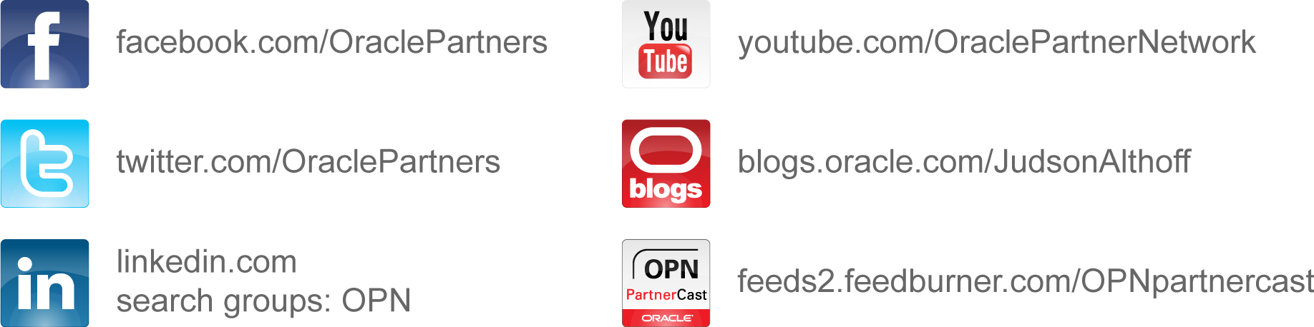
Join the Conversation with OPN

Slide 14



Slide 15
Notes:
Thank you.

Slide 16
声明：
所有的版权属于原有公司，文件均来自公开渠道
此文件仅供学习使用，任何人不得进行以此为商业目的的行为
如有疑问，请立即删除
学习世界五百强和咨询公司PPT课程请访问如下网站搜索：“司马懿”
百度传课：司马懿PPT学校
https://www.chuanke.com
网易学堂：司马懿PPT学校
https://study.163.com
知乎： 司马懿PPT学校
https://www.zhiu.com

