Slide 1


An Introduction to Functional Setup Manager
Chitra Mitra
Product Management Director

Slide 2
Agenda
Introduction
Functional Overview
Product Demo
Q&A
Notes:
Good Morning!
I will start with an overview of the product highlighting some of the key features that are getting rave reviews from our early customers. I will then spend the majority of the time on showing you a demo of the product and finally open up for questions and answers.
Today’s presentation will focus on general functionality of Setup Manager. If you have any HCM specific setup questions, please raise them later with Rashmi. She will connect you with the right people to get those answers.

Slide 3
Introduction
Functional Setup Manager:

Slide 4
Initial Implementation
Configure
Implement
Deploy
Maintain
Plan
Incremental Change
Functional Setup Manager provides a guided process for end-to-end implementation of Fusion Applications
Notes:
Let’s get started.
Functional Setup Manager provides an integrated process that guides you through the entire lifecycle of Fusion applications implementation step -- from planning, through configuration, implementation and then deploying setups to production using export and import and finally maintaining setups as time goes by.

Slide 5
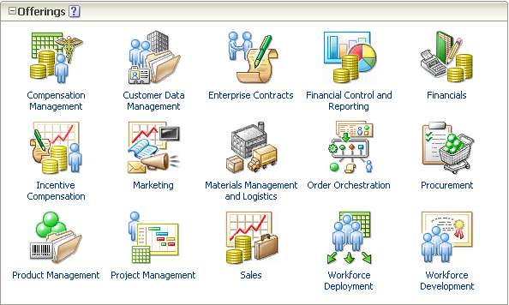
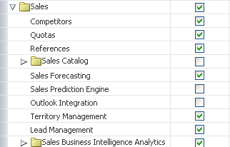
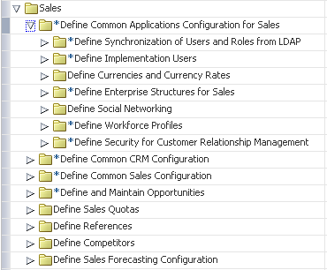
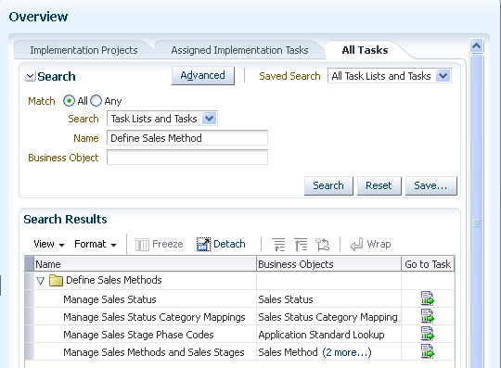
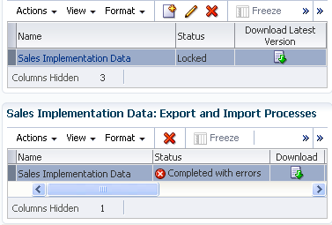
Functional Setup Manager
Each step builds upon the decisions made in the previous steps to provide a fully integrated applications implementation process
Plan
Configure
Implement
Getting Started
Configure Offerings
Manage Implementation Projects
Maintain
Export & Import
All Tasks (Search)
Manage Configuration Packages
Notes:
As you’ll see in the product demo. Functional Setup Manager builds upon the actions you take in each steup to continuously optimized the downstream processes for you.

Slide 6
Functional Overview
Functional Setup Manager:

Slide 7
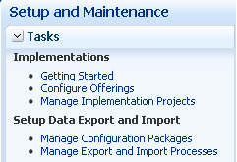
Functional Overview
Single, intuitive interface standardizes implementation process of all Fusion Applications
Notes:
In the past, different applications typically used to have their own setup interfaces. Therefore, every time you implemented a new application you needed to relearn how to set them up.
In contrast, Functional Setup Manager is included with every Fusion Applications. Although individual setup tasks are different depending on which Fusion Offering you are implementing, the same standard implementation process is used always.

Slide 8
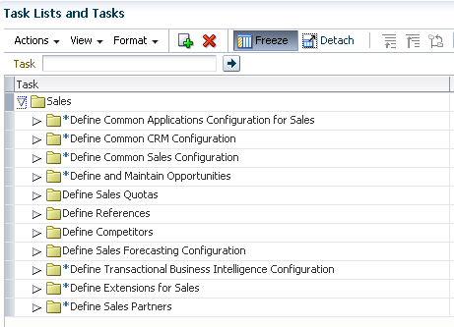
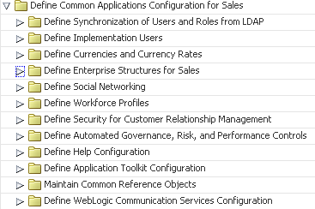
Functional Overview
Generated task list shows all setup tasks including pre-requisites giving complete visibility to setup requirements
Notes:
Functional Setup Manager also auto-generates the entire task list needed for end to end implementation of a Fusion Application including prerequisites and shows all dependencies. Now when you are implementing, say Sales, you do not have to look up a user guide to find out what are all the setups needed before you can start transaction.

Slide 9
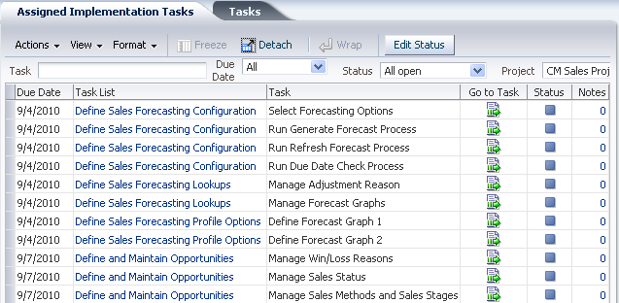
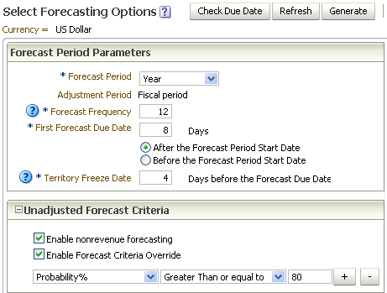
Functional Overview
Ability to perform setup tasks directly from task lists makes navigation to user interfaces much simpler
Notes:
The users who has the responsibility to enter setup data, on the other hand, find the ability to perform all the setup tasks directly form a single source very productive. We hear from the users that in the past often each user needed to know the exact navigation path from the maze of menu items to reach the right UI. Now the navigation has become very simple. No matter what application owns the UI, all of the setup interfaces can be reached directly for the setup task list.

Slide 10
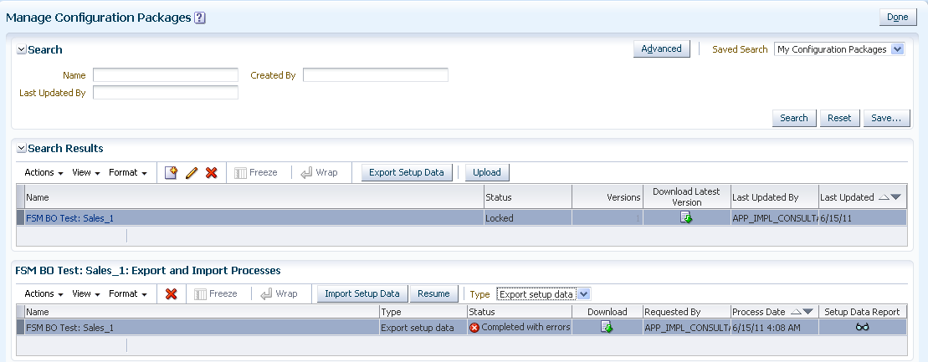
Functional Overview
One-click export and import enables consistent, expeditious replication of setup configurations
Notes:
Once setup is completed only half the work is done. Usually setup is not performed directly in the production instance. Therefore, moving the same setup from test to production instance is a major factor in the success of implementation process. FSM has simplified the export/import capability so that any functional user is able to move the desired setup configurations from one instance into another.

Slide 11
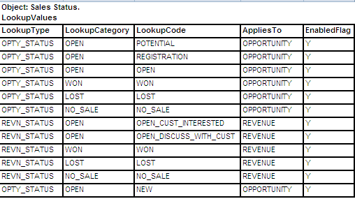
Functional Overview
Setup data reports provide easier setup data verification and a better alternative to manual documentation of setup configurations
Notes:
Finally, you also have the ability to generate setup data reports based on the exported or imported setup data. This not only helps to verify setup data but it also helps with documentation. For example, if most of your implementation engagement you probably need to provide some data reports for your clients to sign-off. You can leverage these reports to provide accurate information on setup data.

Slide 12
Product Demo
Functional Setup Manager:

Slide 13
Key Takeaways
Self-Service Administration
An integrated, guided process for managing applications setup lifecycle at the business user level
Complete Transparency
Auto-generated, sequential task lists address prerequisites and dependencies to give full visibility to end-to-end setup requirements
Configurable & Extendable
Prepackaged list of setup tasks can be easily configured and extended to better fit with the business requirements
Setup Once & Reuse
Export and import capabilities facilitate replicating consistent applications setup across many instances
Comprehensive Reporting
Built-in reports help to analyze, validate and audit setup configurations and data

Slide 14

Q&A

Slide 17
声明：
所有的版权属于原有公司，文件均来自公开渠道
此文件仅供学习使用，任何人不得进行以此为商业目的的行为
如有疑问，请立即删除
学习世界五百强和咨询公司PPT课程请访问如下网站搜索：“司马懿”
百度传课：司马懿PPT学校
https://www.chuanke.com
网易学堂：司马懿PPT学校
https://study.163.com
知乎： 司马懿PPT学校
https://www.zhiu.com

Slide 18
声明：
所有的版权属于原有公司，文件均来自公开渠道
此文件仅供学习使用，任何人不得进行以此为商业目的的行为
如有疑问，请立即删除
学习世界五百强和咨询公司PPT课程请访问如下网站搜索：“司马懿”
百度传课：司马懿PPT学校
https://www.chuanke.com
网易学堂：司马懿PPT学校
https://study.163.com
知乎： 司马懿PPT学校
https://www.zhiu.com

