Slide 2

Building Mobile Web Applications with Oracle Application Express

Slide 3
The following is intended to outline our general product direction. It is intended for information purposes only, and may not be incorporated into any contract. It is not a commitment to deliver any material, code, or functionality, and should not be relied upon in making purchasing decisions. The development, release, and timing of any features or functionality described for Oracle’s products remains at the sole discretion of Oracle.

Slide 4
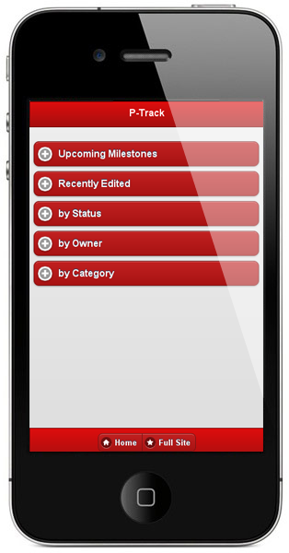
Agenda
Mobile Web Applications
jQuery Mobile
Building Mobile Web Applications
Deploying Mobile Web Applications

Slide 5
Mobile Web Applications

Slide 6
Mobile Web Applications
What are mobile web applications?
Increasingly popular way to deliver content and business applications to mobile devices
Alternative to developing native mobile apps
No need for download and installation via an App Store
Run on any OS, desktop, tablet, smartphone
Require browser and Internet connection

Slide 7
Mobile Web Applications
Development and Deployment
Easy to develop using standard web technologies and frameworks
Web apps are used through a web browser with the bulk of functionally executed on the web server
Advances in HTML, CSS and JavaScript allow for shifting more functionality to the browser, providing richer user experience and better performance
Easy to maintain and easy roll out of upgrades

Slide 8
Mobile Web Applications
Limitations
Browsers do not typically have access to advanced functions of a device, like GPS, camera, address book, etc. *
Web apps are often slower than native apps
Mobile web apps require permanent Internet connection
Using offline web application caching and platforms like PhoneGap, Titanium, etc. provides ways to address these limitations
* HTML 5 geolocation, File uploads and camera access with Media Capture and File API in iOS6

Slide 9
Mobile Web Applications in APEX 4.2
APEX applications generally work on most modern mobile devices, like iPhone, Android, tablets etc
Standard applications may not be ideal for smaller screens
APEX 4.2 provides mobile enabled themes and templates based on jQuery Mobile
Provides a more native-like mobile user experience
Optimized for mobile screens and touch interfaces

Slide 10
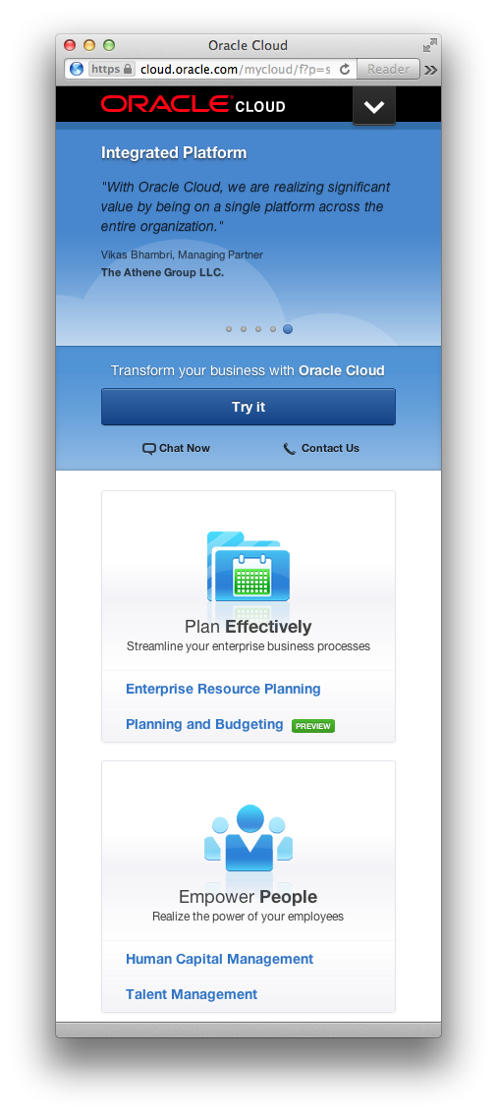
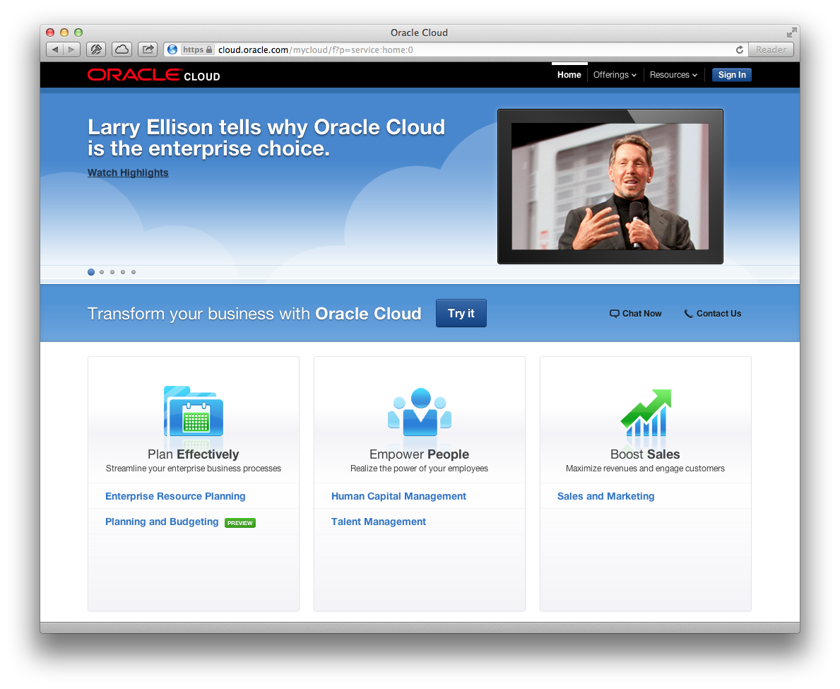
Responsive Web Design

Slide 11
jQuery Mobile

Slide 12

jQuery Mobile
Overview
Touch-optimized JavaScript framework for smartphones & tablets
Built on jQuery and jQuery UI foundation
Unified user interface system across all popular mobile platforms
Lightweight size and minimal image dependencies for speed
Responsive design techniques allow the same underlying codebase to automatically scale from smartphone to tablet and desktop-sized screens

Slide 13
jQuery Mobile
Overview
AJAX-based navigation system to enable animated page transitions while maintaining back button, bookmarking and and clean URLs
Support for touch and mouse events to allow for different user input methods using a simple API
Accessibility features like WAI-ARIA integrated throughout framework
Support for screen readers and other assistive technologies

Slide 14
jQuery Mobile
Differences between jQuery and jQuery Mobile
jQuery: Library that makes it easier to write JavaScript through selectors, event handling and support for AJAX requests
jQuery Mobile:
Framework built on top of jQuery
Used by developers to build mobile interfaces
Coding is done using plain HTML markup for the most part
jQuery Mobile automatically applies styles and add functionality to widgets

Slide 15
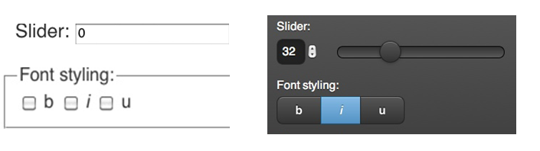
jQuery Mobile
Progressive enhancement
Brings content and functionality to all mobile and desktop platforms
Rich, installed application-like experience on newer mobile platforms
Basic but functional experience on older and less capable devices

Slide 16
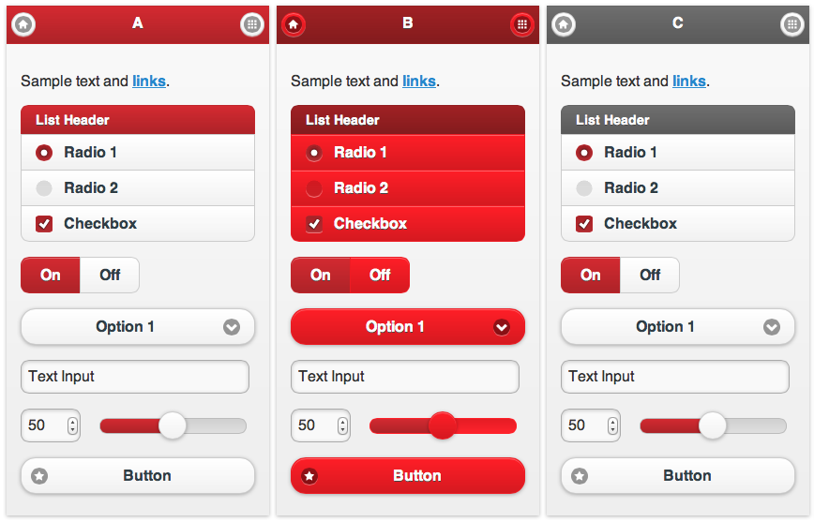
jQuery Mobile
Customizable user interface
Built-in theming framework
ThemeRoller application
http://jquerymobile.com/themeroller/

Slide 17
jQuery Mobile
Events
Touch events: tap, tapholdswipe, swipeleft, swiperight
Orientation change event: orientationchange
Scroll events: scrollstart, scrollstop
Page change events
Page transition events
Page initialization events

Slide 18
jQuery Mobile
Supported Platforms
3-level graded platform support system, supported platforms include:
Apple iOS (iPhone, iPod Touch, iPad)
Android
Windows Phone
Blackberry

Slide 19
jQuery Mobile
Basic page template - Header
<!DOCTYPE html>
<html>
<head>
<title>My Page</title>
<meta name="viewport" content="width=device-width, initial-scale=1">
<link rel="stylesheet" href="/mobile/jquery.mobile-1.1.0.min.css" />
<script src="/jquery-1.7.1.min.js"></script>
<script src="/mobile/jquery.mobile-1.1.0.min.js"></script>
</head>
<body>…</body>
</html>

Slide 20
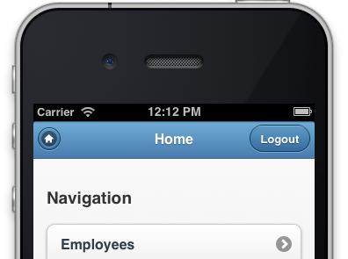
jQuery Mobile
Basic page template - Body
<!DOCTYPE html>
<html>
<head>...</head>
<body>
<div data-role="page">
<div data-role="header”><h1>My Title</h1></div><!-- /header -->
<div data-role="content”><p>Hello world</p></div><!-- /content -->
</div><!-- /page -->
</body>
</html>

Slide 21
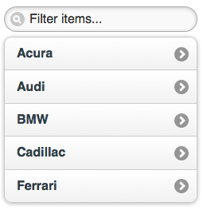
jQuery Mobile
Basic List View
<ul data-role="listview"
data-inset="true"
data-filter="true">
<li><a href="#">Acura</a></li>
<li><a href="#">Audi</a></li>
<li><a href="#">BMW</a></li>
<li><a href="#">Cadillac</a></li>
<li><a href="#">Ferrari</a></li>
</ul>

Slide 22
Building Mobile Web Applications

Slide 23
Building Mobile Web Apps with APEX 4.2
Declarative support for building mobile web applications
APEX Applications support multiple user interfaces: e.g. Desktop and Smartphone
Mobile pages use jQuery Mobile through jQuery Mobile based themes and templates
HTML5 based charts and new HTML5 item types

Slide 24
Building Mobile Web Apps with APEX 4.2
User Interfaces
APEX applications can be associated with multiple user interfaces
Each user interface is associated with one theme
User interface also defines device specific login URLs, home page URLs, global pages (page 0) and device auto detection
Individual pages support only one user interface
Applications can include desktop and mobile specific pages
Use responsive design techniques for cross device pages

Slide 25
Building Mobile Web Apps with APEX 4.2
Enhanced Wizards
Create application wizard allows for selecting user interface
Create page wizards show options available for user interfaces currently associated with an application
Wizards generate components appropriate for device:
Report & Form wizard creates List View & Form for mobile devices
Chart wizard creates HTML5 charts for mobile devices
Some elements omitted in wizards for mobile, e.g. tabs

Slide 26
Building Mobile Web Apps with APEX 4.2
Updated Regions
jQuery Mobile list view region: default for mobile navigation, drill-down, certain types of reports, report & form pages
Plug-ins to allow for setting of compatibility mode (Desktop / Mobile / PhoneGap)
Dynamic actions to support touch events, tap, tap & hold, swipe, scrolling, orientation change, etc.

Slide 27
Building Mobile Web Apps with APEX 4.2
Updated Item Types
New HTML5 item types
Date, Email, Number, Tel, Color, Range, ….
New HTML5 attributes
Auto-complete, max, min, readonly, required, …
Text Filed has Sub-types – Email, Phone, URL
Shows most appropriate keypad, native select lists, data pickers, …

Slide 28
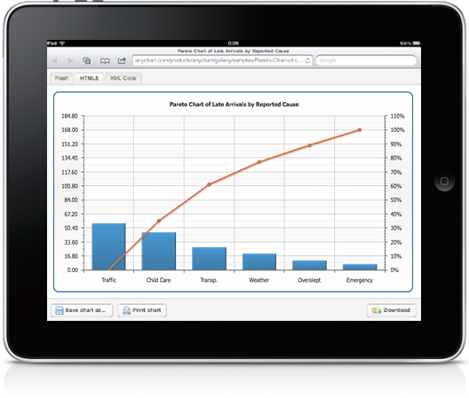
Building Mobile Web Apps with APEX 4.2
Non-Flash Charts
Support for Non-Flash charts using Anychart’s HTML5 charts
For desktop apps, Flash-preferred is used with HTML fall-back
For mobile apps charts are created as HTML5-only

Slide 29
Building Mobile Web Apps with APEX 4.2
Mobile Calendars
Mobile-friendly calendar templates
New list-view for date entries
Date entries shown below calendar on mobile devices

Slide 30
Deploying Mobile Web Applications

Slide 31
Deployment of Mobile Applications
In-house applications
Deploy to APEX instance in company internal network
Access from outside the network via VPN
Public-facing applications
Deploy on APEX instance that’s accessible from Internet
Deploy to hosted site like the Oracle Cloud

Slide 32
Deployment of Mobile Applications
Open apps in built-in web browser (Safari, Chrome, etc)
Add to Home Screen (menu icon, opens app in browser)
Native Apps using PhoneGap, Titanium, Rhodes, etc
Wrap web app into framework that runs web apps as native apps
Access to native features, like GPS, accelerometer, camera, compass
Local deployment of CSS, JS, images
Distribution via App Store

Slide 33


Slide 34



Slide 35
声明：
所有的版权属于原有公司，文件均来自公开渠道
此文件仅供学习使用，任何人不得进行以此为商业目的的行为
如有疑问，请立即删除
学习世界五百强和咨询公司PPT课程请访问如下网站搜索：“司马懿”
百度传课：司马懿PPT学校
https://www.chuanke.com
网易学堂：司马懿PPT学校
https://study.163.com
知乎： 司马懿PPT学校
https://www.zhiu.com

