Slide 1
Restoring America’s Economic Growth
Frederick W. Smith,
Chairman and CEO, FedEx Corporation

Slide 2
Historical U.S. GDP Growth
Average Annual GDP Growth | to 2007 | to 2011
5 years | 2.7% | 0.5%
10 years | 3.0% | 1.6%
20 years | 3.0% | 2.6%
30 years | 3.1% | 2.7%
50 years | 3.3% | 3.1%

Slide 3
Jobs Growth Clearly Linked to Business Investment
Notes:
This shows year-over-year growth in real equipment & software spending (a proxy for capital spending) versus private sector employment growth.
High correlation between growth in business capital spending and jobs (.85)

Slide 4
Under-Investment a Major Factor in Slower Gross Job Creation Over the Past Decade
Notes:
Looking at gross job gains, a measure of new job creation before netting out job losses, also shows a strong relationship with business investment.
In the last decade, investment share of GDP never regained levels reached in the late-1990s, and neither did gross job creation.
Technical Note: The Business Employment Dynamics (BED) survey measures gross jobs gains for expanding and new establishments and gross job losses for contracting and closing establishments; the difference between the two would be net job gains/losses (not pictured here) and would be roughly analogous to the monthly nonfarm payrolls report, though different methodologies mean the two do not match up exactly. However, they show the same directional trends over time, with the BED offering a different angle on labor market turnover.

Slide 5
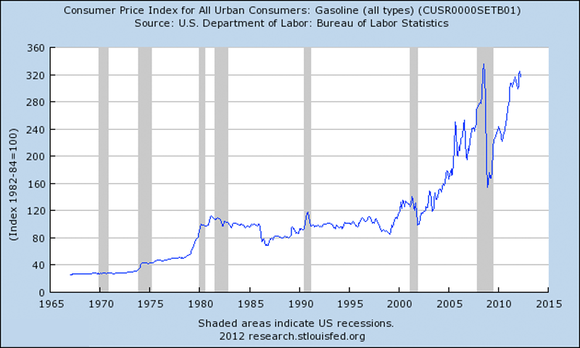
Oil Prices Over Past Four Decades

Slide 6
Household Spending on Gasoline

Slide 7
U.S. Liquid Fuel Production

Slide 8
Demand and Production - Fuel

Slide 9
Petroleum and the U.S. Current Account Deficit

Slide 10
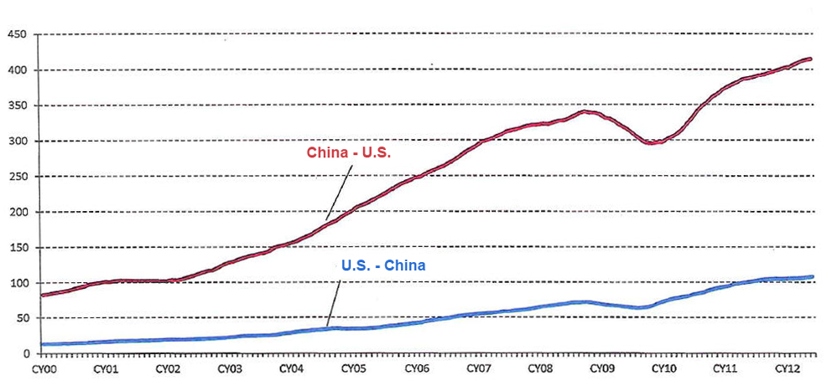
U.S. Merchandise Export/Import with China
U.S. merchandise trade with China $billions
12-month rolling total
Source: Census Bureau

Slide 11
声明：
所有的版权属于原有公司，文件均来自公开渠道
此文件仅供学习使用，任何人不得进行以此为商业目的的行为
如有疑问，请立即删除
学习世界五百强和咨询公司PPT课程请访问如下网站搜索：“司马懿”
百度传课：司马懿PPT学校
https://www.chuanke.com
网易学堂：司马懿PPT学校
https://study.163.com
知乎： 司马懿PPT学校
https://www.zhiu.com

