Slide 1

Selling Security Solutions to Small Businesses
2011

Slide 2

Improving Small Business Security with Intel Technologies
After this training you will understand:
1. Why security is so important for small businesses
2. How small businesses can reduce security risks
3. The Intel technologies that provide security solutions for small businesses

Slide 3
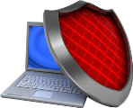


Why is Security So Important for Small Businesses?
Security
practices not
keeping pace
Increased cost
of lost data
Security threats evolving
A laptop is stolen every 53 seconds¹
75% of SMB have experienced two or more cyber attacks in a twelve month period²
Nearly 50% of small businesses do not have a plan to deal with IT disruptions³
Only 23% of small businesses backup data daily³
On average, small businesses experience three IT disruptions a year⁴
50% of small businesses have lost critical data within the last year³
Security disruptions can mean lost business

Slide 4




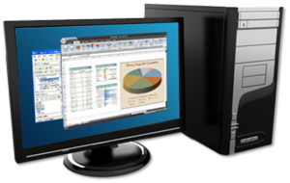
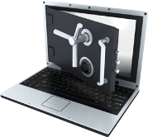

How Small Businesses Can Reduce Security Risks
Protect data from attacks
Protect data in case of laptop loss or theft
Simplify data backups
Run frequent PC virus scans with the latest security software
Deploy software updates and quickly fix problem PCs
Install an anti-theft solution in all laptops so sensitive data is not compromised
Frequently encrypt data on PCs and servers
Automate data backup across the network
Ensure hard drive reliability

Slide 5


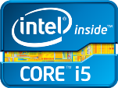

Enhancing Security with 2nd Generation
Intel® Core™ Processor
Family-based PCs

Slide 6




Intel PC Solutions Have Built-in Security Features
To Help Protect Data From Attacks
Small Business Concern | Too long to fix remote systems | Security software disabled or out of date
Solution | PC built with 2nd gen Intel® Core™ vPro™ processor family | PC built with 2nd gen Intel® Core™ vPro™ processor family
Software
Intel Hardware
Built-in Technology | KVM Remote Control⁵ | Intel® Active Management Technology⁶
Small Business Benefit | Fix more security issues faster⁵ | Increase security and update reliability⁶
Other names and brands may be claimed as the property of others
Notes:
6

Slide 7







Protect Data in Case of PC Loss or Theft
Small Business Concern | Lost or stolen notebook | Data not encrypted
Solution | PC built with 2nd gen Intel® Core™ processor family | PC built with 2nd gen Intel® Core™ i5 processor
Software
Intel Hardware
Built-in Technology | Intel® Anti-Theft Technology⁷ | Intel® Advanced Encryption Standard New Instructions (AES-NI)⁸
Small Business Benefit | Disable PCs at hardware level in the event of loss or theft⁷ | Secure sensitive data up to 4x faster⁹
±
± Software and services only available in select locations. Contact Absolute Software for availability of products and services.
Other names and brands may be claimed as the property of others
Notes:
7

Slide 8
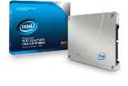

Simplify PC Data Backups
Small Business Concern | Hard drive failures | Data backup not performed
Solution | PC built with 2nd gen Intel® Core™ i5 processor and Intel® Solid State Drives | PC built with 2nd gen Intel® Core™ vPro™ family processor, and storage device
Intel Hardware
Built-in Technology | Intel® Multi-Level Cell NAND Flash Memory | Intel® Rapid Storage Technology
Small Business Benefit | Reduce hard drive failure rates over traditional hard drives¹⁰ | Automate data backups¹¹
+
Other names and brands may be claimed as the property of others
Notes:
8

Slide 9









Which Intel PC Security Solution is Best for Your Small Business Customer?
Entry-level computing
Smart performance
Smart performance. IT intelligent.
 | Protect data from attacks | Increase security update reliability
 |  | Fix more security issues fast with KVM Remote Control⁵
 |  | Keep security tasks in the background
 | Protect data in case of PC loss or theft | Faster data encryption
 |  | Disable PCs that are lost or stolen
 | Simplify data backups | Automate data backups with SATA drive
Deliver robust, unique security protection from Intel

Slide 10
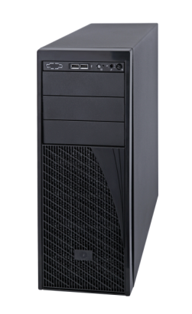
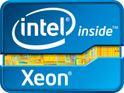
Enhancing Security with Intel® Xeon® Processor
E3-based Servers

Slide 11

Protect Data with Entry Servers Based on the Intel® Xeon® Processor E3-1200 Family
Small Business Concern | Keeping security software up-to-date | Data encryption slowing down system speed
Solution | Server built on the Intel® Xeon® processor E3-1200 family | Server built on the Intel® Xeon® processor E3-1200 family
Intel Hardware
Built-in Technology | Intel® Active Management Technology¹² | Intel® Advanced Encryption Standard New Instructions (AES-NI)¹³
Small Business Benefit | Remotely and proactively update anti-virus software across the network | Increase security while maintaining system performance
Other names and brands may be claimed as the property of others
Notes:
11

Slide 12
Additional Dependability Built-In with
Intel® Xeon® Processor-based Servers
Small Business Concern | Memory errors causing system crash | Data loss or system downtime
Solution | Server built on the Intel® Xeon® processor E3-1200 family | Server built on the Intel® Xeon® processor E3-1200 family
Intel Hardware
Built-in Technology | ECC Memory Support | Intel® Rapid Storage Technology
Small Business Benefit | Correct memory errors to prevent data corruption &server shutdown | Protect data from a potential hard drive failure
Other names and brands may be claimed as the property of others
Notes:
12

Slide 13


Help Your Customer Understand the Additional Security Features of Intel® Xeon® Processor-based Servers
Desktop processor
based server
Server based on Intel® Xeon® processor E3-1200 family
Protect data from attacks | Remote Management with Intel® Active Management Technology¹²
 | Faster data encryption with Intel® AES-NI¹³
Dependability to operate 24/7 | Correct memory errors to keep network running
 | Redundant storage to help prevent the loss of critical business data
 | Extensively tested and validated with Intel® Server Validation
A Smart Investment to Keep Business Running 24/7

Slide 14
Overcoming Buyer Objections
“Our current systems seem secure. How would new PCs help?”

Slide 15
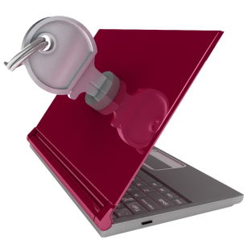
“My current systems seem secure. How would new PCs help?”
Your Response
PCs older than three years experience 60% more security incidents than newer PCs.⁴
2nd gen Intel® Core™ i5 processors have built-in security:
Intel AES-NI⁸ for 4x faster encryption of sensitive data⁹
Optional Intel® Anti-Theft Technology to disable a laptop if it’s lost or stolen⁷
Help protect your company’s data by updating your PCs.

Slide 16
Overcoming Buyer Objections
“How will anti-theft technology protect my company’s data?”

Slide 17
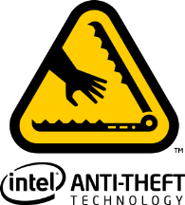
“How will anti-theft technology protect my company’s data?”
Your Response
Intel® Anti-Theft Technology⁷ can disable a PC if it’s lost or stolen, protecting critical company data.
Works even without network connectivity.
Non-destructive: Once recovered, PCs can be reactivated to full functionality.

Slide 18
Overcoming Buyer Objections
“I don’t run security applications because they slow down our systems.”

Slide 19
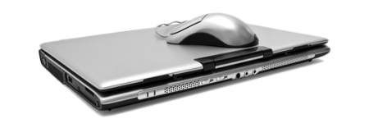

“I don’t run security applications because they slow down our systems.”
Your Response
PCs built with 2nd gen Intel® Core™ i5 processors encrypt sensitive data up to 4x faster.^{8,9}
Intel security solutions help keep data safe without slowing your business down.

Slide 20
Overcoming Buyer Objections
“Why pay more for a PC built with a 2nd gen Intel® Core™ vPro™ processor?”

Slide 21
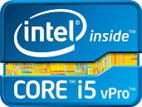
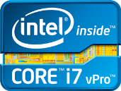
“Why pay more for a PC built with a 2nd generation Intel® Core™ vPro™ processor?”
Your Response
2nd generation Intel® Core™ vPro™ processor family offers smart security benefits.
IT support can remotely repair PCs, even if they are powered down, with KVM Remote Control.⁵
Automate data backups with Intel® Rapid Storage Technology and a SATA drive.¹¹
More security. Less stress.
Notes:
Key Takeaway: Your customers’ small businesses are probably having to do more with less. Intel®Core™ vPro™ technology enables very important improvements in machine management, productivity, and security. In short, a lot more capability for the money.
Points to Cover:
Intel®Core™ vPro™ processors help small businesses stay safe. Easy PC care features mean LESS INTERRUPTION to business operations. People can get more done, and IT staff can dedicate their time to improving systems rather than fixing them. Small businesses can conduct secure maintenance, virus patch updates, and repair systems—remotely and after hours—even when the machine is off.
Intel®Core™ vPro™ technology adds the capability to do KVM Remote Control.With KVM Remote Control out-of-band (regardless of power, OS or hard drive state) capability of Intel® Core™ vPro™ technology, a small business IT department or their service provider can help ensure that the latest security updates have a faster penetration rate.

Slide 22
Overcoming Buyer Objections
“I don’t need a server.
My PC (or desktop-derived server)
is reliable”

Slide 23
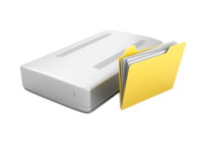

“I don’t need a server.
My PC (or desktop-derived server) is reliable.”
Your Response
“Your PC won’t be able to keep up as your volume of data grows.”
Always-present file storage and data backup
Faster data encryption with Intel® AES-NI¹³

Slide 24
Legal Information

Slide 25
Legal Information
“Notebook Total Cost of Ownership: 2008 Update,” Gartner, February 2008 (www.Gartner.com)
2. Symantec, “2010 SMB Information Protection Survey, http://www.symantec.com/content/en/us/about/media/pdfs/SMB_ProtectionSurvey_2010.pdf?om_ext_cid=biz_socmed_twitter_2010Jun_worldwide_SMB
3. Source: Rubicon Consulting, 2009, US based survey
4. Source: SMB Disaster Preparedness Survey, Symantec, Q3 2009 http://www.symantec.com
5. KVM Remote Control (Keyboard, Video, Mouse) is only available with Intel® Core™ i5 vPro™ and Core™ i7 vPro™ processors with Intel® Active Management technology activated and configured and with integrated graphics active. Discrete graphics are not supported.
6. Requires activation and a system with a corporate network connection, an Intel® AMT-enabled chipset, network hardware, and software. For notebooks, Intel AMT may be unavailable or limited over a host OS-based VPN, when connecting wirelessly, on battery power, sleeping, hibernating, or powered off. Results dependent upon hardware, setup, and configuration. For more information, visit: http://www.intel.com/technology/platform-technology/intel-amt.
7. No system can provide absolute security under all conditions. Requires an enabled chipset, BIOS, firmware and software, and a subscription with a capable service provider. Consult your system manufacturer and service provider for availability and functionality. Intel assumes no liability for lost or stolen data and/or systems or any other damages resulting thereof. For more information, visit http://
www.intel.com/go/anti-theft.
8. Intel ® AES-NI requires a computer system with an AES-NI-enabled processor, as well as non-Intel software to execute the instructions in the correct sequence. AES-NI is available on select Intel® Core™ processors. For availability, consult your system manufacturer. For more information, see http://software.intel.com/en-us/articles/intel-advanced-encryption-standard-instructions-aes-ni/.

Slide 26
Legal Information
9. Software and workloads used in performance tests may have been optimized for performance only on Intel® microprocessors. Performance tests, such as SYSmark* and MobileMark*, are measured using specific computer systems, components, software, operations, and functions. Any change to any of those factors may cause the results to vary. You should consult other information and performance tests to assist you in fully evaluating your contemplated purchases, including the performance of that product when combined with other products. (Cross Client) Cross-client claim based on lowest performance data number when comparing desktop and mobile benchmarks. Configurations and performance test as follows: (Mobile) Comparing pre-production Intel® Core™ i5-2520M Processor (2C4T, 2.5 GHz, 3 MB cache), Intel reference board, 4 GB (2x2 GB) PC3-10700 (DDR3-1333)-CL9, Hitachi* Travelstar 320 GB hard-disk drive, Intel® HD Graphics 3000, Driver: 2185 (BIOS:v.34, Intel v.9.2.0.1009), Microsoft* Windows* 7 Ultimate 64-bit RTM Intel® Core™2 Duo Processor T7250 (2M Cache, 2.00 GHz, 800 MHz FSB), Intel reference board, Micron* 4 GB (2x2 GB) PC3-8500F (DDR3-1066)-400, Hitachi* 320 GB hard-disk drive, Mobile Intel 4 Series Express Chipset Family with 8.15.10.2182 (BIOS: American Megatrends AMVACRB1.86C.0104.B00.0907270557, 9.1.2.1008) (Desktop) Pre-production Intel® Core™ i5-2400 Processor (4C4T, 3.1GHz, 6 MB cache), Intel reference board, Micron* 4 GB (2x2 GB) PC3-10700 (DDR3-1333)-CL9, Seagate* 1 TB, Intel® HD Graphics 2000, Driver: 2185 (BIOS:v.35, Intel v.9.2.0.1009) , Microsoft* Windows* 7 Ultimate 64-bit RTM Intel® Core™ 2 Duo E6550 (2C2T, 2.33 GHz, 4 MB cache), Intel DG945GCL Motherboard, Micron 2 GB (2x1 GB) DDR2 667 MHz, Seagate 320 GB hard-disk drive, Intel® GMA 950, Driver: 7.14.10.1329, (BIOS:CL94510J.86A.0034, INF: 9.0.0.1011), Microsoft Windows* 7 Ultimate 64-bit RTM Business productivity claims based on SYSmark* 2007, which is the latest version of the mainstream office productivity and Internet content creation benchmark tool used to characterize the performance of the business client. SYSmark 2007 preview features user-driven workloads and usage models developed by application experts. Multitasking claims based on PCMark Vantage*, a hardware performance benchmark for PCs running Microsoft* Windows* 7 or Windows Vista*, includes a collection of various single and multi-threaded CPU, Graphics, and HDD test sets with a focus on Windows* application tests. Security workload consists of SiSoftware Sandra* 2010—AES256 CPU Cryptographic subtest measures CPU performance while executing AES (Advanced Encryption Standard) encryption and decryption algorithm. For more information go to htp://www.intel.com/performance.
10. Source: Intel®- IT@Intel®2009 Enterprise-wide Deployment of Notebook PCs with Solid-State Drives" August 2009, http://download.intel.com/it/pdf/Enterprise-wide_Deployment_of_Notebook_PCs_with_Solid-State_Drives.pdf
11. Check with your storage device manufacture for specific features implemented in their designs.
12. Intel® Active Management Technology Requires activation and a system with a corporate network connection, an Intel® AMT-enabled chipset, network hardware and software. For notebooks, Intel AMT may be unavailable or limited over a host OS-based VPN, when connecting wirelessly, on battery power, sleeping, hibernating or powered off. Results dependent upon hardware, setup & configuration. For more information, visit http://www.intel.com/technology/platform-technology/intel-amt
13. Intel® AES-NI requires a computer system with an AES-NI enabled processor, as well as non-Intel software to execute the instructions in the correct sequence. For availability, consult your reseller or system manufacturer. For more information, see http://software.intel.com/en-us/articles/intel-advanced-encryption-standard-instructions-aes-ni/
Intel may make changes to specifications, release dates and product descriptions at any time, without notice.
© 2011, Intel Corporation. All rights reserved. Intel, the Intel logo, Intel Core, Intel vPro, Pentium, Centrino, and Intel Xeon are trademarks of Intel Corporation in the U.S. and other countries.
Other names and brands may be claimed as the property of others.

Slide 27
声明：
所有的版权属于原有公司，文件均来自公开渠道
此文件仅供学习使用，任何人不得进行以此为商业目的的行为
如有疑问，请立即删除
学习世界五百强和咨询公司PPT课程请访问如下网站搜索：“司马懿”
百度传课：司马懿PPT学校
https://www.chuanke.com
网易学堂：司马懿PPT学校
https://study.163.com
知乎： 司马懿PPT学校
https://www.zhiu.com

