Slide 1
Scheduler-Problem with scheduler If User and Person are different November 11, 2010

Slide 2
Overview
When trying to create a new Schedule, and error is displayed if the user name and person name do not match: "The person does not exist or is not active"
Fix:
Modify the field class names
Modify the scheduler.xml

Slide 3
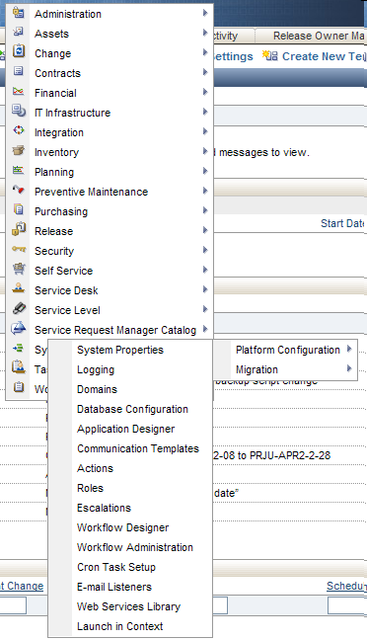
Step 1: Log into Maximo
Go to the Application Designer.
- Go To → System Configuration → Platform Configuration → Application Designer

Slide 4
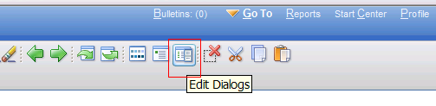
Step 2: Application Designer
Bring up the Scheduler Application
Bring up the “Edit Dialogs”

Slide 5
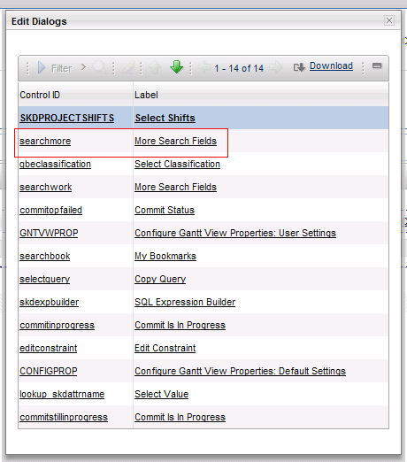
Step 3: More Search Fields
Click on “More Search Fields”

Slide 6
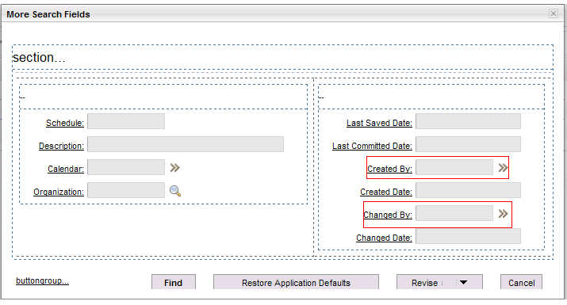
Step 4: “More Search Fields” dialog opens Close the “Edit Dialogs”

Slide 7
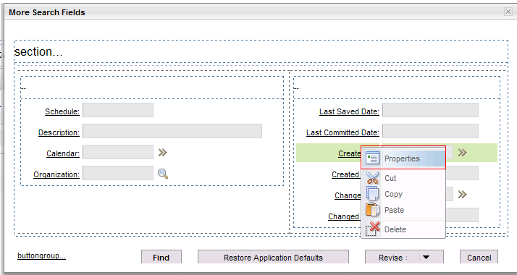
Step 5: Change “Created By” Properties
Right click on the “Created By” column.
Click on ‘Properties’ option

Slide 8
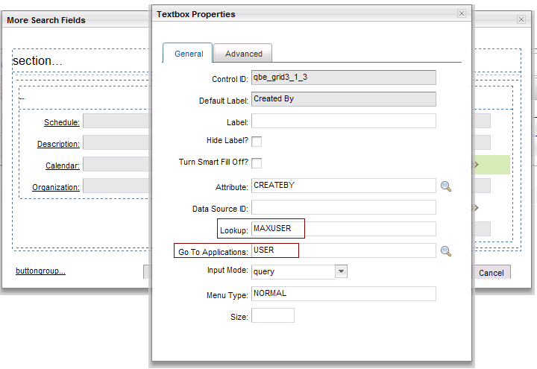
Step 6: Modify ‘Lookup’ and ‘Go To Application’
Modify the Lookup and Go To Application.
Lookup=‘MAXUSER’
Go To Application=“USER”

Slide 9
Step 7
Close Textbox Properties dialog

Slide 10
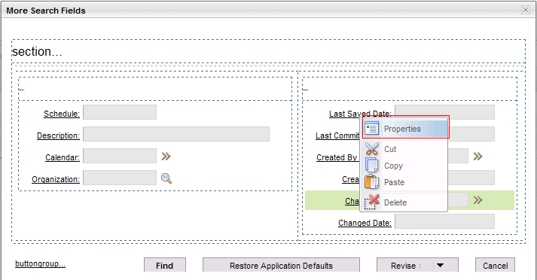
Step 8: Change “Changed By” Properties
Right click on the “Changed By” column.
Click on ‘Properties’ option

Slide 11
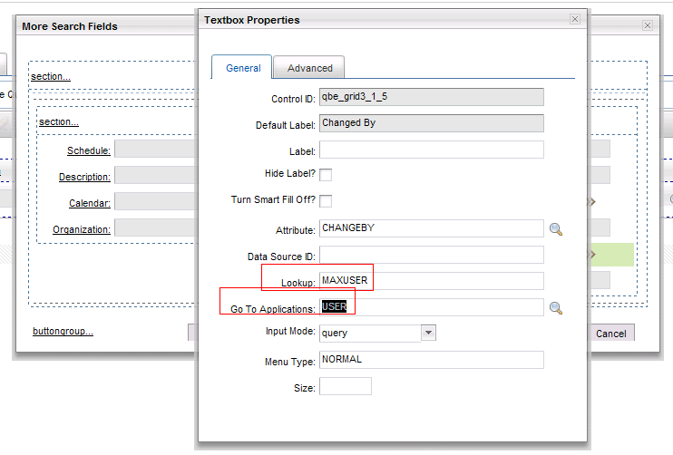
Step 9: Modify ‘Lookup’ and ‘Go To Application’
Modify the Lookup and Go To Application.
Lookup=‘MAXUSER’
Go To Application=“USER”

Slide 12

Step 10
Close the ‘Textbox properties’ dialog
Close the ‘More Search Fields’ dialog
Save the Application Designer

Slide 13
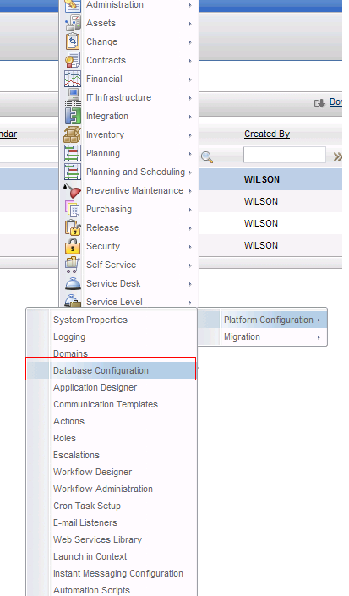
Step 11 :Database Configuration
Go To → System Configuration → Platform Configuration → Database Configuration

Slide 14
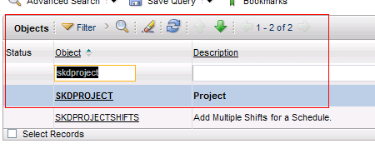
Step 12: Database Configuration
Filter for the “SKDPROJECT” object

Slide 15
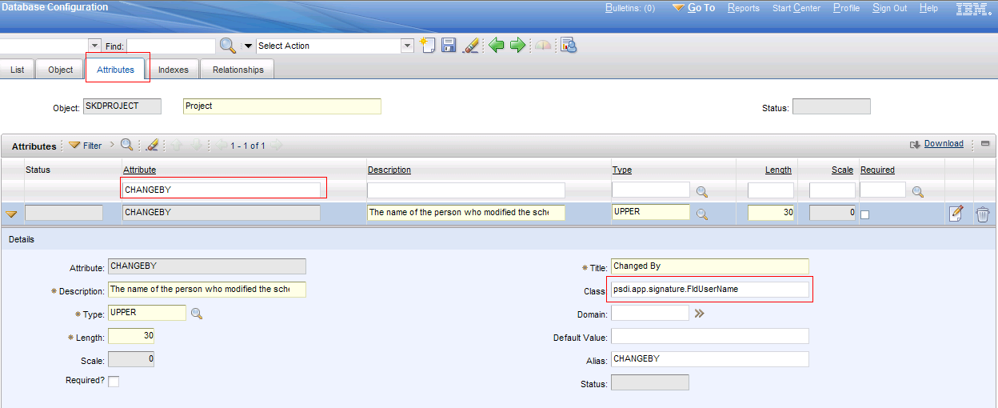
Step 13: Database Configuration
Click on “Attributes” tab
Filter for “CHANGEBY” attribute
Modify the Class to: psdi.app.signature.FldUserName

Slide 16
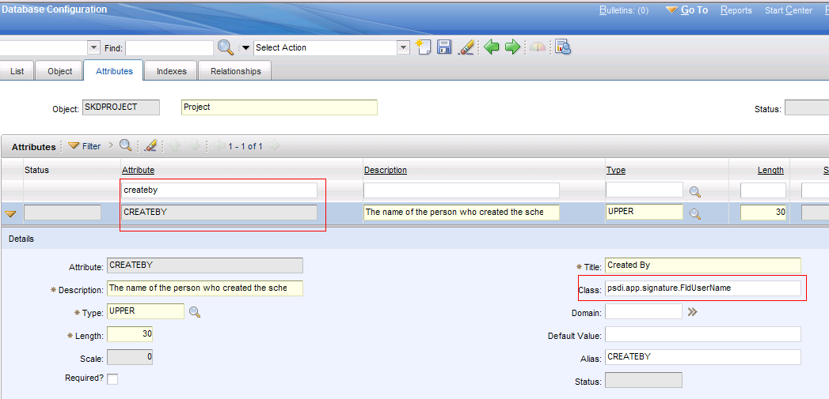
Step 14:Database Configuration
Click on “Attributes” tab
Filter for “CREATEBY” attribute
Modify the Class to: psdi.app.signature.FldUserName

Slide 17

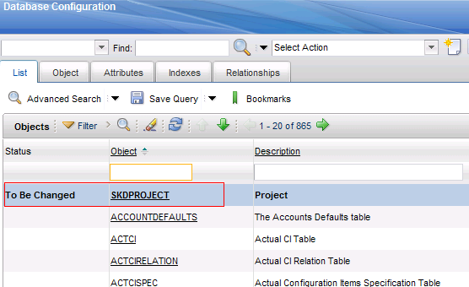
Step 15:Database Configuration
Save the ‘Database Configuration’
Go To List Tab and remove the filter for SKDPROJECT
And you see something like this:

Slide 18
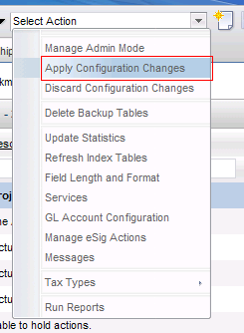
Step 16: Database Configuration
Select Action – ‘Apply Configuration Changes”

Slide 19
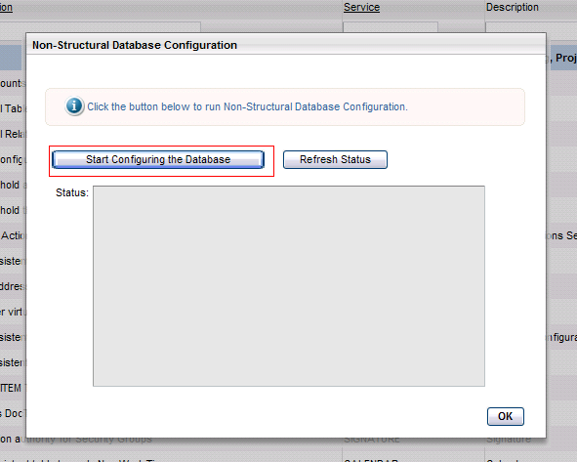
Step 17: Database Configuration
Now click on “Start Configuring the Database” button.

Slide 20
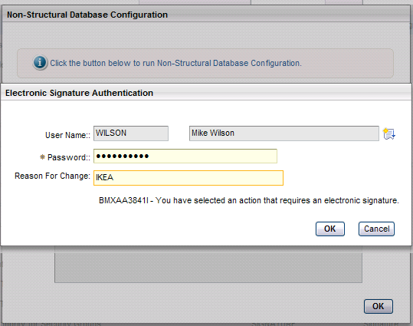
Step 18: Database Configuration
Input the Password and Reason for Change
Click OK button

Slide 21
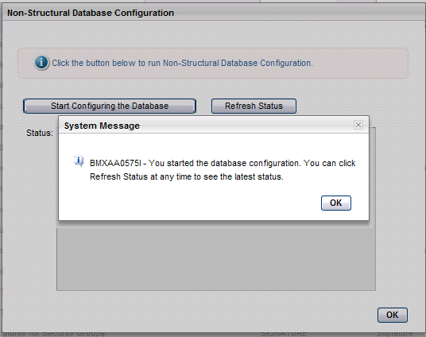
Step 19: Database Configuration
Please wait few minutes for the next screen.
Then click OK on the BMXAA message

Slide 22
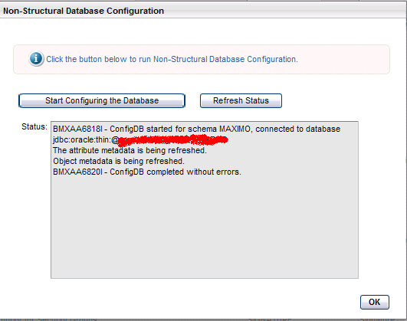
Step 20: Database Configuration
Refresh the status in a couple of minutes
If the , BMXAA6820I - ConfigDB completed without errors.
Click OK

Slide 23
Test the Scheduler Issue
Test the Scheduler Issue

Slide 24
声明：
所有的版权属于原有公司，文件均来自公开渠道
此文件仅供学习使用，任何人不得进行以此为商业目的的行为
如有疑问，请立即删除
学习世界五百强和咨询公司PPT课程请访问如下网站搜索：“司马懿”
百度传课：司马懿PPT学校
网易学堂：司马懿PPT学校
知乎： 司马懿PPT学校
访问地址
https://www.chuanke.com
访问地址
https://study.163.com
访问地址
https://www.zhiu.com

