Slide 1


AL_Tables
Jim Kirk August, 2011

Slide 2
Agenda – metadata tables
AL_Statistics
AL_History
AL_Lang & AL_Langxmlltext
AL_Cache & AL_Cache_Stats
AL_Audit & AL_Audit_Info
The intent is to present the logic behind some of the resolutions you have all used or seen in the past. This content is for primary support engineers and not to be posted to case notes, external KBA or wiki content. You have no doubt heard these before:
My logs aren't’ being deleted, why?
Uncheck ‘Use Collected Statistics’ and rerun the job.
Change the Cache Type to ‘In-Memory’.
I get ‘Virtual Memory’ warnings or errors.
My AL_Statistics table is huge.
My Management Console Admin/Batch is very slow, why?
Y

Slide 3
Data Integrator Background

Slide 4
Acta
Roots:
Business Objects's Data Integrator is a data integration and ETL tool that was previously known as ActaWorks.
Acta Technology_ posted in April 2002
Acta provides the industry's first and only batch and real-time data integration platform expanding extraction, transformation, and loading (ETL) technology beyond its traditional data warehousing role to more effectively integrate business intelligence (BI), enterprise resource planning (ERP), customer relationship management (CRM), supply chain management (SCM), and eCommerce solutions. With Acta's highly scalable data integration software, enterprises can rapidly design and deploy data flows that provide customers, suppliers, employees, and partners with the critical information they need, faster and at lower cost.

Slide 5
Metadata AL Tables
ReferenceGuide\Metadata in Repository Tables and Views
This will contain a small sampling of the tables and their purpose.
It will include sample sql to query against the content for reporting.

Slide 6
AL_Cache & AL & Cache_Stats

Slide 7
References
Wiki DI caching -> http://wiki.sdn.sap.com/wiki/x/aYJCE
Wiki Cache transforms -> http://wiki.sdn.sap.com/wiki/x/94NCE

Slide 8
Can I determine the size of the cache (say one table)?
table size = (in bytes)
# of rows * # of columns * 20 bytes (average column size) * 1.3 (30% overhead)
Example: a modest transactional table with manageable data types.
250000 * 20 * 20 * 1.3 = 169mb

Slide 9
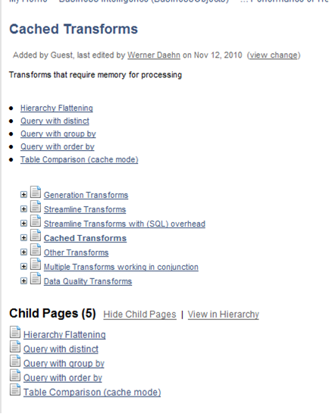
What do we know up front uses cache? http://wiki.sdn.sap.com/wiki/display/BOBJ/Cached+Transforms

Slide 10
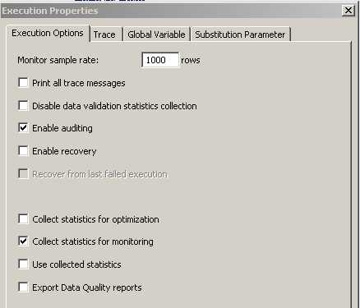
Definition - Collect statistics for optimization
Select this check box if you want to collect statistics that the Data Services optimizer will use to choose an optimal cache type (in-memory or pageable). This option is not selected by default.
For more information, see Caching sources in the Performance Optimization Guide.
For more information, see the Using Caches chapter in the Performance Optimization Guide

Slide 11
Caching Data Reference Using Caches in Performance Opt Guide
You can improve the performance of data transformations that occur in memory by caching as much data as possible. By caching data, you limit the number of times the system must access the database.
SAP BusinessObjects Data Services provides the following types of caches that your data flow can use for all of the operations it contains:
In-memory
Use in-memory cache when your data flow processes a small amount of data that fits in memory.
Pageable cache
Use pageable cache when your data flow processes a very large amount of data that does not fit in memory. When memory-intensive operations (such as Group By and Order By) exceed available memory, the software uses pageable cache to complete the operation.
Pageable cache is the default cache type. To change the cache type, use the Cache type option on the data flow Properties window.
Note: If your data fits in memory, it is recommended that you use in-memory cache because pageable cache incurs an overhead cost.
SAP BusinessObjects Data Services uses cache statistics collected from previous job runs to automatically determine which cache type to use for a data flow. Cache statistics include the number of rows processed.
The default cache type is pageable. the software can switch to in-memory cache when it determines that your data flow processes a small amount of data that fits in memory.
A cache (pronounced CASH) is a place to store something temporarily

Slide 12
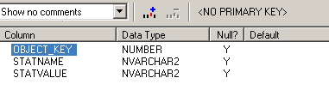
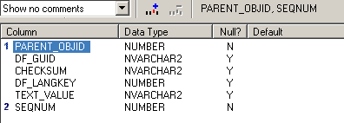
Definitons (on Oracle) AL_Cache_Stats AL_Cache
When the collect statistics for optimization is checked these two tables populate based on design and cache used while running in pageable mode.

Slide 13
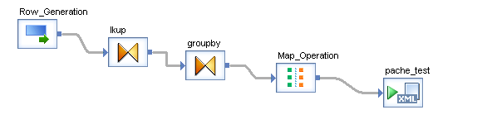

Simple test case illustrating collect stats
Row gen for 20mil rows; two lookups on a table with addresses, a groupby on region + zip code and orderby region; map op to discard all and xml template for the target. This design will leverage paging. On a fresh repo or after truncating the al_cache and al_cache_statistics tables run the job with ‘Collect statistics for Optimization’ and for monitoring checked. NOTE: Whenever the job is run to collect stats it will run in pageable.
Then run this sql on the repo:
select s.STATNAME,s.statvalue, c.text_value from al_cache_stats s, al_cache c
where s.object_key = c.parent_objid and c.SEQNUM <> '-1' and s.STATNAME = 'cachesize‘
Statvalue in bits. The following illustrations are for #1 the sql results, and #2 the activity on Pcache directory.

Slide 14
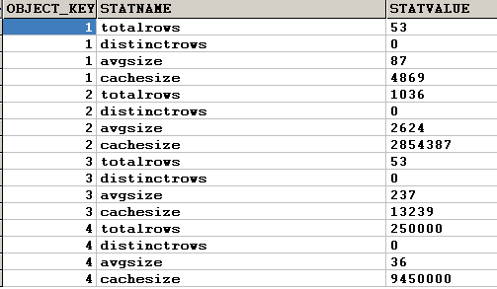
Al_cache_stats will have four rows per transformation using cache
With four objects\functions requiring cache add four the stats up.12,309,256 bytes or 12.3mb

Slide 15
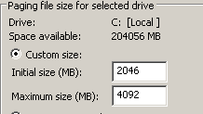

Now run using collected stats
Trace Log:
(12.2) 12-15-11 10:28:28 (20296:18372) DATAFLOW: Data flow <_df_pache_sdn1> is started.
(12.2) 12-15-11 10:28:28 (20296:18372) DATAFLOW: Cache statistics determined that data flow <_df_pache_sdn1> uses <4> caches with a total size of <12317626> bytes. This is less than(or equal to) the virtual memory <1290797056> bytes available for caches. Statistics is switching the cache type to IN MEMORY.(12.2) 12-15-11 10:28:28 (20296:18372) DATAFLOW: Data flow <_df_pache_sdn1> using IN MEMORY Cache.
NOTE:
DON”T confuse the cache types here with the OS resources.
On a Windows machine with virtual memory, the computer can look for areas of RAM that have not been used recently and copy them onto the hard disk. The area of the hard disk that stores the RAM image is called a page file
The virtual memory manager might issue the message: "Your system is low on virtual memory. Windows is increasing the size of your virtual memory paging file." This happens if it is required to swap out a page from RAM to the pagefile while all pages in the pagefile are already taken. With that message, it will allocate more space to the pagefile and use the added space to store the newly- swapped-out page (and subsequent pages).

Slide 16
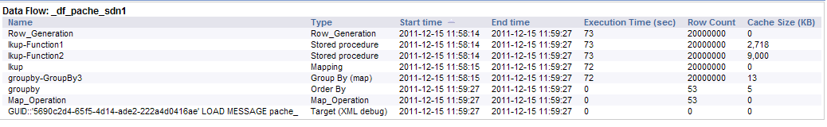

Force to run in-memory
On the Data Flow set cache type to in-memory, and job execution options check only collect stats for monitoring. This forces the job to run in-memory.
11.7mb total cache memory required here, the system saw 24mb total increase while the job was running. The content of the two cache tables was truncated. If there are stats and the DF is set to default ‘pageable’ and the run is set without checking either collect or use stats the rows for this job, data flow are deleted.
Trace on MS SQL contains ‘DELETE FROM AL_CACHE_STATS WHERE OBJECT_KEY in (1)’

Slide 17
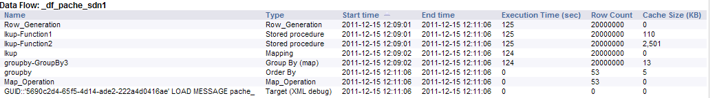
Start over, or take a deep breath.
Leave DF as in-memory but collect stats for optimization and monitoring.
Trace:
16756 18060 DATAFLOW 12/15/2011 12:09:01 PM Switching cache type from IN MEMORY to PAGEABLE for data flow <_df_pache_sdn1> to allow collection of statistics for16756 18060 DATAFLOW 12/15/2011 12:09:01 PM optimization. PAGEABLE cache is chosen while collecting statistics to allow the data flow to finish any amount of data being16756 18060 DATAFLOW 12/15/2011 12:09:01 PM cached.16756 18060 DATAFLOW 12/15/2011 12:09:01 PM Data flow <_df_pache_sdn1> using PAGEABLE Cache with <1231 MB> buffer pool.
Run again using collected stats and the job runs in pageable.

Slide 18
Trace log examples
First run on new job, with use collected stats checked and DF set to default cache type == pageable.
18408 20152 DATAFLOW 12/16/2011 2:03:07 PM Cache statistics for data flow <_df_al_stats_rpivot_jwrk> are not available to be used for optimization and need to be18408 20152 DATAFLOW 12/16/2011 2:03:07 PM collected before they can be used.18408 20152 DATAFLOW 12/16/2011 2:03:07 PM Data flow <_df_al_stats_rpivot_jwrk> using PAGEABLE Cache with <1486 MB> buffer pool.

Slide 19
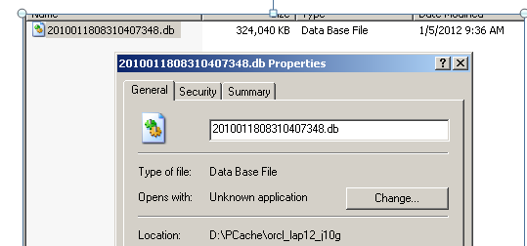
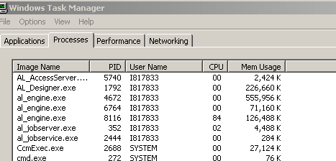
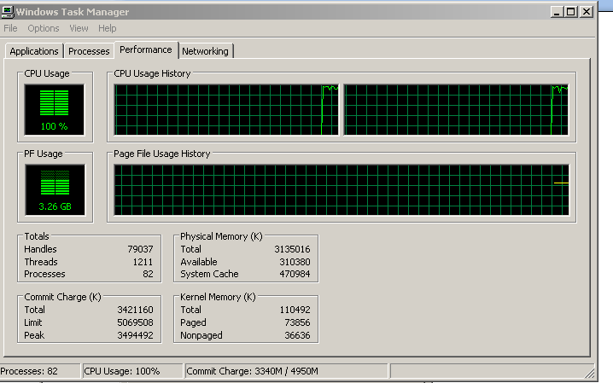
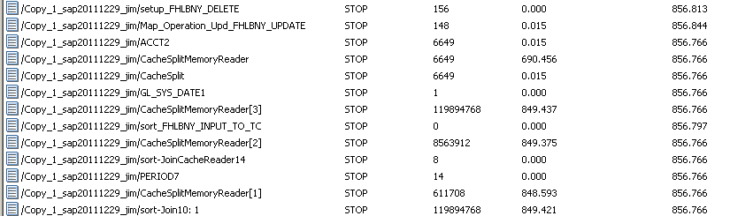
Customer Example – cache, bad join, 119mil rows

Slide 20
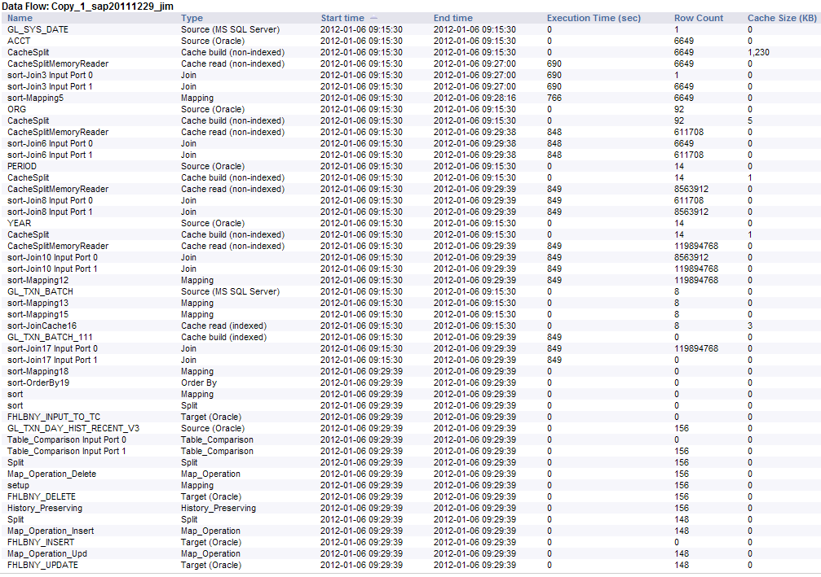
Lots of threads

Slide 21
Thank You!
Contact information:
In Exile.

Slide 24
声明：
所有的版权属于原有公司，文件均来自公开渠道
此文件仅供学习使用，任何人不得进行以此为商业目的的行为
如有疑问，请立即删除
学习世界五百强和咨询公司PPT课程请访问如下网站搜索：“司马懿”
百度传课：司马懿PPT学校
网易学堂：司马懿PPT学校
知乎： 司马懿PPT学校
访问地址
https://www.chuanke.com
访问地址
https://study.163.com
访问地址
https://www.zhiu.com

