Slide 1

Small Business Mobility
Speaker Name
Title
© Copyright 2012 Hewlett-Packard Development Company, L.P. The information contained herein is subject to change without notice.
Partner logo

Slide 2


Agenda
The small business mobility market
What’s in it for you?
Next steps
Partner logo
© Copyright 2012 Hewlett-Packard Development Company, L.P. The information contained herein is subject to change without notice. HP Confidential.
2

Slide 3
What’s in it for you?

Slide 4
Mobility is transforming small business
94%
117%
69%
Of mobile device users agree that their use of mobile devices for works tasks has made them more efficient.
The increase of employees’ use of tablets in the next two years
Of employees own the mobile device they use for work.
Better access to people and information to make better/faster decisions
Increase in bandwidth requirements
BYOD is commonplace, not just a trend
The Mobility Edge: CDW’s 2012 Small Business Mobility Report, October 2012
Notes:
Worker productivity continues to be key focus of the mid-market. Continuing economic concerns are forcing businesses to persist in finding ways to do more with less and they are embracing mobility as a way to achieve that goal.
Mobility is allowing employees to work more effectively inside and outside of the office. Mid-size businesses are arming employees with smartphones, laptops, touchpads, as well as dealing with a trend of employees using their own personal devices for work-related activities.
They are finding new ways of staying in touch with and servicing customers such as video collaboration and social media.
They are exploring technology approaches such as cloud computing that can help them streamline their business, cut costs and increase productivity.
Transcript:
We're our own best reference here. In our six data centers, we run now 100% HP Networking. So believe it or not, every time you attach to our network, you're a great reference. You're running it every single day. So you have that conversation with the CIO and when you're done with that what's going to happen is you'll go down to the technical folks and let me tell you what they're going to tell you. Well, you know, we've always bought Cisco and, you know, I'm certified at Cisco. So if I was to buy your stuff, what happens to my certification?
Transcript:
We're our own best reference here. In our six data centers, we run now 100% HP Networking. So believe it or not, every time you attach to our network, you're a great reference. You're running it every single day. So you have that conversation with the CIO and when you're done with that what's going to happen is you'll go down to the technical folks and let me tell you what they're going to tell you. Well, you know, we've always bought Cisco and, you know, I'm certified at Cisco. So if I was to buy your stuff, what happens to my certification?
Author’s Original Notes:
5 January 2018
Transcript:
We're our own best reference here. In our six data centers, we run now 100% HP Networking. So believe it or not, every time you attach to our network, you're a great reference. You're running it every single day. So you have that conversation with the CIO and when you're done with that what's going to happen is you'll go down to the technical folks and let me tell you what they're going to tell you. Well, you know, we've always bought Cisco and, you know, I'm certified at Cisco. So if I was to buy your stuff, what happens to my certification?
Author’s Original Notes:
HP Confidential
Transcript:
We're our own best reference here. In our six data centers, we run now 100% HP Networking. So believe it or not, every time you attach to our network, you're a great reference. You're running it every single day. So you have that conversation with the CIO and when you're done with that what's going to happen is you'll go down to the technical folks and let me tell you what they're going to tell you. Well, you know, we've always bought Cisco and, you know, I'm certified at Cisco. So if I was to buy your stuff, what happens to my certification?
Author’s Original Notes:
4

Slide 5


Small business wireless networks are at a breaking point
Inconsistent user experience
Increasing the number of wireless users and devices degrades overall user experience
Higher bandwidth applications (e.g., HD video conferencing, voice, radiology, video on demand)
Business disruption
Rogue access points
Security gaps
Unreliable performance
Constrained budgets and headcount
Time consuming installation and deployment
Complex management
Partner logo
© Copyright 2012 Hewlett-Packard Development Company, L.P. The information contained herein is subject to change without notice. HP Confidential.
5
Notes:
All of these developments are bringing wireless networks to a breaking point.
Increased workforce mobility
High levels of mobility driving demand for integrated enforcement of access control, security policies and management
Proliferation of cloud services, multi-media applications and SaaS
Cloud services, Multi-media and SaaS are driving demand for high bandwidth/higher user density applications with better capacity.
Complexity of management
Spiraling IT footprint/costs
Businesses want to meet the increasing demand for mobile local area network access while lowering the cost of ownership to deal with the user device sprawl caused by the consumerization of IT with employees having a notebook, tablet and smartphone for business use.
Businesses want a converged wired and wireless infrastructure for consistent enforcement of access control, security policies and management.
High bandwidth mobility services are needed for multi-media and hi-res medical imaging applications such as PACS
Businesses want to meet the increasing demand for mobile local area network access while lowering the cost of ownership to deal with the user device sprawl caused by the consumerization of IT with employees having a notebook, tablet and smartphone for business use
Simplified management with consistent policy enforcement across wired and wireless infrastructures.
Ensuring quality of service for concurrent users and bandwidth intensive applications
On line learning – students all accessing course material simultaneously
Digital imaging for healthcare – bandwidth intensive
Double the number of users per access point
Up to 50% improvement in performance
Customers forced to use many different management tools.
Single-pane-of-glass management
Reduction of OPEX: training on only one application & troubleshooting and event correlation – events in real time across wired/wireless
Wired, wireless solution that has a single security approach
Integrated security for client authentication regardless of method of access

Slide 6
A major business opportunity
Source: Canalys, October 2011

Slide 7
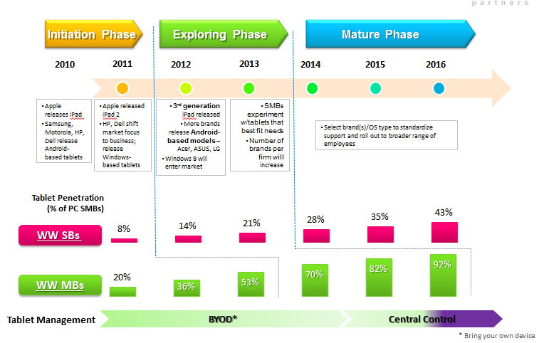
Momentum is building
Tablet penetration driving WLAN upgrades and demand
SMB Mobility Market Evolution
2011-12 U.S. Small Business Market Opportunity Assessment, AMI-Partners, 2011

Slide 8
Your opportunity
Regions to update
Revenue opportunity
Services opportunity
Promotions and SPIFFs

Slide 9
HP Small Business Mobility Solutions

Slide 10

HP Small Business Portfolio
Addressing common business needs
Small business customers demand ease of use
Networks play a major role in today’s businesses which increases the need for security and reliability
Flexibility is a key attribute when discussing deployment options
Partner logo
© Copyright 2012 Hewlett-Packard Development Company, L.P. The information contained herein is subject to change without notice. HP Confidential.
10

Slide 11
HP is #1 worldwide in smart managed switch sales!
More sales than Cisco, Netgear or D-Link
Source: Infonetics Research
When: March 2012 report current to Q4 CY2011
Category: Web Managed
Worldwide port share (%)
HP: 31.5%
Netgear: 23.9%
D-Link: 18.1%
Cisco: 9.1%
Source: Dell’Oro Group
When: March2012 report current to Q4 CY2011
Category: Smart/Web Managed
Worldwide port share (%)
HP: 30.8%
Netgear: 23.4%
D-Link: 17.7%
Cisco: 10.2%

Slide 12

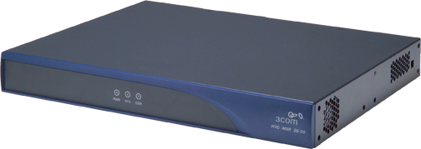
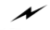
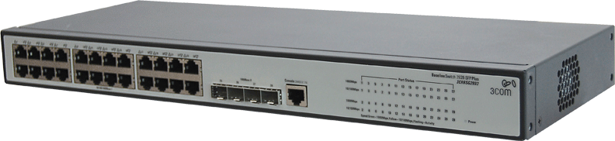




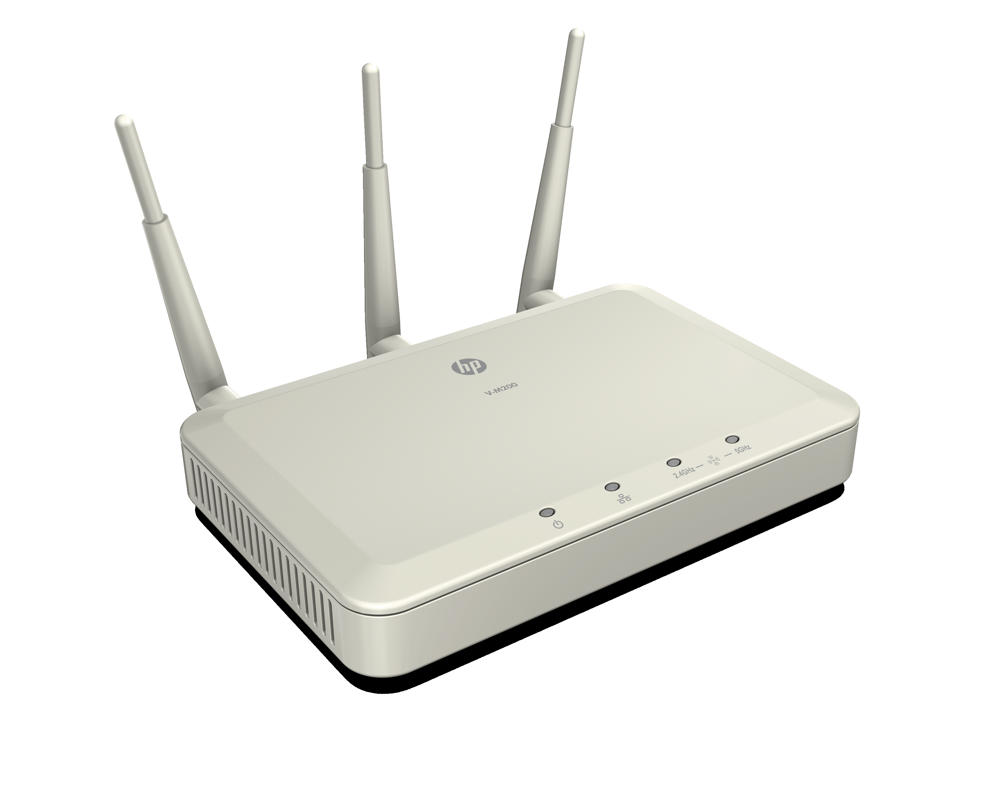

Business-grade mobility solutions
Ideal for entry-level deployments
Wireless router
Internet
Benefits
Simple device configuration and management with intuitive Web interface for simple device configuration and management
Ease of deployment with plug-and-play installation of wired/wireless connectivity
Seamless interoperability with industry standards-based technology
HP 1910-8G-PoE + (65W) Switch
Client PC
HP ML110 Server
Client PC
Network Printer
Wireless Client PC
HP M200 802.11n Access Point
Storage / Backup device
Wireless Client PC
Notes:
Scenario: First network

Slide 13
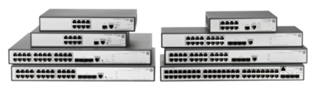
HP 1910 Switch Series
Performance
Wire-speed Gigabit
Extra SFP ports for fiber
Security
Access Control Lists
VLANs
802.1X
Control
Static routes
Fiber connectivity
Link aggregation
Simple administration via a web browser
Cost effective
Lifetime warranty*
IPv6 functionality
*HP warranty includes repair or replacement of hardware for as long as you own the product, with next business day advance replacement (available in most countries) For details, visit hp.com/networking/warranty

Slide 14
HP M200 802.11n Access Point
Flexible Connectivity for Mobile Users
Supports up to 64 clients wirelessly, without out the need to lay and maintain wires for each user
Enterprise Grade Security
Prevent unauthorized users from accessing the network while allowing secure access for guests
Protect Data from eavesdroppers
Easy to use and deploy
Independent access point that is easy to deploy
Simple to use Web UI with Quick Setup pages consolidates key settings onto one page for simple and rapid configuration for common deployment scenarios
TCO and Investment Protection
Lifetime Warranty*
Support for legacy 802.11a/b/g clients as well as newer advanced 802.11n clients that utilize the 5GHz frequency band
*HP warranty includes repair or replacement of hardware for as long as you own the product, with next business day advance replacement (available in most countries) For details, visit hp.com/networking/warranty

Slide 15

Advanced Mobility Solutions
Ideal for growing businesses who require comprehensive WLAN coverage
Benefits
Fast wireless deployment with Quick Start Wizard
Streamlined wireless administration with centralized management
Safeguard data with advanced security features
Sleek, unobtrusive design for office settings
Internet
HPN Router
HP 1910-24G-PoE Switch (170W)
(Smart Gigabit Switch)
Client PC
Servers
Wireless Client PC
Client PC
Network Printer
HP M220
Access Point
(802.11n 2.4GHz)
Wireless Client PC
Storage / Backup device
Notes:
Applications and uses

Slide 16
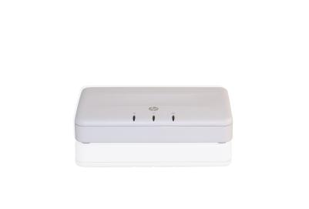
HP M220 details
Simplified administration of multiple Access Points
Often small businesses need more than one AP to provide good network coverage. But multiple APs can be hard to administer.
With the M220, when you change the settings of one M220 Access Point, other M220s in your network automatically get updated. We call this clustering.
Clustering simplifies set up and ongoing administration
Clustering enhances security.
Clustering even allows Layer 2 roaming so you can maintain a wireless connection while being mobile in your facility
No additional hardware is required; this is “controller-less”.
Sweet spot is 3 to 8 APs but will supports sites with up to 10.

Slide 17
What is clustering?
Primary Use Case
Clustering
Provides a single point of administration and lets you deploy, view, configure, and secure the wireless network as a single entity rather than a series of separate wireless devices
A group of up to 10 access points in the same subnet
Multiple clusters can exist on the same network
Configured with the same wireless parameters
Examples
SSID (wireless network name)
Wireless encryption – security
Radio setting
VLANs
1 cluster with many APs
(up to 10 APs)
Secondary Use Case
Cluster A
Cluster B
Multiple clustered AP groups in either the same network or separate networks/locations
Notes:
The AP cluster is a group of APs in the same wired subnet that share a common configuration. If the configuration of a member of the cluster is changed by the administrator, the cluster dynamically exchanges the new setting with all members of the cluster. This eliminates the need to separately access each access point to make the configuration change. One manages the cluster by accessing a member AP of the cluster via the Web user interface.
Multiple clusters can exist within a subnet. Each cluster can have up to 10 members.

Slide 18
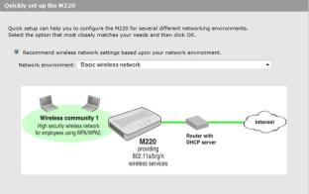
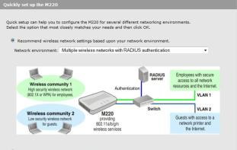
M220 802.11n Quick Setup Wizard
The Quick Setup Wizard presents the user with only the configuration fields necessary to complete the use case scenario
5 deployment scenarios are available ranging from basic to advance network setup
Simplifies installation by taking the guess work out of configuring the AP
Notes:
Knowing which configuration parameters to set to achieve the networking and wireless requirements of the small business can be challenging in configuring any access point. The Quick Setup Wizard presents the user with five use scenarios to choice that best matches their desired wireless LAN network environment. The wizard presents the user with the fields necessary to configure to enable the use scenario. The scenarios range from basic single AP deployment with one wireless community (SSID) to multiple wireless communities with RADIUS based user authentication.
This takes the guess work out of configuring the wireless network.

Slide 19


Benefits
For your business
New revenue streams with a complete solution driving services sales
Compete more effectively on small business deals
Simplified solution deployment and management
For your customers
Increased business agility and competitiveness
High-speed connectivity for business-critical applications
Flexibility for customers to interact with employees through mobile, high-speed wireless connectivity
Reliable and secure infrastructure to mitigate business disruption
Partner logo
© Copyright 2012 Hewlett-Packard Development Company, L.P. The information contained herein is subject to change without notice. HP Confidential.
19

Slide 20

Collateral and training for partners
Collateral
SB mobility brochure
Customer presentation
Training
Regions to update with partner portal links
On demand training Slidecast
Sales enablement
SB mobility battlecard
SB mobility ad copy guidelines
SB product selection guide
Solution video
Solution demo
HP M220 Access Point battlecard
HP 1910 Switch Series battlecard
Partner logo
© Copyright 2012 Hewlett-Packard Development Company, L.P. The information contained herein is subject to change without notice. HP Confidential.
20

Slide 21
Thank you

Slide 22

HP 1910 Switch Series
Key features | Benefits
Supports basic routing – set up to 32 static routes and 8 virtual VLAN interfaces | Use local routing to tie multiple workgroups together, whether on different physical segments or on different VLANs. Local routing on a switch can boost workgroup performance and offload central router tasks.
Supports Access Control Lists (ACLs) and 802.1X | Enhanced security. Use 802.1X to enforce network access controls. ACL rules can granularly define who has access to what areas of your network.
Extra ports for SFP fiber connectivity. True ports, not combo ports. | Greater port capacity and switch performance than switches using combo ports.
Smart web-based management with advanced features. | Simple to use web interface allows you to customize network operation.
Choose from among four Power over Ethernet models. Two 24-port models, one 170 Watts of PoE and the other 365 Watts of PoE. Two 8-port models, one 65W of PoE and the other 180W of PoE. | It is most cost-effective to buy the model that most matches the PoE power level you require. PoE enables powering of client devices like IP phones, thin clients, wireless APs, etc without additional wiring.
Lifetime Warranty. Covers power supply and fans. Next business day advanced hardware replacement. | High quality products giving peace of mind about the network installation.
HP Confidential

Slide 23
Features/benefits of the V-M200 Access Point
Feature | Benefit
Fully Standards Compliant 802.11n Access Point | Supports all compliant wireless devices Better Coverage and Range than 802.11 a/b/g AP Higher Throughput than 802.11 a/b/g AP
Independently Managed using Intuitive Web UI | Simple to use and configure Rapidly get your wireless network up and running
Dual Band Capability | Get the highest speeds possible yet still seamlessly support legacy 802.11 a or b/g clients
4 SSIDs, 4 VLANs | Allows administrator to separate clients into 4 different user classes, each with customized security and QOS features
Powered by 802.3af PoE or standard AC power supply | Powered by PoE enabled switch or PoE Injector for areas with inaccessible power outlet or plug into a nearby outlet for simple deployment
WPA/WPA2 (Personal/Enterprise) Encryption | Prevent Eavesdroppers from deciphering your wireless Data
802.1x Authentication | Prevent unauthorized users from accessing your network
802.1p, Diffserv, and WMM QOS | Increases performance and/or traffic reliability for sensitive applications such ad Voice and Video.

Slide 24
HP M220 802.11n Access Point features and benefits
Key features | Benefits
IEEE 802.11n wireless networking | High speed data transfer – up to 300 Mbps. Rapid access to applications, Internet and data transfer over the wireless LAN
Dual band operation at 2.4GHz or 5GHz | Choice of radio configuration to best support wireless clients including legacy wireless standards such as 802.11b/g and 802.11a
Innovative “clustering” to simplify management of up to 10 Access Points | Simplified wireless LAN administration of multiple APs on the network
Lifetime Warranty | Peace of mind – next business day replacement in the event of hardware failure. Phone support for as long as you own the product.
Notes:
IEEE 802.11n has been a standard for several years. Many laptops today support 802.11n. This standard can offer up to 300 Mbps throughput between the client and access point providing almost LAN like application performance and data transfers. Dual band operation provides options to accommodate both 802.11n and other legacy standards such as 802.11b, g or 802.11a.
As we discussed today, clustering technology simplifies network setup and ongoing administration of a wireless LAN.
These products are designed by the industry leading HP quality standards and are backed by a lifetime warranty which covers the access point as well as the power adapter – providing the customer piece of mind. This warranty also includes lifetime phone support and next business day advance hardware replacement in most countries.

Slide 25
声明：
所有的版权属于原有公司，文件均来自公开渠道
此文件仅供学习使用，任何人不得进行以此为商业目的的行为
如有疑问，请立即删除
学习世界五百强和咨询公司PPT课程请访问如下网站搜索：“司马懿”
百度传课：司马懿PPT学校
访问地址
https://www.chuanke.com
网易学堂：司马懿PPT学校
访问地址
https://study.163.com
知乎： 司马懿PPT学校
访问地址
https://www.zhiu.com

