Slide 1

Insurance Briefing Series: Hot Topics for Audit Committees
Glenn Gillard, Audit Partner
David Kinsella, Audit Manager

Slide 2
The Audit Committee Agenda
Glenn Gillard, Audit Partner
Investments – the impact of the credit crisis
Counterparty Risk – A new focus
David Kinsella, Audit Manager
Audit Committee Structure
Dealing with Internal Auditors
Glenn Gillard, Audit Partner
External audit – Reporting responsibilities
Compliance and Regulatory Hot Issues
Accounting Developments

Slide 3
- Investments
- Counterparty Risks
Glenn Gillard, Partner, Audit
Notes:
3
3

Slide 4
Investments The Impact of the Credit Crisis
Understanding your IM Arrangements
Investment Guidelines
Need to update
Scope of guidelines
Reliance on group arrangements
Service Level Agreements
Pricing Sources
Hard to value securities
Investment committee

Slide 5
Investments The Impact of the Credit Crisis
Impairment
GAAP Differences
Irish GAAP: Permanent Impairment
IFRS: Objective evidence of Impairment (‘Incurred Loss Model’)
Measurement of Impairment
IFRS: Loans and Receivables: Carrying value vs PV of Future Cash
IFRS: Available for Sale: Carrying value vs Fair Value
Irish GAAP: Permanent = PV of future cash flows?
Post Balance Sheet
Adjusting: Evidence of conditions that existed at the balance sheet date
Market movement vs Observable evidence of impairment

Slide 6
Investments The Impact of the Credit Crisis
Safeguarding of Assets
Custodian relationships
Is there a custody network
Is sub custody used
Is there pooling with other group assets
Derivative Arrangements
Counterparty Risk
Collateral arrangements
Up to date ISDAs
Banking Arrangements
Understanding the breadth of relationships

Slide 7
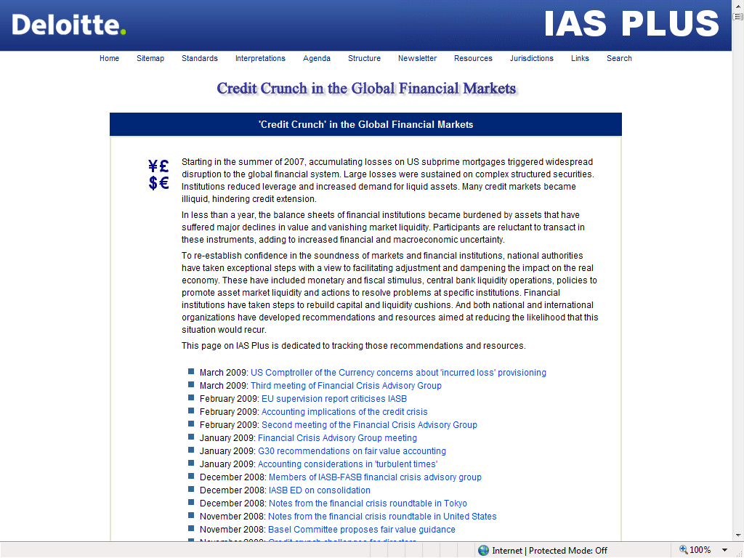
Investments The Impact of the Credit Crisis
International Developments
Future of mark to market
US Congress
Incurred Loss Provisioning
Comptroller of the Currency
IASB/FASB Financial Crisis
Advisory Group
Disclosure developments
Revision to IFRS 7/FRS 29
FAS 157: 3 Tier Disclosure
Quoted
Observable inputs
Unobservable inputs

Slide 8
Counterparty Risk A New Focus
Funds Withheld Arrangements
FR Focus
Separately identifiable
Rating assessment
Exposure to Fronters/Brokers
Settlement exposure
Reinsurer Security
Method for monitoring

Slide 9
- Audit Committee Structure
- Dealing with Internal Auditors
David Kinsella, Manager, ERS
Notes:
9
9

Slide 10
Background
Audit Committees are as effective as the people who sit on them. Today’s audit committee member needs to be knowledgeable, dedicated and independent in order to carry out the remit of this now vital committee.
Effective Audit Committees are cornerstones of the public’s confidence in corporate governance and financial reporting. To remain effective they need to keep pace with the change drivers relating to their role and also to focus on issues relevant to the current environment
Extracted from: Audit Committees - A Framework for Assessment The Audit Faculty of The Institute of Chartered Accountants in England and Wales
10
Hot Topics for Audit Committees

Slide 11
Why do you need an Audit Committee
Corporate Goverance is highly topical in the current environment for all stakeholders
Regulator
Investors
Customers
Lenders
Employees
Legislative & Regulatory Requirements
Companies Act 2003
Corporate Governance for Reinsurance Undertakings 2007
11
Hot Topics for Audit Committees

Slide 12
Role of the Audit Committee
The Audit Committees responsibilities fall under 4 main headings.
Financial & Other Reporting
Preparation of Financial Statements
External Audit
Appointment & Assessment
Internal Audit
- Appointment, Planning & Reporting
Internal Control & Risk Management
Identification, Management & Reporting of risks
12
Hot Topics for Audit Committees

Slide 13
Benefits of an Audit Committee
Audit Committees are a sub-committee of the Board and although the Boards responsibilities are not lessened by the existence of the Audit Committee its existence can help the Board operate more effectively by help to:
Strengthen the quality of financial reporting
Strengthen the independence of Internal Audit
Provide a forum for continuous review of internal controls & risk management
13
Hot Topics for Audit Committees

Slide 14
Challenges facing today's Audit Committee
Increased regulatory requirements
Increased demand for highest Corporate Governance from stakeholders
Increasing demand for limited specialist resources
Law of the PRC on Banking Regulation and Supervision (China)
FFIEC Internet Banking Authentication (US)
Financial Services and Markets Act (UK)
Sarbanes Oxley (US)
Financial Conglomerates Directive (EU)
Resinsurance Directive (EU)
Patriot Act (US)
UCITS III
Directive (EU)
Transparency Directive (EU)
MiFid (EU)
Payment Services Directive (EU)
IFRS (EU)
Basel II (EU)
IFRS phase 2
Solvency II (EU)
2000
2002
2004
2006
2008
2010
2012
e-Privacy directive (EU)
Consumer Credit Act (UK)
TCF
(UK)
UCPD (EU)
Basel II (US)
Market Abuse Directive (EU)
3rd money laundering directive (EU)
Credit for Consumer
Directive (EU)
Insurance Law of the PRC revised (China)
Securities Law of the PRC, Revised (China)
Financial Instruments and Exchange Law (FIEL) (Japan)
IFRS convergence with GAAP (US)
The regulations included in the above illustration is not a comprehensive list of regulations influencing the global financial services industry.
The timeline indicates when a regulation was or is due to be implemented.
14
Footer

Slide 15
How Internal Audit can assist the Audit Committee
Provide the Audit Committee with:
Detailed Audit plan based on formal risk assessment methodology
Present audit reports at each Audit Committee Meeting
Update the Audit Committee on outstanding audit issues
Communicate all critical audit issues or new / heightened risks in a timely manner
Use specialists as required
15
Hot Topics for Audit Committees

Slide 16
Internal Audit Enablers
Approved Audit Charter
Audit Methodology
Experienced & Qualified Resources
Commitment from Management and Directors
16
Hot Topics for Audit Committees

Slide 17
Hints & Tips for the Audit Committee Questions the Audit Committee might ask about Internal Controls
Has the company documented its assessment of risks and its systems of internal controls?
Are you aware of any material weakness in internal control? If such weaknesses exist now how would you be informed?
Are you aware of other internal control matters that call for corrective action?
Have appropriate actions been taken in response to previous comments and recommendations made by the external or internal auditors?
What are the critical internal control areas that warrant the attention of the Audit Committee, and why are they important?
Have the external auditors modified their planned audit approach based on the results of their tests of the systems of internal control?
Have any areas of risk to the company been identified that require special attention or monitoring?
Have any problems been noted that need to be resolved before the year end of that may require legal or other specialist advice?
Is the internal audit function adequately staffed and organised with a formal internal audit charter?
What activities would the external or internal auditors recommend the Audit Committee undertake in connection with its oversight of internal controls?
Has the company succeeded in creating an environment conducive to the achievement of effective systems of internal controls?
17
Hot Topics for Audit Committees

Slide 18
Hints & Tips for the Audit Committee Questions the Audit Committee might ask about Internal Controls
Do the systems in place provide reasonable assurance that errors and conditions contrary to policy are reported?
Does management do an adequate job of monitoring reported exceptions as possible indications of a need for improvements?
During the course of the audit, did any conditions come to the auditors’ attention that may warrant in depth investigation by management, the internal auditors or the Audit Committee?
What is the quality of long range planning and budgetary controls employed by the company?
Does the company control its electronic data processing operations effectively?
Are the company’s policy and procedure manuals reasonably formal and updated on a regular basis?
Is an assessment of significant risks undertaken? Are risks linked to internal controls? Have management made an assessment of control?
Are you aware of any situation where management exceeded its authority in any matters prescribed by the Board of failed to comply with any resolution passed by the Board?
Does the company have adequate procedures to indentify connected party transactions?
Does the company have adequate insurance cover?
What induction and staff training on internal control systems takes place?
What regular reports on control effectiveness are considered by management?
Does any formal review of error, control breach or control ineffectiveness take place? What lessons were learned?
18
Hot Topics for Audit Committees

Slide 19
Hints & Tips for the Audit Committee Questions the Audit Committee might ask about the Internal Audit Function
Position
Does internal audit have full authority, independence and access throughout the organisation?
Are the terms of responsibility and scope set out in an internal audit charter?
Purpose
Is a risk focused approach used to plan work?
Is the work plan focused on business processes and not simply on departments/companies/sites?
Is internal audit a challenger of and advisor to the risk management process?
Does internal audit see its role as acting as an agent of change?
People
Has a skills audit been undertaken?
Is there a clear training and development plan?
Do the team understand the business?
Are the teams’ skills appropriate to their work?
19
Hot Topics for Audit Committees

Slide 20
Hints & Tips for the Audit Committee Questions the Audit Committee might ask about Internal Audit
Process
What knowledge sources/bases does audit use?
Have the style and content of reports been subject to review?
Are best practice tools being used? (e.g. Automated work papers and IT tools)
Is there a continuous risk based process in place?
Performance
Are performance targets set and measured?
Do auditors give feedback on performance?
Do audit have a customer service mentality?
Do staff have a structured evaluation process?
Does audit benchmark itself?
What quality control assessment is carried out?
20

Slide 21
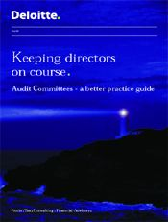

In order to assist Directors discharge their duties we have developed a guide which focuses on the practical steps that need to be taken to establish an Audit Committee and aims to draw attention to the factors that will help to make an Audit Committee effective.
“Keeping directors on course
Audit Committees – a better practice guide”
21

Slide 22
External Audit – Reporting responsibilities
Compliance and Regulatory Hot Issues
Accounting Developments
Glenn Gillard, Partner, Audit
Notes:
22
22

Slide 23
External Audit Reporting Requirements
Insurance Act
Ability to fulfil obligations to policyholders
Ability to meet its financial obligations under the Regulations
Quality a report
Decide to resign
Aware of faces while auditing a controlling party
Reinsurance Regulations
Ability of undertaking to fulfil obligations to 3rd parties
Ability to meet its obligations under the Regulations
Material defects in financial systems and controls
Material defects in the records
Qualify a report
Decide to resign
Aware of facts while auditing a controlling party
23
Hot Topics for Audit Committees

Slide 24
Compliance & Regulatory Hot Issues
Corporate Governance Guidelines
Audit committee requirement
Risk Register
Compliance Function
Solvency II
Preparation for smaller (re)insurers
Data Protection
Application to reinsurers
24
Hot Topics for Audit Committees

Slide 25
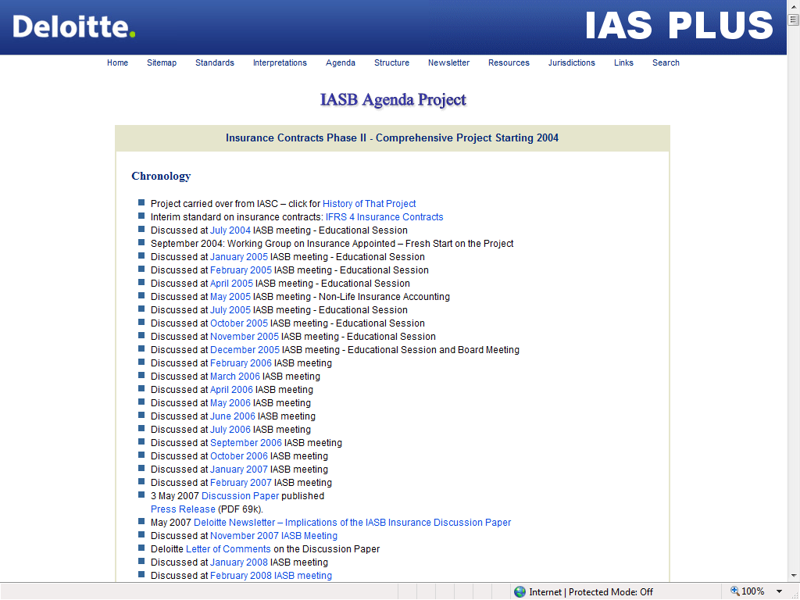
Accounting Developments
The move to IFRS
US Roadmap
IFRS for NPAEs: The end of Irish GAAP?
Insurance Contracts: Phase 2
Measurement Approach
2011?
25
Hot Topics for Audit Committees

Slide 26
Summary Slide
So don’t forget...
Risk Register
Actuaries and Computer systems
Investment guidelines
Counterparty Risk
Auditor reporting
26
Hot Topics for Audit Committees

Slide 27

2009 Insurance Briefing Series
Keeping you up to date
Month | Topic
June | Anti Money Laundering
September | Regulatory updates for insurers
October 20th | Motor insurance survey briefing
October 22nd | Annual financial reporting seminar
December tbc | Finance Bill for financial services
Glenn Gillard
Partner
Audit
Tel: 01 4172802
Email: ggillard@deloitte.ie
David Kinsella
Manager
Enterprise Risk Services
Tel: 01 417 2529
Email: davkinsella@deloitte.ie

Slide 28

Notes:
28

Slide 29

© 2009 Deloitte Touche Tohmatsu.
Deloitte refers to one or more of Deloitte Touche Tohmatsu, a Swiss Verein, and its network of member firms, each of which is a legally separate and independent entity. Please see www.deloitte.com/about for a detailed description of the legal structure of Deloitte Touche Tohmatsu and its Member Firms.
These materials and the information contained herein are provided by Deloitte & Touche and are intended to provide general information on a particular subject or subjects and are not an exhaustive treatment of such subject(s). Accordingly, the information in these materials is not intended to constitute accounting, tax, legal, investment, consulting or other professional advice or services. The information is not intended to be relied upon as the sole basis for any decision which may affect you or your business. Before making any decision or taking any action that might affect your personal finances or business, you should consult a qualified professional adviser. These materials and the information contained therein are provided as is, and Deloitte & Touche makes no express or implied representations or warranties regarding these materials or the information contained therein. Without limiting the foregoing, Deloitte & Touche does not warrant that the materials or information contained therein will be error-free or will meet any particular criteria of performance or quality. Deloitte & Touche expressly disclaims all implied warranties, including, without limitation, warranties of merchantability, title, fitness for a particular purpose, non-infringement, compatibility, security and accuracy.
Your use of these materials and information contained therein is at your own risk, and you assume full responsibility and risk of loss resulting from the use thereof. Deloitte & Touche will not be liable for any special, indirect, incidental, consequential or punitive damages or any other damages whatsoever, whether in an action of contract, statute, tort (including, without limitation, negligence) or otherwise, relating to the use of these materials or the information contained therein.

Slide 30
声明：
所有的版权属于原有公司，文件均来自公开渠道
此文件仅供学习使用，任何人不得进行以此为商业目的的行为
如有疑问，请立即删除
学习世界五百强和咨询公司PPT课程请访问如下网站搜索：“司马懿”
百度传课：司马懿PPT学校
https://www.chuanke.com
网易学堂：司马懿PPT学校
https://study.163.com
知乎： 司马懿PPT学校
https://www.zhiu.com

