Slide 1

Executive Summary: Deploy Database as a Service
Sunil Babu
Senior Enterprise Architect
Social. Mobile. Complete.

Slide 2
Deploy a Database-as-a-Service
Evolution to Database-as-a-Service
Consolidation
Service Delivery
Enterprise Cloud
Summary

Slide 3

Evolution to Database-as-a-Service

Slide 4





Design Phase should deliver
Deployment builds on these assets
Standardized
Platform
Database Service
Catalog
Standard
Processes
GOLD
Zero application outage
Zero data loss
SILVER
Seconds to minutes of downtime
Near-zero or zero data loss
BRONZE
Minutes to days of downtime Near-zero data loss

Slide 5














Evolution to Database-as-a-Service
Phased functionality rollout
Traditional Silos
Standardized Platform
Consolidated Platform
Service Delivery Platform
Enterprise Cloud Platform
Simple
Efficient
Agile
Unified
Enterprise Cloud Architecture
Platform agnostic, Platform Optimized
Flexible
Resilient
Secure

Slide 6
Evolution to Database-as-a-Service
Phased workload rollout
Low Hanging
New Deployments
Production
Mixed Workloads
Mission Critical
1
xxxx
19
xxx
Immediate Platform candidates
2
xxxx
20
xxx)
Workload suitability to a consolidated environment varies greatly
Define clear criteria to identify low hanging fruit
Make sure to plan for early success
Reduce risks by staging migrations
Apply lessons from early migrations to later migrations
Develop a flexible architecture to host a broad mix of workloads
No
constraints
3
xxxx
21
xx
35
4
xxxx
22
xxx
5
xx
23
xxx
34
28
26
37
23
6
xxxx
24
xxx
2
13
10
7
xxxx
25
xxx
25
11
3
8
xxx
26
xxx
29
27
12
24
xxx
xxx
30
31
9
27
10
xx
28
xxx
Constraint to Migrate
Unlikely to be migrated
6
11
xxx
29
xxx
22
17
12
xxx
30
xxxx
33
32
15
13
xxx
31
xxx
8
16
9
14
xxx
32
xxx
15
xxx
33
xxxx
16
xxx
34
xxx
21
5
18
17
xxx
35
xxxx
14
18
x
36
xxx
Longer term Platform prospects
37
xxxx
7
36
4
Workload Legend
Many
constraints
1
19
20
OLTP
OLQP
Technical readiness for the Platform
DW /BI
Not Ready
Very Ready
Hybrid

Slide 7
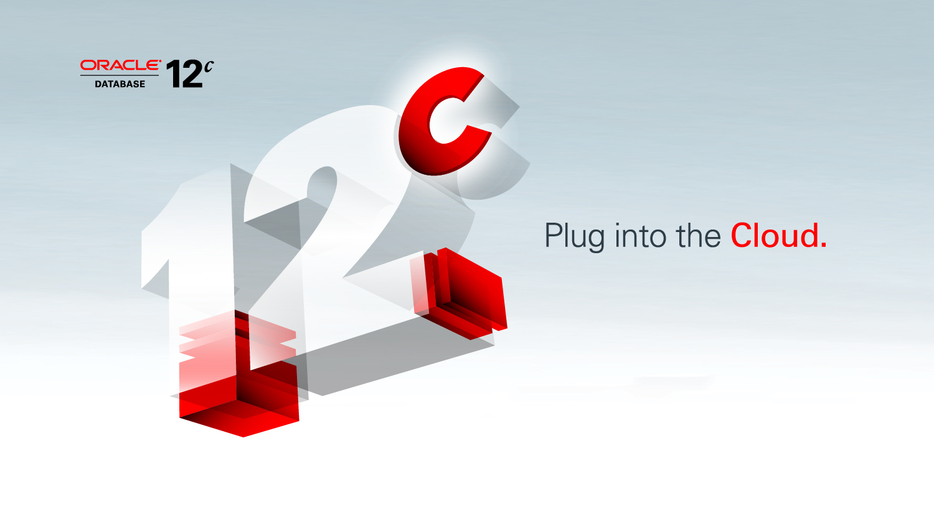
Graphic Section Divider
Consolidated Platform

Slide 8
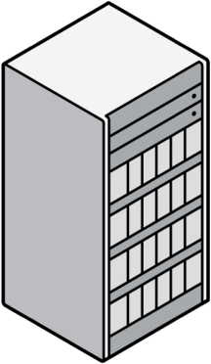



Database Consolidation Methods
Traditional consolidation methods
Virtual Machines
Dedicated Databases
Schema Consolidation
Consolidation Efficiency
Share Servers
Share Servers & OS
Share Servers, OS & Database

Slide 9




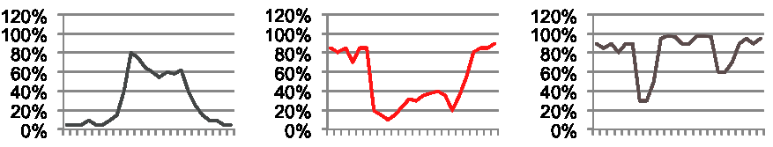




Consolidation Planning Two distinct tools available
Usage based Capacity Planner
Resources: CPU, Memory, I/O, Storage
Built-in conflict resolution rules
Workload capture and replay
Real Application Testing for Consolidation
Production
Test
Clients
Replay Driver
Storage
Storage
Capture
Process
Replay
Analysis & Reporting
Notes:
9
Inverse this. Show two applications that look like they cannot be consolidated but actually can

Slide 10
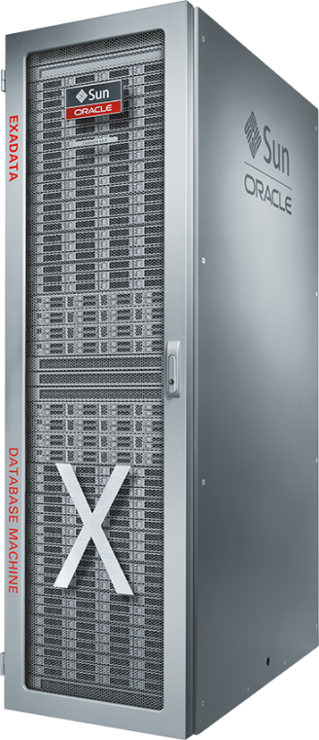
Optimized Consolidation Platform
Exadata enables safe consolidation of diverse workloads
Application
Database Resource Manager provides CPU resource management for conventional and pluggable databases
Priorities, CPU limits and fine-grain SQL management
Exadata uniquely provides I/O management by tenant pluggable database, job, SQL, user, service, etc.
Exadata uniquely provides database workload aware network resource management *NEW*
Prioritizes critical messages through the entire fabric
Example: Web users prioritized over ad-hoc reporting
Database
Network
Storage
End-to-End Prioritization

Slide 11

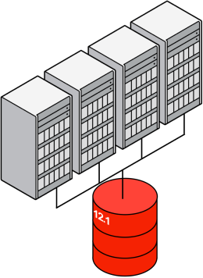
Maximum Availability Architecture
Continuous Database Services
Active-Active
Architecture
Online Rolling
Maintenance
No-Disruption
Failover
Improved in Database
12c
✗

Slide 12

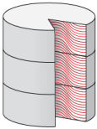







Database Services Security
Defense in depth leveraging all existing capabilities
PREVENTIVE
DETECTIVE
ADMINISTRATIVE
Encryption
Activity Monitoring
Sensitive Data & Database Discovery
Redaction & Masking
Database Firewall
Configuration & Vulnerability Scan
Privileged User
Controls
Auditing and Reporting
Privilege Analysis

Slide 13



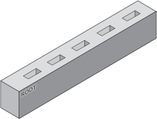



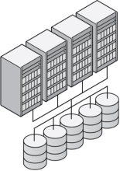

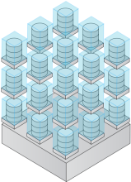

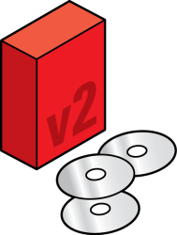
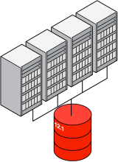
Seamless user and application experience Two step deployment process
1. User selects desired service class
GOLD
Database
Services
✔
SILVER
BRONZE
Database Services
2. Application connects to database service
Service is automatically deployed using pre-defined templates and optimal consolidation model

Slide 14

Service Delivery Platform

Slide 15








Rapid Response to Business Needs
Traditional Database Deployment (Admin driven)
Database-as-a-Service Deployment (End-user driven)
Specify and procure hardware
DEPLOYMENT PORTAL
Configure hardware
Request database deployment
Database
Deploy hardware
Adjust capacity as demand changes
OS and Storage
Databases
Server Hardware
Deploy operating system and configure storage
Retire database when not needed
Deploy database
User unaware of underlying I/F
Time to provision = weeks to months
Time to provision = minutes
Notes:
Traditional IT operations are very admin driven, very customized for the application environment, and slow due to transition between different admin teams like hardware, storage, database, etc

Slide 16
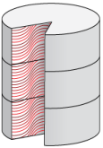



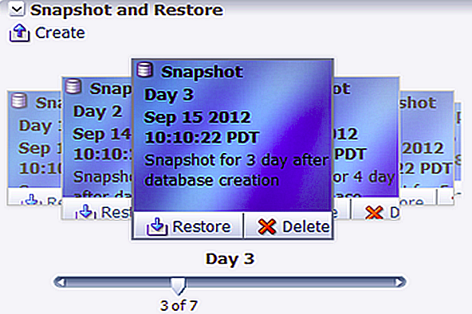
Rapid Provisioning includes Data
Full database provisioning in minutes
Production Database
Masking & Sub setting
Test Master Database
Features
Leverage storage copy on-write technologies fast provisioning
Integrated lifecycle management (lineage and association tracking)
“Time travel” capability to restore and access past data
Benefits
Agile provisioning (~ 2 minutes to provision a 1 TB database)
Over 90% storage savings (100 KB of additional space for cloning a 1 TB database)
Reduced administrative overhead from integrated lifecycle management
010110011 101001010
000111010
Notes:
Features
Leverage storage copy on-write technologies fast provisioning
Initial support for NAS (Oracle ZFS Appliance and Netapp)
Integrated lifecycle management (lineage and association tracking)
“Time travel” capability to restore and access past data
Benefits
Agile provisioning (~ 2 minutes to provision a 1 TB database)
Over 90% storage savings (100 KB of additional space for cloning a 1 TB database)
Reduced administrative overhead from integrated lifecycle management

Slide 17















Improved Agility With Changing Workloads
Expand Cluster to Support Flexible Consolidation Model
Node1
Node2
Services
CDB Instance 1
CDB Instance 2
Single SGA per
CDB Instance
DW
BI
CRM
HCM
ERP
Multitenant Container Database (CDB)
Notes:
Multitenant plays well with RAC. It’s a symbiotic relationship.
Multitenant makes RAC better and RAC makes Multitenant better.

Slide 18






Improved Agility With Changing Workloads
Expand Cluster to Support Flexible Consolidation Model
Node1
Node3
Node2
Services
CDB Instance 1
CDB Instance 3
CDB Instance 2
Single SGA per
CDB Instance
DW
BI
CRM
HCM
ERP
Multitenant Container Database (CDB)

Slide 19

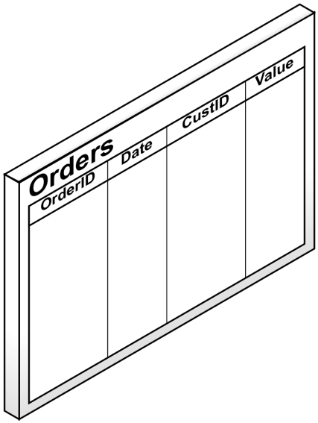



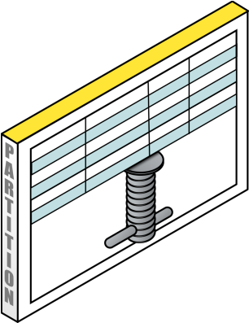
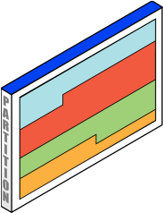
Automatic Data Optimization
New in Database12c
Reduce storage footprint, read compressed data faster
Partitioned By Time
Oldest Data
Most Recent Data
19
Copyright © 2012, Oracle and/or its affiliates. All rights reserved.
Confidential – Oracle Restricted

Slide 20


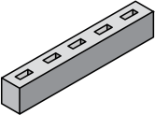
Managing Database Service Level Tiers
Change tiers as databases become more mission critical
GOLD
RAC, Active Data Guard
SILVER
RAC One, Data Guard
BRONZE
Single Instance

Slide 21

Unified Cloud Platform

Slide 22
Summary

Slide 23












Developing a DBaaS solution
Customers deploying today with 11g
Unified Architecture
Orchestration and Arbitrage
Seamless migration
Unified
Cloud
Self-service management
Agility
Metering and Chargeback
Service Delivery
Consolidation
Efficient consolidation
Secure Isolation
Resilient Services

Slide 26
声明：
所有的版权属于原有公司，文件均来自公开渠道
此文件仅供学习使用，任何人不得进行以此为商业目的的行为
如有疑问，请立即删除
学习世界五百强和咨询公司PPT课程请访问如下网站搜索：“司马懿”
百度传课：司马懿PPT学校
https://www.chuanke.com
网易学堂：司马懿PPT学校
https://study.163.com
知乎： 司马懿PPT学校
https://www.zhiu.com

