Slide 2

Oracle Systems Overview
Ivo Sousa
Consultor de Alianças

Slide 3

Agenda
Organograma Canais Oracle Systems
Mínimo OPN (Gold level)
http://www.oracle.com/partners
Assinar o FUDA (VAR) / FUDA Light (T2 – VAD)
Obter Resell Rights (Knowledge Zones)
Registro de Oportunidades (PRM) e OPS (Configurações)
Ativar as Especializações. (Solaris 11)
Equipamentos para Demo (ODA)
Vendas para Governo
Fechamento Oracle Systems
Rebate

Slide 4
Organograma Canais Oracle Systems
Roberto Gero
Director Brazil Hardware Channels
Denis Garcia
Brazil Hardware Channel
Juliana Coimbra
Hardware Channel Operations
Ivo Sousa
Enablement
Cristina Pinheiro Moss
VAD Manager

Slide 5
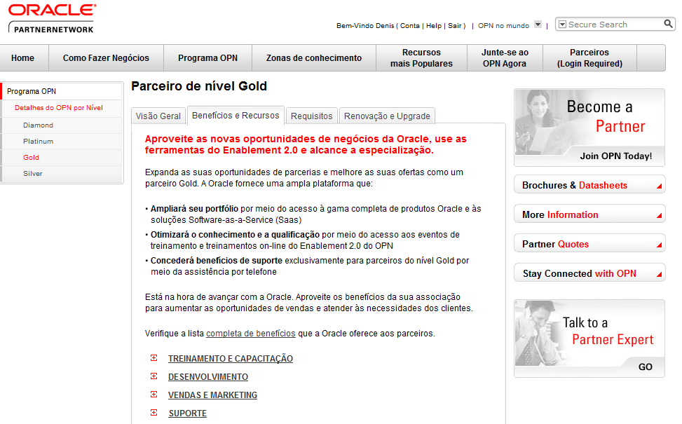
OPN – Gold Level
http://www.oracle.com/partners/ptb/opn-program/opn-details-by-levels/gold/index.html
Notes:
There are three key reasons why you need to become an Oracle Partner.
1). Oracle offers partners unprecedented access to the best portfolio of software and hardware products in the industry.
We are in the unique position to deliver the world's most complete, open, and integrated business software and hardware solutions—from applications to disk.
Also, as you may have heard, Oracle is the technology that powers the cloud. We support private, public and hybrid clouds all along the stack.
Since the Sun acquisition, we have been continually working to deliver products that are optimized to run best on our Hardware solutions. Outstanding results are being documented with Oracle software running on Oracle Hardware, utilizing our newly launched Exastack offering.
Oracle Software running on Exadata and Exalogic machines demonstrate world performance records every day. We are 100,000 people committed to:
Hardware and Software Engineered to Work Together
Oracle remains #1 in many products areas:
Oracle Database continues to be #1 in the world
Oracle Solaris is the #1 Enterprise OS
The new Oracle Fusion Middleware 11g is revolutionizing the software standards in application infrastructure foundation.
And, Oracle Applications including Siebel, PeopleSoft and E Business Suite are widely deployed throughout global companies.
And these are just a few examples of Oracle’s unparalleled product portfolio.
With this foundation, partners can create complete IT solutions to meet any customer’s needs.
2) Our massive install base.
We have more than 370,000 customers all around the world; with approximately 300,000 still not running on Sun Hardware.
Given our broad product portfolio, the cross sell possibilities are unique in the industry.
3) And the best reason to join OPN? Oracle’s flagship partner program “raises the bar” according to industry analysts.
The Channel opportunity offered through OPN is exceptional.
Oracle will never compete with its partners by selling services. A place where other vendors increase their margins is exactly where Oracle relies on partners.
The OPN program is flexible and designed to evolve with your business needs. We offer Specialized partner programs on several levels, increasing partner benefits and visibility at each level.
Our channel plan is designed to help you with key enablement offerings:
Free online training, boot camps, OU discounts, sales plays, marketing kits, Knowledge Zones, customer-facing partner showcases and enhanced incentive programs
There are multiple resources to leverage your capabilities and expand your go to market potential.

Slide 6
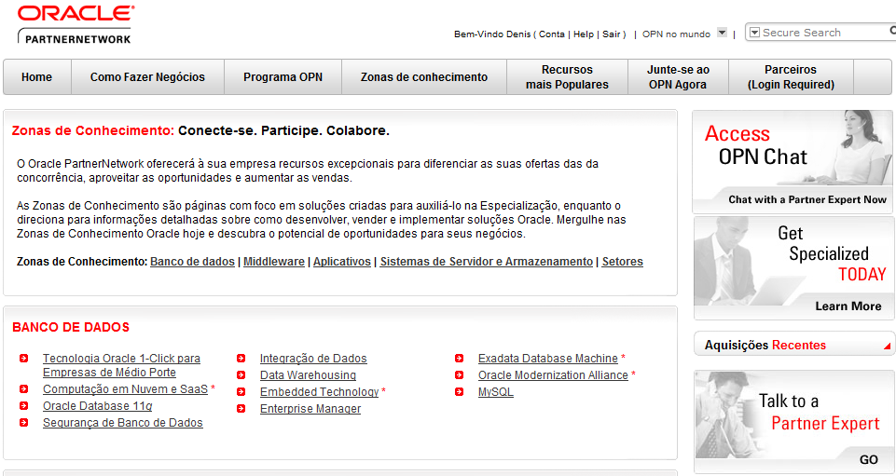
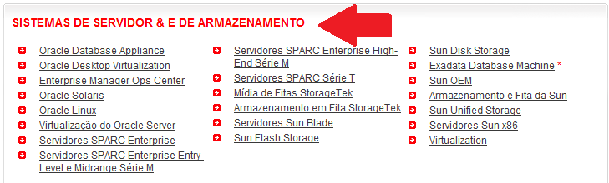
Resell Rights – Direitos de revenda
http://www.oracle.com/partners/ptb/knowledge-zone/index.html
Notes:
2) Our massive install base.
We have more than 370,000 customers all around the world; with approximately 300,000 still not running on Sun Hardware.
Given our broad product portfolio, the cross sell possibilities are unique in the industry.

Slide 7
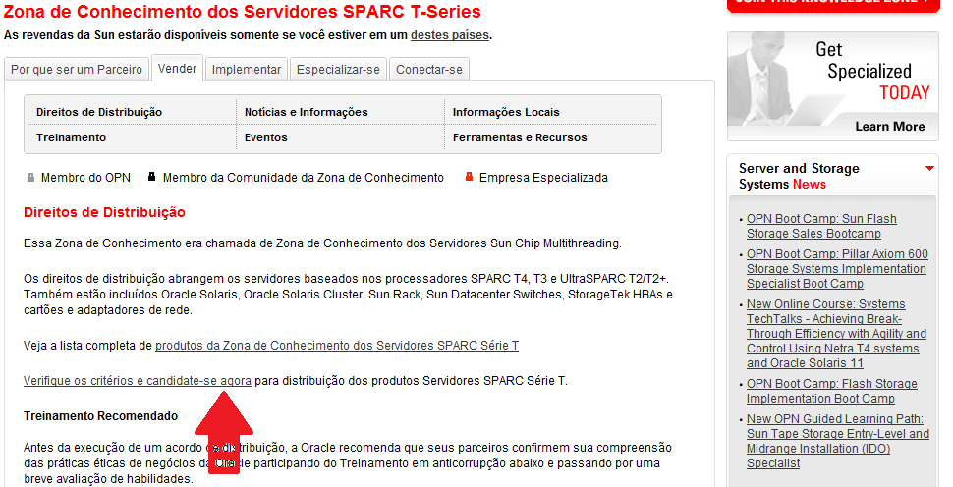
Resell Rights – Direitos de revenda
http://www.oracle.com/partners/en/knowledge-zone/server-storage/sparc-t-series-049237-ptb.html
Notes:
2) Our massive install base.
We have more than 370,000 customers all around the world; with approximately 300,000 still not running on Sun Hardware.
Given our broad product portfolio, the cross sell possibilities are unique in the industry.

Slide 8
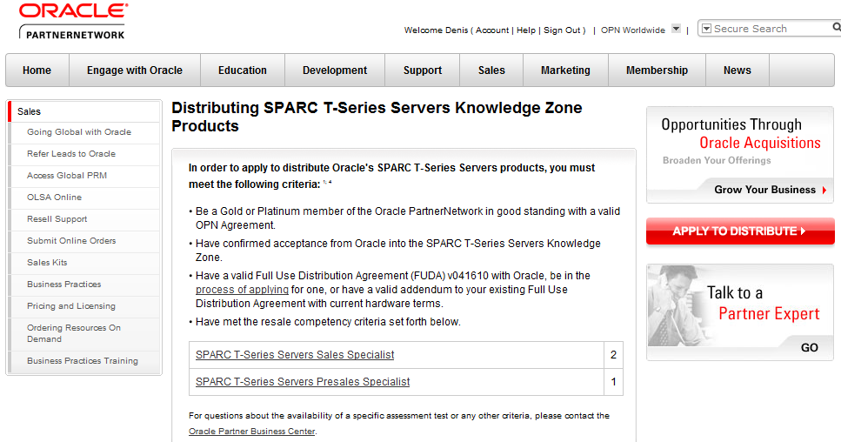
Resell Rights – Direitos de revenda
http://www.oracle.com/partners/secure/sales/sparc-t-resell-306165.html
Notes:
2) Our massive install base.
We have more than 370,000 customers all around the world; with approximately 300,000 still not running on Sun Hardware.
Given our broad product portfolio, the cross sell possibilities are unique in the industry.

Slide 9
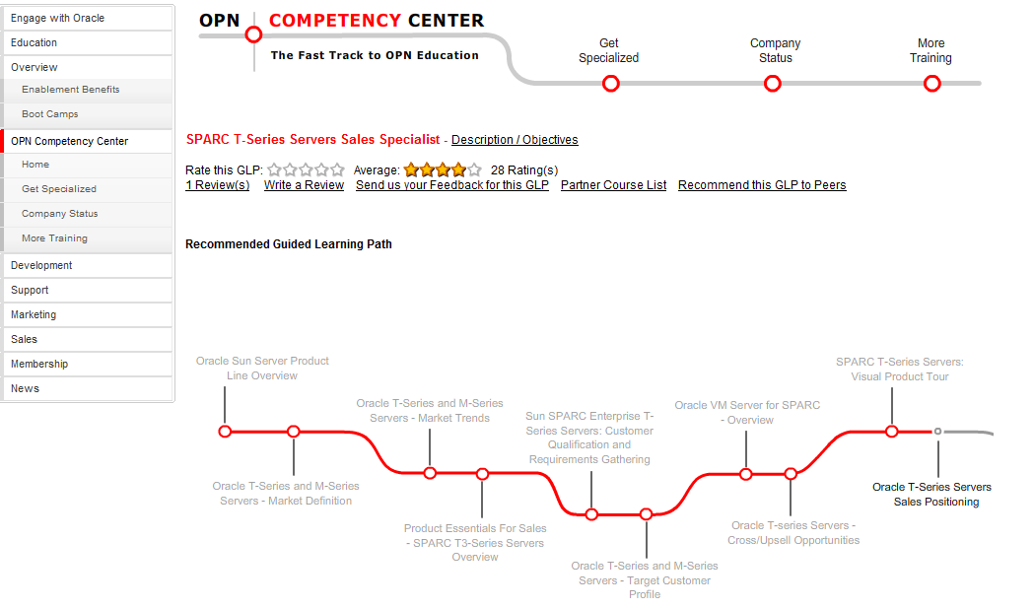
Resell Rights – Direitos de revenda
https://competencycenter.oracle.com/opncc/full_glp.cc?group_id=12744
Notes:
2) Our massive install base.
We have more than 370,000 customers all around the world; with approximately 300,000 still not running on Sun Hardware.
Given our broad product portfolio, the cross sell possibilities are unique in the industry.

Slide 10
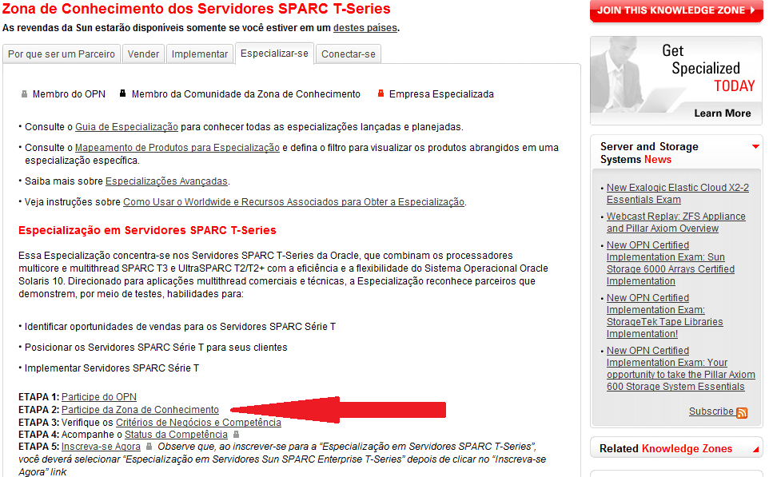
Resell Rights – Direitos de revenda
http://www.oracle.com/partners/en/knowledge-zone/server-storage/sparc-t-series-049237-ptb.html
Notes:
2) Our massive install base.
We have more than 370,000 customers all around the world; with approximately 300,000 still not running on Sun Hardware.
Given our broad product portfolio, the cross sell possibilities are unique in the industry.

Slide 11
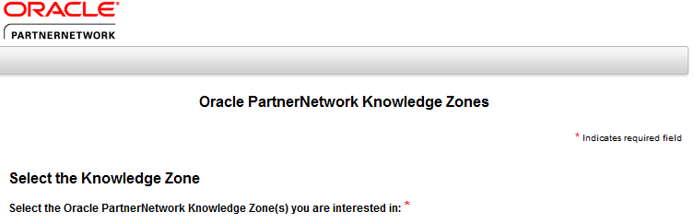
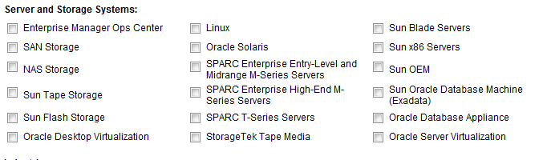
Resell Rights – Zonas de Conhecimento
- Solicitar quais produtos desejam trabalhar
http://www.oracle.com/webapps/dialogue/dlgpage.jsp?p_ext=Y&p_dlg_id=8296613&src=6808891&Act=24
Notes:
2) Our massive install base.
We have more than 370,000 customers all around the world; with approximately 300,000 still not running on Sun Hardware.
Given our broad product portfolio, the cross sell possibilities are unique in the industry.

Slide 12
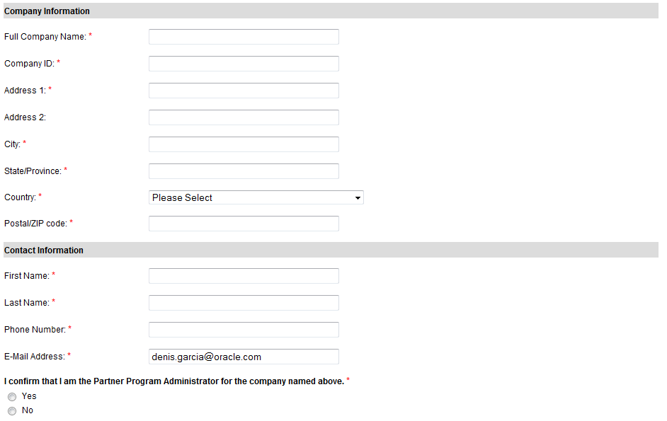
Resell Rights – Zonas de Conhecimento
- Solicitar quais produtos desejam trabalhar
http://www.oracle.com/webapps/dialogue/dlgpage.jsp?p_ext=Y&p_dlg_id=8296613&src=6808891&Act=24
Notes:
2) Our massive install base.
We have more than 370,000 customers all around the world; with approximately 300,000 still not running on Sun Hardware.
Given our broad product portfolio, the cross sell possibilities are unique in the industry.

Slide 13
Resell Rights – Direitos de revenda
http://www.oracle.com/partners/secure/sales/sparc-t-resell-306165.html
Notes:
2) Our massive install base.
We have more than 370,000 customers all around the world; with approximately 300,000 still not running on Sun Hardware.
Given our broad product portfolio, the cross sell possibilities are unique in the industry.

Slide 14
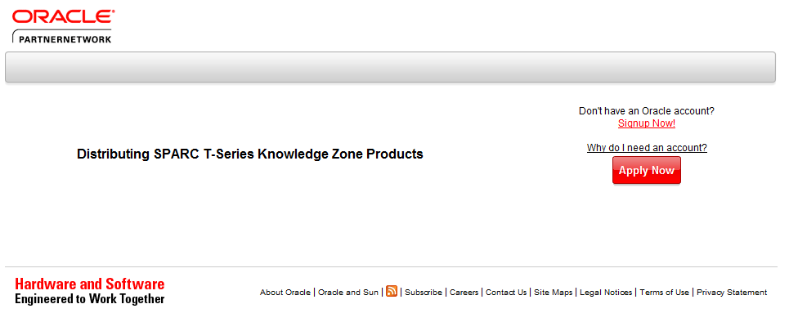
Resell Rights – Direitos de revenda
http://www.oracle.com/webapps/dialogue/ns/dlgwelcome.jsp?p_ext=Y&p_dlg_id=8540203&src=6808891&Act=66
Notes:
2) Our massive install base.
We have more than 370,000 customers all around the world; with approximately 300,000 still not running on Sun Hardware.
Given our broad product portfolio, the cross sell possibilities are unique in the industry.

Slide 15
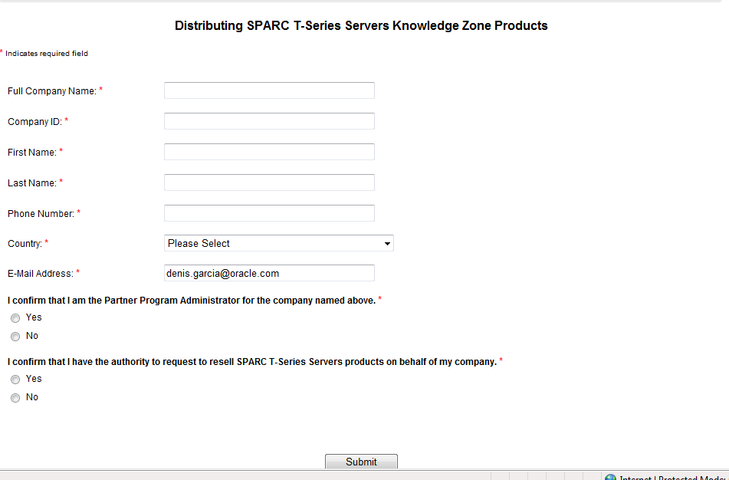
Resell Rights – Direitos de revenda
Notes:
2) Our massive install base.
We have more than 370,000 customers all around the world; with approximately 300,000 still not running on Sun Hardware.
Given our broad product portfolio, the cross sell possibilities are unique in the industry.

Slide 16
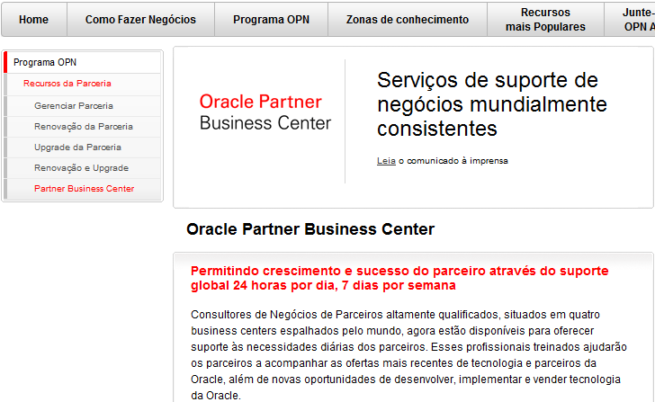
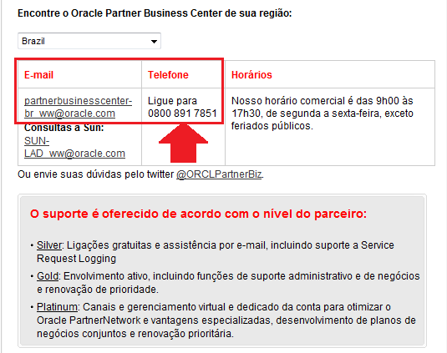
Resell Rights – Direitos de revenda
Suporte PBC - Partner Business Center
http://www.oracle.com/partners/ptb/opn-program/membership-resources/business-center/index.html

Slide 17
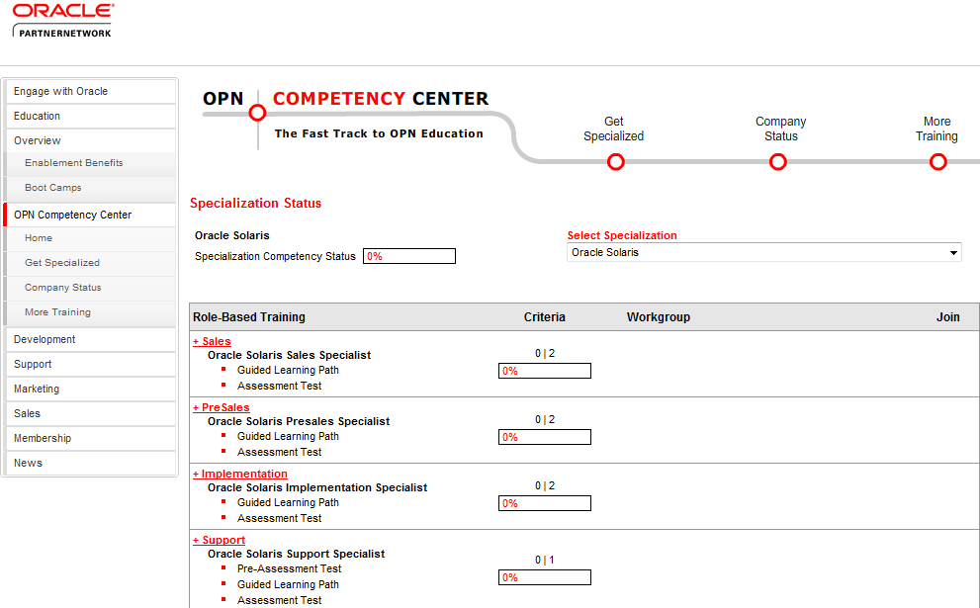
Especialização – Exemplo Solaris

Slide 18
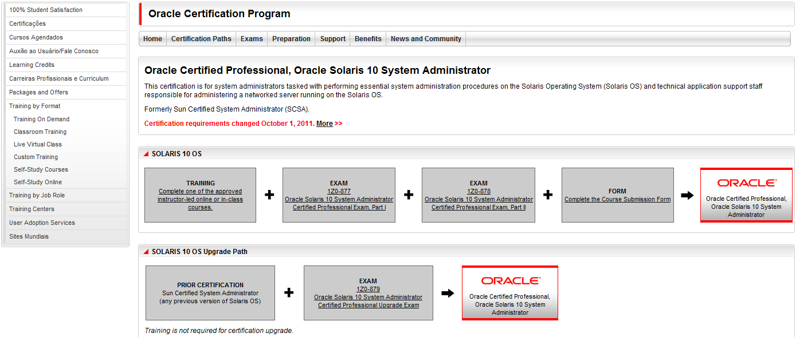
Especializações – Exemplo Solaris

Slide 19
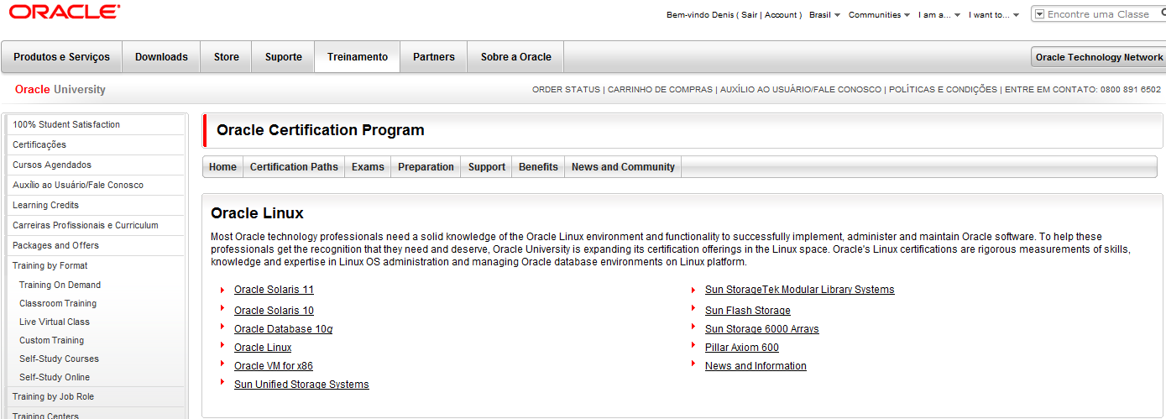
Especializações – Education
http://education.oracle.com/pls/web_prod-plq-dad/db_pages.getpage?page_id=144#14

Slide 20
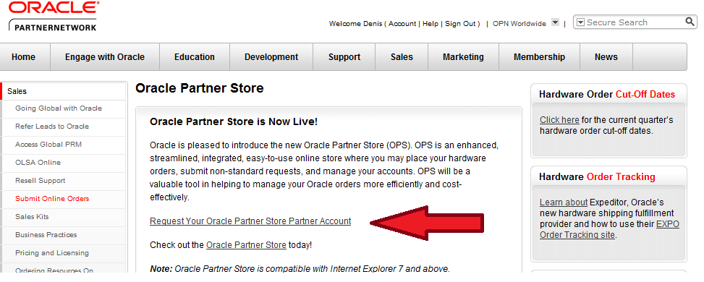
OPS – Oracle Partner Store
http://www.oracle.com/partners/secure/sales/partner-ordering-portal/oracle-partner-store-194347.html

Slide 21
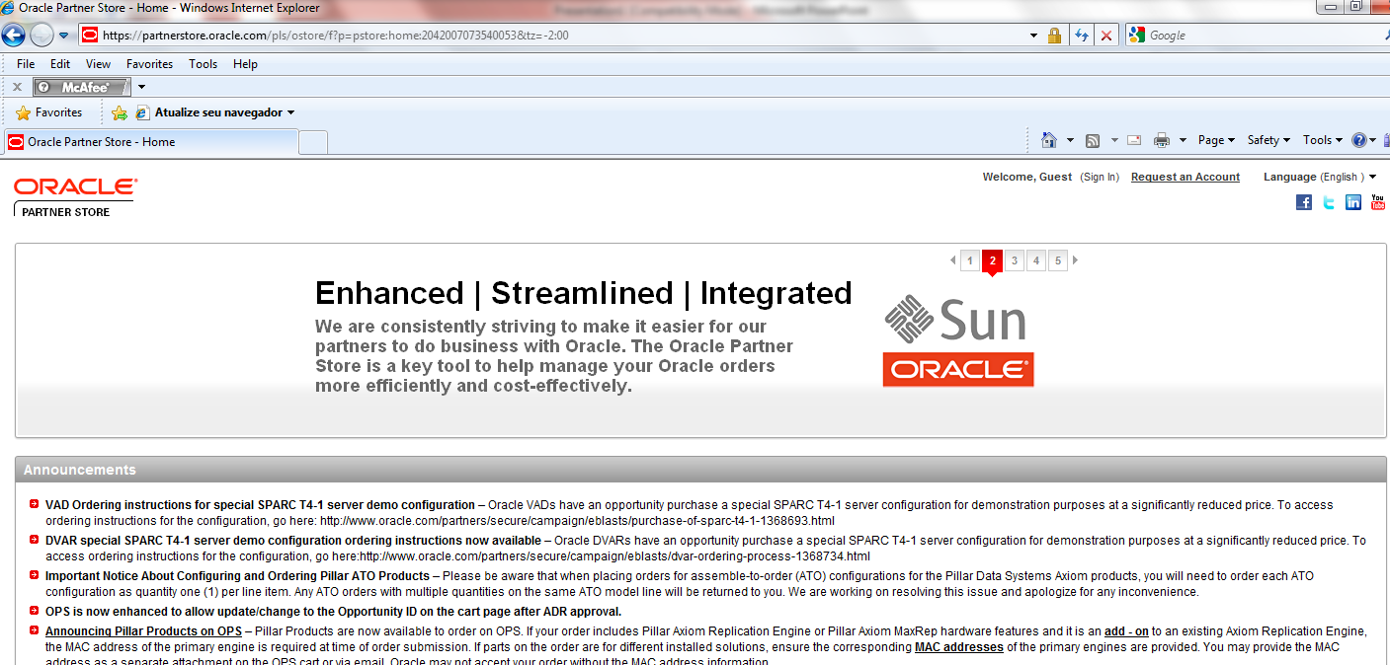
OPS – Oracle Partner Store
https://partnerstore.oracle.com

Slide 22
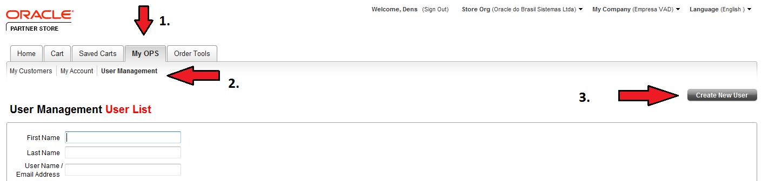
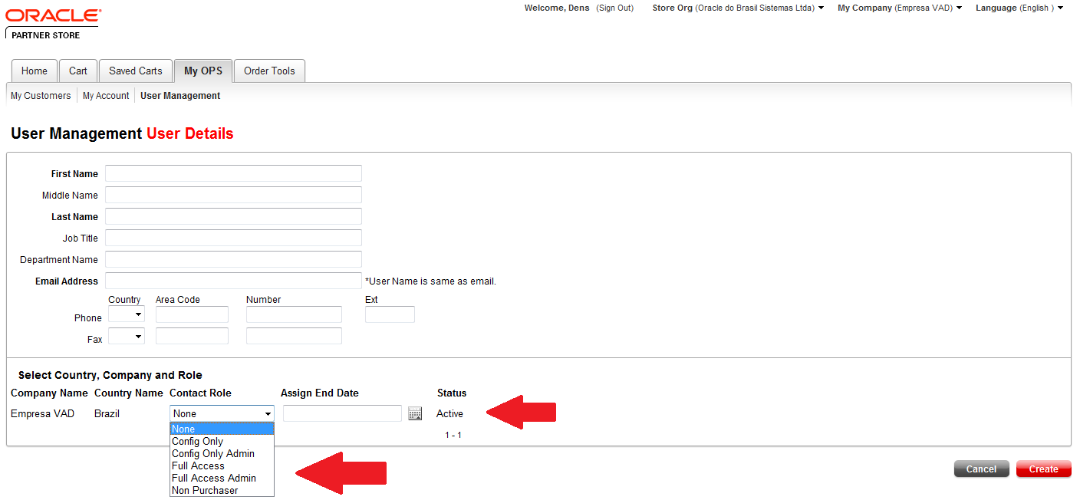
OPS – Oracle Partner Store – Criar Usuário

Slide 23
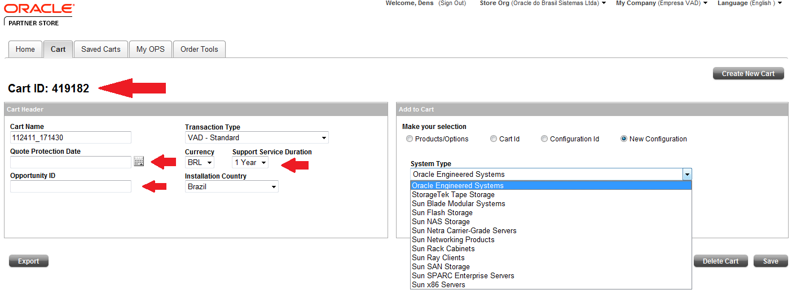
OPS – Oracle Partner Store

Slide 24
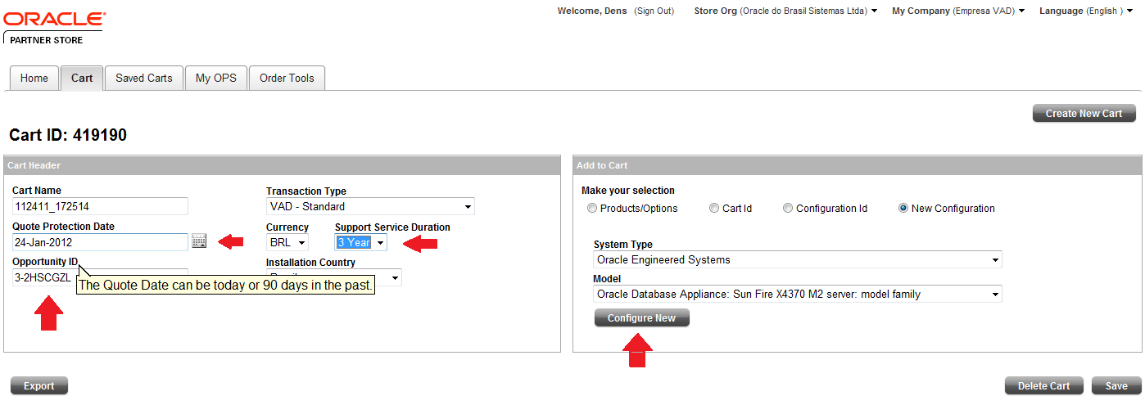
OPS – Oracle Partner Store

Slide 25
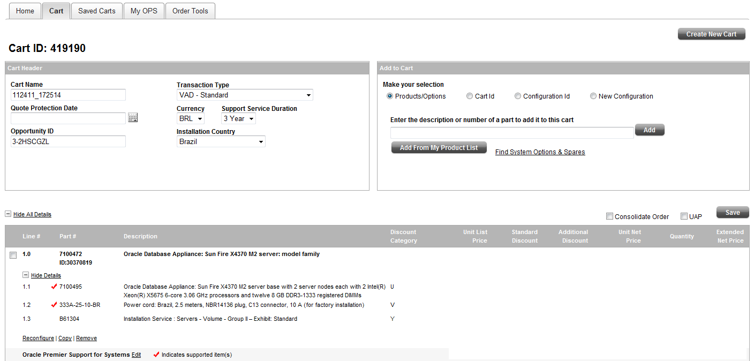
OPS – Oracle Partner Store

Slide 26
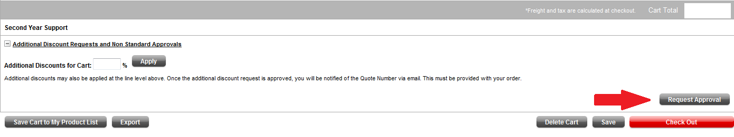
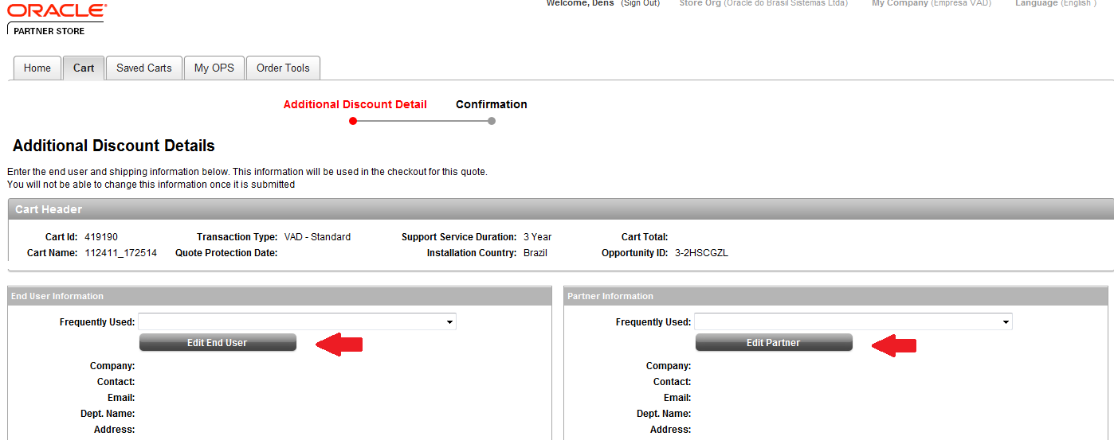
OPS – Oracle Partner Store

Slide 27
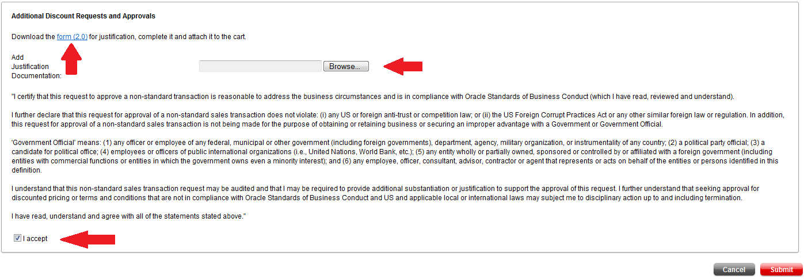
OPS – Oracle Partner Store - DAT

Slide 28
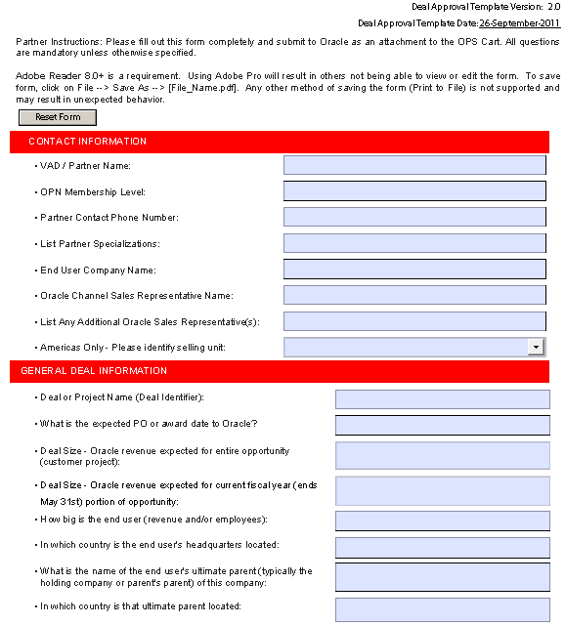
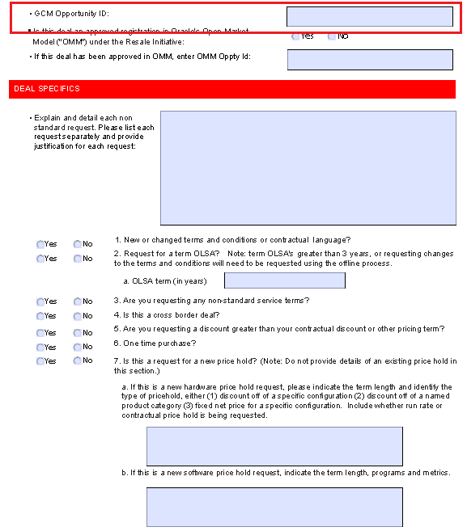
OPS – Oracle Partner Store - DAT

Slide 29
Back Office Brasil Time
Ana Tavares
Manager / Lad Sales Orders / DPO
E-mail : ana.tavares@oracle.com
Fone : 11 – 5187-6149
Daniela Bannitz
VADs
Partners/ Clientes região BR ( exceto SP)
E-mail : daniela.bannitz@oracle.com
Fone : 11-5189-3014
Mariana Lima
VAD (Distribuidores)
Partners / Regiões SP
E-mail : mariana.rosanti.lima@oracle.com
Fone : 11-5187-6414

Slide 30
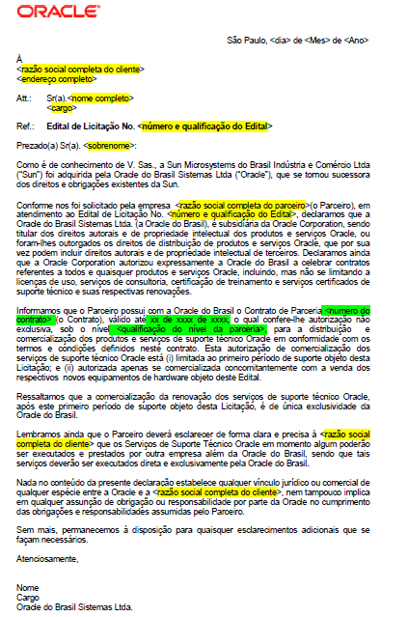
Venda para Governo
Documentos necessários: FUDA, LDD, GDD e PS
Carta padrão Oracle:

Slide 31
Ano Fiscal Oracle x Fechamento Oracle Systems
Ano Fiscal Oracle – Junho 2012 a Maio 2013
Q1 Jun/Jul/Ago
Q2 Set/Out/Nov
Q3 Dez/Jan/Fev
Q4 Mar/Abr/Mai
Datas fechamento de Oracle Systems
Sempre um mês antes do final do quarter Oracle

Slide 32
Rebate
Oportunidades registradas pelo canal e aprovadas pela Oracle
Vendas com Suporte Premier
Não é válido para Contas Estratégicas e Governo
Pedidos feitos através do VAD
Válido para contas privadas
 |  | VAR Allocation
Oracle’s 2000 list Rebate (Fulfillment) |  | -
Registered Broad Customer Base Rebate |  | 3%
Broad Market Strategic Product Rebate* |  | 5%

Slide 33
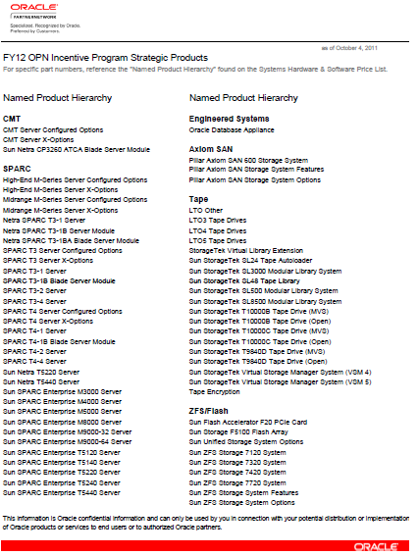
Lista de Produtos Estratégicos H2

Slide 35
声明：
所有的版权属于原有公司，文件均来自公开渠道
此文件仅供学习使用，任何人不得进行以此为商业目的的行为
如有疑问，请立即删除
学习世界五百强和咨询公司PPT课程请访问如下网站搜索：“司马懿”
百度传课：司马懿PPT学校
https://www.chuanke.com
网易学堂：司马懿PPT学校
https://study.163.com
知乎： 司马懿PPT学校
https://www.zhiu.com

