Slide 1
FedEx Ship Manager® at fedex.com
Shipping Administration
Presentation for administrators

Slide 2






What is Shipping Administration?
The Shipping Administration feature on FedEx
Ship Manager® at fedex.com is a spend-management application that gives you centralized control and administration over the decentralized and global shipping of your company
Administrator
Department One
Department Two
Notes:
Shipping Administration is a unique feature on our Web-based shipping solution FedEx Ship Manager at fedex.com. It allows a single administrator, or a group of users who have been given administrative privileges, to centrally manage shipments that are processed by multiple individuals from multiple locations within a company ⎯ all through the convenience of the Internet.
It is designed for organizations that:
Have a large number of individual shippers with Internet access.
Need to centrally manage and control all shipments and related costs.
Value the “require” reference field option, especially for billing shipping costs to customers.
FedEx confidential and proprietary ⎯ do not copy. These are speaker’s notes. They are not approved for distribution.

Slide 3
Is Shipping Administration right for your organization?
Do you need to:
  Make sure costs are properly allocated to the right
  cost centers?
  Figure out and correct shipping-related invoicing errors?
  Control access to and use of account information?
  Provide a shipping solution that is time- and cost-efficient and less error-prone?
  Gain visibility into company shipping activity on every level — locations, departments, accounts, and internal and external users?
  Manage who ships and what services and features
  they can access?
  Create custom reports to monitor and access
  the shipping activity of the entire company?
Notes:
If the answer to these questions is yes, then Shipping Administration is the solution for you.
By utilizing the Shipping Administration feature of FedEx Ship Manager at fedex.com, your organization can enjoy the best of both worlds: increased office efficiency through decentralized shipping, yet centralized control through enhanced reporting and tracking.
FedEx confidential and proprietary ⎯ do not copy. These are speaker’s notes. They are not approved for distribution.

Slide 4
Shipping Administration is your solution
Shipping Administration gives you:
  Operational efficiency
    Through FedEx Ship Manager® at fedex.com, you provide a time- and cost-efficient shipping solution for your entire company that:
      Is available 24 hours a day, 7 days a week
      Is available from any computer with Internet access
      Requires no proprietary hardware or software
      Is automatically updated when new features are added
      Eliminates the need for centralized shipping areas
    You manage the shipping process by permitting or restricting FedEx® services
    You manage the billing process through reference field configuration and cost-code validation

Slide 5
Shipping Administration is your solution (cont.)
Shipping Administration gives you:
  Control and flexibility
    You determine how to organize and control users to best fit the needs of the company
      Create the user to control their user ID, password and shipping profile
      Invite the user, which gives them autonomy over their user ID, password and shipping profile
      Set up users anywhere in the world
    You can set up departments as separate geographical locations or as functional groups within the organization that use different account numbers or cost centers
    You can assign an account number or multiple account numbers to a department

Slide 6
Shipping Administration is your solution (cont.)
Shipping Administration gives you:
  Control and flexibility
    You can permit or restrict FedEx® services, customize shipping features, and set shipping defaults at the department and user levels
    You can set up reference field control(s) on up to four references for billing and charge-back purposes
    You can create, mandate and validate the reference information entered into the
    reference fields

Slide 7
Shipping Administration is your solution (cont.)
Shipping Administration gives you:
  Administration and management
    You can search and sort on both the user and department screens to help streamline administrative tasks
    You can import departments, users and references for fast setups or to change
    existing information
    You can set up a central address book with
    up to 15,000 recipients that can be shared companywide
    You can assign company and department administrative privileges to other users to help you delegate responsibility and provide an extra layer of support

Slide 8
Shipping Administration is your solution (cont.)
Shipping Administration gives you:
  Visibility and monitoring
    You have insight into the shipping activity of multiple users in multiple locations within
    your company
      You know who’s shipping what, when, to where and how much, and even what’s being returned
    You have access to this shipping information
    24 hours a day, 7 days a week
    You have sole visibility of account numbers
    You can create and save customized and detailed administrative shipping reports that allow you to monitor, manage and measure the shipping activity of all users throughout the company to improve cost control

Slide 9
Getting started
After registering for Shipping Administration on FedEx Ship Manager® at fedex.com, the administrator:
  Logs in as the Shipping Administration administrator
  Determines how to organize and control users to best fit the needs of the company
  Adds one or more departments. Departments can be set up as separate geographical locations or as functional groups within the organization that use different account numbers
  or cost centers
  Assigns account numbers to departments by selecting an existing account number from the available accounts list
  or by adding a new account number
  Sets service and reference options for each department
  Adds users to departments and assigns users to
  account numbers
  Assigns company or department administrative privileges to other users (optional)

Slide 10
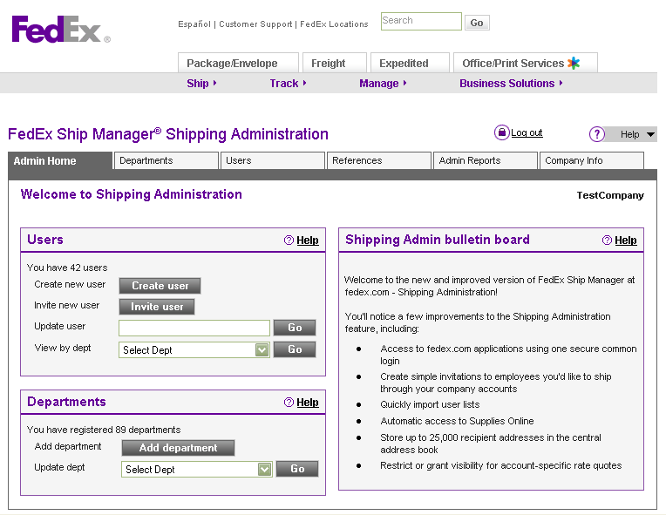
Getting started
Welcome to Shipping
Administration
Admin screen
  From any Shipping
  Administration screen,
  you can access:
    Company information
    Departments
    Users
    References
    Admin reports
    The Address Book tab
Notes:
This screen is the central point for all Shipping Administration administrative tasks.
From the Admin Home screen and related screens (Departments, Users, References, Admin Reports, Company Info) the administrator has access to the following tasks:
Company profile administration: You can manage basic company information.
Department administration: You can add a new department, view all departments, perform a keyword search for a specific department, and view and update the profile, privileges, references and defaults for an individual department.
User administration: You can add new users, view a list of all users, perform a keyword search for a specific user, delete a user, and update the profile, privileges, references and defaults for a specific user.
References: You can configure up to four default reference codes that will autopopulate the corresponding reference fields on the FedEx Ship Manager at fedex.com screens when users log in. In addition to adding and updating references, you can create and edit a reference list and add a reference to a reference list.
Admin reports: You can create, add, edit and delete reports for any shipments processed in the past 45 days. Reports allow you to monitor and manage the shipping activity of all users throughout the company. Once you’ve created a report, you can click on a tracking number to view a shipment’s status-tracking detail.
Central address book administration: From the Address Book tab, you can configure a central address book of up to 15,000 recipients as well as customize and control users’ access to personal, shared and central address books in the user profile.
FedEx confidential and proprietary ⎯ do not copy. These are speaker’s notes. They are not approved for distribution.

Slide 11
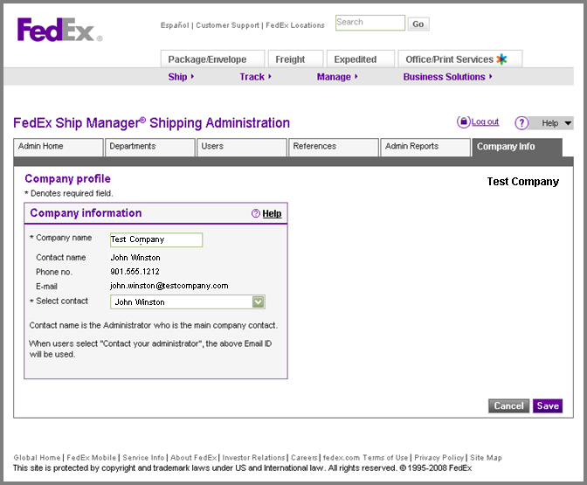
Updating company information
Company profile
  Use this screen to:
    View or update company
    information
    Update the admin e-mail
    address used for the
    “Contact your
    administrator” link
    on the Shipping
    Administration
    user log-in page
Notes:
The “Company profile” screen contains all the basic company information, which includes company name, company telephone and contact information for the company administrator. It is also where the administrator configures global settings, which apply across the entire company and cannot be customized by department or user.
FedEx confidential and proprietary ⎯ do not copy. These are speaker’s notes. They are not approved for distribution.

Slide 12
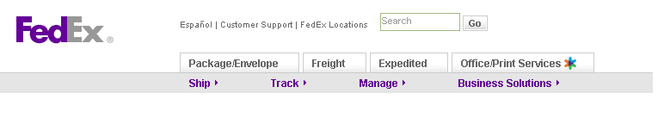
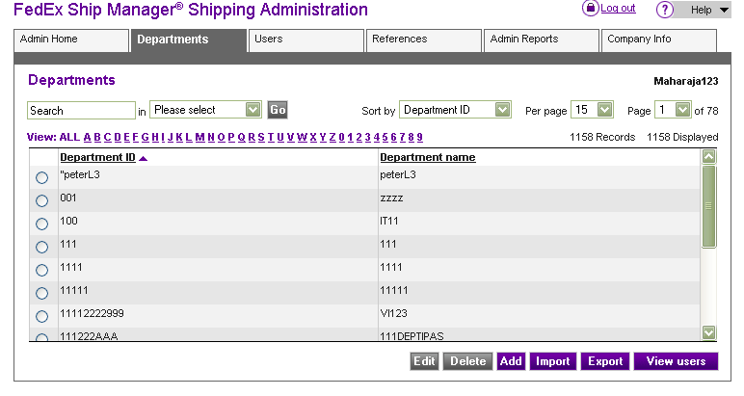
Managing departments
View departments
  When you click on the
  Department tab, the
  Departments screen
  displays
  The Departments screen
  contains key information
  about departments, such
  as department name and
  department ID
  You can search, sort,
  view, add, update,
  delete, import and
  export multiple
  departments here
Test Company

Slide 13
Adding departments and users
Add a department
  Adding departments is a four-screen process that includes:
    Profile screen: Complete the details that identify the department and assign account numbers
    Privileges screen: Define user privileges and set service choices
    References screen: Configure information for references users will see on the FedEx Ship Manager® at fedex.com screens
    Default screen: Set up feature and shipping defaults
Add a user
  Follow the same four-screen process used for adding a department to configure privileges, references and defaults
  for the individual user or
  Use a single-screen process to choose the current privileges, references and defaults set up for the department you have selected for that user

Slide 14
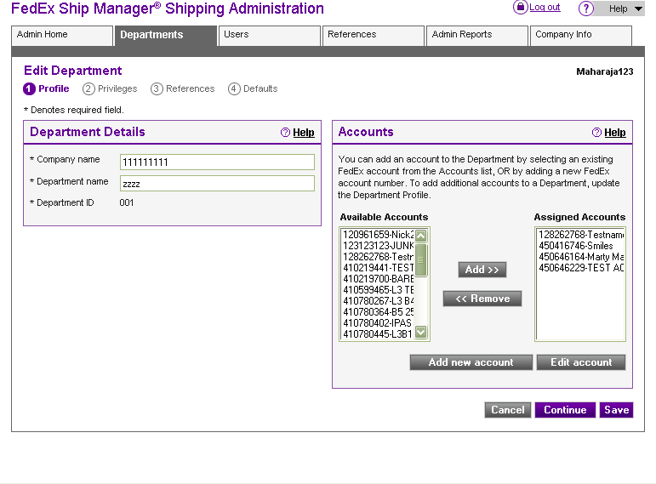
Adding departments
Department profile
  Enter and update
  a department's information
  and assign one or more
  account numbers to the
  department, or remove
  account numbers
  as necessary
Notes:
The first step in adding a department includes creating a department profile:
Department information: providing basic information that identifies the department.
Account settings: assigning a FedEx account number(s) to the department.
FedEx confidential and proprietary ⎯ do not copy. These are speaker’s notes. They are not approved for distribution.

Slide 15
Adding departments
Department privileges
  Allow or restrict service
  choices
  Allow or restrict special
  user rights and privileges,
  including:
    Choosing which address
    book(s) users can access
    Allowing users to create
    up to 20 sender profiles
    Allowing users to process
    return shipments
    Allowing users view rates and transit times
    Allowing users to add additional handling charges
    Allowing users to view and update default shipping information
    Allowing users to view and update default references
Notes:
The second step in adding a department is configuring the department privileges ⎯ the set of default privileges that will be used by members of this department:
Service choices: allowing department users access to all FedEx services or restricting access to specific services. If you restrict access to specific services, the FedEx Ship Manager at fedex.com shipping screen will display only those services available to users.
Special rights and privileges that the administrator can provide or deny to users in the department include:
Choosing which address book(s) users can access.
Allowing users to create up to 20 sender profiles, which gives them the ability to ship packages on behalf of others in the company.
Allowing users to process return shipments and requiring that they provide an RMA number.
Allowing users to configure a thermal printer and scale from their local computer.
Allowing users to add additional handling charges to each shipment.
Allowing users to view and update default shipping information on their Preferences screen.
Allowing users to view and update the default references that the administrator has assigned in the References screen.
FedEx confidential and proprietary ⎯ do not copy. These are speaker’s notes. They are not approved for distribution.

Slide 16
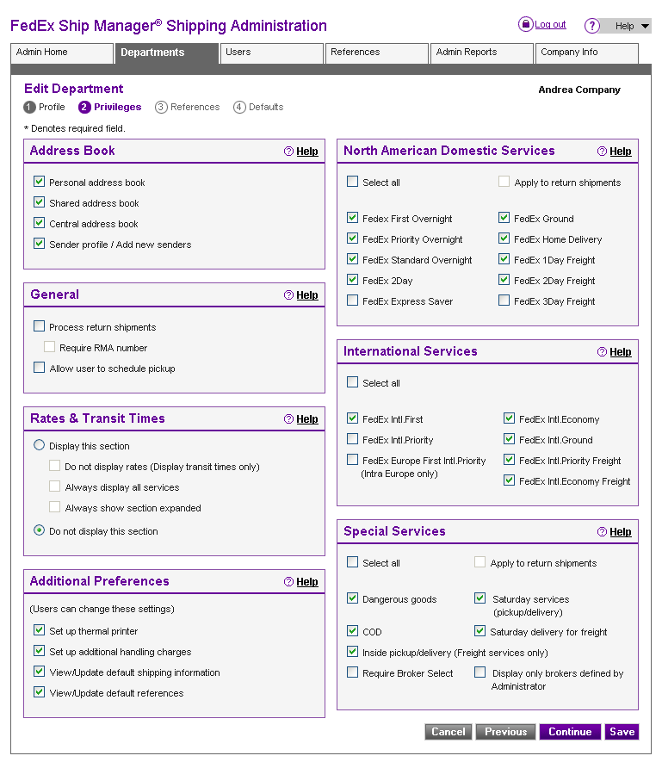
Notes:
The second step in adding a department is configuring the department privileges ⎯ the set of default privileges that will be used by members of this department:
Service choices: allowing department users access to all FedEx services or restricting access to specific services. If you restrict access to specific services, the FedEx Ship Manager at fedex.com shipping screen will display only those services available to users.
Special rights and privileges that the administrator can provide or deny to users in the department include:
Choosing which address book(s) users can access.
Allowing users to create up to 20 sender profiles, which gives them the ability to ship packages on behalf of others in the company.
Allowing users to process return shipments and requiring that they provide an RMA number.
Allowing users to configure a thermal printer and scale from their local computer.
Allowing users to add additional handling charges to each shipment.
Allowing users to view and update default shipping information on their Preferences screen.
Allowing users to view and update the default references that the administrator has assigned in the References screen.
FedEx confidential and proprietary ⎯ do not copy. These are speaker’s notes. They are not approved for distribution.

Slide 17
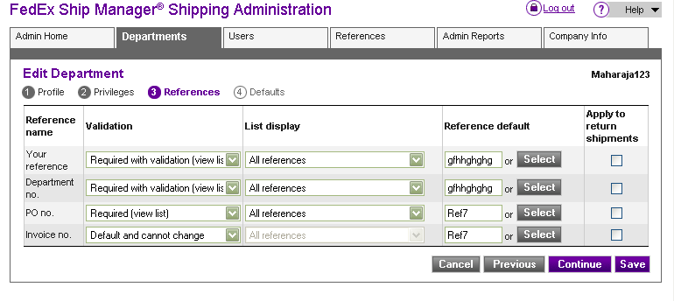
Adding Departments
Department references
  Set up reference
  validation for the
  reference fields
  Create reference lists
  Specify or create
  reference default
  information
  Select reference settings
  for return shipments
Test Company
Notes:
The third step in adding a department is configuring the department reference information that will appear on the corresponding reference fields on the FedEx Ship Manager at fedex.com screens when Shipping Administration users log in.
A reference is an optional number or description that appears on the FedEx invoice or within the Shipping Administration administrative reports. An administrator has the option of configuring up to four default reference codes that will autopopulate the corresponding reference fields. Defaults can be entered for your reference, department number, purchase order number and invoice number.
FedEx confidential and proprietary ⎯ do not copy. These are speaker’s notes. They are not approved for distribution.

Slide 18
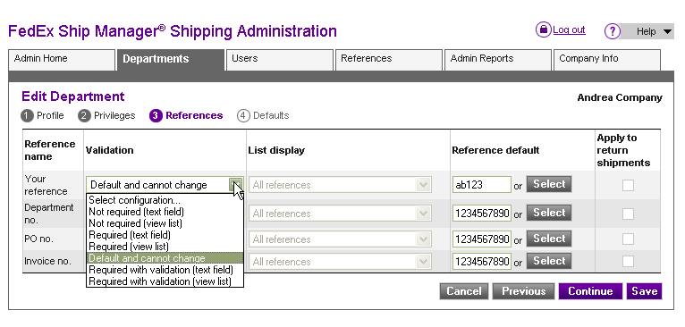
Adding Departments
Department references (cont.)
  Validation options include:
    Not required (text field)
    Not required (view list)
    Required (text field)
    Required (view list)
    Required with validation (text field)
    Required with validation (view list)
    Default and cannot change
Notes:
Not required (text field). With this option, the user is not required to enter a reference in order to ship and will see a text entry field on the Ship screen.
Not required (view list). With this option, the user is not required to enter a reference in order to ship, but the administrator is required to provide a list of references. Should the user choose to enter a reference, they click on the Select button next to the “Your reference” field and a popup screen containing reference options will appear. The user can select any option listed, then click on the OK button to continue.
Required (text field). With this option, the user is required to enter an alphanumeric reference in the text entry field in order to ship.
Required (view list). With this option, the user is required to enter a reference from the pop-up screen in order to ship.
Required with validation (text field). With this option, the user is required to enter a reference that matches one in the database or a specifically assigned list in order to ship, and the administrator is required to provide references to validate against.
Required with validation (view list). With this option, the user is required to enter a reference from the pop-up screen and the administrator is required to provide references to validate against.
Default and cannot change. With this option, the user cannot change the default reference text that appears in the reference field on the Ship screen.
FedEx confidential and proprietary ⎯ do not copy. These are speaker’s notes. They are not approved for distribution.

Slide 19
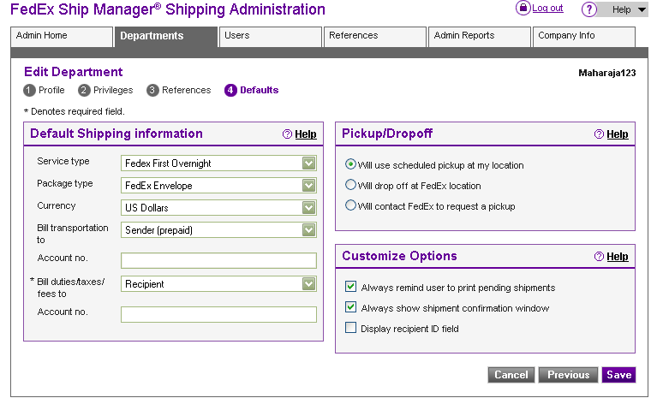
Adding departments
Department defaults
  Set service settings to
  most-frequently-used
  settings to facilitate
  faster use
  Set defaults for options
  to ensure a consistent
  user experience
  across the department
  Default settings entered
  here correspond with
  options available
  on the user’s Preferences screen
Test Company

Slide 20
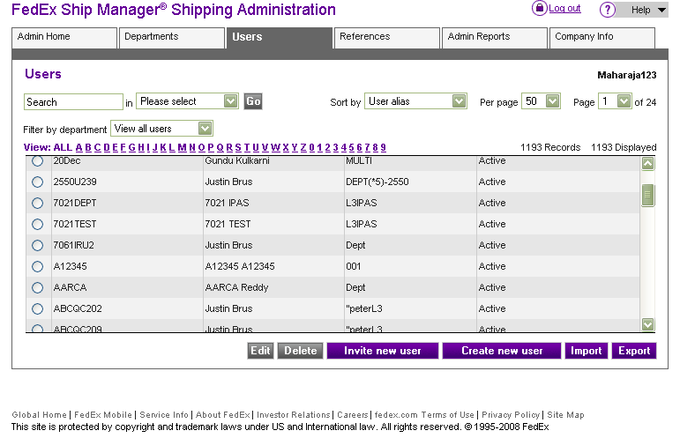
Managing users
View users
  When you click on the
  Users tab, the Users
  screen displays
  This screen contains
  key information about
  users, such as user name,
  user ID, department and
  deactivated status
  You can search, sort,
  view, add, update, delete,
  import and export multiple
  users here
Test Company

Slide 21
Adding users
You have two ways to add users, depending on the amount of control or flexibility you want to have
  If you want to create and manage a user’s ID, password and shipping profile, use the “Create
  new user” functionality
  If you prefer that the user have autonomy
  over these factors, use the “Invite new user” functionality

Slide 22
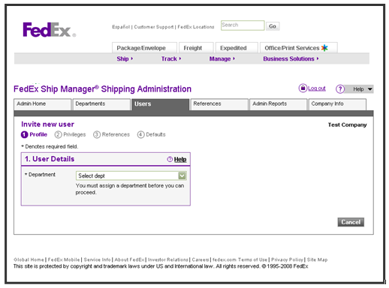
Adding users
Create users
  Select the “Create
  user” button from
  the Admin Home screen
  or the Users screen
  The Profile screen will
  appear. Assign the
  user to a department
  by selecting one from
  the drop-down menu

Slide 23
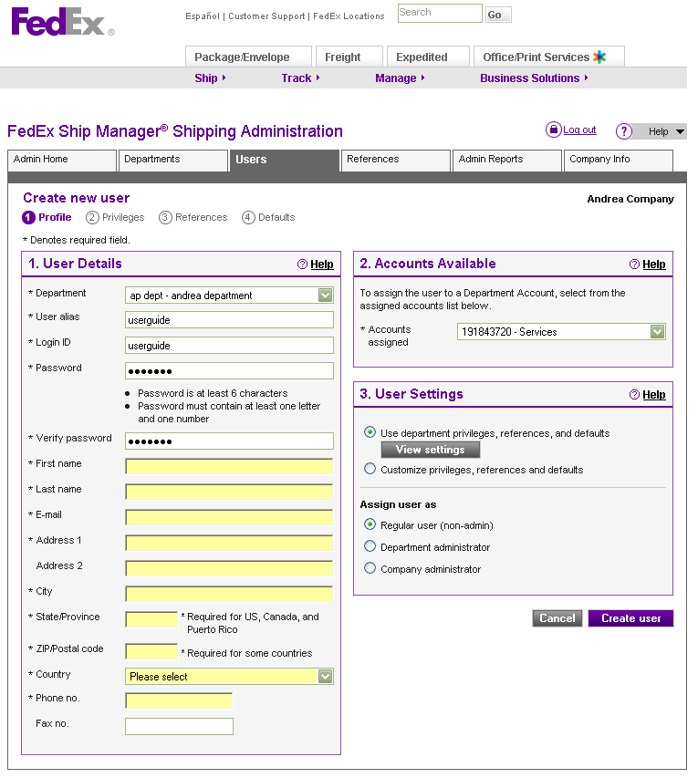
Adding users
User profile
  Use this screen to enter
  and update user
  information, assign
  an account number
  to the user, assign
  user settings, and
  assign the user’s role
Notes:
As a member of a department, a user automatically inherits the same physical address, privileges and default settings for that department. If desired, these settings can be customized at the user level.
If the administrator does not want to customize settings for the user, select the option “Use department privileges, references and defaults.”
If the administrator wants to assign administrative privileges to the user, select “Department administrator” or “Company administrator,” depending on the level of control the administrator wants the user to have.
FedEx confidential and proprietary ⎯ do not copy. These are speaker’s notes. They are not approved for distribution.

Slide 24
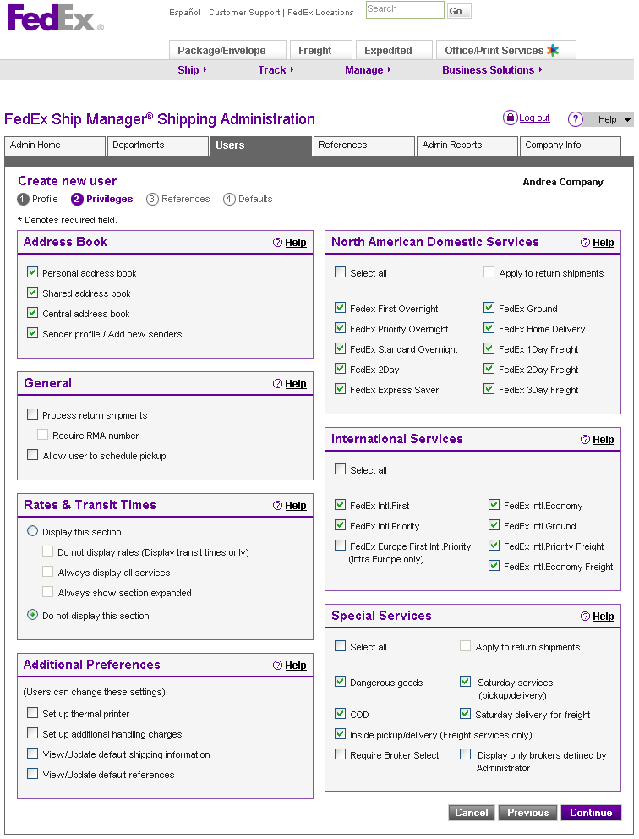
Adding users
User privileges
  Instead of allowing the
  same default department
  settings to apply to a
  particular user, you can
  assign unique privileges
  when adding the user to
  the department, including:
    Allowing or restricting
    specific rights and
    privileges to the user
    Allowing or restricting
    shipping service choices
    to the user

Slide 25
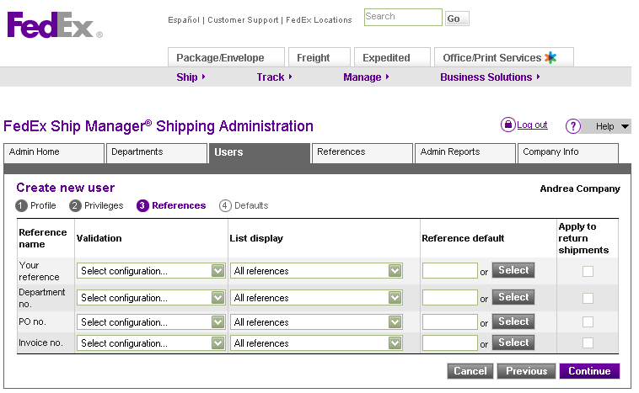
Adding users
User references
  Customize references
  at the user level

Slide 26
Adding users
User defaults
  Customize defaults
  at the user level
    These default settings
    correspond with options
    available on the user’s
    Preferences screen

Slide 27
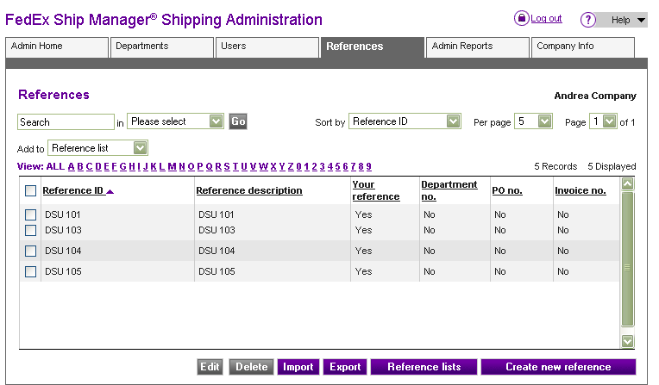
Managing references
View references
  When you click on the
  References tab, the
  References screen
  displays
  This screen contains
  key information about
  references, such
  as reference ID and
  reference description
  You can view, search,
  sort, add, update, delete,
  import and export
  references here, as well
  as view, update and add
  to current reference lists,
  and create new ones

Slide 28
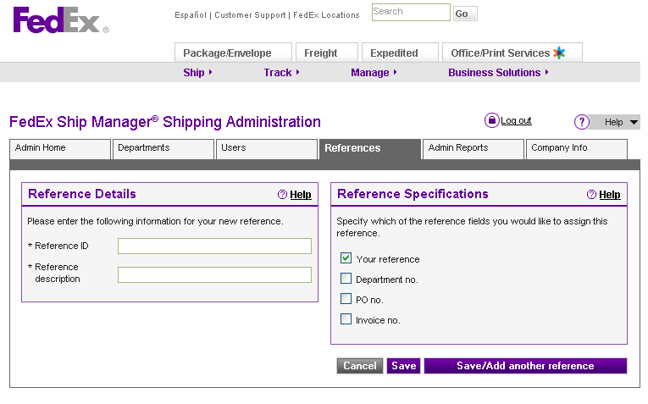
Adding references
Add a reference
  Adding a reference is
  a three-step process:
    Add the appropriate
    information in the
    Reference ID and
    Reference Description
    fields
    Select one or more of the
    reference field options;
    you must select at
    least one
    Click on Save/Update.
    The reference information
    is added and you are returned to the References screen.
    Or, if you want to save the entry and add more, click on
    “Save/Add another reference”

Slide 29
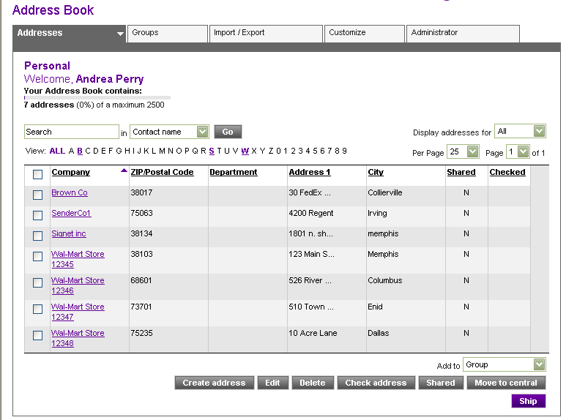
Managing address books
Address book
  You can set up and
  manage three separate
  address books and assign
  privileges to users
  and departments:
    Central address book
    Shared address book
    Personal address book
  The central address book
  can hold up to 25,000
  individual recipient
  addresses
  The shared address book
  is a collection of addresses from other users’
  personal address books
Notes:
Personal address book. Select this option to view your own list of recipient addresses. You can add, change and delete recipient addresses from your personal address book. Users will also be able to add, change and delete recipient addresses if you give them permission to have a personal address book. You can have 2,000 recipients in your personal address book.
Central address book. Add, update, delete, import and export up to 15,000 recipient addresses and make this information available to all Shipping Administration users associated with the same company ID. If a central address book is in use, recipient addresses display inside the personal address book on the Shipping screen.
Shared address book. The shared address book allows users to view the address book of another Shipping Administration user, but not make any changes to it. As an administrator, you can select which addresses users and departments can view. Individual users can access multiple shared address books as long as they know the user.
FedEx confidential and proprietary ⎯ do not copy. These are speaker’s notes. They are not approved for distribution.

Slide 30
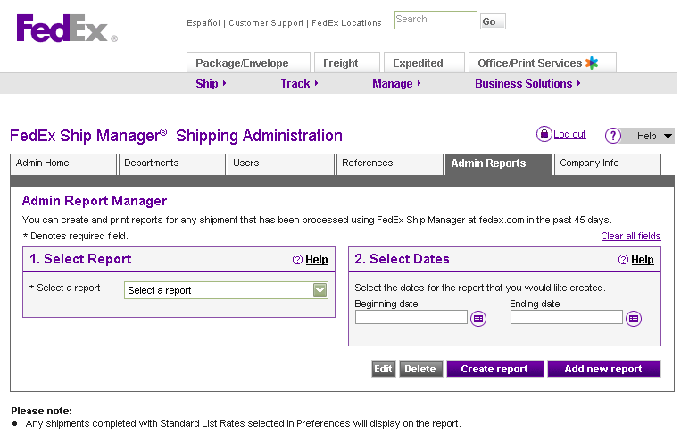
Admin reports
Admin report
  Administrator reports
  allow a company
  centralized visibility
  of the shipping activity
  of users across
  the company
  Customized administrator
  reports can display valuable
  information, such as service
  information, reference
  values and estimated
  shipping charges
  Up to 25 administrative
  report configurations can
  be saved

Slide 31
Admin reports
Admin report (cont.)
  Create, add, edit and delete
  reports for any shipment
  processed through FedEx
  Ship Manager® at fedex.com
  in the past 45 days
  To create a report from a list
  of existing saved reports,
  select a report from the
  “Select report” drop-down
  menu, select beginning
  and ending dates from
  the drop-down menus
  provided, and click on the
  “Create report” button
Notes:
Once the report is generated, you can view and print the entire report, or download the entire report by saving it to a location of your choosing on your hard drive in comma-separated variable (CSV) format.
You can track the status of any shipment from within the report by clicking on the tracking number(s) provided.
FedEx confidential and proprietary ⎯ do not copy. These are speaker’s notes. They are not approved for distribution.

Slide 32
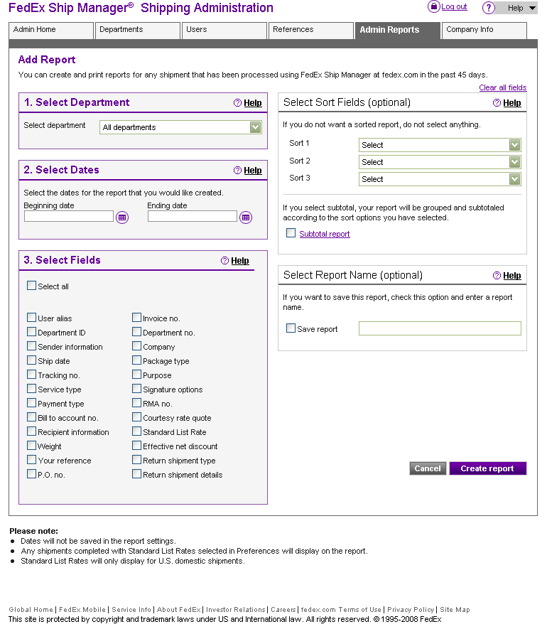
Admin reports
Add report
  Add new customized
  reports for an individual
  department or for the
  entire company
    Select up to 19 enhanced
    detail fields to appear on
    the report
    Select up to three options
    for sorting the report total
    and subtotal
    Set the date range for
    the report
Notes:
If you want to save the report, select the “Save report” option and enter a report name. A maximum of 25 administrative report configurations can be saved.
FedEx confidential and proprietary ⎯ do not copy. These are speaker’s notes. They are not approved for distribution.

Slide 33
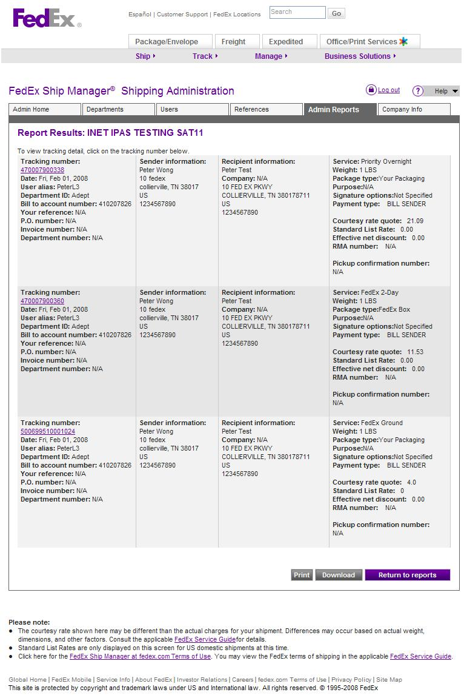
Admin reports
Report results
  The report results include
  all sender and recipient
  information, as well as all
  reference information that
  can be used for monitoring
  departmental shipments
  You can view and print the
  entire report, or download
  the entire report by saving
  it to a location of your
  choosing on your hard
  drive in comma-separated
  variable (CSV) format

Slide 34
To register for Shipping Administration
Select Prepare Shipment Online from the Ship
tab at fedex.com
Click on Sign Up Now! to register for a fedex.com login and complete the online registration form
  Please note: If you’re already a registered fedex.com user, you will still need to enter your user ID and password and answer a few questions specific to FedEx Ship Manager® at fedex.com
On the confirmation page you’ll see an additional
option to register for the Shipping Administration
feature. Complete the additional steps for validation
and registration

Slide 35
To register for Shipping Administration (cont.)
A confirmation page will appear, confirming that you’ve successfully registered as a Shipping Administration administrator
Return to the FedEx Ship Manager® at fedex.com log-in screen and again enter your user ID and password

Slide 36
声明：
所有的版权属于原有公司，文件均来自公开渠道
此文件仅供学习使用，任何人不得进行以此为商业目的的行为
如有疑问，请立即删除
学习世界五百强和咨询公司PPT课程请访问如下网站搜索：“司马懿”
百度传课：司马懿PPT学校
https://www.chuanke.com
网易学堂：司马懿PPT学校
https://study.163.com
知乎： 司马懿PPT学校
https://www.zhiu.com

