Slide 1

Treasury Hot Topics Seminar
Building the business case for a payment factory and in-house bank
19 February 2009

Notes:
Date

Slide 2
Agenda
Next Generation Payment Factory
Making the best use of SEPA, SWIFTNet and Systems
Most promising developments within the Treasury world
Evolution from Traditional to Next Generation Payment Factory
Summary of Benefits
Conclusion
Notes:
Date

Slide 3
Agenda
Next Generation Payment Factory
Making the best use of SEPA, SWIFTNet and Systems
Most promising developments within the Treasury world
Evolution from Traditional to Next Generation Payment Factory
Summary of Benefits
Conclusion
Notes:
Date

Slide 4
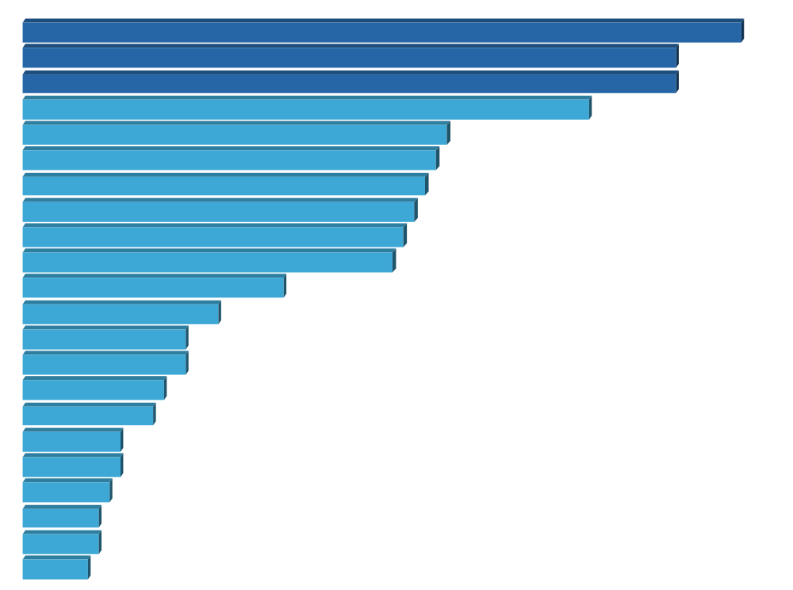
Promising developments
In-house banking – 11,0%
Payment factories – 10,0%
Straight through processing – 10,0%
Shared service centres – 8,7%
Global banking – 6,5%
New concepts and ideas to increase knowledge and understanding of risk – 6,3%
Innovative financial instruments/structured finance solutions – 6,2%
Credit risk management tools – 6,0%
On-line dealing platforms – 5,8%
SWIFTNet – 5,7%
Webservices – 4,0%
Euro capital market – 3,0%
Alternative risk transfer products – 2,5%
Other – 2,5%
Bank industry consolidation – 2,2%
IFRS – 2,0%
Basel II – 1,5%
CLS (Continuous Link Settlement) – 1,5%
Outsourcing – 1,3%
Sarbox – 1,2%
Decreased market volatility – 1,2%
Increased market volatility – 1,0%
The future
Main promising developments in treasury that will add value to the business
Slide <number>
Notes:
Date
AS we mentioned earlier IT seems to be seem both as an obstacle, but also an enabler if performed correctly, with IN-house banking (which is largely it dependent), Payment factories and STP seen as being most likely to add value.
This was followed up with use of shared service centres to perhaps reduce costs and improve operational risk, global banking.

Slide 5
Agenda
Next Generation Payment Factory
Making the best use of SEPA, SWIFTNet and Systems
Most promising developments within the Treasury world
Evolution from Traditional to Next Generation Payment Factory
Summary of Benefits
Conclusion
Notes:
Date

Slide 6


Example Payment(s) Process without Payment Factory
Business Unit A
A/C A
Vendor A
EFT A
Bank A
Payments
Payments
Business Unit B
A/C B
Vendor B
EFT A2
Business Unit C
A/C C
Payments
Payments
EFT B
Bank B
Vendor C
Business Unit D
Manual Payment
A/C D
Bank C
Multiple Processes
Multiple Payment Formats
Multiple Interfaces
Multiple Accounts
Multiple Bank Statements
Multiple Signatories
X Multiple locations
Slide <number>

Slide 7
Example Traditional Payment Factory
Business Unit A
Payment Factory
A/C A
Vendor A
Business Unit B
Bank A
EFT A
A/C B
Vendor B
Internal Interfaces
External
Interfaces
Business Unit C
A/C C
Bank B
EFT B
Vendor C
Business Unit D
A/C D
EFT C
Bank C
1 Standard Process/ Team
1 set of formats internally
1 standard (internal) interface
Slide <number>

Slide 8
Example Traditional Payment Factory
Business Unit A
Payment Factory
A/C A
Vendor A
Business Unit B
Bank A
EFT A
A/C B
Vendor B
Internal Interfaces
External
Interfaces
Business Unit C
A/C C
Bank B
EFT B
Vendor C
Business Unit D
A/C D
EFT C
Bank C
1 Standard Process/ Team
1 set of formats
1 standard (internal) interface
Slide <number>

Slide 9

Example Next Generation Payment Factory
A/C A
Vendor A
Business Units
Payment Factory
Bank A
Internal
A/C B
Vendor B
Business Units
A/C C
Business Units
Bank B
Interface
SWIFTNet
interface
Business Units
Vendor C
A/C D
Bank C
One EFT System
One Set of Formats (SCORE)
Direct Connection to your banks
Multiple Accounts
Multiple Bank Statements
Multiple Signatories
Slide <number>

Slide 10
What is Payment on Behalf ?
(a) Own Payments – V – (b) Payments on Behalf
(a)
Straight Through Process
Multiple External Accounts Required
Expensive Cross Border Payments
BU 1
Belgium
$ Payment Requests
Traditional Payment Factory
BU1
$ a/c in Country A
Cross Border Payments
Straight Through Process
Vendor a/c in USA
BU 2
United kingdom
BU 2
$ a/c in Country B
BU 3
France
BU 3
$ a/c in Country C
BU 4
Sweden
BU 4
$ a/c in Country D
(b)
BU 1
USA
$ Payment Requests
Next Generation Payment Factory
Value Added Transaction Processing
One Treasury payment account per country
  Reduced risk of fraudulent payment from external accounts
Significant reduction in Cross Border payments
  From XX,000 @ approx $5 each, to X,000 =
Conversion to Domestic Payments
Domestic Payments
Treasury
$ a/c in USA
Vendor a/c in USA
BU 2
United kingdom
BU 3
France
BU 4
Sweden
Slide <number>

Slide 11
Example Next Generation and Payment Factory
Business Units
Cash Settlements Centre
Vendor A
Payment Factory
Treasury A/C
Country A
Vendor B
Payments
Business Units
Bank A
Vendor C
Business Units
Vendor A
SWIFTNet
interface
Treasury A/C
Country B
Payments
Vendor B
Bank B
Business Units
Vendor C
In-House
Bank
Reporting
SEPA
Reporting
Corporate Treasury
Reduce number of bank accounts even further
Operating Parameters
Slide <number>

Slide 12
Agenda
Next Generation Payment Factory
Making the best use of SEPA, SWIFTNet and Systems
Most promising developments within the Treasury world
Evolution from Traditional to Next Generation Payment Factory
Summary of Benefits
Conclusion
Notes:
Date

Slide 13
Potential benefits
Quantitative
Reduce bank fees and/or number of bank accounts
Convert x-border payments to cheaper products
Reduce the number of payment systems/bank interfaces to be developed and maintained
Overall reduction in FTE’s involved in the payments processes
Consolidated/Accurate information to reduce cost of liquidity:
    Improve daily cash management
    Improve quality of L/T cash forecast for risk management.
Slide <number>

Slide 14
Summary of Potential benefits
Qualitative
Single technology for communication with the banking environment with a lower cost and greater degree of bank independence
Minimise corporate risk by reducing locations where cash leaves the co.
Consolidated information for bank fee management & reconciliation
Improved operational flexibility, especially when integrating multinational businesses.
Improved centralised information and ease compliance for IFRS/Sarbox
Achieve critical mass to improve segregation of duties in high risk areas.
Along with an in-house bank, constitute the building blocks for a shared service centre.
Opportunity to build a centre of excellence offering expert [banking] transaction related Customer Service to the business
Slide <number>

Slide 15
Agenda
Next Generation Payment Factory
Making the best use of SEPA, SWIFTNet and Systems
Most promising developments within the Treasury world
Evolution from Traditional to Next Generation Payment Factory
Summary of Benefits
Conclusion
Notes:
Date

Slide 16

Conclusion
Savings:
Reduce number of bank accounts
Reduced number of X-border payments
Less external payments
Less banking fees
Reduced number of interfaces and payment systems needed
Reduced number of FTE’s needed
Better visibility on outgoing cash
Costs:
Implementing IHB module
Implementing SwiftNet
Connect TMS to SwiftNet
Develop payment format & Interface to PF
Change management
Slide <number>

Slide 17
Thank you!
Damien McMahon
Director – Finance & Treasury Solutions Group
damien.mcmahon@pwc.be
+32 2 710 9439
Gunter Geysen
Manager – Finance & Treasury Solutions Group
gunter.geysen@pwc.be
+32 2 259 3163
© 2009 PricewaterhouseCoopers. All rights reserved. “PricewaterhouseCoopers” refers to the network
of member firms of PricewaterhouseCoopers International Limited, each of which is a separate and independent legal entity. *connectedthinking is a trademark of PricewaterhouseCoopers LLP (US).

Notes:
Date

Slide 18
声明：
所有的版权属于原有公司，文件均来自公开渠道
此文件仅供学习使用，任何人不得进行以此为商业目的的行为
如有疑问，请立即删除
学习世界五百强和咨询公司PPT课程请访问如下网站搜索：“司马懿”
百度传课：司马懿PPT学校
https://www.chuanke.com
网易学堂：司马懿PPT学校
https://study.163.com
知乎： 司马懿PPT学校
https://www.zhiu.com

