Slide 1
“Project Panthera”: Better Analytics with SQL, MapReduce and HBase
Jason Dai
Principal Engineer
Intel SSG (Software and Services Group)

Slide 2
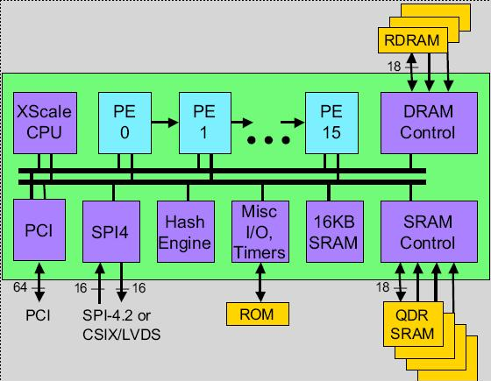
My Background and Bias
Years of development on parallel compiler
Lead architect of Intel network processor compiler
Auto-partitioning & parallelizing for many-core many-thread (128 HW threads @ year 2002) CPU
Currently Principal Engineer in Intel SSG
Leading the open source Hadoop engineering team
HiBench, HiTune, “Project Panthera”, etc.
Intel IXP2800

Slide 3
Agenda
Overview of “Project Panthera”
Analytical SQL engine for MapReduce
Document store for better query processing on HBase
Summary

Slide 4
Project Panthera
Our open source efforts to enable better analytics capabilities on Hadoop/HBase
Better integration with existing infrastructure using SQL
Better query processing on HBase
Efficiently utilizing new HW platform technologies
Etc.
https://github.com/intel-hadoop/project-panthera

Slide 5
Current Work under Project Panthera
An analytical SQL engine for MapReduce
Built on top of Hive
Provide full SQL support for OLAP
A document store for better query processing on HBase
A co-processor application for HBase
Provide document semantics & significantly speedup query processing

Slide 6
Agenda
Overview of “Project Panthera”
Analytical SQL engine for MapReduce
Document store for better query processing on HBase
Summary

Slide 7
Full SQL Support for Hadoop Needed
Analytic
Full SQL support for OLAP
Required in modern business application environment
Business users
Enterprise analytics applications
Third-party tools (such as query builders and BI applications)
Hive – THE Data Warehouse for Hadoop
HiveQL: a SQL-like query language (subset of SQL with extensions)
Significantly lowers the barrier to MapReduce
Still large gaps w.r.t. full analytic SQL support
Multiple-table SELECT statement, subquery in WHERE clauses, etc.

Slide 8
An analytical SQL engine for MapReduce
The anatomy of a query processing engine
Parser
AST (Abstract Syntax Tree)
Semantic Analyzer (Optimizer)
Execution Plan
Execution
Query
Our SQL engine for MapReduce
(Open Source) SQL Parser*
SQL-AST Analyzer & Translator
Hive Semantic Analyzer
Hadoop MR
SQL-AST
Hive-AST
Driver
SQL
Query
Subquery Unnesting
Multi-Table SELECT
INTERSECT Support
MINUS Support
…
…
HiveQL
Hive Parser
Hive-AST
*https://github.com/porcelli/plsql-parser

Slide 9
Current Status
Enable complex SQL queries (not supported by Hive today), such as,
Subquery in WHERE clauses (using ALL, ANY, IN, EXIST, SOME keywords)
select * from t1 where t1.d > ALL (select z from t2 where t2.z!=9);
Correlated subquery (i.e., a subquery referring to a column of a table not in its FROM clause)
select * from t1 where exists ( select * from t2 where t1.b = t2.y );
Scalar subquery (i.e., a subquery that returns exactly one column value from one row)
select a,b,c,d,e,(select z from t2 where t2.y = t1.b and z != 99 ) from t1;
Top-level subquery
(select * from t1) union all (select * from t2) union all (select * from t3 order by 1);
Multiple-table SELECT statement
select * from t1,t2 where t1.c > t2.z;
https://github.com/intel-hadoop/hive-0.9-panthera

Slide 10
Current Status
NIST SQL Test Suite Version 6.0
http://www.itl.nist.gov/div897/ctg/sql_form.htm
A widely used SQL-92 conformance test suite
Ported to run under both Hive and the SQL engine
SELECT statements only
Run against Hive/SQL engine and a RDBMS to verify the results
 | Ported Query# From NIST | Hive 0.9 |  | SQL Engine
 |  | Passed Query# | Pass Rate | Passed Query# | Pass Rate
All queries | 1015 | 777 | 76.6% | 900 | 88.7%
Subquery related queries | 87 | 0 | 0% | 72 | 82.8%
Multiple-table select queries | 31 | 0 | 0% | 27 | 87.1%

Slide 11
The Path to Full SQL support for OLAP
A SQL compatible parser
E.g., Hive-3561
Multiple-table SELECT statement
E.g., Hive-3578
Full subquery support & optimizations
E.g., subquery unnesting (Hive-3577)
Complete SQL data type system
E.g., DateTime types and functions (Hive-1269)
...
See the umbrella JIRA Hive-3472

Slide 12
Agenda
Overview of “Project Panthera”
Analytical SQL engine for MapReduce
Document store for better query processing on HBase
Summary

Slide 13
Query Processing on HBase
Hive (or SQL engine) over HBase
Store data (Hive table) in HBase
Query data using HiveQL or SQL
Series of MapReduce jobs scanning HBase
Motivations
Stream new data into HBase in near realtime
Support high update rate workloads (to keep the warehouse always up to date)
Allow very low latency, online data serving
Etc.

Slide 14
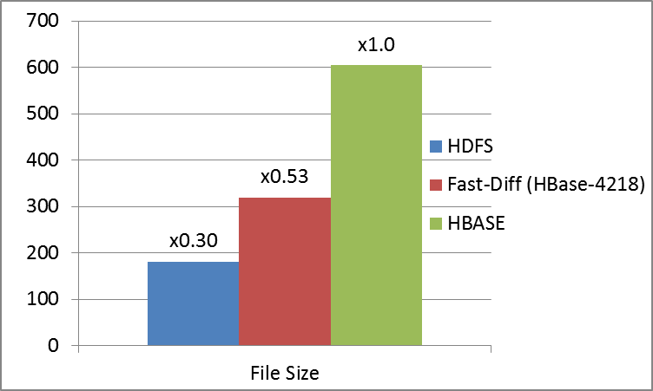
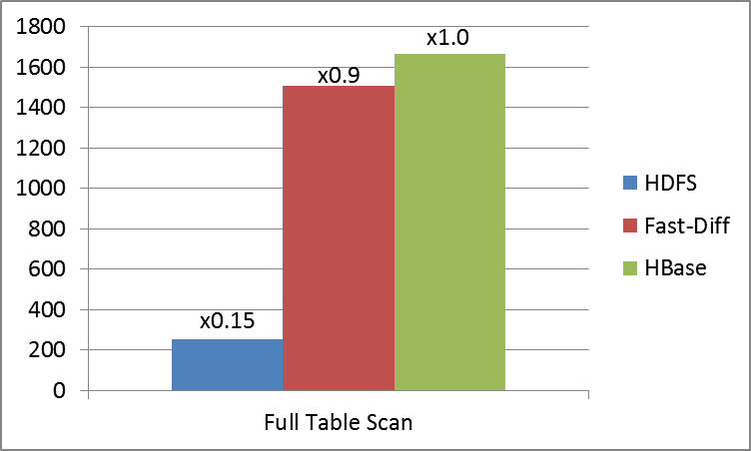
Overheads of Query Processing on HBase
Space overhead
Fully qualified, multi-dimentional map in HBase vs. relational table
Performance overhead
Among many reasons
Highly concurrent read/write accesses in HBase vs. read-most analytical queries
2~3x space overhead (a 18-column table)
HBase Table
(r₁, cf₁:C₁, ts) | v₁
(r₁, cf₁:C₂, ts) | v₂
… | …
(r₁, cf₁:C_{n}, ts) | v_{n}
(r₂, cf₁:C₁, ts) | v_{n+1}
… | …
Relational (Hive) Table
Row Key | C₁ | C₂ | … | C_{n}
r₁ | v₁ | v₂ | … | v_{n}
r₂ | v_{n+1} | v_{n+2} | … | v_{2n}
… | … | … | … | …
~6x performance overhead (full 18-column table scan )

Slide 15
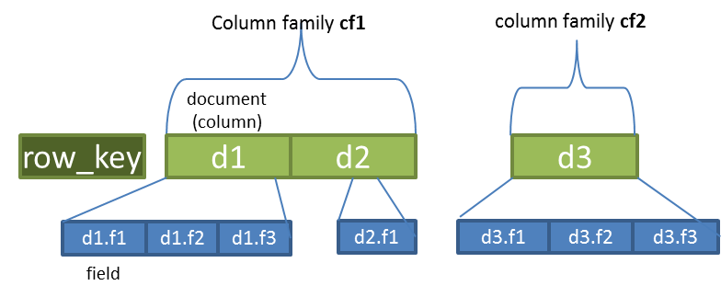
A Document Store on HBase
DOT (Document Oriented Table) on HBase
Each row contains a collection of documents (as well as row key)
Each document contains a collection of fields
A document is mapped to a HBase column and serialized using Avro, PB, etc.
Mapping relational table to DOT
Each column mapped to a field
Schema stored just once
Read overheads amortized across different fields in a document
…
Row Key | C₁ | C₂ | … | C_{n}
r₁ | v₁ | v₂ | … | v_{n}
r₂ | v_{n+1} | v_{n+2} | … | v_{2n}
… | … | … | … | …
Implemented as a HBase Coprocessor Application
https://github.com/intel-hadoop/hbase-0.94-panthera

Slide 16
Working with DOT
Hive/SQL queries on DOT
Similar to running Hive with HBase today
Create a DOT in HBase
Create external Hive table with the DOT
Use “doc.field” in place of “column qualifier” when specifying “hbase.column.mapping”
Transparent to DML queries
No changes to the query or the HBase storage handler
CREATE EXTERNAL TABLE table_dot (key INT, C1 STRING, C2 STRING, C3 DOUBLE) STORED BY 'org.apache.hadoop.hive.hbase.HBaseStorageHandler'
WITH SERDEPROPERTIES ("hbase.columns.mapping" = ":key,f:d.c1,f:d.c2, f:d.c3")
TBLPROPERTIES ("hbase.table.name"=" table_dot");

Slide 17
Working with DOT
Create a DOT in HBase
Required to specify the schema and serializer (e.g., Avro) for each document
Stored in table metadata by the preCreateTable co-processor
I.e., the table schema is fixed and predetermined at table creation time
OK for Hive/SQL queries
HTableDescriptor desc = new HTableDescriptor(“t1”);
//Specify a dot table
desc.setValue(“hbase.dot.enable”,”true”);
desc.setValue(“hbase.dot.type”, ”ANALYTICAL”);
…
HColumnDescriptor cf2 = new HColumnDescriptor(Bytes.toBytes("cf2"));
cf2.setValue("hbase.dot.columnfamily.doc.element",“d3”); //Specify contained document
String doc3 = " { \n" + " \"name\": \"d3\", \n"
+ " \"type\": \"record\",\n" + " \"fields\": [\n"
+ " {\"name\": \"f1\", \"type\": \"bytes\"},\n"
+ " {\"name\": \"f2\", \"type\": \"bytes\"},\n"
+ " {\"name\": \"f3\", \"type\": \"bytes\"} ]\n“ + "}";
cf2.setValue(“hbase.dot.columnfamily.doc.schema.d3”, doc3Schema); //specify the schema for d3
desc.addFamily(cf2Desc);
admin.createTable(desc);

Slide 18
Working with DOT
Data access for DOT
Transparent to the user
Just specify “doc.field” in place of “column qualifier”
Mapping between “document”, “field” & “column qualifier” handled by coprocessors automatically
Additional check for Put/Delete today
All fields in a document expected to be updated together; otherwise:
Warning for Put (missing field set to NULL value)
Error for DELETE
OK for Hive queries
Scan scan = new Scan();
scan.addColumn(Bytes.toBytes(“cf1"), Bytes.toBytes(“d1.f1")).
addColumn(Bytes.toBytes(“cf2"), Bytes.toBytes(“d3.f1”));
SingleColumnValueFilter filter = new SingleColumnValueFilter(
Bytes.toBytes("cf1"), Bytes.toBytes("d1.f1"),
CompareFilter.CompareOp.EQUAL,
new SubstringComparator("row1_fd1"));
scan.setFilter(filter);
HTable table = new HTable(conf, “t1”);
ResultScanner scanner = table.getScanner(scan);
for (Result result : scanner) {
System.out.println(result);
}

Slide 19
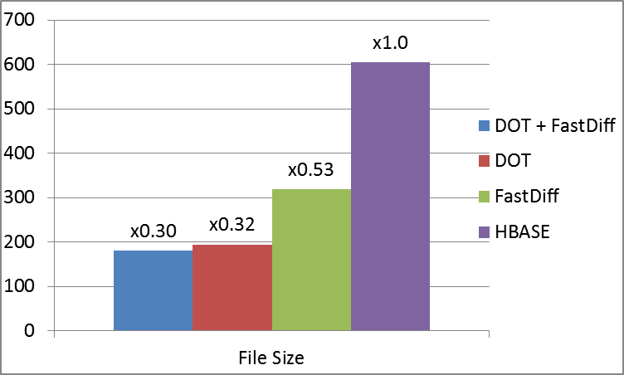
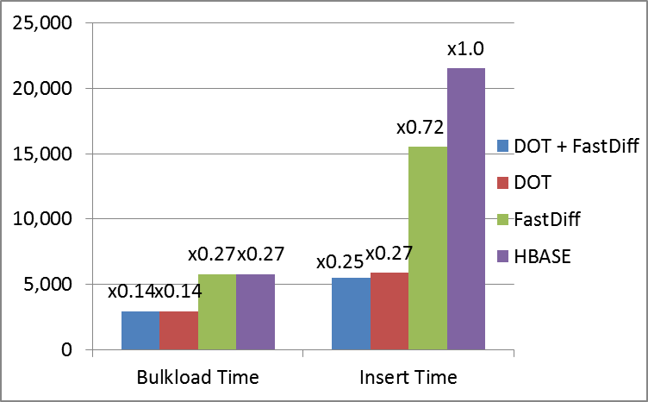
Some Results
Benchmarks
Create an 18-column table in Hive (on HBase) and load ~567 million rows
Table storage
1.7~3x space reduction w/ DOT
Data loading
~1.9x speedup for bulk load w/ DOT
3~4x speedup for insert w/ DOT

Slide 20
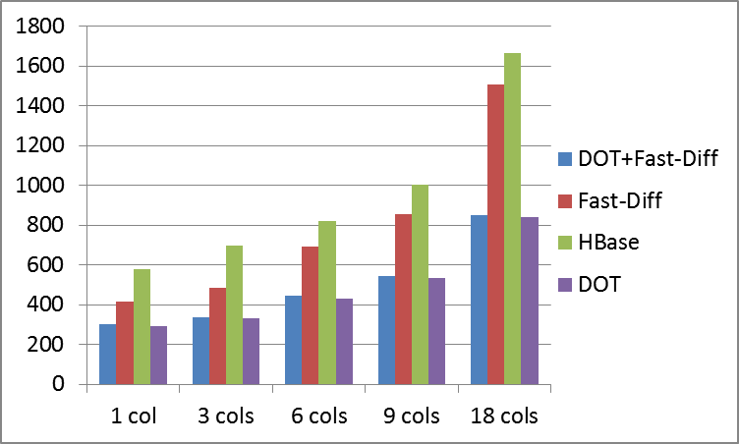
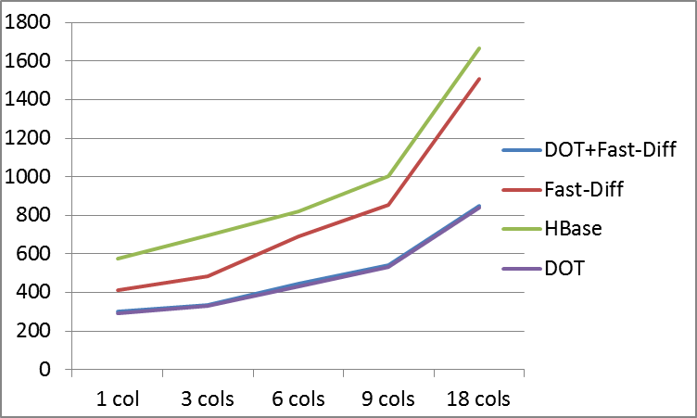
Some Results
Benchmarks
Select various numbers of columns form the table
select count (col₁, col₂, …, col_{n}) from table
SELECT performance: up to 2x speedup w/ DOT

Slide 21
Summary
“Project Panthera”
Our open source efforts to eanle better analytics capabilities on Hadoop/HBase
https://github.com/intel-hadoop/project-panthera/
An analytical SQL engine for MapReduce
Provide full SQL support for OLAP
Complex subquery, multiple-table SELECT, etc.
Umbrella JIRA HIVE-3472
A document store for better query processing on HBase
Provide document semantics & significantly speedup query processing
Up to 3x storage reduction, up to 2x performance speedup
Umbrella JIRA HBASE-6800

Slide 22
Thank You!
This slide deck and other related information will be available at http://software.intel.com/user/335224/track
Any questions?

Slide 23


Slide 24
声明：
所有的版权属于原有公司，文件均来自公开渠道
此文件仅供学习使用，任何人不得进行以此为商业目的的行为
如有疑问，请立即删除
学习世界五百强和咨询公司PPT课程请访问如下网站搜索：“司马懿”
百度传课：司马懿PPT学校
https://www.chuanke.com
网易学堂：司马懿PPT学校
https://study.163.com
知乎： 司马懿PPT学校
https://www.zhiu.com

