Slide 1

Peter Broffman
Corporate Affairs Group
January 2012

Slide 2


Intel® Easy Steps
What is it?
A basic technology literacy education program.
Who’s it for?
Adult learners with little or no experience with computers.
What does it teach?
Participants learn the “basics” of the computer, enabling them
to use the computer in ways that are relevant to their daily lives.
What skills will participants learn?
Through active, hands-on experience, participants learn to explore
and use basic computer applications that are used in everyday life:
Internet Spreadsheets
Email Multimedia
Word processing Skype
Social Media (FB)
What will this enable participants to do?
Communicate with friends, family and business associates though email, research and access information on the Internet, create resumes, flyers, invitations, budgets, business documents, presentations, and more.
Optional modules: How to apply basic skills to business and entrepreneurship
How is this Implemented?
Through partnerships with external organizations: Intel licenses materials, the external organization supports implementation.

Slide 3
Intel® Easy Steps Program Offerings
Intel® Easy Steps
Program Offerings
Intel® Easy Steps
Basic Course
(facilitated course)
Intel® Easy Steps
Activity Cards
(self-instruction)
plus
Modules 1- 5
Introduction to computer operations and basic software applications*, with practical examples for adult users
Step-by-Step instruction on how to create a specific document or artifact
May be customized for specific targeted audiences.
May be used to supplement Basic Course, or for independent self-instruction
Modules 6-14 (optional)
Examples of how to apply basic skills in employment and entrepreneurship, plus additional tools (Skype, Google Docs, Social Media)
* Technology areas: Word Processing, Spreadsheets, Multimedia, Internet & Email
* Technology areas: Word Processing. Spreadsheets, Multimedia, Internet & Email

Slide 4
Intel® Easy Steps Basic Course Content
Module | Title | Activity
PART 1 - Learning New Skills
1 | Introducing Computers and Operating Systems | Basic PC operations, create files, keyboarding, Notepad
2 | Introducing Internet and Email | Internet search, browsing, create and use email
3 | Introducing Word Processing | Explore WP; create flyer, resume, greeting Card
4 | Introducing Spreadsheets | Explore Spreadsheet; create budget, address book
5 | Introducing Multimedia | Explore PPT; create presentation, add graphics, media
PART 2 - Applying Skills to Business and Entrepreneurship
6 | Introduction to Entrepreneurship | Create Mind Map (business ideas) via PPT and Graphics
7 | Money Management & Finances | Start-up Costs and Cash Flow, sharing thru Skype
8 | Developing a Marketing Plan | Create Mkt. Plan presentation, communicate via email
9 | Branding | Create logo, letterhead, business cards, email signature
10 | Marketing Material | Create brochure, catalogue; communicate via Skype
11 | Online Marketing | Create web site, use social media (FB) to communicate
12 | Collecting Feedback Online | Create survey (Google Docs), share via Skype Share
PART 3 - Showcasing Your Work
13 | Developing a Product Portfolio | Prepare presentation using PPT
14 | Showcase | Present your PTT presentation showing your work
Supported by Intel® Education Help Guide
http://www.intel.com/education/helpguide/index.htm

Slide 5
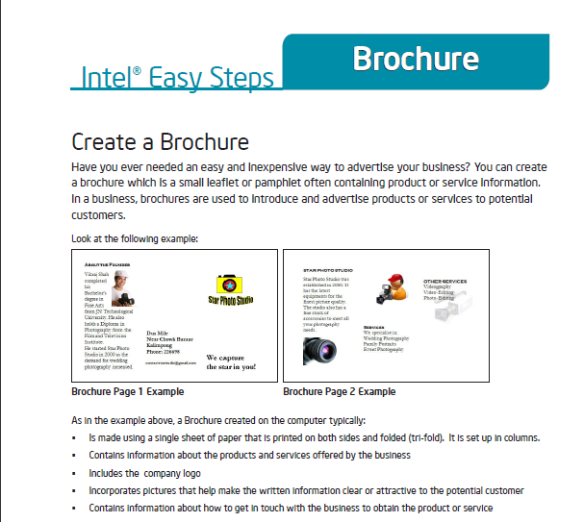
Intel® Easy Steps Activity Cards
Self-Instruction in key technology areas
Intel Easy Steps provides a series of Activity Cards, each of which provides instruction on how to create a useful product or complete a specific task.
Each Activity Card has:
A sample of the product
Step-by-Step instructions to create the product, supported by the Intel® Education Help Guide
A “Challenge” suggesting a way to improve the product
Review Checklist
Partial SAMPLE
Examples of Products:
Advertisement/Poster
Brochure
Budget
Flyer
Invitation
Letter
Newsletter
Supported by Intel ®Education Help Guide

Slide 6
Activity Cards (currently available)
How to Create…
Activity Cards distributed as supplement to Basic Course
1. Address Book
2. Advertisement Poster
3. Brochure
4. Budget
5. Business Card
6. Certificate
7. E- card
8. Email
9. Flyer
10. Health Check Card
11. Internet Download
12. Internet Search
13. Internet Surfing
14. Inventory
Invitation
Job Application
Letter
Logo Letterhead
Newsletter
Presentation
Receipt
Resume
Survey Form
How to Use…
Printer
Scanner
Webcam
The Portfolio of Activity Cards will be expanded over time.
Activity Cards may be developed for targeted audiences

Slide 7

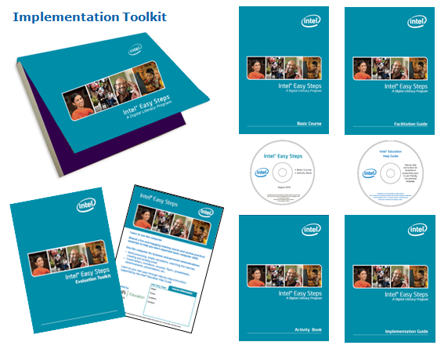
What Intel provides…
A complete Implementation Toolkit:
Implementation Guide with information, instructions, etc.
No-fee license to all Course Materials:
Basic Course
Facilitation Guide for Trainers
Activity Book
Intel® Education Help Guide
Intel® PC Basics (as reference guide)
Evaluation Toolkit
Marketing templates
Services of an Intel® Easy Steps Senior Trainer (ST) to conduct a Train-the-Trainer for the partner organization.

Slide 8
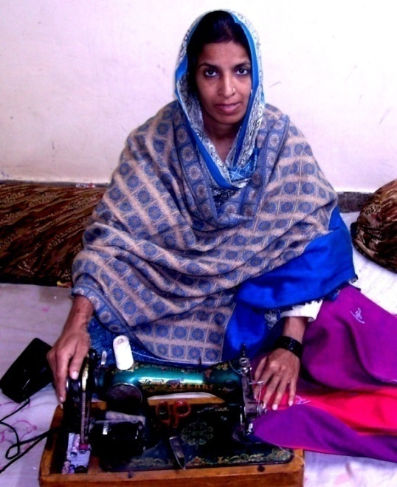

Case Example:
Lubna
39 year-old woman from Pakistan
Works as tailor in her village
Has never travelled outside her province
Completed Intel® Easy Steps
Now uses a computer to:
Research clothing designs from around the world
Create designs using CAD software
Market her business
“I attended the Intel Easy Steps workshop and learnt about computers for the first time. I was so motivated as a new user that I decided to purchase a computer for use at home. The experience completely changed my life”

Slide 9
Contact
Peter Broffman
Corporate Affairs Group
Email: peter.broffman@intel.com
Phone: +1-503-613-3193

Slide 11
声明：
所有的版权属于原有公司，文件均来自公开渠道
此文件仅供学习使用，任何人不得进行以此为商业目的的行为
如有疑问，请立即删除
学习世界五百强和咨询公司PPT课程请访问如下网站搜索：“司马懿”
百度传课：司马懿PPT学校
https://www.chuanke.com
网易学堂：司马懿PPT学校
https://study.163.com
知乎： 司马懿PPT学校
https://www.zhiu.com

