Slide 1
JavaFx 컨트롤
김성영교수
금오공과대학교
컴퓨터공학과

Slide 2
학습 내용
버튼 컨트롤
입력 컨트롤
뷰 컨트롤
미디어 컨트롤
차트 컨트롤

Slide 3
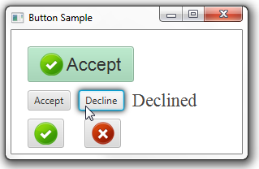
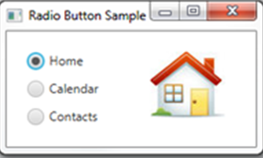
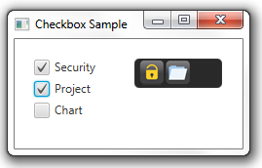
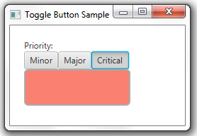
버튼 컨트롤
버튼 컨트롤의 종류
Button
RadioButton
CheckBox
ToggleButton

Slide 4
버튼 컨트롤
Button
text : 사용자에게 보여주는 문자열
ImageView를 사용하여 버튼에 아이콘 추가
<Button text = "아이콘버튼">
<graphic>
<ImageView>
<Image url="@images/history_view.gif/>
</ImageView>
</graphic>
</Button>

Slide 5
버튼 컨트롤
CheckBox
text : 사용자에게 보여주는 문자열
userdata : 프로그램에서 처리하는 데이터
selected: true인 경우 선택, false인 경우 미선택
<CheckBox text="라벨1" userData="값1"/>
<CheckBox text="라벨2" userData="값2", selected="true"/>

Slide 6
버튼 컨트롤
ToggleGroup
ToggleGroup을 참조할 경우 하나의 그룹으로 묶음
<fx:define>태그 사용해서 RadioButton의 toggleGroup 속성에 동일한 id 참조하여 그룹으로 묶음
<fx:define>
<ToggleFroup fx:id="groupname"/>
</fx:define>
<RadioButton text="라벨1" userData="값1" toggleGroup=$groupName/>
<RadioButton text="라벨2" userData="값2",toggleGroup=$groupName selected="true"/>

Slide 7
버튼 컨트롤
EventHandler
CheckBox, RadioButton, ToggleButton의 경우 사용자가 클릭시 ActionEvent가 발생하여 EventHandler로 처리 가능
onActio 속성을 작성하여 이벤트 처리 메소드로 연결
<CheckBox ... onAction="#handleChkAction"/>

Slide 8
버튼 컨트롤
SelectedToggle
그룹 내에서 선택 변경을 감시하고 싶을 때 사용
선택이 변경되면 changed() 메소드가 실행
newValue에는 마지막으로 선택된 컨트롤 대입
group.selectedToggleProperty().addListener(new ChangeListener<Toggle>() {
@Override
public void changed(ObservableValue<? extends Toggle> observable, Toggle oldValue, Toggle newValue) { …}
});

Slide 9
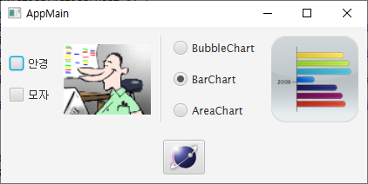
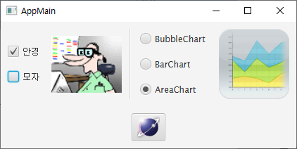
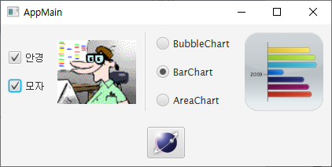
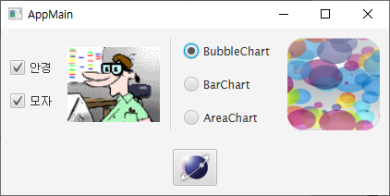
버튼 컨트롤
예제 17-1-1

Slide 10
버튼 컨트롤
root.fxml
<BorderPane prefHeight="150.0" prefWidth="420.0" xmlns:fx="http://javafx.com/fxml/1" xmlns="http://javafx.com/javafx/8" fx:controller="sec07.exam01_button.RootController">
<padding>
<Insets bottom="10.0" left="10.0" right="10.0" top="10.0" />
</padding>
<center>
<HBox alignment="CENTER" prefHeight="100.0" prefWidth="400.0" spacing="10">
<children>
<VBox alignment="CENTER_LEFT" prefHeight="100.0" prefWidth="100.0" spacing="20.0">
<children>
<CheckBox fx:id="chk1" onAction="#handleChkAction" text="안경" />
<CheckBox fx:id="chk2" onAction="#handleChkAction" text="모자" />
</children>
</VBox>
<ImageView fx:id="checkImageView" fitWidth="100.0" preserveRatio="true">
<image><Image url="@images/geek.gif" /></image>
</ImageView>

Slide 11
버튼 컨트롤
root.fxml
<Separator orientation="VERTICAL" prefHeight="100.0" />
<VBox alignment="CENTER_LEFT" prefHeight="100" prefWidth="150" spacing="20.0">
<fx:define><ToggleGroup fx:id="group"/></fx:define>
<children>
<RadioButton fx:id="rad1" text="BubbleChart" userData="BubbleChart">
<toggleGroup>
<ToggleGroup fx:id="group" />
</toggleGroup>
</RadioButton>
<RadioButton fx:id="rad2" selected="true" text="BarChart" toggleGroup="$group" userData="BarChart" />
<RadioButton fx:id="rad3" text="AreaChart" toggleGroup="$group" userData="AreaChart" />
</children>
</VBox>
<ImageView fx:id="radioImageView" fitWidth="100.0" preserveRatio="true">
<image><Image url="@images/BarChart.png" /></image>
</ImageView>
</children>
</HBox>
</center>

Slide 12
버튼 컨트롤
root.fxml
<bottom>
<Button fx:id="btnExit" onAction="#handleBtnExitAction" BorderPane.alignment="CENTER">
<graphic>
<ImageView>
<image>
<Image url="@images/exit.png" />
</image></ImageView>
</graphic>
<BorderPane.margin><Insets top="20.0" /></BorderPane.margin>
</Button>
</bottom>
</BorderPane>

Slide 13
버튼 컨트롤
RootController.java
public class RootController implements Initializable {
@FXML private CheckBox chk1;
@FXML private CheckBox chk2;
@FXML private ImageView checkImageView;
@FXML private ToggleGroup group;
@FXML private ImageView radioImageView;
@FXML private Button btnExit;
@Override
public void initialize(URL location, ResourceBundle resources) {
group.selectedToggleProperty().addListener(new ChangeListener<Toggle>() {
@Override
public void changed(ObservableValue<? extends Toggle> observable, Toggle oldValue, Toggle newValue) {
Image image = new Image(getClass().getResource("images/" + newValue.getUserData().toString() + ".png").toString());
radioImageView.setImage(image);
}
});
}

Slide 14
버튼 컨트롤
RootController.java
public void handleChkAction(ActionEvent e) {
if(chk1.isSelected() && chk2.isSelected()) {
checkImageView.setImage(new Image(getClass().getResource("images/geek-glasses-hair.gif").toString()));
}
else if(chk1.isSelected()) {
checkImageView.setImage(new Image(getClass().getResource("images/geek-glasses.gif").toString()));
}
else if(chk2.isSelected()) {
checkImageView.setImage(new Image(getClass().getResource("images/geek-hair.gif").toString()));
}
else {
checkImageView.setImage(new Image(getClass().getResource("images/geek.gif").toString()));
}
}
public void handleBtnExitAction(ActionEvent e) {
Platform.exit();
}
}

Slide 15



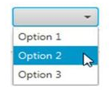
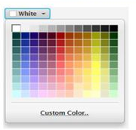
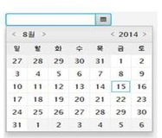
입력 컨트롤
버튼 컨트롤의 종류
Label & TextField
TextArea
ColorPicker
PasswordField
ComboBox
DataPicker

Slide 16
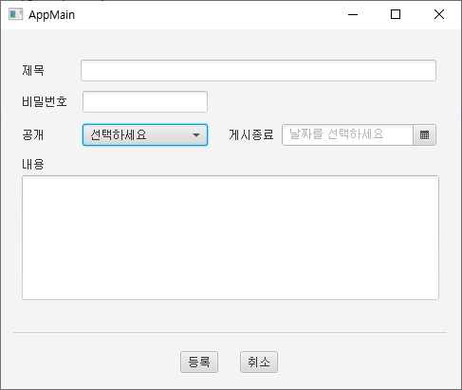
입력 컨트롤
예제 17-2-1
제목 : TextField
비밀번호 : PasswordField
공개 : ComboBox
게시종료 : DatePicker
내용 : TextArea
하단버튼 : Button

Slide 17
버튼 컨트롤
root.fxml
<AnchorPane xmlns:fx="http://javafx.com/fxml" fx:controller="sec07.exam02_input.RootController"
prefHeight="380" prefWidth="485" >
<children>
<Label layoutX="22.0" layoutY="36.0" text="제목" />
<TextField fx:id="txtTitle" layoutX="84.0" layoutY="32.0" prefHeight="23.0" prefWidth="375.0" />
<Label layoutX="22.0" layoutY="69.0" text="비밀번호" />
<PasswordField fx:id="txtPassword" layoutX="86.0" layoutY="65.0" prefHeight="23.0" prefWidth="132.0" />
<Label layoutX="22.0" layoutY="104.0" text="공개" />
<ComboBox fx:id="comboPublic" layoutX="86.0" layoutY="100.0" prefHeight="23.0" prefWidth="132.0" promptText="선택하세요" >
<items>
<FXCollections fx:factory="observableArrayList">
<String fx:value="공개"/>
<String fx:value="비공개"/>
</FXCollections>
</items>
</ComboBox>
<Label layoutX="240.0" layoutY="104.0" text="게시종료" />
<DatePicker fx:id="dateExit" layoutX="296.0" layoutY="100.0" promptText="날짜를 선택하세요"/>
<Label layoutX="22.0" layoutY="135.0" text="내용" />
<TextArea fx:id="txtContent" layoutX="22.0" layoutY="154.0" prefHeight="132.0" prefWidth="440.0"/>
<Separator layoutX="13.0" layoutY="320" prefHeight="0.0" prefWidth="457.0" />
<Button fx:id="btnReg" layoutX="189.0" layoutY="340" text="등록" onAction="#handleBtnRegAction"/>
<Button fx:id="btnCancel" layoutX="252.0" layoutY="340" text="취소" onAction="#handleBtnCancelAction"/>
</children>
</AnchorPane>

Slide 18
버튼 컨트롤
RootController.java
public class RootController implements Initializable {
@FXML private TextField txtTitle;
@FXML private PasswordField txtPassword;
@FXML private ComboBox<String> comboPublic;
@FXML private DatePicker dateExit;
@FXML private TextArea txtContent;
@Override
public void initialize(URL location, ResourceBundle resources) {}
public void handleBtnCancelAction(ActionEvent e) {
Platform.exit();
}
}

Slide 19
버튼 컨트롤
RootController.java
public void handleBtnRegAction(ActionEvent e) {
String title = txtTitle.getText();
System.out.println("title: " + title);
String password = txtPassword.getText();
System.out.println("password: " + password);
String strPublic = comboPublic.getValue();
System.out.println("public: " + strPublic);
LocalDate localDate = dateExit.getValue();
if(localDate != null) {
System.out.println("dateExit: " + localDate.toString());
}
String content = txtContent.getText();
System.out.println("content: " + content);
}

Slide 20
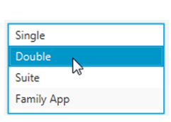
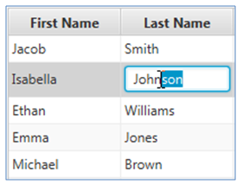
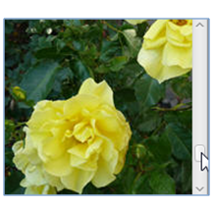
뷰 컨트롤
뷰 컨트롤의 종류
ListView
ImageView
TableView

Slide 21
뷰 컨트롤
ImageView 컨트롤
fitWidth : 폭
fitHeight : 높이
preserveRatio: true인 경우 종횡비 유지 (ImageView 크기 변화),
false인 경우 종횡비 무시 (ImageView 크기 고정)
<ImageView fitWidth=“100.0" fitHeight=“60.0" preserveRatio="true"/>

Slide 22
뷰 컨트롤
ImageView 컨트롤
(1) ImageView 생성자 매개값으로 Image객체 설정
(2) ImageView의 setImage() 메소드로 설정
(1)
<ImageView preserverRatio="true">
<Image url="@images/flower.png">
</ImageView>
(2)
<ImageView fitWidth="200" fitHeight="150" preserverRatio="true">
<Image>
<Image url="@images/flower.png">
</Image>
</ImageView>

Slide 23
뷰 컨트롤
ListView 컨트롤
preWidth : 폭
preHeight : 높이
항목 추가시에 setItems(ObservableList<T> value) 메소드 사용
<ListView preWidth="100.0" preHeight="60.0" />
listView.setItems(FXCollections.observableArrayList(“Swing”,JavaFX”));

Slide 24
뷰 컨트롤
ListView 컨트롤
고정항목일 경우 FXML 파일에서 선언하는 방법
<ListView fx:id="listView" preHeight="100.0" preWidth="290.0">
<items>
<FXCollections fx:factory="observableArrayList">
<String fx:value="Swing"/>
<String fx:value-"JavaFX"/>
</FXCollections>
</items>
</ListView>

Slide 25
뷰 컨트롤
ListView 컨트롤
선택된 인덱스와 항목을 얻을 경우 사용하는 속성 감시
selectedItemProperty() : 선택된 항목
selectedIndexProperty() : 선택된 인덱스
listView.getselectioinModel().selectedItemProperty().addListener(
new ChangeListener<String>() {
@Override
public void Changed(ObserableValue<? extends String> observable, String oldValue, String newValue) { ...}
}
);

Slide 26
뷰 컨트롤
TableView 컨트롤
TableView를 FXML로 선언하는 방법
<TableView fx:id="tableView" prefHeight="100.0" prefWidth="290.0">
<columns>
<TableColumn prefWidth="100.0" text="스마트폰" />
<TableColumn prefWidth="100.0" text="이미지" />
</columns>
</TableView>

Slide 27
뷰 컨트롤
TableView 컨트롤
getColumns().get(인덱스)
PropertyValueFactory("모델속성명")
: 모델 속성값을 TableColumn값으로 세팅
TableColumn의 setStyle() 메소드로 CSS 적용
TableColumn tcSmartPhone = tableView.getColumns().get(0);
tcSmartPhone.setCellValueFactory(new PropertyValueFactory("smartPhone"));
tcSmartPhone.setStyle("-fx-aligment:CENTER;");

Slide 28
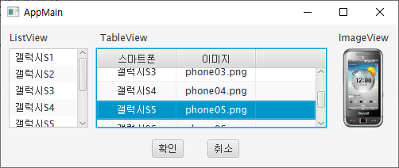
입력 컨트롤
예제 17-3-1
ListView 항목 선택시 같은 인덱스의 TableView의 행이 자동선택
TableView에서 행이 선택되면 ImageView에 이미지 출력

Slide 29
뷰 컨트롤
Phone.java
public class Phone {
private SimpleStringProperty smartPhone;
private SimpleStringProperty image;
public Phone() {
this.smartPhone = new SimpleStringProperty();
this.image = new SimpleStringProperty();
}
public Phone(String smartPhone, String image) {
this.smartPhone = new SimpleStringProperty(smartPhone);
this.image = new SimpleStringProperty(image);
}
public String getSmartPhone() {
return smartPhone.get();
}
public void setSmartPhone(String smartPhone) {
this.smartPhone.set(smartPhone);;
}
public String getImage() {
return image.get();
}
public void setImage(String image) {
this.image.set(image);;
}
}

Slide 30
뷰 컨트롤
root.fxml
<AnchorPane xmlns:fx="http://javafx.com/fxml" fx:controller="sec07.exam03_view.RootController"
prefHeight="180.0" prefWidth="500.0" >
<children>
<Label layoutX="11.0" layoutY="9.0" text="ListView" />
<ListView fx:id="listView" layoutX="10.0" layoutY="30.0" prefHeight="100.0" prefWidth="100.0" />
<Label layoutX="125.0" layoutY="9.0" text="TableView" />
<TableView fx:id="tableView" layoutX="120.0" layoutY="30.0" prefHeight="100.0" prefWidth="290.0">
<columns>
<TableColumn prefWidth="100.0" text="스마트폰" />
<TableColumn prefWidth="100.0" text="이미지" />
</columns>
</TableView>
<Label layoutX="425.0" layoutY="9.0" text="ImageView" />
<ImageView fx:id="imageView" fitHeight="100.0" fitWidth="60.0" layoutX="430.0" layoutY="30.0" preserveRatio="true" />
<Button layoutX="190.0" layoutY="145.0" onAction="#handleBtnOkAction" text="확인" />
<Button layoutX="260.0" layoutY="145.0" onAction="#handleBtnCancelAction" text="취소" />
</children>
</AnchorPane>

Slide 31
뷰 컨트롤
RootController.java
public class RootController implements Initializable {
@FXML private ListView<String> listView;
@FXML private TableView<Phone> tableView;
@FXML private ImageView imageView;
@Override
public void initialize(URL location, ResourceBundle resources) {
listView.setItems(FXCollections.observableArrayList(
"갤럭시S1", "갤럭시S2", "갤럭시S3", "갤럭시S4", "갤럭시S5", "갤럭시S6", "갤럭시S7"
));
listView.getSelectionModel().selectedIndexProperty().addListener(new ChangeListener<Number>() {
@Override
public void changed(ObservableValue<? extends Number> observable, Number oldValue, Number newValue) {
tableView.getSelectionModel().select(newValue.intValue());
tableView.scrollTo(newValue.intValue());
}
});
ObservableList phoneList = FXCollections.observableArrayList(
new Phone("갤럭시S1", "phone01.png"),
new Phone("갤럭시S2", "phone02.png"),
new Phone("갤럭시S3", "phone03.png"),
new Phone("갤럭시S4", "phone04.png"),
new Phone("갤럭시S5", "phone05.png"),
new Phone("갤럭시S6", "phone06.png"),
new Phone("갤럭시S7", "phone07.png")
);

Slide 32
뷰 컨트롤
RootController.java
TableColumn tcSmartPhone = tableView.getColumns().get(0);
tcSmartPhone.setCellValueFactory(
new PropertyValueFactory("smartPhone")
);
tcSmartPhone.setStyle("-fx-alignment: CENTER;");
TableColumn tcImage = tableView.getColumns().get(1);
tcImage.setCellValueFactory(
new PropertyValueFactory("image")
);
tcImage.setStyle("-fx-alignment: CENTER;");
tableView.setItems(phoneList);
tableView.getSelectionModel().selectedItemProperty().addListener(new ChangeListener<Phone>() {
@Override
public void changed(ObservableValue<? extends Phone> observable, Phone oldValue, Phone newValue) {
if(newValue!=null) {
imageView.setImage(new Image(getClass().getResource("images/" + newValue.getImage()).toString()));
}
}
});
}

Slide 33
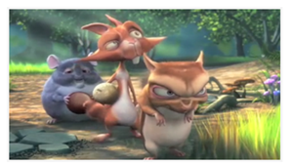
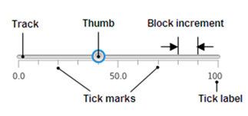
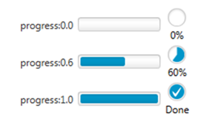
미디어 컨트롤
Slider
미디어 컨트롤의 종류
MediaView
ProgressVar & ProgressIndicator

Slide 34
미디어 컨트롤
MediaPlayer & MediaView
fitWidth : 폭
fitHeight : 높이
preserveRatio: true인 경우 종횡비 유지 (MediaView 크기 변화),
false인 경우 종횡비 무시 (MediaView 크기 고정)
미디어 소스 경로를 객체 형태로 전달하여 생성
<MediaView fitHeight="200.0" fitWidth="300.0" preserveRatio="false"/>
Media media = new Media("미디어 소스 경로");
MediaPlayer mediaPlayer = new MediaPlayer(media);

Slide 35
미디어 컨트롤
MediaPlayer & MediaView
상대경로를 객체 형태로 전달하여 생성
미디어 소스가 비디오일 때 setMediaPlayer() 메소드로 MediaPlayer 객체 등록 (오디도일 때 필요 없음)
Media media = new Media(getClass().getResource("media/video.m4v").toString());
MediaPlayer mediaPlayer = new MediaPlayer(media);
mediaView.setMediaPlayer(mediaPlayer);

Slide 36
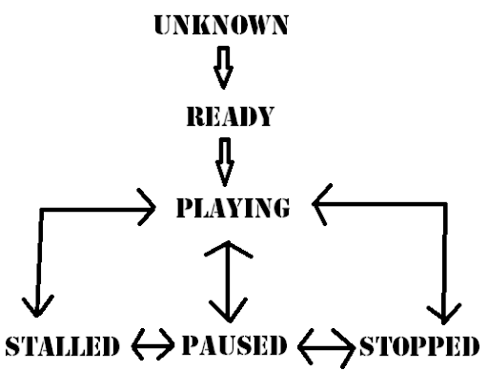
미디어 컨트롤
Unknown : Mediaplayer가 생성된 직후 상태
Ready : 미디어 소스를 재생할 준비가 되면 자동 변경
Playing : Ready상태에서 setAutoPlay(true)나 play()호출 시

Slide 37
미디어 컨트롤
Paused : Playing 상태에서 pause() 호출
Stopped : Playing 상태에서 stop() 호출
Stalled : Playing 상태에서 재생 버퍼에 충분한 데이터가 없을 경우
Endofmedia : 미디어 소스를 모두 재생했을 때

Slide 38
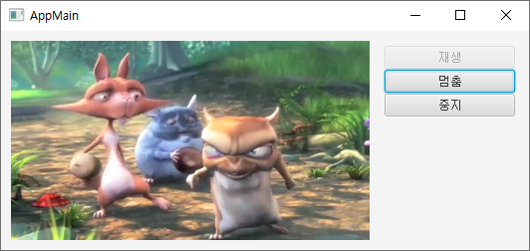
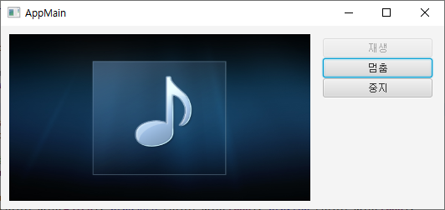
미디어 컨트롤
예제 17-4-1
재생 버튼을 누르면 미디어(오디오) 재생
멈춤 버튼 누르면 미디어(오디오) 멈춤
중지 버튼 누르면 미디어(오디오) 처음으로 돌아가기

Slide 39
미디어 컨트롤
root.fxml
<AnchorPane xmlns:fx="http://javafx.com/fxml" fx:controller="sec07.exam04_mediaview.RootController"
prefHeight="220.0" prefWidth="530.0" >
<children>
<StackPane layoutX="10.0" layoutY="10.0">
<children>
<ImageView fx:id="imageView" fitHeight="200.0" fitWidth="360.0" preserveRatio="false">
<image><Image url="@media/audio.png" /></image>
</ImageView>
<MediaView fx:id="mediaView" fitHeight="200.0" fitWidth="360.0" preserveRatio="false" />
</children>
</StackPane>
<Button fx:id="btnPlay" layoutX="385.0" layoutY="15.0" prefHeight="23.0" prefWidth="131.0" text="재생" />
<Button fx:id="btnPause" layoutX="385.0" layoutY="39.0" prefHeight="23.0" prefWidth="131.0" text="멈춤"/>
<Button fx:id="btnStop" layoutX="385.0" layoutY="63.0" prefHeight="23.0" prefWidth="131.0" text="정지"/>
</children>
</AnchorPane>

Slide 40
미디어 컨트롤
RootController.java
public class RootController implements Initializable {
@FXML private MediaView mediaView;
@FXML private ImageView imageView;
@FXML private Button btnPlay;
@FXML private Button btnPause;
@FXML private Button btnStop;
private boolean endOfMedia;
@Override
public void initialize(URL location, ResourceBundle resources) {
//미디어 객체 생성
Media media = new Media(getClass().getResource("media/video.m4v").toString());
//Media media = new Media(getClass().getResource("media/audio.wav").toString());
//미디어 플레이어 생성 및 미디어 뷰에 설정
MediaPlayer mediaPlayer = new MediaPlayer(media);
mediaView.setMediaPlayer(mediaPlayer);
//해당 상태가 되면 실행할 Runnable 설정
mediaPlayer.setOnReady(new Runnable() {
@Override
public void run() {
btnPlay.setDisable(false); btnPause.setDisable(true); btnStop.setDisable(true);
if(mediaPlayer.isAutoPlay()) {mediaView.setVisible(false);}
}
});

Slide 41
미디어 컨트롤
RootController.java
mediaPlayer.setOnPlaying(()->{
btnPlay.setDisable(true); btnPause.setDisable(false); btnStop.setDisable(false);
});
mediaPlayer.setOnPaused(()->{
btnPlay.setDisable(false); btnPause.setDisable(true); btnStop.setDisable(false);
});
mediaPlayer.setOnEndOfMedia(()->{
endOfMedia = true;
btnPlay.setDisable(false); btnPause.setDisable(true); btnStop.setDisable(true);
});
mediaPlayer.setOnStopped(()->{
mediaPlayer.seek(mediaPlayer.getStartTime());
btnPlay.setDisable(false); btnPause.setDisable(true); btnStop.setDisable(true);
});
//버튼 ActionEvent 처리
btnPlay.setOnAction(event->{
if(endOfMedia) {
mediaPlayer.stop();
mediaPlayer.seek(mediaPlayer.getStartTime());
}
mediaPlayer.play();
endOfMedia = false;
});
btnPause.setOnAction(event->mediaPlayer.pause());
btnStop.setOnAction(event->mediaPlayer.stop());
}
}

Slide 42
미디어 컨트롤
Slider 컨트롤
Slider value의 범위 [0.0~100.0]
MediaPlayer의 volume 속성은 [0.0~1.0]
<Slider prefHeight="100.0" prefWidth="60.0" showTickLabels="true" showTickMarks="true"/>
sliderVolume.valueProperty().addListener(new ChangeListener<Number>() {
@Override
public void changed(ObservableValue<? extends Number> observable, Number oldValue, Number newValue) {
mediaPlayer.setVolume(sliderVolume.getValue() / 100.0);
}
});

Slide 43
미디어 컨트롤
ProgressVar & ProgressIndicator
MediaPlayer의 재생시간 : 현재 재생시간 / 전체 재생시간
<ProgressBar fx:id="progressBar" layoutX="385.0" layoutY="121.0" prefHeight="18.0" prefWidth="98.0" progress="0.0" />
<ProgressIndicator fx:id="progressIndicator" layoutX="489.0" layoutY="112.0" prefHeight="47.0" prefWidth="31.0" progress="0.0" />
double progress = mediaPlayer.getCurrentTime().toSeconds() / mediaPlayer.getTotalDuration().toSeconds();
progressBar.setProgress(progress);
progressIndicator.setProgress(progress);

Slide 44
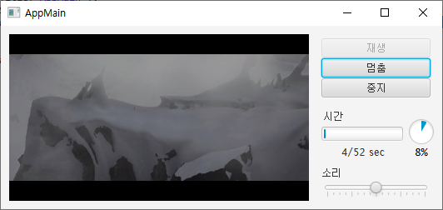
미디어 컨트롤
예제 17-4-2
예제 17-4-1를 개선하시오.
재생 시간을 표시하도록 ProgressBar와 ProgressIndicator 추가
볼륨 조정할 수 있도록 Slider 컨트롤 추가

Slide 45
미디어 컨트롤
root.fxml
<AnchorPane xmlns:fx="http://javafx.com/fxml" fx:controller="sec07.exam05_slider_progressbar.RootController“ prefHeight="220.0“ prefWidth="530.0" >
<children>
// (생략)
<Label layoutX="387.0" layoutY="101.0" text="시간" />
<ProgressBar fx:id="progressBar" layoutX="385.0" layoutY="121.0" prefHeight="18.0" prefWidth="98.0" progress="0.0" />
<ProgressIndicator fx:id="progressIndicator" layoutX="489.0" layoutY="112.0" prefHeight="47.0" prefWidth="31.0" progress="0.0" />
<Label fx:id="labelTime" alignment="CENTER" layoutX="386.0" layoutY="142.0" prefHeight="18.0" prefWidth="98.0" text="0/0 sec" />
<Label layoutX="385.0" layoutY="169.0" text="소리" />
<Slider fx:id="sliderVolume" layoutX="385.0" layoutY="187.0" prefHeight="14.0" prefWidth="131.0" showTickMarks="true"/>
</children>
</AnchorPane>

Slide 46
미디어 컨트롤
RootController.java
mediaPlayer.setOnReady(new Runnable() {
@Override
public void run() {
mediaPlayer.currentTimeProperty().addListener(new ChangeListener<Duration>() {
@Override
public void changed(ObservableValue<? extends Duration> observable, Duration oldValue, Duration newValue) {
double progress = mediaPlayer.getCurrentTime().toSeconds() / mediaPlayer.getTotalDuration().toSeconds();
progressBar.setProgress(progress);
progressIndicator.setProgress(progress);
labelTime.setText( (int)mediaPlayer.getCurrentTime().toSeconds()+"/"+ (int)mediaPlayer.getTotalDuration().toSeconds()+" sec");
}
});

Slide 47
미디어 컨트롤
RootController.java
mediaPlayer.setOnReady(new Runnable() {
@Override
public void run() {
mediaPlayer.currentTimeProperty().addListener(new ChangeListener<Duration>() {
@Override
public void changed(ObservableValue<? extends Duration> observable, Duration oldValue, Duration newValue) {
double progress = mediaPlayer.getCurrentTime().toSeconds() / mediaPlayer.getTotalDuration().toSeconds();
progressBar.setProgress(progress);
progressIndicator.setProgress(progress);
labelTime.setText( (int)mediaPlayer.getCurrentTime().toSeconds()+"/"+ (int)mediaPlayer.getTotalDuration().toSeconds()+" sec");
}
});

Slide 48
미디어 컨트롤
RootController.java
//(생략)
mediaPlayer.setOnEndOfMedia(()->{
progressBar.setProgress(1.0);
progressIndicator.setProgress(1.0);
endOfMedia = true;
btnPlay.setDisable(false);
btnPause.setDisable(true); btnStop.setDisable(true);
});
//(생략)
//볼륨설정
sliderVolume.valueProperty().addListener(new ChangeListener<Number>() {
@Override
public void changed(ObservableValue<? extends Number> observable, Number oldValue, Number newValue) {
mediaPlayer.setVolume(sliderVolume.getValue() / 100.0);
}
});
sliderVolume.setValue(50.0);

Slide 49
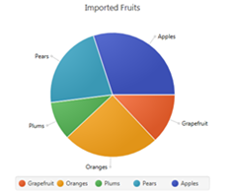
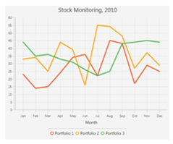
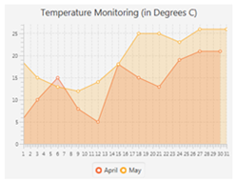
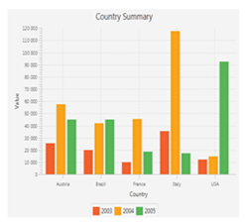
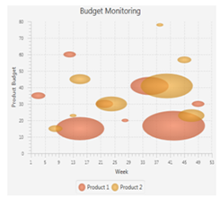
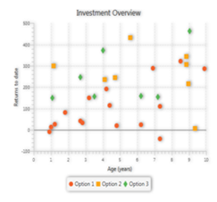
차트 컨트롤
차트 컨트롤의 종류
PieChart
BarChart
LineChart
BubbleChart
AreaChart
ScatterChart

Slide 50
차트 컨트롤
Chart
PieChart의 경우 X, Y축이 없으므로 FXML 배치시 쉬움
xAxis, yAxis : x축, y축
CategoryAxis : 분류 눈금
NumberAxis : 숫자 눈금
<PieChart/>
<BarChart>
<xAxis>
<CategoryAxis side="BOTTOM" />
</xAxis>
<yAxis>
<NumberAxis side="LEFT" />
</yAxis>
</BarChart>

Slide 51
차트 컨트롤
XY축이 필요 없는 경우
pieChart.setData(FXCollections.observableArrayList(
new PieChart.Data("AWT", 10),
new PieChart.Data("Swing", 30),
new PieChart.Data("SWT", 25),
new PieChart.Data("JavaFX", 35)
));

Slide 52
차트 컨트롤
XY축이 필요 있는 경우
XYChart.Series series1 = new XYChart.Series(); // 시리즈 생성
series1.setName("남자"); // 시리즈 이름 생성
series1.setData(FXCollections.observableArrayList( // 시리즈 데이터 세팅
new XYChart.Data("2015", 70),
new XYChart.Data("2016", 40),
new XYChart.Data("2017", 50),
new XYChart.Data("2018", 30)
));
barChart.getData().add(series1) // 차트에 시리즈 추가

Slide 53
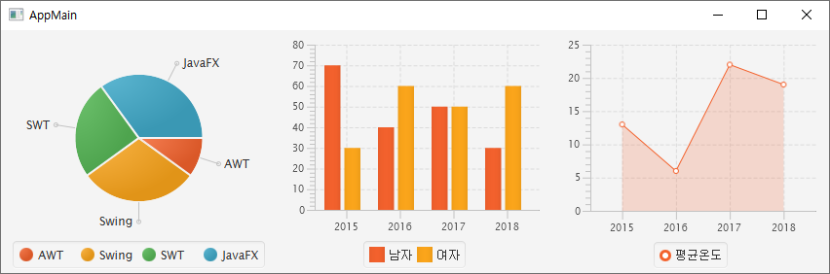
차트 컨트롤
예제 17-5-1
임의의 4가지 분류에 대하여 pieChart를 작성하시오.
임의의 값에 대하여 남녀에 대한 BarChart를 작성하시오.
임의의 값에 대하여 평균온도에 대한 AreaChart를 작성하시오.

Slide 54
차트 컨트롤
root.fxml
<HBox xmlns:fx="http://javafx.com/fxml" fx:controller="sec07.exam06_chart.RootController"
prefHeight="250" prefWidth="850" >
<children>
<PieChart fx:id="pieChart" />
<BarChart fx:id="barChart">
<xAxis>
<CategoryAxis side="BOTTOM" />
</xAxis>
<yAxis>
<NumberAxis side="LEFT" />
</yAxis>
</BarChart>
<AreaChart fx:id="areaChart">
<xAxis>
<CategoryAxis side="BOTTOM" />
</xAxis>
<yAxis>
<NumberAxis side="LEFT" />
</yAxis>
</AreaChart>
</children>
</HBox>

Slide 55
차트 컨트롤
RootController.java
public class RootController implements Initializable {
@FXML private PieChart pieChart;
@FXML private BarChart barChart;
@FXML private AreaChart areaChart;
@Override
public void initialize(URL location, ResourceBundle resources) {
pieChart.setData(FXCollections.observableArrayList(
new PieChart.Data("AWT", 10),
new PieChart.Data("Swing", 30),
new PieChart.Data("SWT", 25),
new PieChart.Data("JavaFX", 35)
));
XYChart.Series series1 = new XYChart.Series();
series1.setName("남자");
series1.setData(FXCollections.observableArrayList(
new XYChart.Data("2015", 70),
new XYChart.Data("2016", 40),
new XYChart.Data("2017", 50),
new XYChart.Data("2018", 30)
));

Slide 56
차트 컨트롤
RootController.java
XYChart.Series series2 = new XYChart.Series();
series2.setName("여자");
series2.setData(FXCollections.observableArrayList(
new XYChart.Data("2015", 30),
new XYChart.Data("2016", 60),
new XYChart.Data("2017", 50),
new XYChart.Data("2018", 60)
));
barChart.getData().add(series1);
barChart.getData().add(series2);
XYChart.Series series3 = new XYChart.Series();
series3.setName("평균온도");
series3.setData(FXCollections.observableArrayList(
new XYChart.Data("2015", 13),
new XYChart.Data("2016", 6),
new XYChart.Data("2017", 22),
new XYChart.Data("2018", 19)
));
areaChart.getData().add(series3);
}
}

Slide 57
다음 강의 주제
JavaFX 메뉴바와 툴바

