Slide 1
JavaFX (실습)
김성영교수
금오공과대학교
컴퓨터공학과

Slide 2
학습 내용
Canvas를 이용한 사각형 출력
TableView를 이용한 데이터 출력 및 저장
MediaView, ImageView의 컨트롤

Slide 3
Canvas를 이용한 사각형 출력
Canvas를 이용하여 GUI 화면에 마우스를 입력 받아 입력 받은 그 좌표에 사각형이 출력되는 코드를 작성하라

Slide 4
Canvas를 이용한 사각형 출력
rect.java
package main;
import javafx.application.Application;
import javafx.fxml.FXMLLoader;
import javafx.scene.Parent;
import javafx.scene.Scene;
import javafx.stage.Stage;
public class rect extends Application{
@Override
public void start(Stage stage) throws Exception {
// TODO Auto-generated method stub
Parent root = FXMLLoader.load(getClass().getResource("rectfxml.fxml"));
Scene scene = new Scene(root,700,700);
stage.setScene(scene);
stage.setTitle("사각형 출력");
stage.show();
}
public static void main(String[] args){
launch(args);
}
}

Slide 5
Canvas를 이용한 사각형 출력
rectfxml.fxml
<?xml version="1.0" encoding="UTF-8"?>
<?import java.lang.*?>
<?import javafx.scene.canvas.*?>
<?import javafx.scene.control.*?>
<?import javafx.scene.layout.*?>
<?import javafx.scene.layout.*?>
<BorderPane xmlns="http://javafx.com/javafx"
xmlns:fx="http://javafx.com/fxml"
fx:controller="main.rectController">
<center>
<Canvas fx:id="canvas" width="700" height="700" />
</center>
</BorderPane>

Slide 6
Canvas를 이용한 사각형 출력
rectController.java
public class rectController implements Initializable {
@FXML
public Canvas canvas;
public GraphicsContext gc;
@Override
public void initialize(URL arg0, ResourceBundle arg1) {
// TODO Auto-generated method stub
gc = canvas.getGraphicsContext2D();
canvas.addEventHandler(MouseEvent.MOUSE_PRESSED ,new EventHandler<MouseEvent>() { //마우스버튼을 눌렀을 때
@Override
public void handle(MouseEvent event) {
gc.clearRect(0, 0, canvas.getWidth(), canvas.getHeight()); //clear
draw(event.getX(),event.getY()); //사각형 출력
}
});
}
void draw(double x, double y) {
gc.setFill(Color.SKYBLUE);
gc.fillRect(x-25, y-25, 50, 50);
}
}

Slide 7
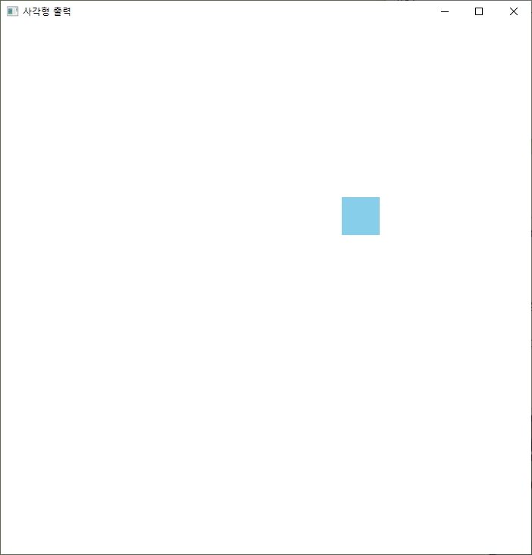
Canvas를 이용한 사각형 출력

Slide 8
TableView를 이용한 데이터 출력 및 저장
TableView를 이용하여 저장된 데이터를 선택하면 그에 관한 이미지가 뜨고, 정보를 추가해 TableView에 데이터가 저장되는 코드를 작성하라

Slide 9
TableView를 이용한 데이터 출력 및 저장
dataoutput.java
public class dataoutput extends Application {
@Override
public void start(Stage stage) throws Exception {
// TODO Auto-generated method stub
Parent root = FXMLLoader.load(getClass().getResource("datafxml.fxml"));
Scene scene = new Scene(root,640,375);
stage.setScene(scene);
stage.setTitle("데이터 출력");
stage.show();
}
public static void main(String[] args) {
// TODO Auto-generated method stub
launch(args);
}
}

Slide 10
TableView를 이용한 데이터 출력 및 저장
datafxml.fxml
<HBox alignment="CENTER" prefHeight="374.0" prefWidth="630.0" xmlns="http://javafx.com/javafx/8" xmlns:fx="http://javafx.com/fxml/1"
fx:controller="main.dataController">
<children>
<VBox alignment="CENTER" prefHeight="220" prefWidth="300">
<children>
<TableView fx:id="mytable" prefHeight="306.0" prefWidth="177.0">
<columns>
<TableColumn prefWidth="75.0" fx:id="name" text="이름" />
<TableColumn prefWidth="75.0" fx:id="nickname" text="별명" />
<TableColumn prefWidth="75.0" fx:id="kind" text="종족" />
</columns>
<opaqueInsets>
<Insets />
</opaqueInsets>
<VBox.margin>
<Insets right="10.0" />
</VBox.margin>
</TableView>
<Button fx:id="push" mnemonicParsing="false" prefHeight="22.0" prefWidth="254.0" text="추가하기" onAction="#pushbutton">

Slide 11
TableView를 이용한 데이터 출력 및 저장
datafxml.fxml
<VBox.margin>
<Insets right="10.0" top="10.0" />
</VBox.margin></Button>
</children>
</VBox>
<ImageView fx:id="image" fitHeight="356.0" fitWidth="294.0" pickOnBounds="true" preserveRatio="true">
<HBox.margin>
<Insets left="10.0" />
</HBox.margin>
</ImageView>
</children>
</HBox>

Slide 12
TableView를 이용한 데이터 출력 및 저장
datacontroller.java
public class dataController implements Initializable {
@FXML public ImageView image;
@FXML public Button push;
@FXML public TableView<TableData> mytable;
@FXML private TableColumn<TableData, String> name;
@FXML private TableColumn<TableData, String> nickname;
@FXML private TableColumn<TableData, String> kind;
ObservableList<TableData> list = FXCollections.observableArrayList(
new TableData(new SimpleStringProperty("스폰지밥"), new SimpleStringProperty("스폰지죽"), new SimpleStringProperty("스폰지")),
new TableData(new SimpleStringProperty("뚱이"), new SimpleStringProperty("땅딸이"), new SimpleStringProperty("불가사리")));
@Override
public void initialize(URL location, ResourceBundle resources) {
// TODO Auto-generated method stub
name.setCellValueFactory(cellData ->cellData.getValue().name());
nickname.setCellValueFactory(cellData ->cellData.getValue().nickname());
kind.setCellValueFactory(cellData ->cellData.getValue().kind());
mytable.setItems(list);
mytable.getSelectionModel().selectedItemProperty().addListener(new ChangeListener<TableData>() {
@Override
public void changed(ObservableValue<? extends TableData> observable, TableData oldValue,
TableData newValue) {

Slide 13
TableView를 이용한 데이터 출력 및 저장
datacontroller.java
TableData td = mytable.getSelectionModel().getSelectedItem();
StringProperty name1 = td.name();
Image img = new Image("main/"+name1.get()+".png");
image.setImage(img);
}
});
}
public void pushbutton() {
try {
Stage stage = new Stage();
VBox root = FXMLLoader.<VBox>load(getClass().getResource("addbutton.fxml"));
stage.setScene(new Scene(root,350,380));
stage.setTitle("정보를 입력해주세요.");
stage.showAndWait(); //자식창이 꺼질때까지 기다린 후 뒤에 코드를 실행
input_data(DataModel.name, DataModel.nickname, DataModel.kind);
} catch (IOException e) {
// TODO Auto-generated catch block
e.printStackTrace();
}
}
public void input_data(String name, String nickname, String kind) {
mytable.getItems().add(new TableData(new SimpleStringProperty(name),new SimpleStringProperty(nickname),new SimpleStringProperty(kind)));
}
}
public class DataModel {
public static String name;
public static String nickname;
public static String kind;
}

Slide 14
TableView를 이용한 데이터 출력 및 저장
TableData.java
public class TableData {
private StringProperty name_Table;
private StringProperty nickname_Table;
private StringProperty kind_Table;
public TableData(StringProperty name_Table, StringProperty nickname_Table,StringProperty kind_Table) {
this.name_Table = name_Table;
this.nickname_Table = nickname_Table;
this.kind_Table = kind_Table;
}
public StringProperty name() {
return name_Table;
}
public StringProperty nickname() {
return nickname_Table;
}
public StringProperty kind() {
return kind_Table;
}
}

Slide 15
TableView를 이용한 데이터 출력 및 저장
addbutton.fxml
<VBox alignment="CENTER" prefHeight="415" prefWidth="280.0"
xmlns="http://javafx.com/javafx/8.0.231"
xmlns:fx="http://javafx.com/fxml/1"
fx:controller="main.addController">
<children>
<Text strokeType="OUTSIDE" text="정보 입력" textAlignment="CENTER"
textOrigin="CENTER" wrappingWidth="406.109375">
<font>
<Font size="30.0" />
</font>
</Text>
<Text strokeType="OUTSIDE" text="이름">
<font>
<Font size="18.0" />
</font>
<VBox.margin>
<Insets left="10.0" top="10.0" />
</VBox.margin>
</Text>
<TextField fx:id="nameText" prefHeight="22.0" prefWidth="200.0">
<VBox.margin>
<Insets left="40.0" right="40.0" />
</VBox.margin>
</TextField>
<Text strokeType="OUTSIDE" text="별명">
<font>
<Font size="18.0" />
</font>

Slide 16
TableView를 이용한 데이터 출력 및 저장
addbutton.fxml
<VBox.margin>
<Insets left="10.0" top="30.0" />
</VBox.margin>
</Text>
<TextField fx:id="nicknameText" prefHeight="22.0" prefWidth="200.0">
<VBox.margin>
<Insets left="40.0" right="40.0" />
</VBox.margin>
</TextField>
<Text strokeType="OUTSIDE" text="종족">
<font>
<Font size="18.0" />
</font>
<VBox.margin>
<Insets left="10.0" top="30.0" />
</VBox.margin>
</Text>
<ComboBox fx:id="combo" prefHeight="22.0" prefWidth="158.0"
promptText="Select">
<items>
<FXCollections fx:factory="observableArrayList" >
<String fx:value="스폰지" />
<String fx:value="불가사리" />
<String fx:value="오징어" />
<String fx:value="게" />
<String fx:value="물고기" />
<String fx:value="기타" />
</FXCollections>
</items>

Slide 17
TableView를 이용한 데이터 출력 및 저장
addbutton.fxml
<VBox.margin>
<Insets left="10.0" />
</VBox.margin>
</ComboBox>
<Button fx:id="Yesbtn" alignment="CENTER" mnemonicParsing="false"
prefHeight="22.0" prefWidth="136.0" text="확인" onAction="#yesbutton">
<VBox.margin>
<Insets left="10.0" top="30.0" />
</VBox.margin>
<font>
<Font size="15.0" />
</font>
</Button>
<Button fx:id="Nobtn" alignment="CENTER" mnemonicParsing="false"
prefHeight="22.0" prefWidth="136.0" text="취소" onAction="#nobutton">
<VBox.margin>
<Insets left="10.0" top="10.0" />
</VBox.margin>
<font>
<Font size="15.0" />
</font>
</Button>
</children>
</VBox>

Slide 18
TableView를 이용한 데이터 출력 및 저장
addController.java
public class addController implements Initializable {
@FXMLpublic TextField nameText;
@FXMLpublic TextField nicknameText;
@FXMLpublic ComboBox<String> combo;
@FXMLpublic Button Yesbtn;
@FXMLprivate Button Nobtn;
@Override
public void initialize(URL arg0, ResourceBundle arg1) {
// TODO Auto-generated method stub
}
public void nobutton() {
Stage stage = (Stage) Nobtn.getScene().getWindow(); // 창 닫기
stage.close();
}
public void yesbutton() {
DataModel.name = nameText.getText();
DataModel.nickname = nicknameText.getText();
DataModel.kind = (String)combo.getValue();
Stage stage = (Stage) Yesbtn.getScene().getWindow(); // 창 닫기
stage.close();
}
}

Slide 19
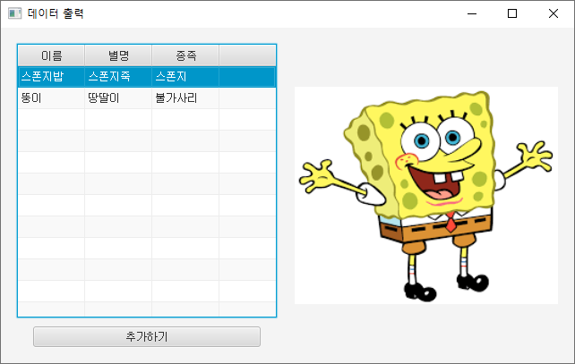
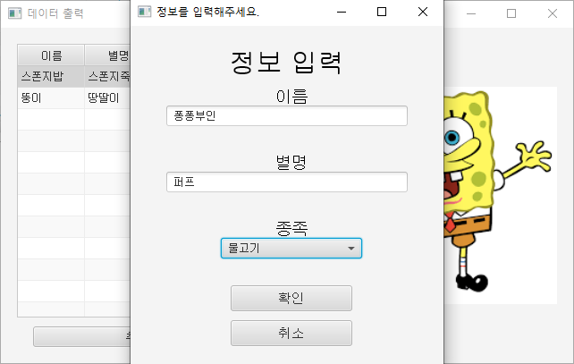
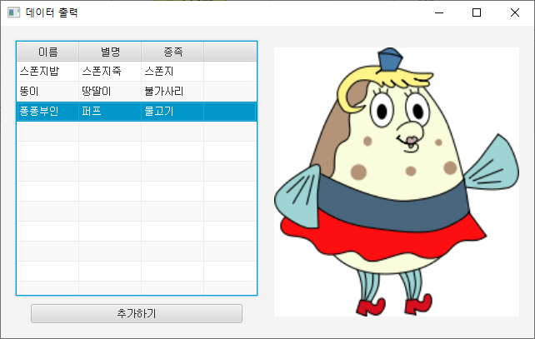
TableView를 이용한 데이터 출력 및 저장

Slide 20
MediaView, ImageView의 컨트롤
Canvas를 이용해 마우스를 입력 받아 선과 원을 그리고 ImageView의 이벤트를 등록한다. 그리고 MediaView를 출력하고 Start와 Stop 이벤트를 등록하는 코드를 작성하라
레이아웃은 GridPane을 이용한다.

Slide 21
MediaView, ImageView의 컨트롤
multimedia.java
public class multimedia extends Application{
@Override
public void start(Stage stage) throws Exception {
// TODO Auto-generated method stub
Parent root = FXMLLoader.load(getClass().getResource("multimediafxml.fxml"));
Scene scene = new Scene(root,600,400);
stage.setScene(scene);
stage.setTitle("멀티미디어");
stage.show();
}
public static void main(String[] args) {
// TODO Auto-generated method stub
launch(args);
}
}

Slide 22
MediaView, ImageView의 컨트롤
multimediafxml.fxml
<GridPane prefHeight="400.0" prefWidth="600.0" xmlns="http://javafx.com/javafx/8.0.231" xmlns:fx="http://javafx.com/fxml/1" fx:controller="main.mmController">
<columnConstraints>
<ColumnConstraints hgrow="SOMETIMES" minWidth="10.0" prefWidth="100.0" />
<ColumnConstraints hgrow="SOMETIMES" minWidth="10.0" prefWidth="100.0" />
</columnConstraints>
<rowConstraints>
<RowConstraints maxHeight="191.0" minHeight="10.0" prefHeight="188.0" vgrow="SOMETIMES" />
<RowConstraints maxHeight="219.0" minHeight="10.0" prefHeight="161.0" vgrow="SOMETIMES" />
<RowConstraints maxHeight="130.0" minHeight="10.0" prefHeight="51.0" vgrow="SOMETIMES" />
</rowConstraints>
<children>
<Canvas fx:id="canvas" height="189.0" width="298.0" />
<ImageView fx:id="imageview" fitHeight="183.0" fitWidth="302.0" pickOnBounds="true" preserveRatio="true" GridPane.columnIndex="1" GridPane.halignment="CENTER">
<image>
<Image fx:id="image" url="@뚱이.jfif" />
</image>
<GridPane.margin>
<Insets bottom="10.0" />
</GridPane.margin></ImageView>

Slide 23
MediaView, ImageView의 컨트롤
multimediafxml.fxml
<MediaView fx:id="mediaview" fitHeight="200.0" fitWidth="200.0" scaleX="1.5" scaleY="1.5" translateX="-100.0" GridPane.columnIndex="1" GridPane.rowIndex="1" />
<Button fx:id="startbtn" mnemonicParsing="false" onAction="#startbutton" prefHeight="34.0" prefWidth="300.0" text="Start" GridPane.rowIndex="2">
<GridPane.margin>
<Insets left="10.0" right="5.0" />
</GridPane.margin>
</Button>
<Button fx:id="stopbtn" mnemonicParsing="false" onAction="#stopbutton" prefHeight="34.0" prefWidth="300.0" text="Stop" GridPane.columnIndex="1" GridPane.rowIndex="2">
<GridPane.margin>
<Insets left="5.0" right="10.0" />
</GridPane.margin>
</Button>
</children>
</GridPane>

Slide 24
MediaView, ImageView의 컨트롤
mmController.java
public class mmController implements Initializable {
@FXMLpublic Canvas canvas;
@FXMLpublic MediaView mediaview;
@FXMLpublic Button startbtn;
@FXMLpublic Button stopbtn;
@FXMLpublic ImageView imageview;
@FXMLpublic Image image;
public GraphicsContext gc;
public MediaPlayer mp;
public Media media;
@Override
public void initialize(URL arg0, ResourceBundle arg1) {
// TODO Auto-generated method stub
media = new Media(getClass().getResource("뚱이 동영상.mp4").toString());
mp = new MediaPlayer(media);
mediaview.setMediaPlayer(mp);
gc = canvas.getGraphicsContext2D();
draw(100,100);
canvas.addEventHandler(MouseEvent.MOUSE_PRESSED ,new EventHandler<MouseEvent>() { //마우스버튼을 눌렀을 때
@Override
public void handle(MouseEvent event) {
gc.clearRect(0, 0, canvas.getWidth(), canvas.getHeight()); //clear
draw(event.getX(),event.getY());
}
});

Slide 25
MediaView, ImageView의 컨트롤
mmController.java
imageview.setOnMouseClicked( new EventHandler<MouseEvent>() {
@Override
public void handle(MouseEvent event) {
// TODO Auto-generated method stub
System.out.println("사진을 눌렀습니다.");
}
});
}
public void startbutton() {
mp.play();
}
public void stopbutton() {
mp.pause();
}
void draw(double x, double y) {
gc.strokeLine(0,0,x+3,y+3); //선
gc.setFill(Color.BLACK); //테두리
gc.fillRoundRect(x-1, y-1, 22, 22, 22, 22);
gc.setFill(Color.SKYBLUE); //원
gc.fillRoundRect(x, y, 20, 20, 20, 20);
}
}

Slide 26
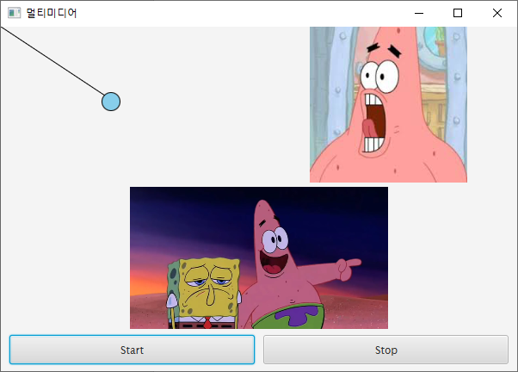
MediaView, ImageView의 컨트롤

Slide 27


MediaView, ImageView의 컨트롤

Slide 28
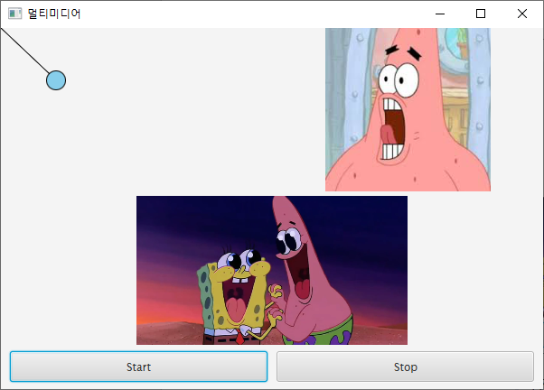
MediaView, ImageView의 컨트롤

