Slide 1
FXML 활용
김성영교수
금오공과대학교
컴퓨터공학과

Slide 2
학습 내용
Toolbar, ColorPicker 실습
ListView, ImageView 실습
TextField, ComboBox,TableView 실습

Slide 3
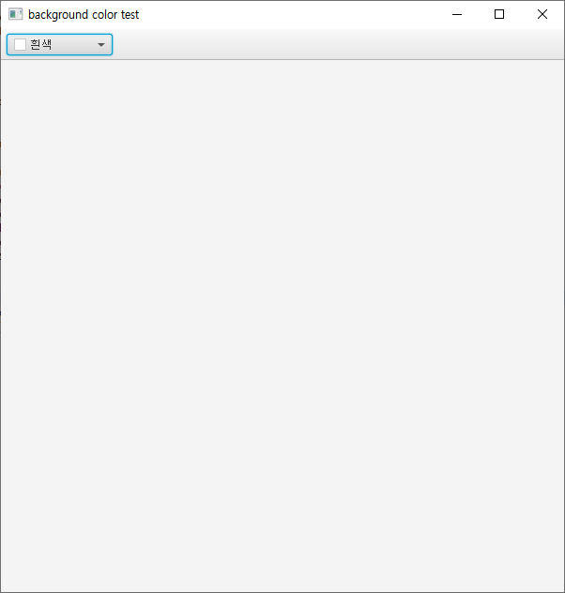
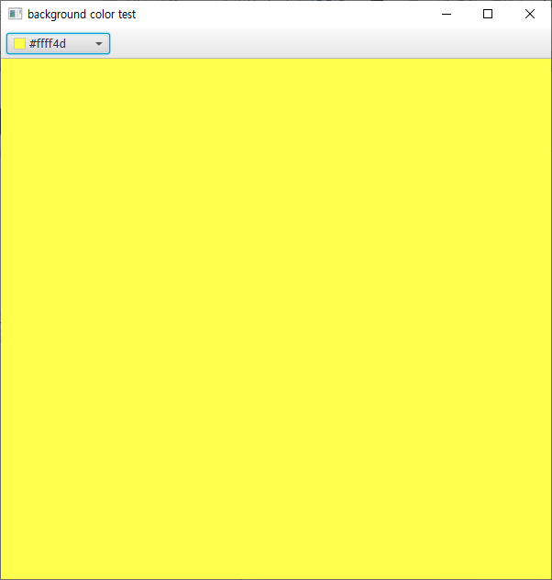
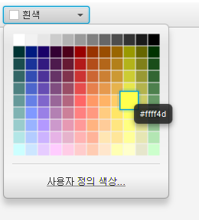
Toolbar, ColorPicker 실습
Toolbar를 사용하여 배경색을 바꾸는 프로그램 코드를 작성하시오. (단, 색은 ColorPicker를 사용하여 선택함)

Slide 4
Toolbar, ColorPicker 실습
Main.java
public class Main extends Application {
@Override
public void start(Stage stage) {
try {
Parent root = FXMLLoader.load(getClass().getResource("color.fxml"));
Scene scene = new Scene(root);
stage.setTitle("background color test");
stage.setScene(scene);
stage.show();
} catch(Exception e) {
e.printStackTrace();
}
}
public static void main(String[] args) {
launch(args);
}
}

Slide 5
Toolbar, ColorPicker 실습
Color.fxml
<BorderPane xmlns:fx="http://javafx.com/fxml/1"
xmlns="http://javafx.com/javafx/8"
prefHeight="600.0" prefWidth="600.0"
fx:controller="chapter12.Controller">
<top>
<VBox>
<children>
<ToolBar>
<items>
<ColorPicker fx:id="colorPicker">
<value>
<Color blue="1.0" green="1.0" red="1.0" />
</value>
</ColorPicker>
</items>
</ToolBar>
</children>
</VBox>
</top>
<center>
<VBox fx:id="box"/>
</center>
</BorderPane>

Slide 6
Toolbar, ColorPicker 실습
Controller.java
public class Controller implements Initializable{
@FXML private ColorPicker colorPicker;
@FXML private VBox box;
Color pickColor;
@Override
public void initialize(URL location, ResourceBundle resources){
colorPicker.setOnAction(e -> {
pickColor = colorPicker.getValue();
box.setStyle("-fx-background-color: " + toRgbString(pickColor) + ";"
);
});
}
private String toRgbString(Color c) {
return "rgb("
+ to255Int(c.getRed())
+ "," + to255Int(c.getGreen())
+ "," + to255Int(c.getBlue())
+ ")";
}
private int to255Int(double d) {
return (int) (d * 255);
}
}

Slide 7
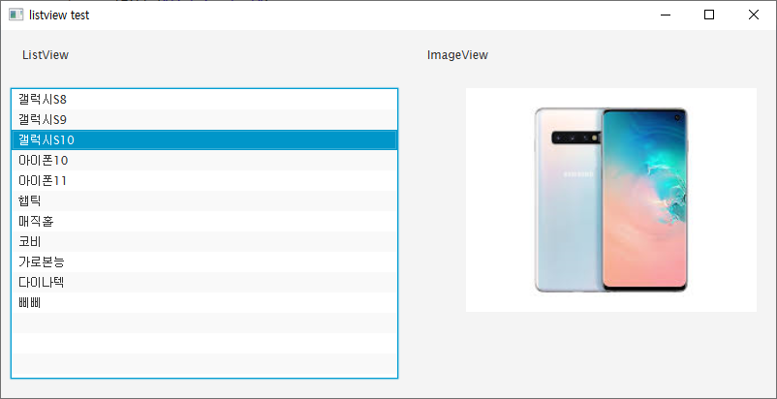
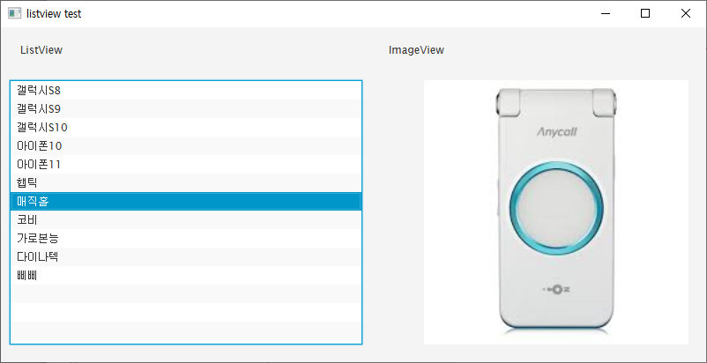
ListView, ImageView 실습
ListView를 사용하여 항목을 클릭하면 ImageView에서 이미지가 출력되는 프로그램의 소스코드를 작성하시오.

Slide 8
ListView, ImageView 실습
Main.java
public class Main extends Application {
@Override
public void start(Stage stage) {
try {
Parent root = FXMLLoader.load(getClass().getResource(“list.fxml"));
Scene scene = new Scene(root);
stage.setTitle(“listView test");
stage.setScene(scene);
stage.show();
} catch(Exception e) {
e.printStackTrace();
}
}
public static void main(String[] args) {
launch(args);
}
}

Slide 9
ListView, ImageView 실습
List.fxml
<AnchorPane xmlns:fx="http://javafx.com/fxml" fx:controller="chapter14.Controller"
prefHeight="380.0" prefWidth="800.0" >
<children>
<Label layoutX="22.0" layoutY="18.0" text="ListView" />
<ListView fx:id="listView" layoutX="10.0" layoutY="60.0" prefHeight="300.0" prefWidth="400.0" />
<Label layoutX="440.0" layoutY="18.0" text="ImageView" />
<ImageView fx:id="imageView" fitHeight="300.0" fitWidth="300.0" layoutX="480.0" layoutY="60.0" preserveRatio="true" />
</children>
</AnchorPane>

Slide 10
ListView, ImageView 실습
Controller.java
public class Controller implements Initializable {
@FXML private ListView<String> listView;
@FXML private ImageView imageView;
@Override
public void initialize(URL location, ResourceBundle resources) {
listView.setItems(FXCollections.observableArrayList(
"갤럭시S8", "갤럭시S9", "갤럭시S10", "아이폰10", "아이폰11", "햅틱", "매직홀", "코비",
"가로본능", "다이나텍", "삐삐"
));
listView.getSelectionModel().selectedIndexProperty().addListener(new ChangeListener() {
@Override
public void changed(ObservableValue observable, Object oldValue, Object newValue) {
if(newValue!=null) {
imageView.setImage(new Image(getClass().getResource(listView.getItems().get((int) (newValue))+ ".png").toString()));
}
}
});
}
}

Slide 11
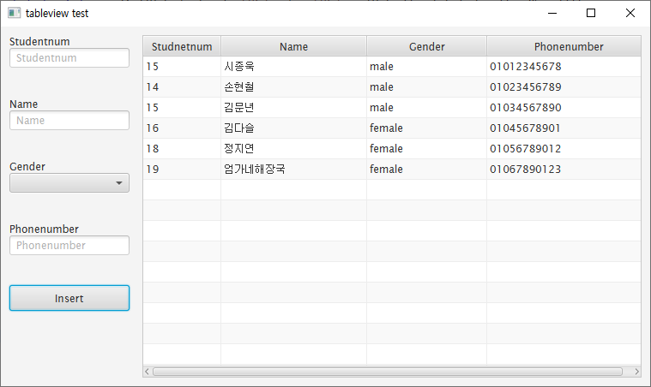
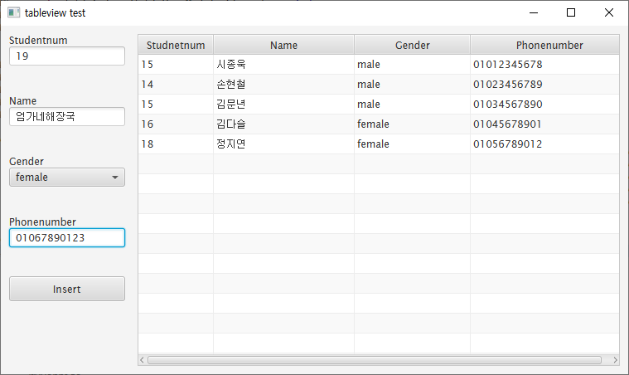
TextField, ComboBox, TableView 실습
TextField나 ComboBox에 값을 입력하거나 선택한 후 추가 버튼을 누르면 TableView에 새로운 행이 추가되는 프로그램 소스코드를 작성하시오.

Slide 12
TextField, ComboBox, TableView 실습
Main.java
public class Main extends Application {
@Override
public void start(Stage stage) {
try {
Parent root = FXMLLoader.load(getClass().getResource(“table.fxml"));
Scene scene = new Scene(root);
stage.setTitle(“tableView test");
stage.setScene(scene);
stage.show();
} catch(Exception e) {
e.printStackTrace();
}
}
public static void main(String[] args) {
launch(args);
}
}

Slide 13
TextField, ComboBox, TableView 실습
Table.fxml
<HBox fx:controller="chapter13.Controller"
xmlns:fx="http://javafx.com/fxml" alignment="center">
<padding>
<Insets top="10" right="10" bottom="10" left="10"/>
</padding>
<VBox>
<Label text="Studentnum" />
<TextField promptText="Studentnum" prefWidth="140" fx:id="studentnumField">
<VBox.margin>
<Insets bottom="35" right="15"/>
</VBox.margin>
</TextField>
<Label text="Name" />
<TextField promptText="Name" prefWidth="140" fx:id="nameField">
<VBox.margin>
<Insets bottom="35" right="15"/>
</VBox.margin>
</TextField>

Slide 14
TextField, ComboBox, TableView 실습
Table.fxml
<ComboBox promptText="Gender" prefWidth="140" fx:id="genderField">
<items>
<FXCollections fx:factory="observableArrayList" >
<String fx:value=“male" />
<String fx:value=“female" />
</FXCollections>
</items>
<VBox.margin>
<Insets bottom="35" right="15"/>
</VBox.margin>
</ComboBox>
<Label text="Phonenumber" />
<TextField promptText="Phonenumber" prefWidth="140" fx:id="phonenumberField">
<VBox.margin>
<Insets bottom="35" right="15"/>
</VBox.margin>
</TextField>

Slide 15
TextField, ComboBox, TableView 실습
Table.fxml
<Button text="Insert" prefWidth="140" prefHeight="30" fx:id="addButton"/>
<VBox.margin>
<Insets bottom="35" right="15"/>
</VBox.margin>
</VBox>
<TableView fx:id="tableView" >
<columns>
<TableColumn text="Studnetnum" fx:id="studentnumColumn" prefWidth="80" />
<TableColumn text="Name" fx:id="nameColumn" prefWidth="170"/>
<TableColumn text="Gender" fx:id="genderColumn" prefWidth="140"/>
<TableColumn text="Phonenumber" fx:id="phonenumberColumn" prefWidth="190"/>
</columns>
</TableView>
</HBox>

Slide 16
TextField, ComboBox, TableView 실습
TableViewModel.java
public class TableViewModel {
private IntegerProperty studentnum;
private StringProperty name;
private StringProperty gender;
private StringProperty phonenumber;
public TableViewModel(IntegerProperty studentnum, StringProperty name, StringProperty gender, StringProperty phonenumber) {
this.studentnum = studentnum;
this.name = name;
this.gender = gender;
this.phonenumber = phonenumber;
}
public IntegerProperty getstudentnum() {
return studentnum;
}
public StringProperty getname() {
return name;
}
public StringProperty getgender() {
return gender;
}
public StringProperty getphonenumber() {
return phonenumber;
}
}

Slide 17
TextField, ComboBox, TableView 실습
Controller.java
public class Controller implements Initializable {
@FXML private TableView<TableViewModel> tableView;
@FXML private TableColumn<TableViewModel, Integer> studentnumColumn;
@FXML private TableColumn<TableViewModel, String> nameColumn;
@FXML private TableColumn<TableViewModel, String> genderColumn;
@FXML private TableColumn<TableViewModel, String> phonenumberColumn;
@FXML private TextField studentnumField;
@FXML private TextField nameField;
@FXML private ComboBox<String> genderField;
@FXML private TextField phonenumberField;
@FXML private Button addButton;

Slide 18
TextField, ComboBox, TableView 실습
Controller.java
ObservableList<TableViewModel> list = FXCollections.observableArrayList(
new TableViewModel(new SimpleIntegerProperty(15),new SimpleStringProperty("시종욱"), new SimpleStringProperty(“male"), new SimpleStringProperty("01012345678")),
new TableViewModel(new SimpleIntegerProperty(14),new SimpleStringProperty("손현철"), new SimpleStringProperty("male"), new SimpleStringProperty("01023456789")),
new TableViewModel(new SimpleIntegerProperty(15),new SimpleStringProperty("김문년"), new SimpleStringProperty("male"), new SimpleStringProperty("01034567890")),
new TableViewModel(new SimpleIntegerProperty(16),new SimpleStringProperty("김다슬"), new SimpleStringProperty(“female"), new SimpleStringProperty("01045678901")),
new TableViewModel(new SimpleIntegerProperty(18),new SimpleStringProperty("정지연"), new SimpleStringProperty(“female"), new SimpleStringProperty("01056789012")));
@Override
public void initialize(URL location, ResourceBundle resources) {
studentnumColumn.setCellValueFactory(cellData -> cellData.getValue().getstudentnum().asObject());
nameColumn.setCellValueFactory(cellData -> cellData.getValue().getname());
genderColumn.setCellValueFactory(cellData -> cellData.getValue().getgender());
phonenumberColumn.setCellValueFactory(cellData -> cellData.getValue().getphonenumber());
tableView.setItems(list);

Slide 19
TextField, ComboBox, TableView 실습
Controller.java
addButton.addEventHandler(MouseEvent.MOUSE_CLICKED, new EventHandler<MouseEvent>() {
@Override
public void handle(MouseEvent event) {
try {
if(nameField.getText().equals("")||phonenumberField.getText().equals(""))
return;
tableView.getItems().add(new TableViewModel(
new SimpleIntegerProperty(Integer.parseInt(studentnumField.getText())),
new SimpleStringProperty(nameField.getText()),
new SimpleStringProperty(genderField.getValue()),
new SimpleStringProperty(phonenumberField.getText())));
studentnumField.setText("");
nameField.setText("");
genderField.setValue(null);
phonenumberField.setText("");
}
catch (NumberFormatException e){}
}
});
}

