Slide 1
Water Quality Monitoring at Black Hawk Lake Watershed
Department of Agricultural and Biosystems Engineering
Ji Yeow Law
Supervisor: Dr. Michelle Soupir
Water Quality Research Lab
ABE 516x Project

Slide 2
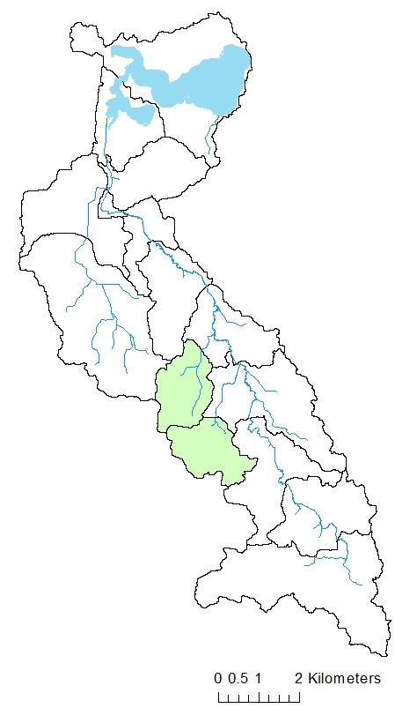
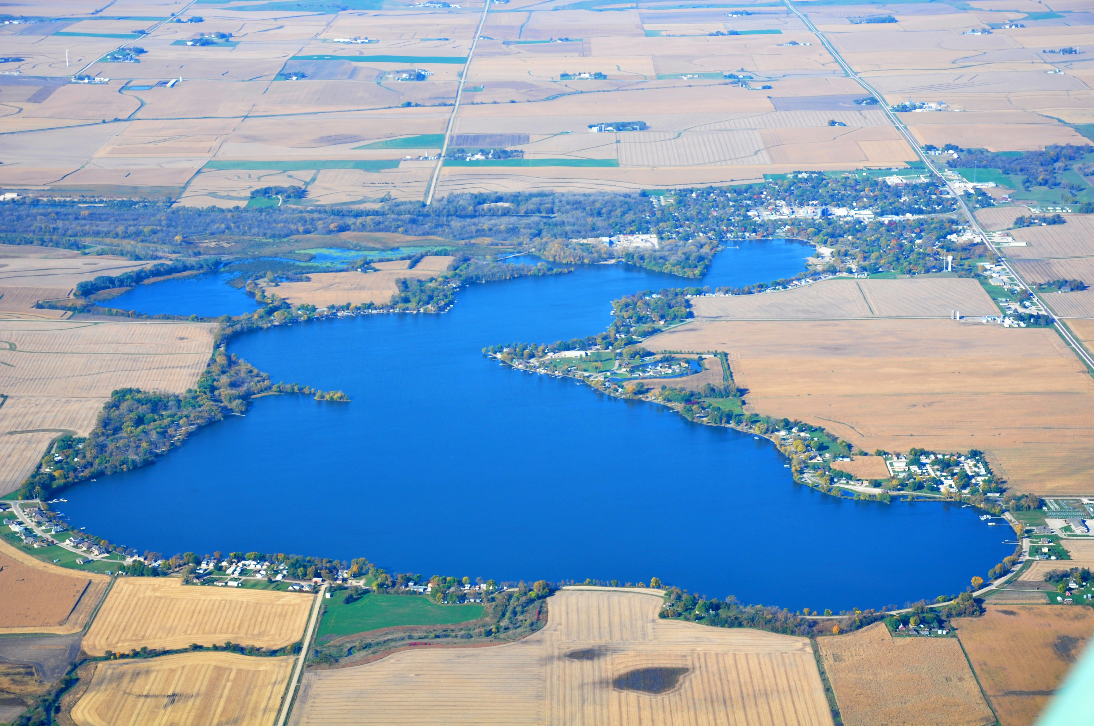
Project Background
A 5-year (2015-2019) monitoring project to:
To compare nutrients (N and P) and sediment loading from catchments with high and low BMPs implementation
Notes:
The objectives of this 5-year monitoring project include the comparison of nutrients and sediment loading from subwatershed with high and low BMPs.

Slide 3
Brief overview of BMPs
Best management practices, a.k.a conservation practices
Designed to reduce impact of agricultural activities on the environment
Also often beneficial to the farmers (e.g. reduced erosion)
Examples of BMPs:
Cover crops
Reduced tillage
Nutrient management

Slide 4
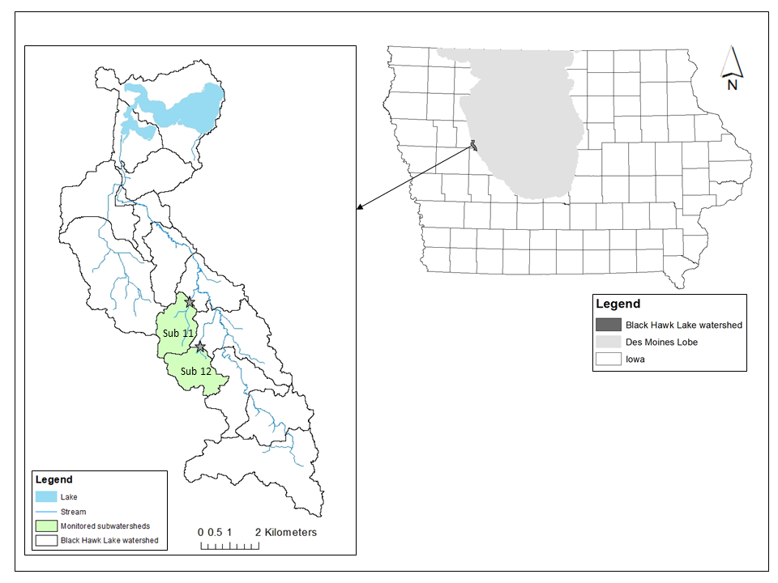
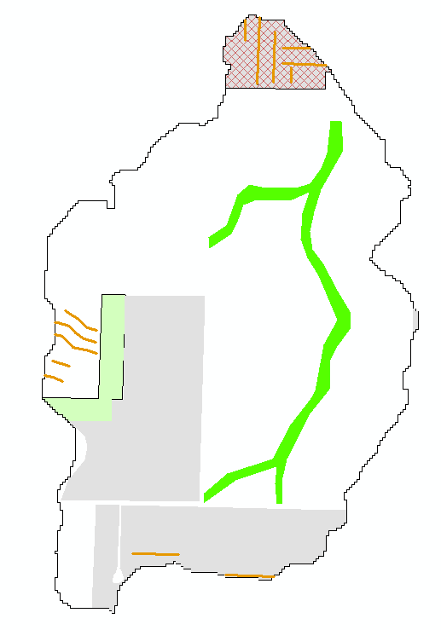
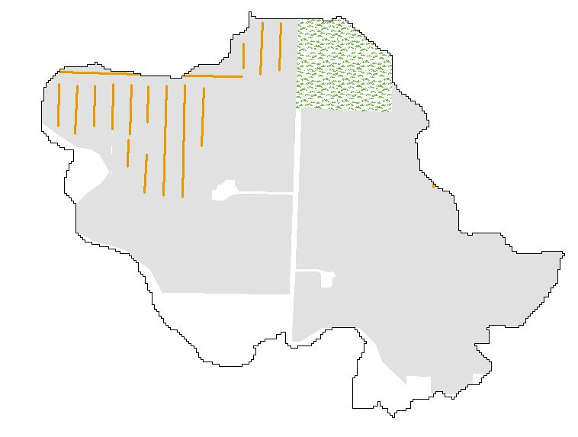
Location background: Black Hawk Lake
Low BMPs
High BMPs
Notes:
Black Hawk Lake is a 387 ha (956 acre) shallow natural lake in west-central Iowa.
Located on the western edge of DSM lobe. Poor to moderate drainage class – most land area is drained to allow row crop production.
The lake is located at the north end of the watershed. Water flows from south to north

Slide 5
Motivation to use Python for data analysis
Provide semi-annual reports to project sponsor
Although simple, but repetitive data analysis process:
Comparison of nutrient/sediment concentration between catchments
Comparison of nutrient/sediment load between catchments
Relationship of environmental factors (e.g. PPT) on nutrient/sediment concentration and load
Changes of personnel over the years
2 graduate students and 1 research staff worked on this project before me
Need a consistent data analysis process (QAQP)

Slide 6
The goal of using Python program
Develop a consistent workflow for any current and future project personnel
Save time from repeating the same tasks semi-annually

Slide 7
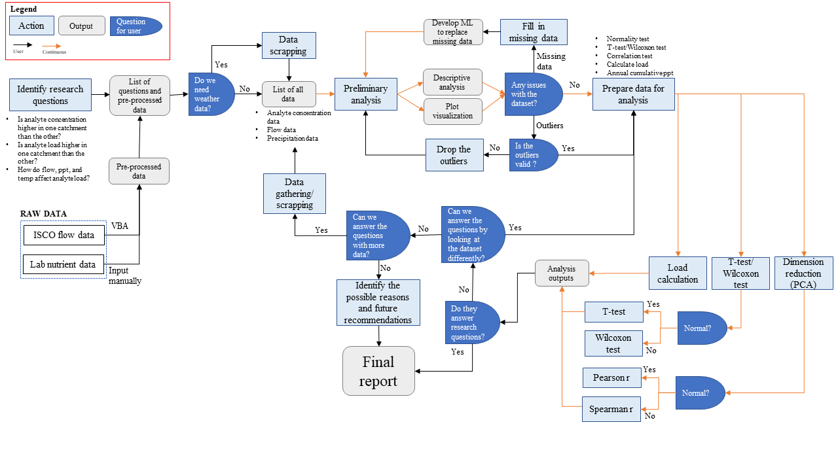
Project Workflow

Slide 8
Data input summary
Flow data
ISCO FlowLink (manual download then VBA)
Nutrient and sediment data
Laboratory analysis (manual input)
Weather data
World weather online (text scrapping)

Slide 9
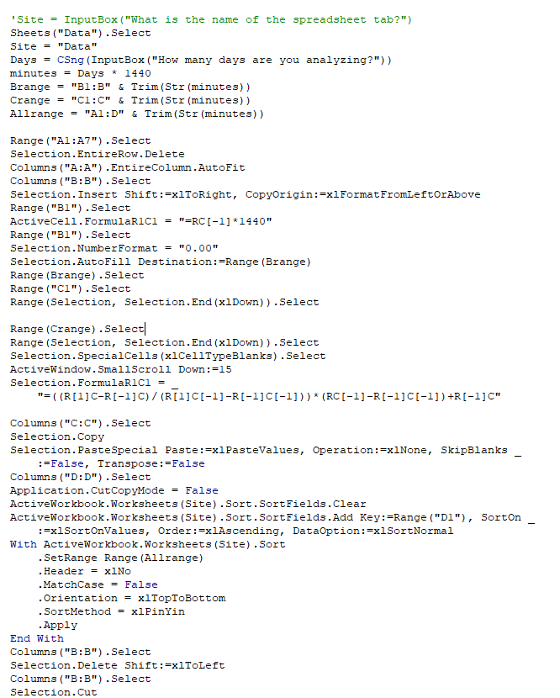
Pre-process flow data on VBA
Download data from Flowlink, then use VBA to calculate flow rate for each sample
Developed by previous grad student
Ease of use for any users without programming background
Will integrate this into Python

Slide 10
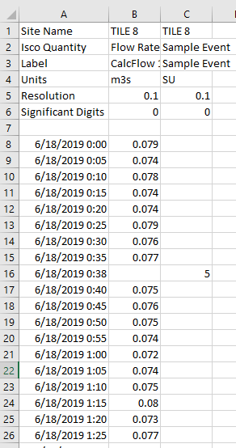
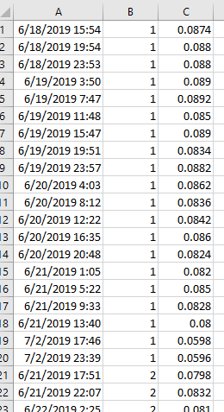
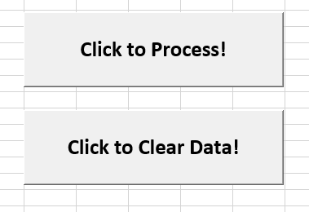
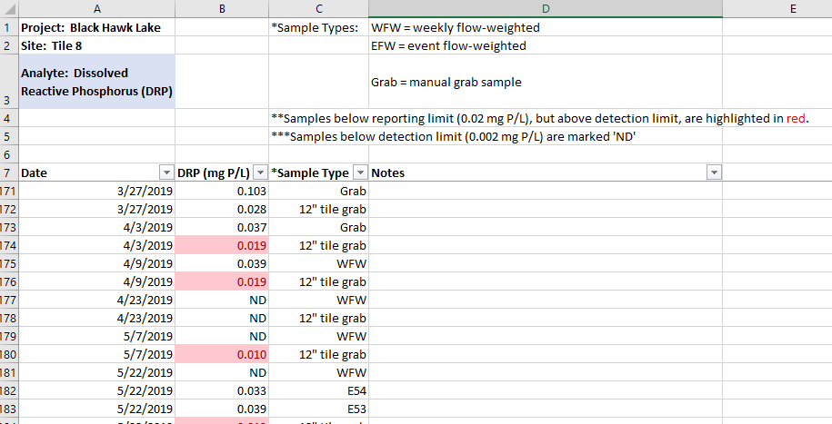
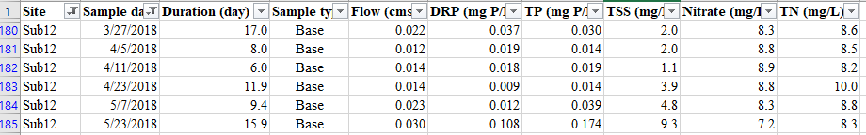
Sample event
Average flow rate
Pre-processed dataset – for Python input

Slide 11
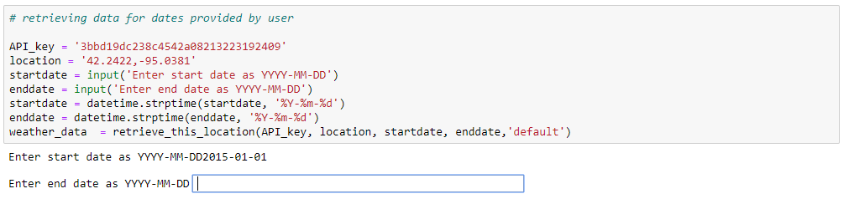
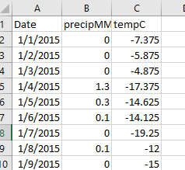
Scrapping weather data
Text scrapping from worldweatheronline.com
Enter start and end date
Only retained PPT and temperature data
May include other weather data in the future if needed
Export as csv – to be used as input file for data analysis

Slide 12
Main program – data analysis
Use loop to breakdown the main dataset, then recategorize them by
Sample type (base vs. event samples)
Sites (catchment 11 vs. 12)
Year (2015….2018)
Use loop to perform the same analysis on various nutrient and sediment data on the above datasets
Mean, median
Box plot
Load calculation (conc. * flow * duration)
Statistical differences between datasets
Correlations of nutrient/sediment in each dataset and environmental parameters (flow, PPT)

Slide 13
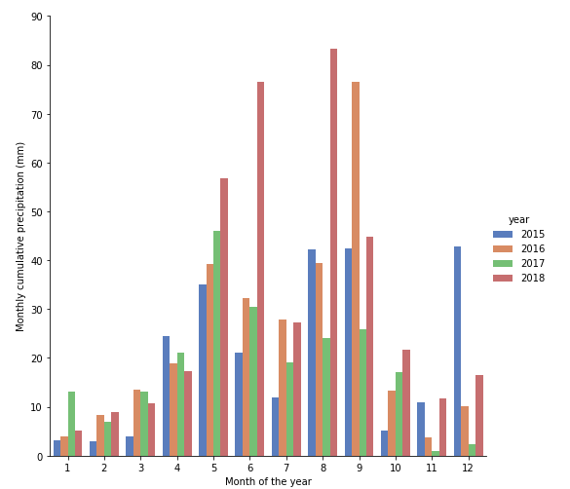
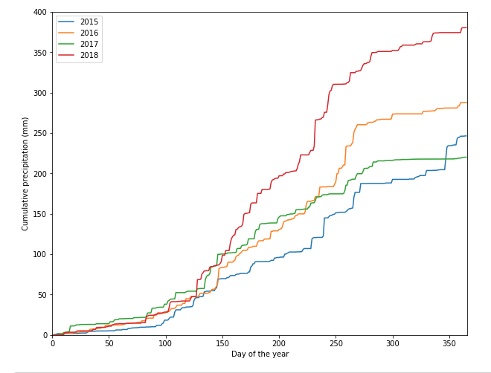
Project (python program) outcome
Monthly, annual cumulative PPT

Slide 14
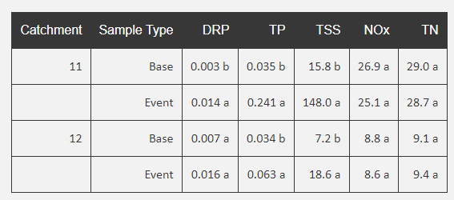
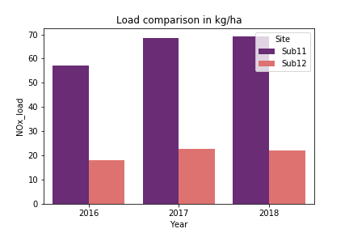
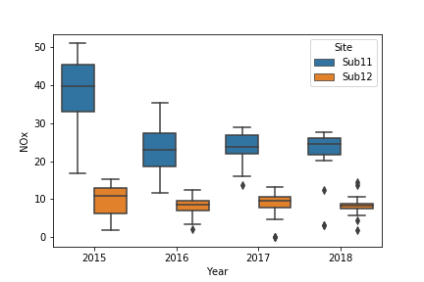
Project (python program) outcomes
Example basic stats outputs
Median table
Box plots (x5)
Load comparison (x5)

Slide 15
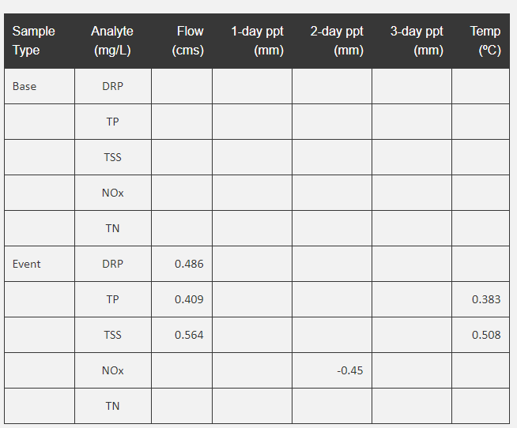
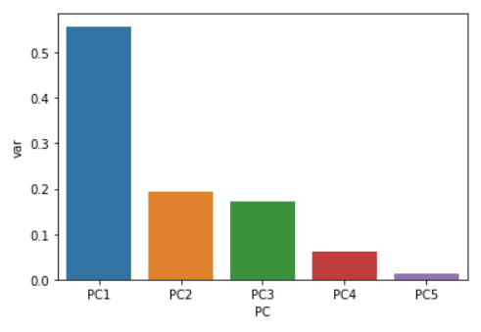
Project (python program) outcomes
Determine dataset normality, then use IF loop to apply the suitable statistical models
Statistical differences (t-test/Wilcoxon) – alphabet annotations in the table (see results in prev. slide)
PCA analysis, then correlation test (Spearman/Pearson)
Nutrient/sediment conc
Flow
1-, 2-, 3-day PPT
Temperature

Slide 16
Quick summary (Nitrate)
Higher N concentration and load were observed in the low-BMP catchment (sub11) during every monitoring year
Nitrate concentration did not increase in 2018 (high PPT year)

Slide 17
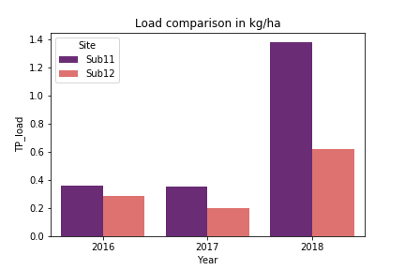
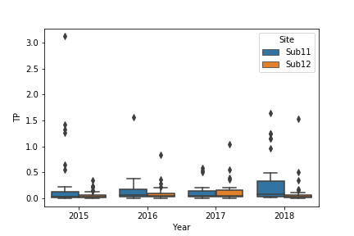
Quick summary (Total P)
Higher TP concentration and load were observed in the low-BMP catchment (sub11) during every monitoring year
TP concentration increased significantly in 2018 (high PPT year)

Slide 18
Conclusions
Comparison of nutrient/sediment concentration between catchments
Significantly higher TP, TSS, NOx, TN concentrations were observed in the low-BMP catchment, but significantly lower DRP concentration was observed in the low-BMP catchment
Comparison of nutrient/sediment load between catchments
Same observation as concentrations
Relationship of environmental factors (e.g. PPT) on nutrient/sediment concentration and load
Only flow rates showed consistent correlations with DRP, TP, and TSS concentrations of event samples.

Slide 19
Class concepts and techniques
Using For, If loop to iterate through main dataset and several subdatasets
Importing raw data – slice, group, merge into the desired formats prior to data analysis
Text scrapping to obtain the latest weather data
Attempted machine learning models (kmeans clustering, linear regression) to fill in missing data using environmental parameters, but was not successful – will test other models in the future

Slide 20
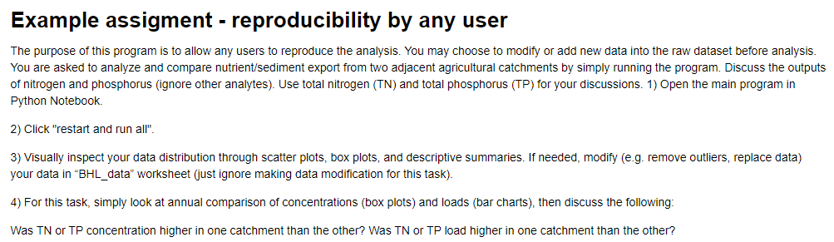
Class exercise
Run the entire program
Select one analyte (DRP, TP, NOx, TN, or TP) – then answer the research questions using the output figures and tables

