Slide 1
Introduction to RSTParser
Yangfeng Ji
Nov. 6, 2014

Slide 2
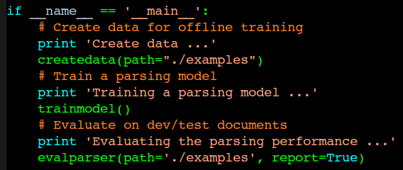
Pipeline
Create training data
In main.py:
Training an RST parser
Evaluate the parser

Slide 3
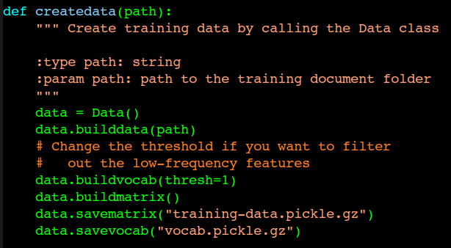
Createdata
Create training data
Training an RST parser
Evaluate the parser

Slide 4
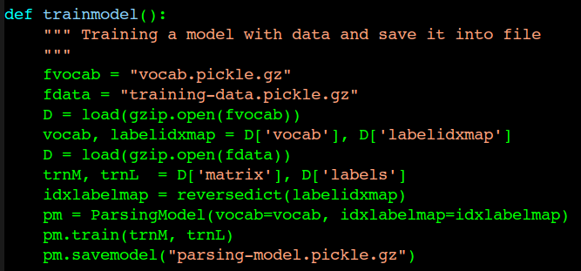
Trainmodel
Create training data
Training an RST parser
Evaluate the parser

Slide 5
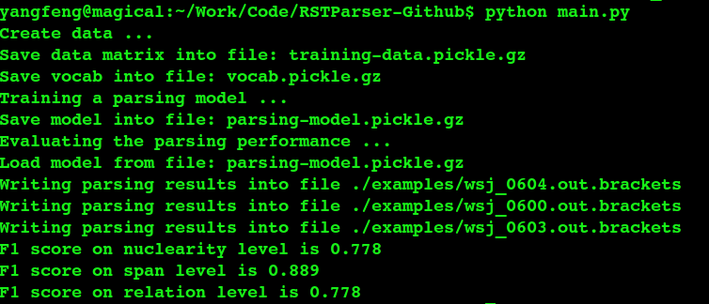
Evalparser
Create training data
Training an RST parser
Evaluate the parser

Slide 6
Improve the performance
Adding more powerful features in FeatureGenerator
Tuning classification parameters in ParsingModel

Slide 7
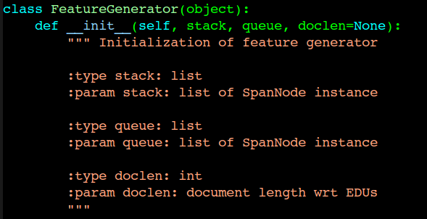
FeatureGenerator
In feature.py:

Slide 8
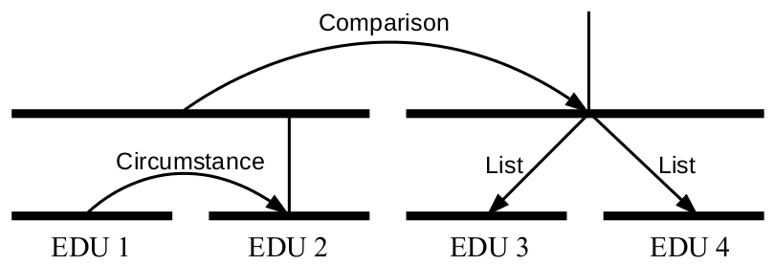
SpanNode
Definition in datastructure.py
Explanation in rstparser.pdf

Slide 9

FeatureGenerator
Create feature templates for both training and test
Each feature template is a tuple
First element in the queue

Slide 10
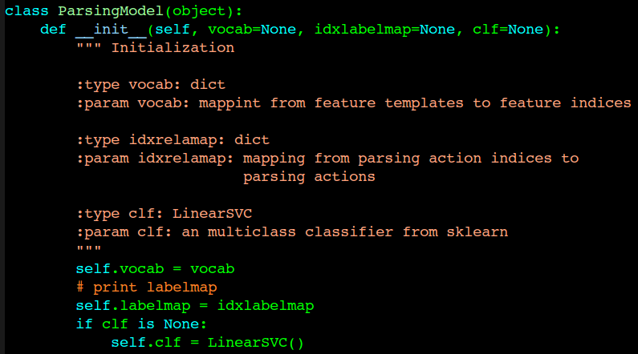
ParsingModel
In model.py

Slide 11
Code Structure
FeatureGenerator
SRParser
RSTTree
Data
ParsingModel

Slide 12
Code: https://github.com/jiyfeng/RSTParser
My email: jiyfeng@gmail.com

