Slide 1
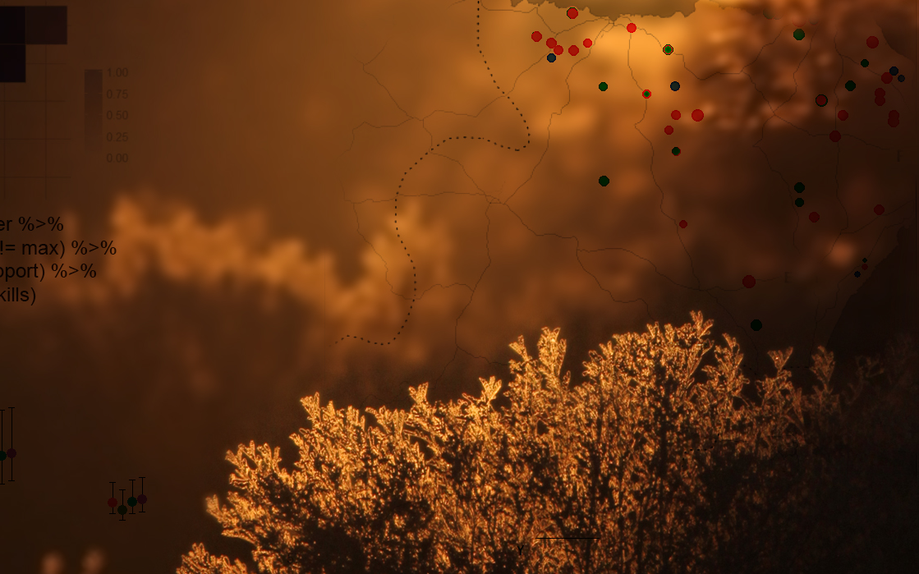

Coding Club an innovative peer-to-peer learning community
https://ourcodingclub.github.io @our_codingclub

