Slide 1
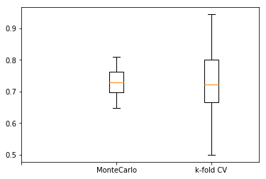
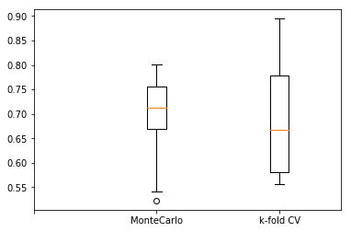
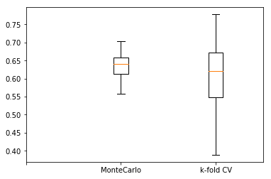
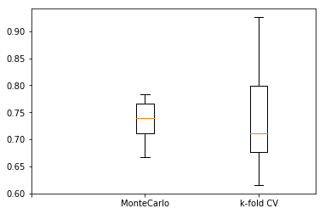
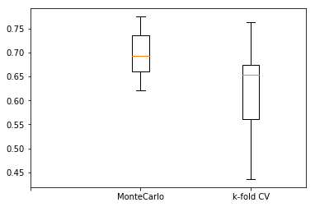
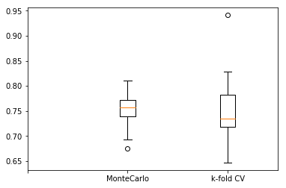

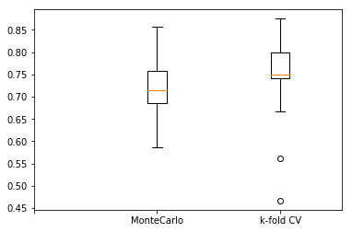
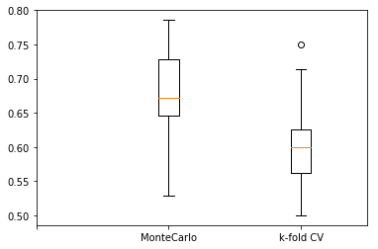
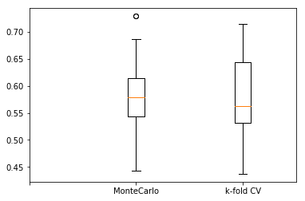
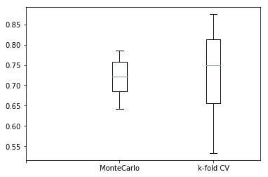
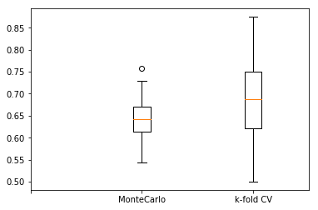
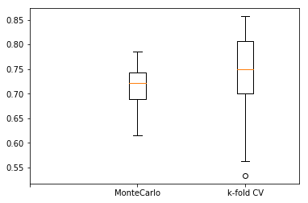
Predicting the Likelihood of Alzheimer’s Disease from Clinical and Magnetic Resonance Image Data Ji Yoon Song
BACKGROUND
METHODS
RESULTS
Alzheimer’s Disease (AD), the most common form of dementia, involves cortical atrophy of the brain.
Magnetic Resonance Image (MRI) scans can reveal the severity of regional atrophy, which correlate with the degree of cognitive impairment.
Since a definitive diagnosis of AD cannot be performed until the brain displays symptoms of the disease, it is imperative to focus detection on its early stages.
Derived Data
Demographics:
Gender, Handedness, Age, Education, Socioeconomic status (SES)
Clinical:
Mini-Mental State Examination (MMSE), Clinical Dementia Rating (CDR)
Derived anatomic volumes: Estimated total intracranial volume (eTIV), Atlas scaling factor (ASF), Normalized whole brain volume (nWBV)
1. Longitudinal
A)
B)
C)
D)
E)
F)
 | MC-mean | MC-st.d | CV-mean | CV-st.d
Logistic | 0.729 | 0.043 | 0.737 | 0.129
MLP | 0.705 | 0.070 | 0.688 | 0.122
KNN | 0.637 | 0.039 | 0.614 | 0.099
GNB | 0.737 | 0.036 | 0.740 | 0.095
RFDT | 0.699 | 0.043 | 0.625 | 0.097
SVC | 0.758 | 0.032 | 0.756 | 0.079
A
B
C
MC
CV
D
MC
CV
E
MC
CV
F
MC
CV
B. Data Processing & Load
Platform:
Python 3.6, NumPy, Pandas and Scikit-learn libraries
Data Paring:
Data with missing columns were discarded.
Data Preparation:
Raw CSV files were read into Pandas dataframes and then processed using LabelEncoder in ‘sklearn.preprocessing’
Two testing methods:
Monte Carlo and K-fold Cross Validation
MC
CV
MC
CV
Sample grey/white/ CSF segmentation image generated from the masked atlas image
2. Cross-sectional
A)
B)
C)
D)
E)
F)
 | MC-mean | MC-st.d | CV-mean | CV-st.d
Logistic | 0.718 | 0.048 | 0.738 | 0.104
MLP | 0.677 | 0.067 | 0.606 | 0.065
KNN | 0.578 | 0.050 | 0.580 | 0.085
GNB | 0.720 | 0.045 | 0.739 | 0.104
RFDT | 0.643 | 0.049 | 0.691 | 0.100
SVC | 0.720 | 0.034 | 0.734 | 0.090
A
B
OBJECTIVE
Data
Cross-Sectional MRI Data
Longitudinal MRI Data
This investigation sought to construct a predictive model for AD by evaluating a variety of machine learning classifiers.
MC
CV
MC
CV
C
D
METHODS
E
MC
CV
F
MC
CV
A. Data Source
C. Classifiers
Logistic Regression
Multilayer Perceptrons
K-Nearest Neighbor
Gaussian Naïve Bayes
Random Forest Decision Tree
Support Vector Classifier
MC
CV
MC
CV
CONCLUSION
The process in this investigation can be used to implement an auxiliary diagnostic tool in the early detection of AD.
The best approach would be to refine the use of kernel SVMs.
N=416,
aged 18-96
N=150,
aged 60-96

