Slide 1
Git and GitHub
2024. 7. 8.
이 주 석

Slide 2
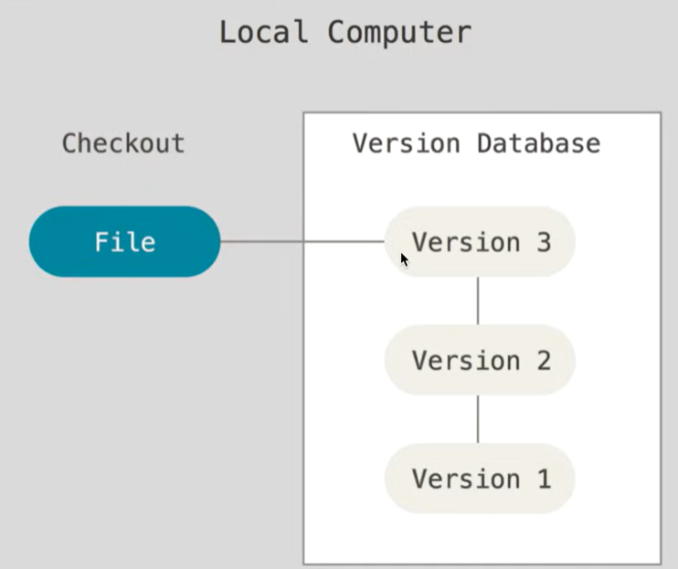
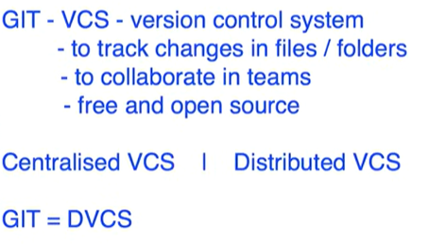
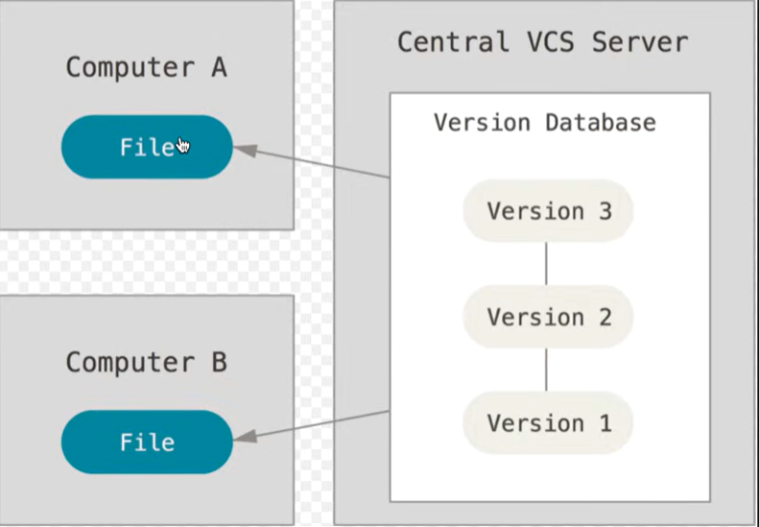



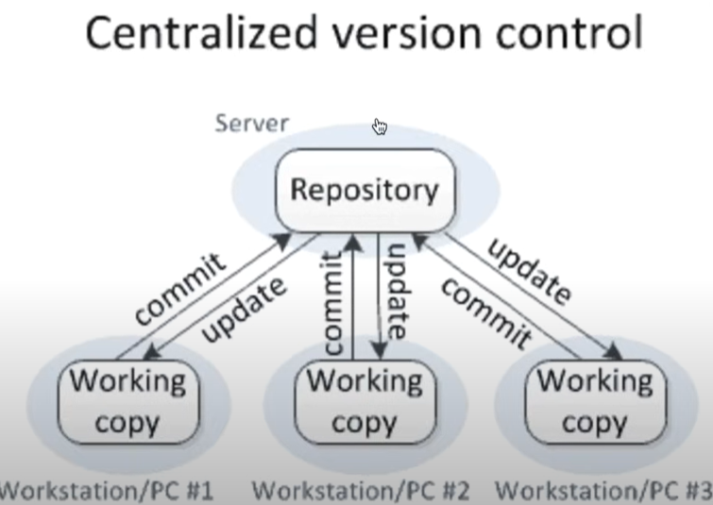
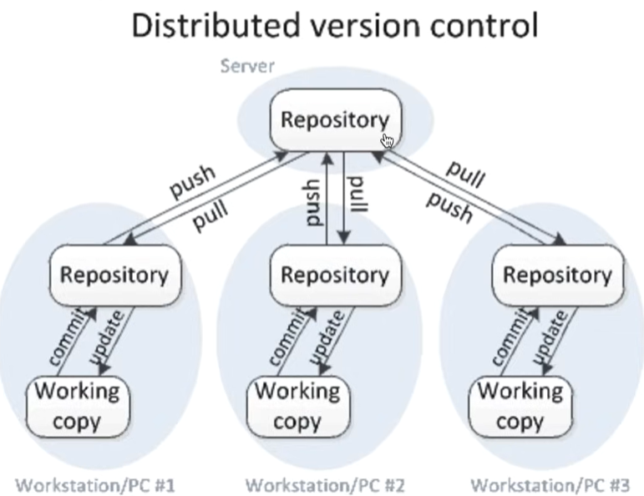
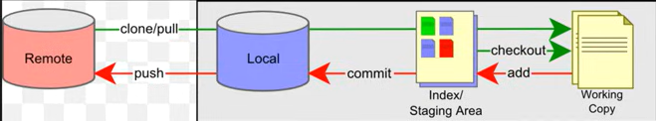
https://www.youtube.com/watch?v=-U-eUHI6euM
Introduction
GIT-VCS (Version Control System) 버전관리 시스템
Local repos.

Slide 3
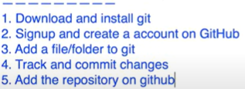

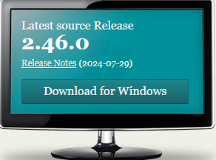

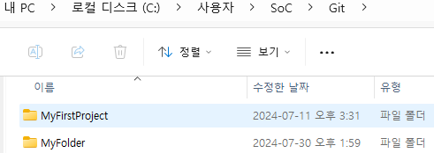

https://www.youtube.com/watch?v=0Icla6TVNNo&t=773s
Install Git window
Step1 : Check if git is already installed
Step 2 : If not, download and install git (git-scm.com)
Step 3 : Signup and create a account on github.com
jslee@ssu.ac.kr, Jj06225044! 가입
Step 4 : Add your github email and user name to git
Step 5 : Add file/folders to git - tracking

Slide 4
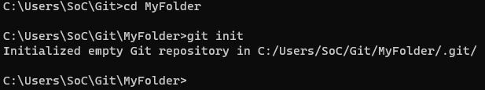
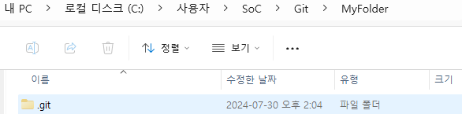
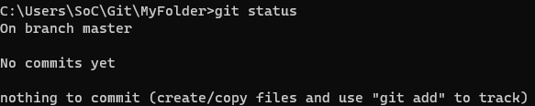

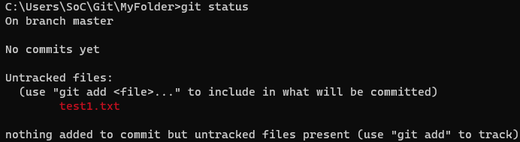
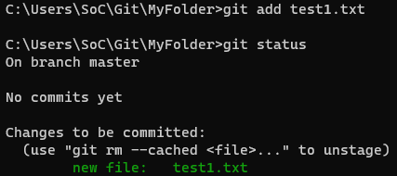
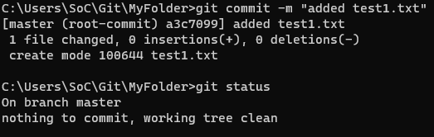
https://www.youtube.com/watch?v=0Icla6TVNNo&t=773s
Install Git window
Step 6 : Commands
goto the location of the folder/project
- git init
- git status
test1.txt 파일을 만들고, git status 하면
- git add
- git commit –m “*** 메시지 적을 것”)
- git status

Slide 5
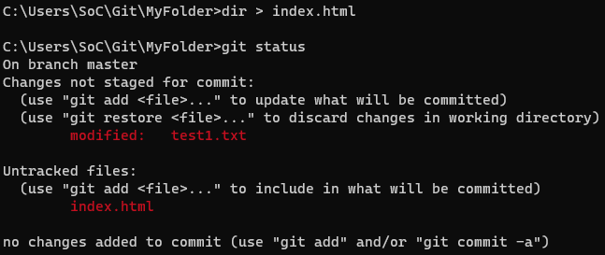
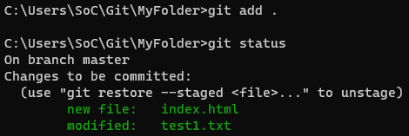
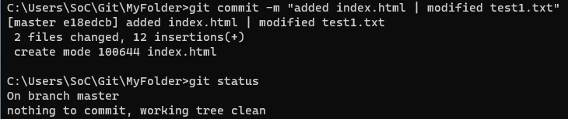
https://www.youtube.com/watch?v=0Icla6TVNNo&t=773s
Install Git window
Step 6 : test1.txt 에 change 1 입력
- dir > index.html (파일 생성)
- git status 하면
- git add . (git add *.*) 함
- git status
- git commit –m “added index.html | modified test1.txt”
- git status

Slide 6
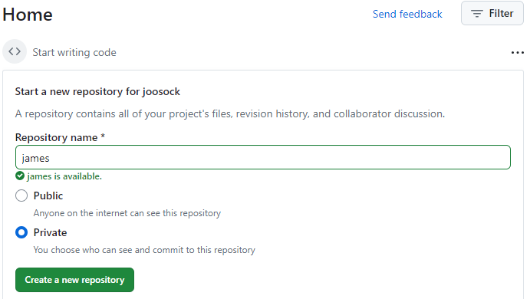
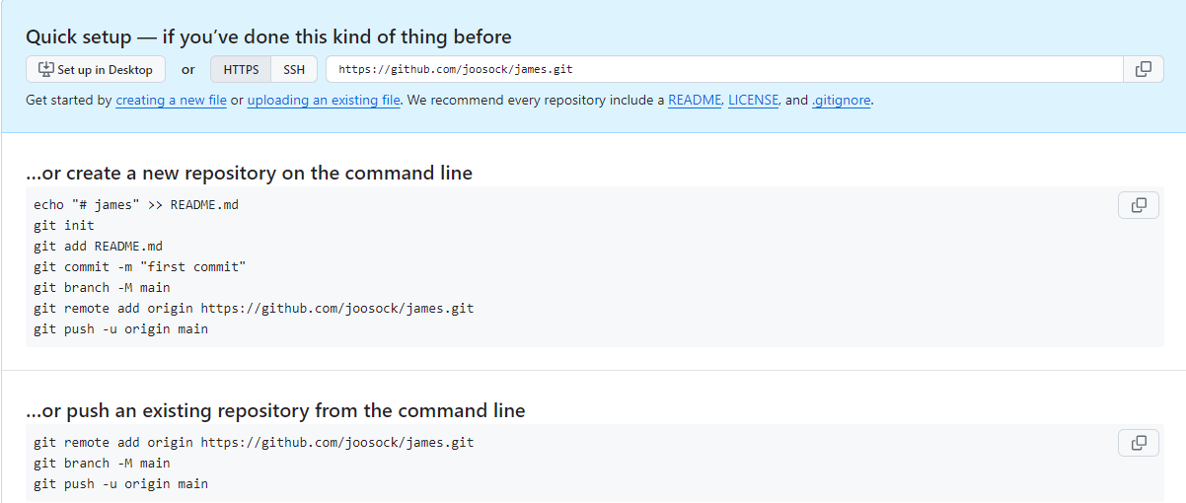
https://www.youtube.com/watch?v=0Icla6TVNNo&t=773s
Install Git window
Step 6 : adding to remote repository, github.com 에 가서 “james” repository 를 만듬
Copy

Slide 7
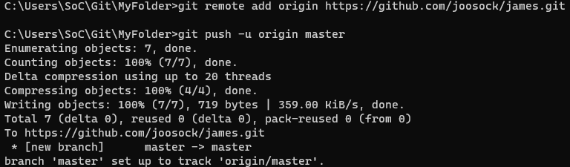
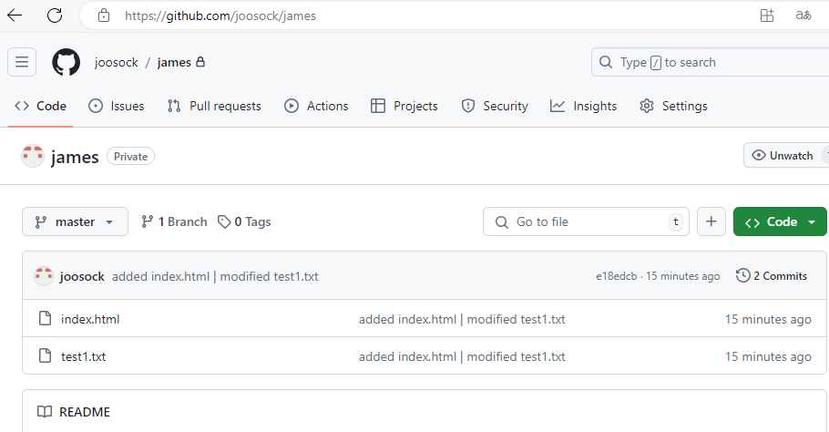
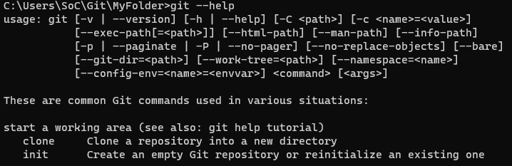
https://www.youtube.com/watch?v=0Icla6TVNNo&t=773s
Install Git window
Step 6 : adding to remote repository, github.com 에 가서 “james” repository 를 만듬
- git remote add origin https://github.com/joosock/james.git
- git push –u origin master 혹은 git push –u origin main
- git - - help 하면 모든 명령어 볼 수 있음

Slide 8
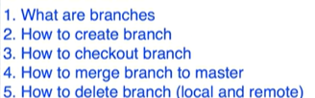
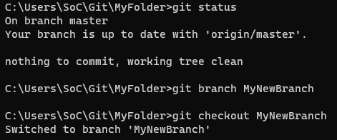
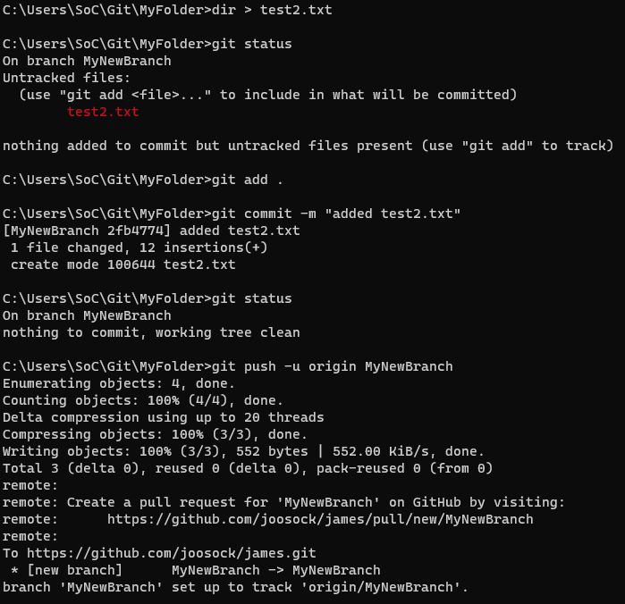
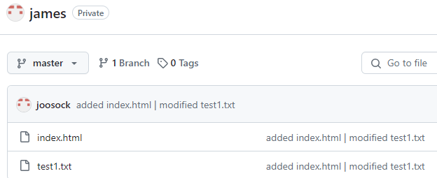
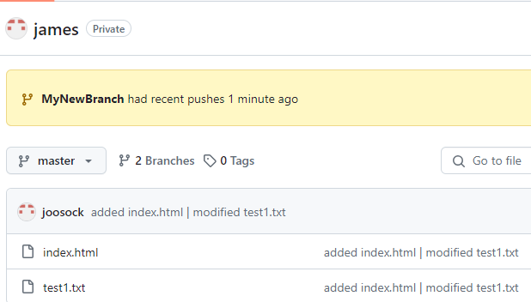
https://www.youtube.com/watch?v=GZILYABgAoo
Branching and Merging
Step 1 : Create branch
- git branch MyNewBranch
Step 2 : Checkout branch
- git checkout MyNewBranch
ss

Slide 9
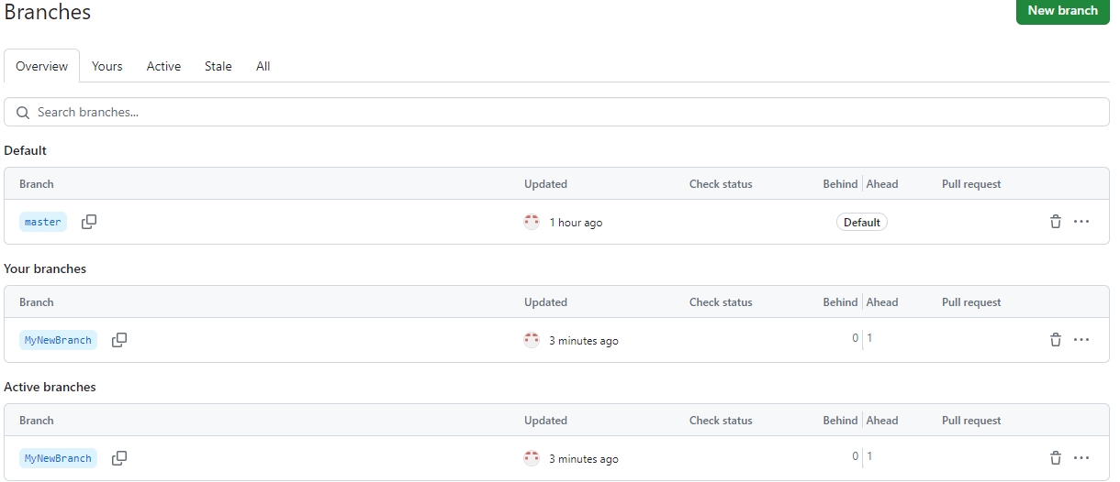
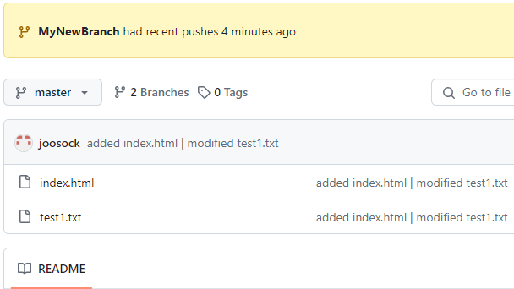
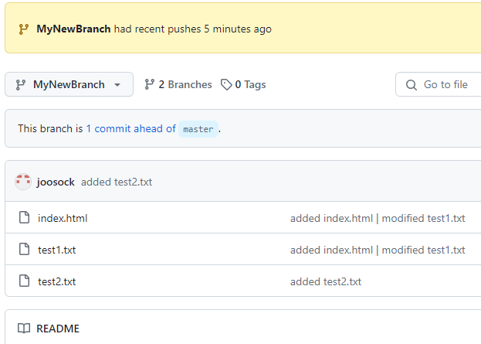
https://www.youtube.com/watch?v=GZILYABgAoo
Branching and Merging
2 Branches 를 클릭
ss

Slide 10
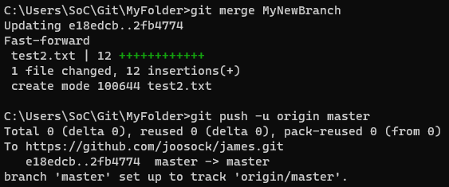
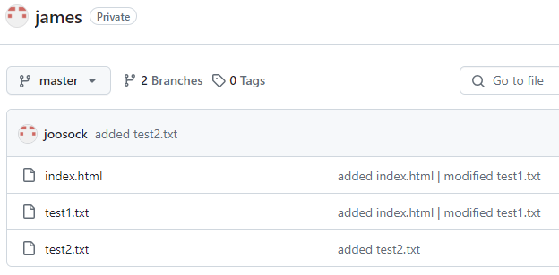
https://www.youtube.com/watch?v=GZILYABgAoo
Branching and Merging
Step3 Merge new branch in master branch
- git merge “branch name”
ss

Slide 11

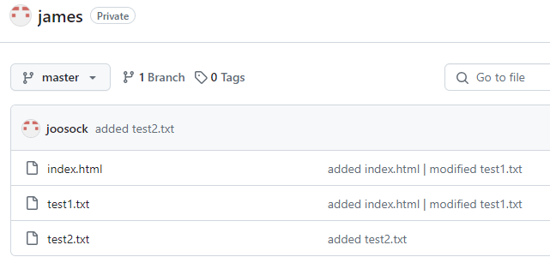
https://www.youtube.com/watch?v=GZILYABgAoo
Branching and Merging
Step4 Delete branch
- git branch –d “branch name” --- delete from local
- git push origin –delete MyNewBranch
ss

Slide 12
https://www.youtube.com/watch?v=-27WScuoKQs
한시간만에 끝내는 Github
중요 함

Slide 13
https://www.youtube.com/watch?v=5qxdokgQ8AA
Sourcetree 기본 사용방법

