Slide 1

Coronavirus cases in Wales: How many hospital provide service in each county of Wlaes, UK?
Capstone Project

Slide 2
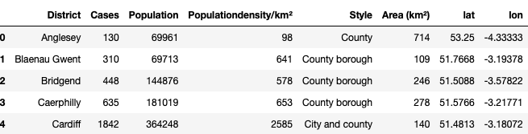
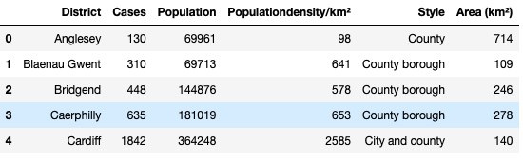
Data Clean and example of data after process and location acquiration

Slide 3
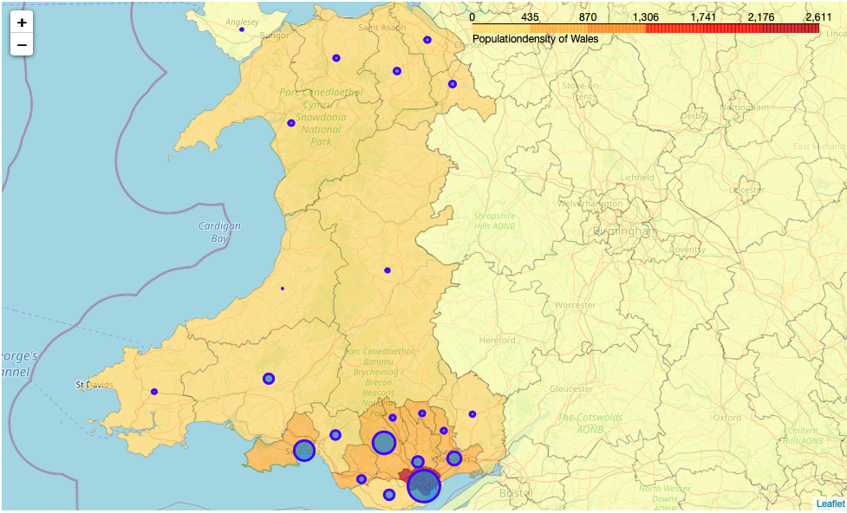
Coronavirus Wales map: How many confirmed cases are there in Wlaes?

Slide 4
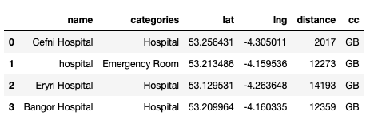
Here is an example of searching hospitals in the region of Anglesey:

Slide 5
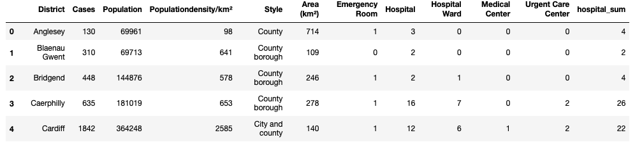
After grouping different types of hospital, Here is the summary table contains the total number of each type of hospitals in each area.

Slide 6
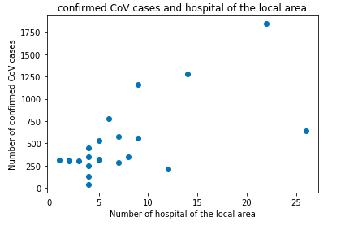
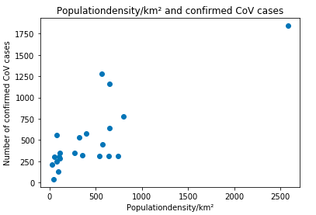
Scatter Plot of number cases to Population density and number of hospitals locally.

